Slide 1

Notes:
I'm a Perl programmer

Slide 2
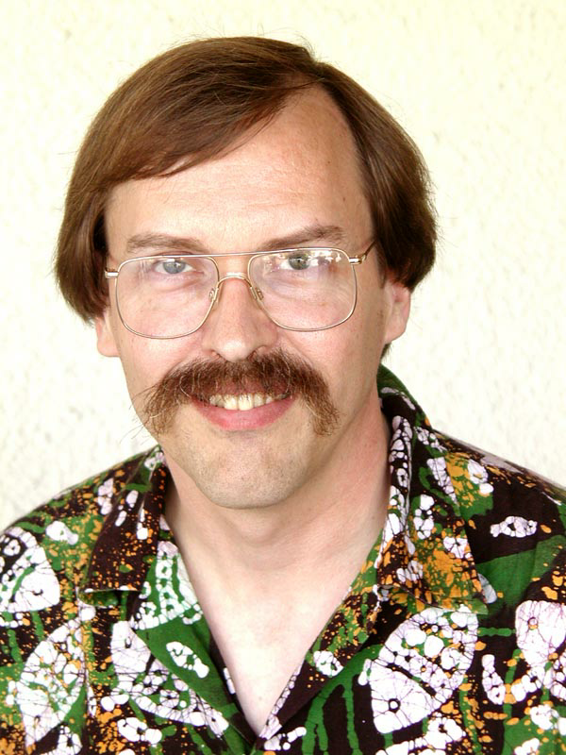
Notes:
July 19, 2000, Perl 6 design process announced
Perl 6 Concurrency
2001-04-01 Parrot Language

Slide 3

Notes:
Parrot VM

Slide 4
Designing Concurrency Features for the Perl 6 Programming Language and Prototype Implementation for the Rakudo Perl 6 Compiler

Slide 5
Designing Concurrency Features for the Perl 6 Programming Language and Prototype Implementation for the Rakudo Perl 6 Compiler

Slide 6
Hybrid Threads for the Parrot Virtual Machine

