Slide 1
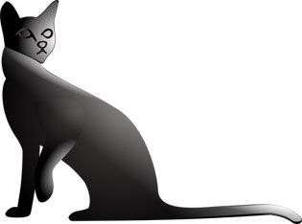

Slide 2


Slide 3
Who we are
What we do
Customers
Philosophy
Notes:
Open source software developer and software consultancy provider
Based in Lancaster, UK

Slide 4
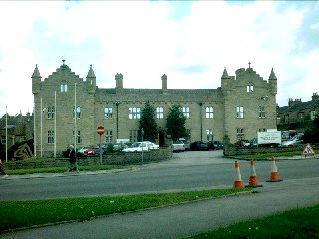
Notes:
headquarters call it "Our Castle"
Matt Trout and Mark Keating
former: developer, systems architect
latter: graphic, web and user interface designer

Slide 5

Notes:
Quick survey: what do people know?
Phrase or one sentence
Most people: old, write one, read never, 1998 CGI

Slide 6

Notes:
#81 website in the world
1% of inter net users visit

Slide 7

Notes:
Who has used it?

Slide 8

Notes:
Everyone knows about Java, J2EE
Also lots of Perl

Slide 9
Notes:
More local example
Based on Catalyst

Slide 10

Notes:
One of the first price comparison websites
Incredibly useful service to users
Why Perl?

Slide 11

Notes:
> 95000 modules
9000 authors
90% already written

Slide 12
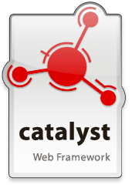
Modern MVC framework
Many models and views
100s of plugins

Slide 13

DBIx::Class
ORM
Schema generation
Relationships
Notes:
Where do we fit into this?
We employ people like Matt

Slide 14
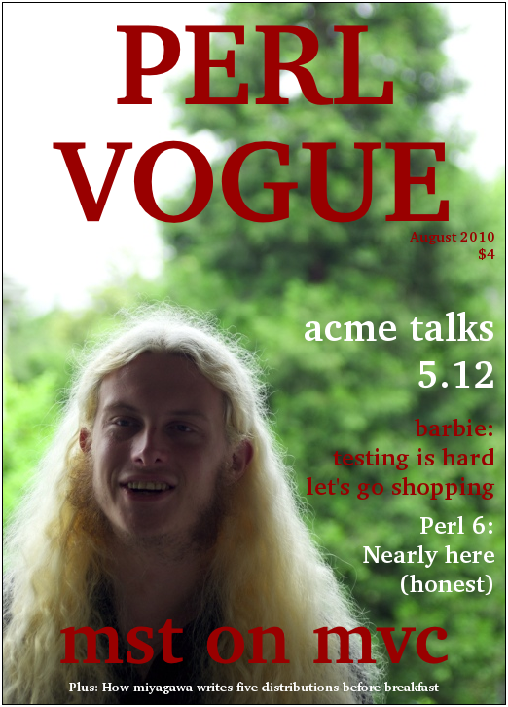
Notes:
Matt unofficial project architect for the past four years.
author of the original project, architect and co-ordinator
Some core developers Catalyst
Host repos, websites, community resources Catalyst

Slide 15
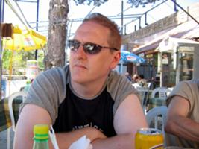
Notes:
Mark Keating
Perl Foundation marketing committee chair

Slide 16

Notes:
Provided core database work and Catalyst support to BBC Media in regards to the iPlayer teams. iPlayer uses both Catalyst and DBIx::Class in the back end of the site.

Slide 17








Notes:
Socialflow: Helped to create the core system that analyses the raw Twitter feed (SF Firehose).
Bit.ly: Helped to re-write the system for analysing bit.ly usage (bit.ly firehose)
Smoothwall: Implementing a new system, this cannot be spoken of any more than that.
Airspace Software: Helped to design and create the Allocate Booking System
Cisco: Ongoing Perl project support
US Census: Creation and implementation of a Catalyst system, also on-site training.
SureVOIP: Catalayst support
Midstream Media: Porting of a large site to a catalyst framework

Slide 18
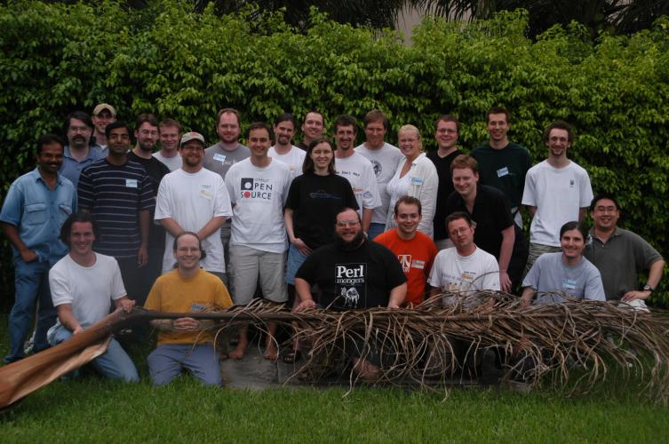
Notes:
great deal of time and energy putting back into the community as much (if not more) than it takes out.
beauty Open Source afforded development level code and production ready libraries and systems for no apparent cost.
mailing lists, irc channels, direct relationships access to hundreds of developers with a high level of experience and knowledge,
again with little to no cost.
balance must be struck,
if companies keep taking from the community with no return contribution, be it time to support modules, releasing development code devoting developer time or by direct cash sponsorship, then the communities themselves will begin to whither.
Communities thrive not just from the online relationships but from the collecting together, be it for hackathons, BoFs, local meetings in groups, conferences and events. The collecting together and sharing knowledge, ideas and experience facilitates strong community bonds. Shadowcat is committed to supporting and enhancing this in the Perl community.
All Shadowcat staff are members of their local Perl Mongers all of us are involved with the organisation or running of local and international conferences, the majority of the staff are active members in the mailing lists and irc channels, we are all members of organisations such as the Enlightened Perl Organisation and support other groups such as YAPC Europe Federation and The Perl Foundation.

Slide 19
http://niner.name/talks/

