Slide 1
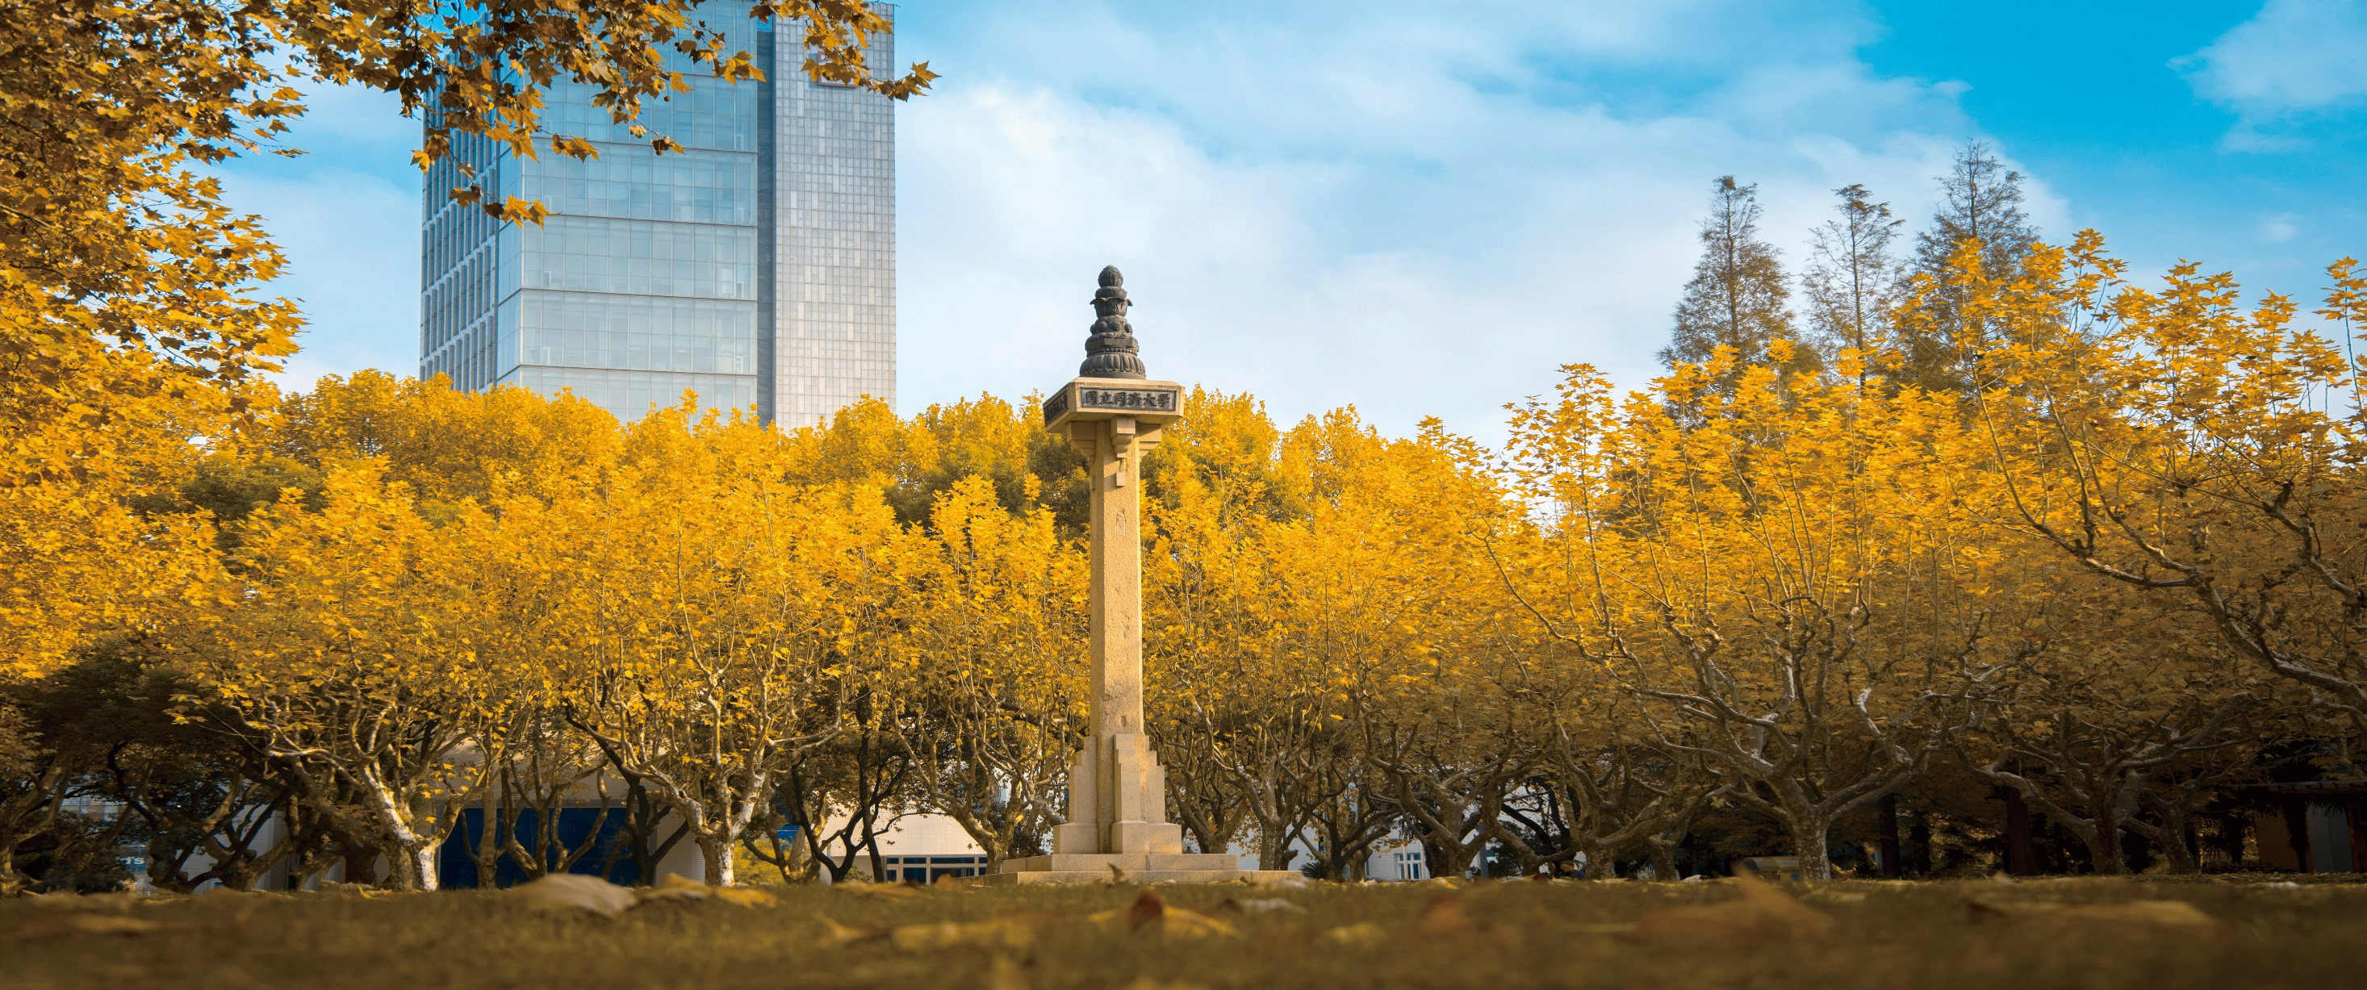


Discrete Mathematics 2025 Spring
魏可佶 kejiwei@tongji.edu.cn

Slide 2
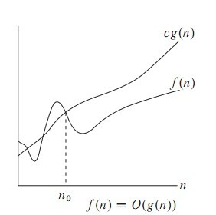
7.1 Undirected Trees
f(n)= O(g(n)) iff there exist positive constants c and n0 such that f(n) ≤ cg(n) for all n ≥ n0
O-notation to give an upper bound on a function
Notes:
7.1.1 无向树的定义及其性质
7.1.2 生成树

Slide 3
Chapter 8: INTRACTABILITY
“Easy” Problems
Sorting a list of n numbers: [42, 3, 17, 26, … , 100]
n log₂ n
Multiplying two n x n matrices:
(
)
(
)
(
)
3 5 2 7
1 6 8 9
2 4 6 10
9 3 2 12
1 5 5 4
5 12 8 6
7 6 1 5
9 23 5 8
n
=
n
n
n
n
Notes:
Given two matrices:
A=[aij],B=[bij]A = [a_{ij}], \quad B = [b_{ij}]A=[aij​],B=[bij​] both of size n×nn \times nn×n, their product C=A⋅BC = A \cdot BC=A⋅B is also n×nn \times nn×n, where each element is:
cij=∑k=1naik⋅bkjc_{ij} = \sum_{k=1}^{n} a_{ik} \cdot b_{kj}cij​=k=1∑n​aik​⋅bkj​
3. Number of Elements in CCC
The result matrix CCC has n×n=n2n \times n = n^2n×n=n2 elements.
4. Total Work
Since each of the n2n^2n2 elements costs O(n)O(n)O(n) operations:
Total operations=n2×n=n3\text{Total operations} = n^2 \times n = n^3Total operations=n2×n=n3

Slide 4
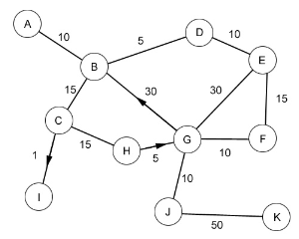
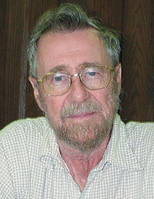
Chapter 8: INTRACTABILITY
“Easy” Problems
The Shortest Path Problem (i.e. “Google Maps”
Depending on implementation:
O(|V|²) or
O(|E| + |V|Log|V|)
Edsgar Dijkstra
https://www.cs.hmc.edu/~cs5grad/cs5/LectureSlides/class07-black-16-functional5.pptx
Notes:
图论树主要关注顶点的连接性和无环性，而数据结构树则更侧重于数据的组织、管理和操作效率。
7.1 无向树
7.2 根树及其应用

Slide 5
Chapter 8: INTRACTABILITY
“Easy” Problems
“Polynomial Time” = “Efficient”
n, n², n³, n⁴, n⁵,…
sorting
How about something like n log₂ n ?
matrix multiplication
shortest paths
The “class” P
Notes:
图论树主要关注顶点的连接性和无环性，而数据结构树则更侧重于数据的组织、管理和操作效率。
7.1 无向树
7.2 根树及其应用

Slide 6
Chapter 8: INTRACTABILITY
“Hard” Problems
The Travelling Salesperson Problem
New York
2566
4664
San Francisco
5868
5563
2417
3627
366
1545
6060
Paris
Claremont
5625
Brute Force? Greed?
Notes:
图论树主要关注顶点的连接性和无环性，而数据结构树则更侧重于数据的组织、管理和操作效率。
7.1 无向树
7.2 根树及其应用

Slide 7
Chapter 8: INTRACTABILITY
The Hamiltonian Path Problem
Athens, GA
Homer, GA
Rome, GA
Damascus, GA
Bethlehem, GA
Those are some peachy names!
Notes:
图论树主要关注顶点的连接性和无环性，而数据结构树则更侧重于数据的组织、管理和操作效率。
7.1 无向树
7.2 根树及其应用

Slide 8
Chapter 8: INTRACTABILITY
n² Versus 2^{n}
The Geoff-O-Matic performs 10⁹ operations/sec
n = 10 n = 30 n = 50 n = 70
n²
2^{n}
n!
100
< 1 sec
900
< 1 sec
2500
< 1 sec
4900
< 1 sec
1024
< 1 sec
10⁹
1 sec
10¹⁵
11.6 days
10²¹
31,688 years
< 1 sec
10¹⁶ years
10⁵⁷ years
10⁹³ years
Notes:
图论树主要关注顶点的连接性和无环性，而数据结构树则更侧重于数据的组织、管理和操作效率。
7.1 无向树
7.2 根树及其应用

Slide 9
Tractability
Chapter 8: INTRACTABILITY
Some problems are intractable: as they grow large, we are unable to solve them in reasonable time
Not in polynomial time: O(2^{n}), O(n!), O(n^{n}),
What constitutes reasonable time?
Standard working definition: polynomial time
On an input of size n the worst-case running time is O(n^{k}) for some constant k
Polynomial time: O(1), O(n lg n), O(n²), O(n³),
Notes:
图论树主要关注顶点的连接性和无环性，而数据结构树则更侧重于数据的组织、管理和操作效率。
7.1 无向树
7.2 根树及其应用

Slide 10
Chapter 8: INTRACTABILITY
Optimization/Decision Problems
Optimization Problems
An optimization problem is one which asks, “What is the optimal solution to problem X?”
Examples:
Maximal Matching
Traveling Salesperson
Minimum Spanning Tree
Decision Problems
An decision problem is one with yes/no answer
Examples:
Does a graph G have a MST of weight ≤ W?
Notes:
图论树主要关注顶点的连接性和无环性，而数据结构树则更侧重于数据的组织、管理和操作效率。
7.1 无向树
7.2 根树及其应用

Slide 11
Chapter 8: INTRACTABILITY
Optimization/Decision Problems
An optimization problem tries to find an optimal solution
A decision problem tries to answer a yes/no question
Many problems will have decision and optimization versions
Eg: Traveling salesman problem
optimization: find hamiltonian cycle of minimum weight
decision: is there a hamiltonian cycle of weight ≤ k
Some problems are decidable, but intractable: as they grow large, we are unable to solve them in reasonable time
Is there a polynomial-time algorithm that solves the problem?
Notes:
图论树主要关注顶点的连接性和无环性，而数据结构树则更侧重于数据的组织、管理和操作效率。
7.1 无向树
7.2 根树及其应用

Slide 12
Chapter 8: INTRACTABILITY
The class P
The class P consists of those problems that are solvable in polynomial time.
More specifically, they are problems that can be solved in time O(n^{k}) for some constant k, where n is the size of the input to the problem
The key is that n is the size of input
“Easy” Problems
Notes:
图论树主要关注顶点的连接性和无环性，而数据结构树则更侧重于数据的组织、管理和操作效率。
7.1 无向树
7.2 根树及其应用

Slide 13
Chapter 8: INTRACTABILITY
The Class P
P: the class of decision problems that have polynomial-time deterministic algorithms.
That is, they are solvable in O(p(n)), where p(n) is a polynomial on n
A deterministic algorithm is (essentially) one that always computes the correct answer
Why polynomial?
if not, very inefficient
nice closure properties
the sum and composition of two polynomials are always polynomials too
Notes:
图论树主要关注顶点的连接性和无环性，而数据结构树则更侧重于数据的组织、管理和操作效率。
7.1 无向树
7.2 根树及其应用

Slide 14
Chapter 8: INTRACTABILITY
Complexity Class P
Deterministic in nature
Solved by conventional computers in polynomial time
O(1) Constant
O(log n) Sub-linear
O(n) Linear
O(n log n) Nearly Linear
O(n²) Quadratic
Polynomial upper and lower bounds
Notes:
图论树主要关注顶点的连接性和无环性，而数据结构树则更侧重于数据的组织、管理和操作效率。
7.1 无向树
7.2 根树及其应用

Slide 15
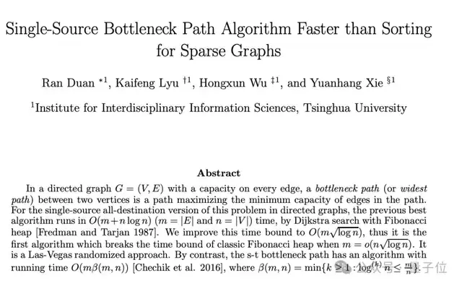
Chapter 8: INTRACTABILITY
Sample Problems in P
Shortest Path Dijkstra algorithm O(V2).
Eulerian path O(E)
MST O(ElogV)
Merge Sort
Huffman Algorithm: Constructing the Optimal Binary (Huffman) Tree.
Others
Notes:
The time complexity of Dijkstra’s algorithm depends on how you implement the priority queue (the data structure that keeps track of the next closest node to process):
Algorithm Sketch (Hierholzer’s Algorithm):
Start from a vertex with an odd degree (or any vertex if all degrees are even).
Follow unused edges until returning to the starting vertex (for circuit) or ending at a vertex with no unused edges (for path).
Stitch any disconnected cycles into the main path.
The time complexity of Kruskal’s algorithm depends on two main steps:
🔹 Step 1: Sorting the edges
If the graph has EEE edges and VVV vertices, the algorithm sorts all edges by weight.
Sorting cost = O(Elog⁡E)O(E \log E)O(ElogE).
Since E≤V2E \leq V^2E≤V2, log⁡E=O(log⁡V2)=O(log⁡V)\log E = O(\log V^2) = O(\log V)logE=O(logV2)=O(logV).
So this step is O(Elog⁡V)O(E \log V)O(ElogV).
🔹 Step 2: Union-Find (Disjoint Set operations)
Kruskal uses Union-Find (DSU) to check whether adding an edge creates a cycle.
Each find or union operation takes almost constant time using union by rank + path compression: O(α(V))O(\alpha(V))O(α(V)), where α\alphaα is the inverse Ackermann function (so small it’s practically ≤ 4 in all real cases).
Over all EEE edges, this is O(E α(V))≈O(E)O(E \, \alpha(V)) \approx O(E)O(Eα(V))≈O(E).
✅ Total complexity
O(Elog⁡V)+O(E α(V))≈O(Elog⁡V)O(E \log V) + O(E \, \alpha(V)) \approx O(E \log V)O(ElogV)+O(Eα(V))≈O(ElogV) 🔹 Space complexity
Storing all edges: O(E)O(E)O(E)
Union-Find parent and rank arrays: O(V)O(V)O(V)
Total: O(V+E)O(V + E)O(V+E).

Slide 16
Chapter 8: INTRACTABILITY
NP
NP is not the same as non-polynomial complexity/running time. NP does not stand for not polynomial.
NP = Non-Deterministic polynomial time
NP means verifiable in polynomial time
Verifiable?
If we are somehow given a ‘certificate’ of a solution we can verify the legitimacy in polynomial time
Notes:
图论树主要关注顶点的连接性和无环性，而数据结构树则更侧重于数据的组织、管理和操作效率。
7.1 无向树
7.2 根树及其应用

Slide 17
Chapter 8: INTRACTABILITY
Sample Problems in NP
MST
Maximal matching
Hamiltonian Cycle (Traveling Salesman)
Graph Coloring
Notes:
图论树主要关注顶点的连接性和无环性，而数据结构树则更侧重于数据的组织、管理和操作效率。
7.1 无向树
7.2 根树及其应用

Slide 18
Chapter 8: INTRACTABILITY
Hamiltonian cycles
Determining whether a directed graph has a Hamiltonian cycle does not have a polynomial time algorithm (yet!)
However if someone was to give you a sequence of vertices, determining whether or not that sequence forms a Hamiltonian cycle can be done in polynomial time
Therefore Hamiltonian cycles are in NP
“Hard” Problem?
Notes:
图论树主要关注顶点的连接性和无环性，而数据结构树则更侧重于数据的组织、管理和操作效率。
7.1 无向树
7.2 根树及其应用

Slide 19
Chapter 8: INTRACTABILITY
NP problems
Graph theory has these fascinating(annoying?) pairs of problems
Shortest path algorithms?
Longest path is NP complete (we’ll define NP complete later)
Eulerian tours (visit every vertex but cover every edge only once, even degree etc). Solvable in polynomial time!
Hamiltonian tours (visit every vertex, no vertices can be repeated). NP complete
Notes:
图论树主要关注顶点的连接性和无环性，而数据结构树则更侧重于数据的组织、管理和操作效率。
7.1 无向树
7.2 根树及其应用

Slide 20
Chapter 8: INTRACTABILITY
Review: P And NP Summary
P = set of problems that can be solved in polynomial time
NP = set of problems for which a solution can be verified in polynomial time
Clearly P ⊆ NP
Open question: Does P = NP?
Most suspect not
An August 2010 claim of proof that P ≠ NP, by Vinay Deolalikar, researcher at HP Labs, Palo Alto, has flaws
Notes:
图论树主要关注顶点的连接性和无环性，而数据结构树则更侧重于数据的组织、管理和操作效率。
7.1 无向树
7.2 根树及其应用

Slide 21
Chapter 8: INTRACTABILITY
NP-complete problems
A decision problem D is NP-complete iff
D ∈ NP
every problem in NP is polynomial-time reducible to D
Notes:
图论树主要关注顶点的连接性和无环性，而数据结构树则更侧重于数据的组织、管理和操作效率。
7.1 无向树
7.2 根树及其应用

Slide 22
Chapter 8: INTRACTABILITY
Reduction
A problem R can be reduced to another problem Q if any instance of R can be rephrased to an instance of Q, the solution to which provides a solution to the instance of R
This rephrasing is called a transformation
Intuitively: If R reduces in polynomial time to Q, R is “no harder to solve” than Q
Example: lcm(m, n) = m * n / gcd(m, n),
lcm(m,n) problem is reduced to gcd(m, n) problem
Notes:
图论树主要关注顶点的连接性和无环性，而数据结构树则更侧重于数据的组织、管理和操作效率。
7.1 无向树
7.2 根树及其应用

Slide 23
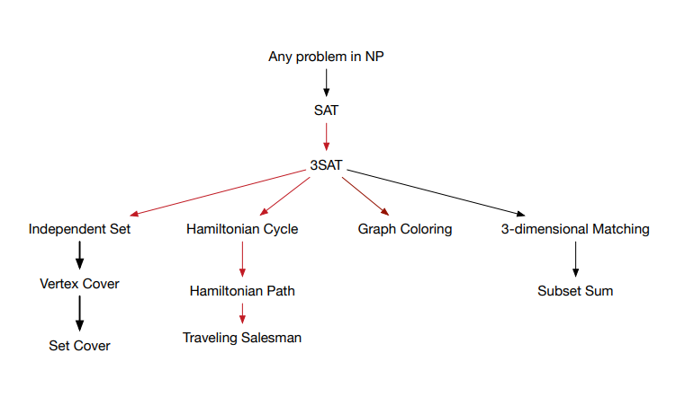
Chapter 8: INTRACTABILITY
Polynomial-Time Reducibility
Language L is polynomial-time reducible to language M if there is a function computable in polynomial time that takes an input x of L and transforms it to an input f(x) of M, such that x is a member of L if and only if f(x) is a member of M.
Notes:
图论树主要关注顶点的连接性和无环性，而数据结构树则更侧重于数据的组织、管理和操作效率。
7.1 无向树
7.2 根树及其应用

Slide 24
7.1.1 Definition and Properties of Undirected Trees
⤷ Undirected Trees, Trivial Trees, and Forests
NP-Hard and NP-Complete
If R is polynomial-time reducible to Q, we denote this R ≤_{p} Q
Definition of NP-Hard and NP-Complete:
If all problems R ∈ NP are polynomial-time reducible to Q, then Q is NP-Hard
Note: An NP-Hard problem need not be NP.
An NP-Hard problem is at least as hard as the NP-complete problems
We say Q is NP-Complete if Q is NP-Hard and Q ∈ NP
If R ≤_{p} Q and R is NP-Hard, Q is also NP-Hard (why?)
Notes:
无向树: 连通无回路的无向图
平凡树: 平凡图
森林: 每个连通分支都是树的非连通的无向图
树叶: 树中度数为1的顶点
分支点: 树中度数≥2的顶点

Slide 25
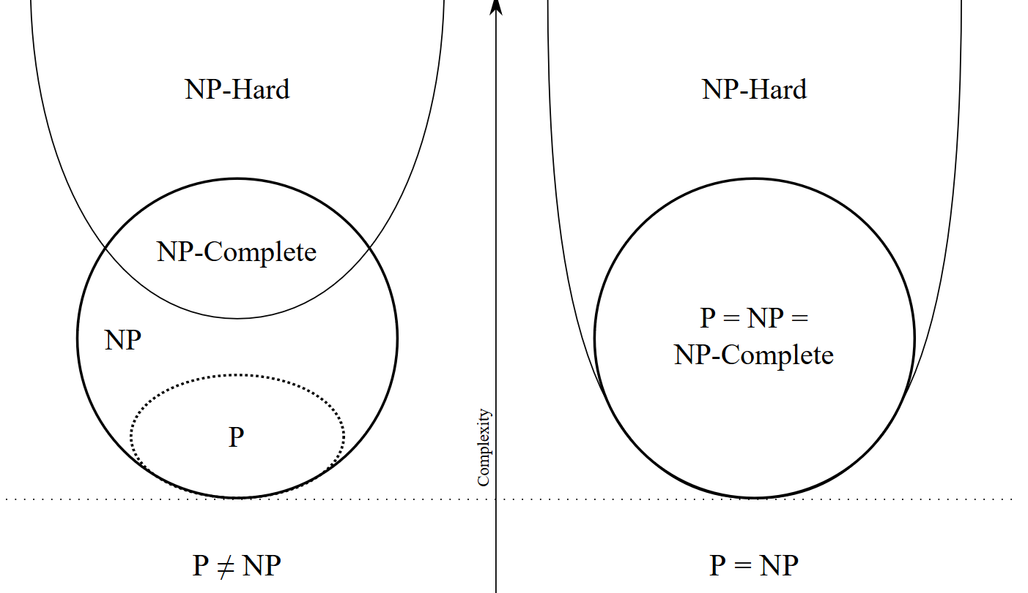
https://upload.wikimedia.org/wikipedia/commons/a/a0/P_np_np-complete_np-hard.svg

Slide 26
Not verifiable in polynomial time
Verifiable in polynomial time
https://upload.wikimedia.org/wikipedia/commons/a/a0/P_np_np-complete_np-hard.svg

Slide 27
7.1.1 Definition and Properties of Undirected Trees
⤷ Proof of Tree Equivalence Theorem
Proof: (2)⇒(3)
③ Inductive step: Assume the conclusion holds for all graphs with up to n≤k (k≥1), consider n=k+1.
④Select any edge e=(u,v), Since the path between u and v is unique, e must be the only path connecting them.
⑤Removing e disconnects the graph into two connected components.
⑥Let these components have n₁ and n₂ vertices, and m₁ ​ and m₂ edges, respectively, where n₁≤k, n₂≤k.
Therefore, m₁=n₁-1, m₂=n₂-1, m= m₁+m₂+1= n-1.
Notes:
教材中略掉了证明
(1)⇒(2) 由连通性, 任意2个顶点之间有一条路径. 又, 假设
某2个顶点之间有2条路径, 则这2条路径可组合成一条回
路, 与树的定义矛盾.
(2)⇒(3) 显然连通, 要证m=n−1. 对n作归纳证明.
当n=1时, 显然m=0, 结论成立.
假设当n≤k(k≥1)时结论成立, 考虑n=k+1. 任取一条边e=
(u,v), 它是u,v之间惟一的通路, 删去e, G被分成2个连通分
支, 设它们分别有n₁, n₂个顶点和m₁, m₂条边, n₁≤k, n₂≤k.
由归纳假设, m₁=n₁-1, m₂=n₂-1, 得m= m₁+m₂+1= n-1

Slide 28
7.1.1 Definition and Properties of Undirected Trees
⤷ Proof of Tree Equivalence Theorem
Proof: (3)⇒(4)
① Suppose G contains a cycle. Then, by removing any edge from the cycle, the resulting graph remains connected.
② Repeat this process until no cycles remain. The resulting graph is a tree with n vertices and m-r edges, r>0.
③ From (1)⇒(2)⇒(3), we know m-r =n-1, which contradicts the assumption that m=n−1.
Proof: (4)⇒(1) We only need to prove that G is connected.
① Assume G is disconnected and has p connected components, where p(p>1).
② Let the k-th component have n_{k} vertices and m_{k} edges, by (1)⇒(2)⇒(3), m_{k}= n_{k}-1, get m= n-p, which contradicts the assumption that m=n−1.
Notes:
教材中略掉了证明
(1)⇒(2) 由连通性, 任意2个顶点之间有一条路径. 又, 假设
某2个顶点之间有2条路径, 则这2条路径可组合成一条回
路, 与树的定义矛盾.
(2)⇒(3) 显然连通, 要证m=n−1. 对n作归纳证明.
当n=1时, 显然m=0, 结论成立.
假设当n≤k(k≥1)时结论成立, 考虑n=k+1. 任取一条边e=
(u,v), 它是u,v之间惟一的通路, 删去e, G被分成2个连通分
支, 设它们分别有n₁, n₂个顶点和m₁, m₂条边, n₁≤k, n₂≤k.
由归纳假设, m₁=n₁-1, m₂=n₂-1, 得m= m₁+m₂+1= n-1

Slide 29
7.1.1 Definition and Properties of Undirected Trees
⤷ Proof of Tree Equivalence Theorem
Proof: (1)⇒(5)
① From (1)⇒(2), there exists a unique path between any two non-adjacent vertices.
② Therefore, adding a new edge between them will create exactly one simple cycle.
Proof: (5)⇒(6)
① First, there must be a path between any two non-adjacent vertices. Otherwise, adding a new edge between them would not create a cycle. Hence, G is connected.
② Second, if removing any edge leaves G still connected, then that edge must lie on a cycle—contradicting the assumption that G has no cycles.
Notes:
教材中略掉了证明
(1)⇒(2) 由连通性, 任意2个顶点之间有一条路径. 又, 假设
某2个顶点之间有2条路径, 则这2条路径可组合成一条回
路, 与树的定义矛盾.
(2)⇒(3) 显然连通, 要证m=n−1. 对n作归纳证明.
当n=1时, 显然m=0, 结论成立.
假设当n≤k(k≥1)时结论成立, 考虑n=k+1. 任取一条边e=
(u,v), 它是u,v之间惟一的通路, 删去e, G被分成2个连通分
支, 设它们分别有n₁, n₂个顶点和m₁, m₂条边, n₁≤k, n₂≤k.
由归纳假设, m₁=n₁-1, m₂=n₂-1, 得m= m₁+m₂+1= n-1

Slide 30
7.1.1 Definition and Properties of Undirected Trees
⤷ Proof of Tree Equivalence Theorem
Proof: (6)⇒(1)
① If G contains a cycle, then removing any edge on that cycle would leave G connected—contradicting the assumption that every edge is a bridge.
②Thus, G has no cycles and is connected, so G is a tree.
Notes:
教材中略掉了证明
(1)⇒(2) 由连通性, 任意2个顶点之间有一条路径. 又, 假设
某2个顶点之间有2条路径, 则这2条路径可组合成一条回
路, 与树的定义矛盾.
(2)⇒(3) 显然连通, 要证m=n−1. 对n作归纳证明.
当n=1时, 显然m=0, 结论成立.
假设当n≤k(k≥1)时结论成立, 考虑n=k+1. 任取一条边e=
(u,v), 它是u,v之间惟一的通路, 删去e, G被分成2个连通分
支, 设它们分别有n₁, n₂个顶点和m₁, m₂条边, n₁≤k, n₂≤k.
由归纳假设, m₁=n₁-1, m₂=n₂-1, 得m= m₁+m₂+1= n-1

Slide 31
7.1.1 Definition and Properties of Undirected Trees
⤷ Minimum Leaf Theorem for Trees
Theorem 7.2: An undirected tree of order n (with n>1) has at least two leaves.
Proof：
① Let the tree have n vertices n(n>1) k leaves (vertices of degree 1), and m edges.
② By the andshaking Lemma, we have: 2 m ≥ k + 2(n-k).
③ According to Theorem 7.1 (the number of edges in a tree is always m=n−1), we substitute:
2 (n-1) ≥ k + 2(n-k)
k≥2.
Notes:
握手定理指出，在任何图中，所有顶点的度之和等于边的数量乘以2。
定理7.2 n阶非平凡的无向树至少有两片树叶 。
证： 设有n(n>1)个顶点, k片树叶, m条边，由握手定理得到：
2 m ≥ k + 2(n-k)
根据定理7.1（边的数量总是等于节点数量减1）, 有m=n-1
2 (n-1) ≥ k + 2(n-k)
解得 k≥2.

Slide 32
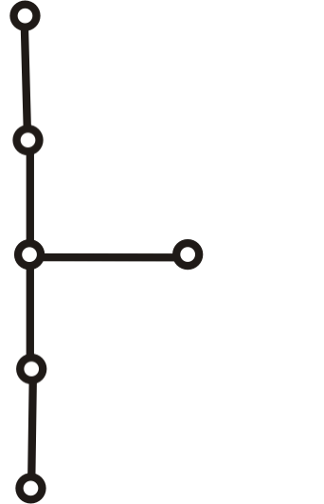
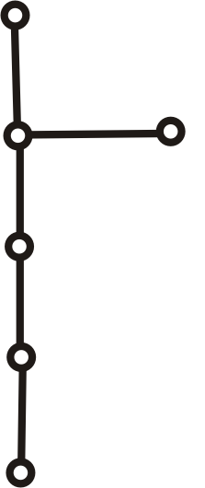
7.1.1 Definition and Properties of Undirected Trees
⤷ Minimum Leaf Theorem for Trees(e.g.)
Example: Given an undirected tree T with one vertex of degree 3, two vertices of degree 2, and all other vertices being leaves, determine the number of leaves and draw all non-isomorphic undirected trees that satisfy these conditions.
Solution : Let the tree have x leaves 、m edges and n (= 1+2+ x ) vertices . The total degree is = 3∗1+2∗2+1∗ x . Using the properties of trees m=n−1 and the Handshaking Lemma：
2×m= 2×(n−1) = 2×(3+x−1)= 2×(2+x)
2×(2+x)=1×3+2×2+x
Answer: The tree has 3 leaves.
The degree sequence of T : 1, 1, 1, 2, 2, 3.
Notes:
例: 已知无向树T中, 有1个3度顶点, 2个2度顶点, 其余顶点全是树叶. 试求树叶数, 并画出满足要求的非同构的无向树.
解:设有x片树叶、m条边和 n (= 1+2+ x )个顶点，总度数= 3∗1+2∗2+1∗ x .由用树的性质m=n−1和握手定理,有：
解得x=3，故T有3片树叶.两棵无向树如果不能通过顶点重命名变换为同一棵树，就被称为非同构的树。
T的度数列为1, 1, 1, 2, 2, 3
握手定理指出，在任何图中，所有顶点的度之和等于边的数量乘以2

Slide 33
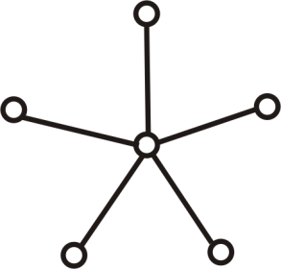
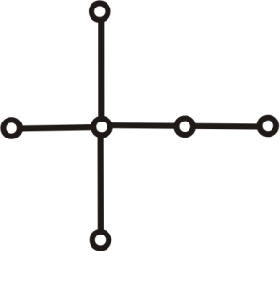
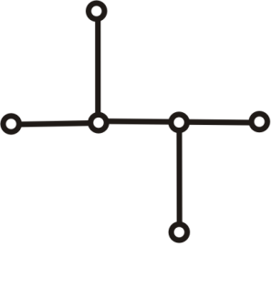
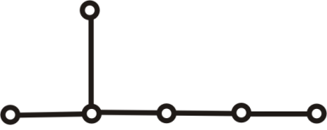
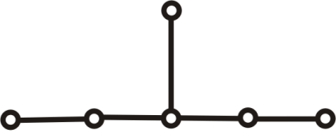
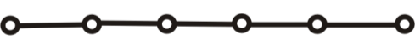
7.1.1 Definition and Properties of Undirected Trees
⤷ Constructing an Undirected Tree: An Example
Example: Draw all non-isomorphic undirected trees of order 6.
Solution: There are 5 edges, and the total degree is 10.
Possible degree sequences:
(1) 1,1,1,1,1,5
(2) 1,1,1,1,2,4
(3) 1,1,1,1,3,3
(4) 1,1,1,2,2,3
(5) 1,1,2,2,2,2
(1)
(2)
(3)
(4a)
(4b)
(5)
Notes:
例： 画出所有6阶非同构的无向树
解： 5条边, 总度数等于10

Slide 34
7.1 Undirected Trees
7.1.1 Definition and Properties of Undirected Trees
7.1.2 Spanning Trees
Notes:
7.1.1 无向树的定义及其性质
7.1.2 生成树

Slide 35
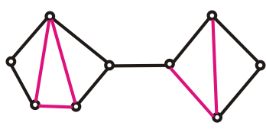
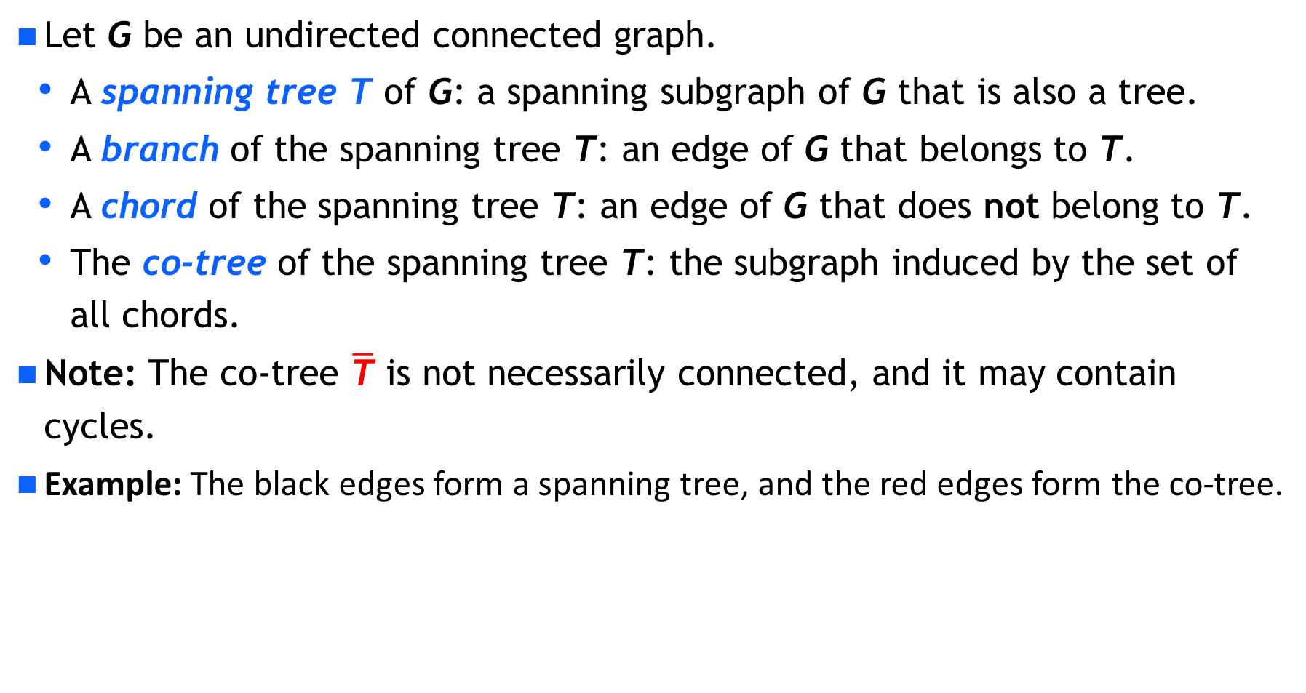
7.1.2 Spanning Trees
⤷ Spanning Tree T and Its Co-Tree $\overline{\text{T}}$
Let G be an undirected connected graph.
A spanning tree T of G: a spanning subgraph of G that is also a tree.
A branch of the spanning tree T: an edge of G that belongs to T.
A chord of the spanning tree T: an edge of G that does not belong to T.
The co-tree of the spanning tree T: the subgraph induced by the set of all chords.
Note: The co-tree $\overline{\text{T}}$ is not necessarily connected, and it may contain cycles.
Example: The black edges form a spanning tree, and the red edges form the co-tree.
Notes:
生成树是生成子图的一种特殊情况，它确保了子图是连通的并且是无环的。每个连通图都有至少一个生成树，但生成子图的数量可能更多，因为它们不受边数和无环性的限制。
设G为无向连通图
G的生成树T : G的生成子图并且是树
生成树T的树枝: G在T中的边
生成树T的弦: G不在T中的边
生成树T的余树 $\overline{\text{T}}$ : 所有弦的集合的导出子图
注意：余树 $\overline{\text{T}}$ 不一定连通, 也不一定不含回路
例：图中黑边构成生成树，红边构成余树

Slide 36
7.1.2 Spanning Trees
⤷ Spanning Tree Existence Theorem
Theorem 7.3: Every undirected connected graph has a spanning tree.
Proof: Use the cycle-breaking method.
① If the graph contains no cycles, then the graph itself is a spanning tree.
② Otherwise, remove any edge from a cycle — this does not destroy connectivity.
③ Repeat this process until there are no cycles remaining. The resulting graph is a spanning tree of the original graph.
Corollary 1: If an undirected connected graph has n vertices and m edges, then m≥n−1.
Corollary 2: If an undirected connected graph has n vertices and m edges, then the co-tree of any spanning tree contains m−n+1 edges.
Notes:
定理7.3 任何无向连通图都有生成树.
证：用破圈法. 若图中无圈, 则图本身就是自己的生成树.
否则删去圈上的任一条边, 不破坏连通性, 重复进行直到
无圈为止, 得到图的一棵生成树.
推论1 设n阶无向连通图有m条边, 则m≥n−1.
推论2 设n阶无向连通图有m条边, 则它的生成树的余树
有m−n+1条边.

Slide 37
7.1.2 Spanning Trees
⤷ Weighted Graphs and Minimum Spanning Trees
Each edge e of a graph G is assigned a real number w(e), called the weight of edge e.
The graph G together with the weights on its edges is called a weighted graph, denoted by G=<V,E,W>.
Let H be a subgraph of G, The weight of H denoted W(H) is the sum of the weights of all edges in H.
Minimum Spanning Tree (MST): A spanning tree of a weighted graph G that has the minimum total weight among all possible spanning trees.
Notes:
生成树主要用于确保连通性和简化复杂性，而最小生成树主要用于在保持连通性的前提下，寻求成本最低的解决方案。
综上所述，最小生成树在生成树的基础上增加了对总边权重最小化的考虑，它在网络设计和优化问题中具有重要的应用价值。
图G的每一条边e附加一个实数w(e), 称作边e的权. 图G连
同附加在边上的权称作带权图, 记作G=<V,E,W>. 设H是G
的子图, H所有边的权的和称作H的权, 记作W(H).
最小生成树: 带权图G的所有生成树中权最小的生成树
避圈法 (Kruskal) ——求最小生成树的算法
设G是n阶无向连通带权图G.
(1) 按权从小到大排列边(环除外), 设W(e₁)≤W(e₂)≤…≤W(e_{m}).
(2) 令T←∅, i←1, k←0.
(3) 若e_{i}与T中的边不构成回路，则令T←T∪{e_{i}}, k←k+1.
(4) 若k<n-1, 则令i←i+1, 转(3).

Slide 38
7.1.2 Spanning Trees
⤷ Kruskal’s MST Algorithm – Cycle-Avoidance Approach
Kruskal’s Algorithm — An algorithm for finding a minimum spanning tree. Let G be an undirected connected weighted graph of order n.
(1) Sort all edges in non-decreasing order of weight (excluding cycles), i.e. W(e₁)≤W(e₂)≤…≤W(e_{m}).
(2) Initialize T←∅, i←1, k←0.
(3) If e_{i} does not form a cycle with the edges already in T， then set T←T∪{e_{i}}, k←k+1.
(4) If k<n-1, then set i←i+1, and repeat step (3).
Notes:
生成树主要用于确保连通性和简化复杂性，而最小生成树主要用于在保持连通性的前提下，寻求成本最低的解决方案。
综上所述，最小生成树在生成树的基础上增加了对总边权重最小化的考虑，它在网络设计和优化问题中具有重要的应用价值。
图G的每一条边e附加一个实数w(e), 称作边e的权. 图G连
同附加在边上的权称作带权图, 记作G=<V,E,W>. 设H是G
的子图, H所有边的权的和称作H的权, 记作W(H).
最小生成树: 带权图G的所有生成树中权最小的生成树
避圈法 (Kruskal) ——求最小生成树的算法
设G是n阶无向连通带权图G.
(1) 按权从小到大排列边(环除外), 设W(e₁)≤W(e₂)≤…≤W(e_{m}).
(2) 令T←∅, i←1, k←0.
(3) 若e_{i}与T中的边不构成回路，则令T←T∪{e_{i}}, k←k+1.
(4) 若k<n-1, 则令i←i+1, 转(3).

Slide 39
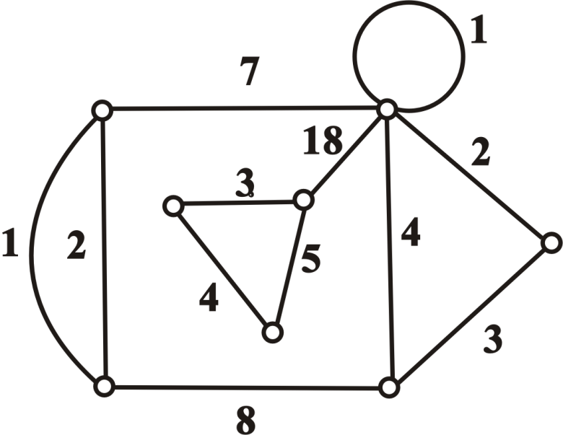
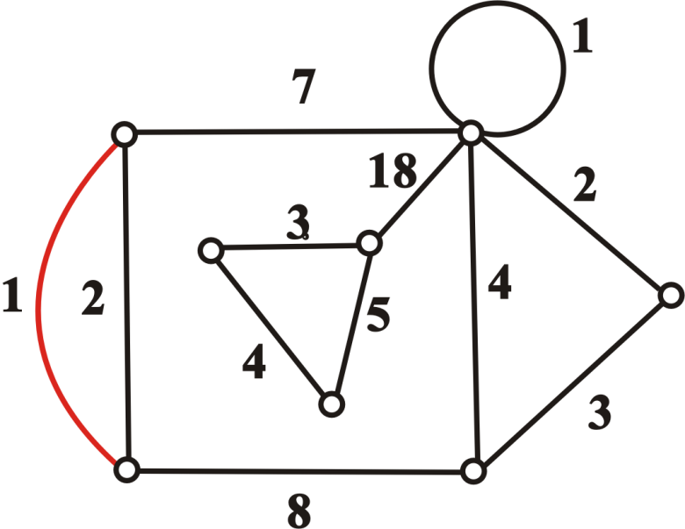
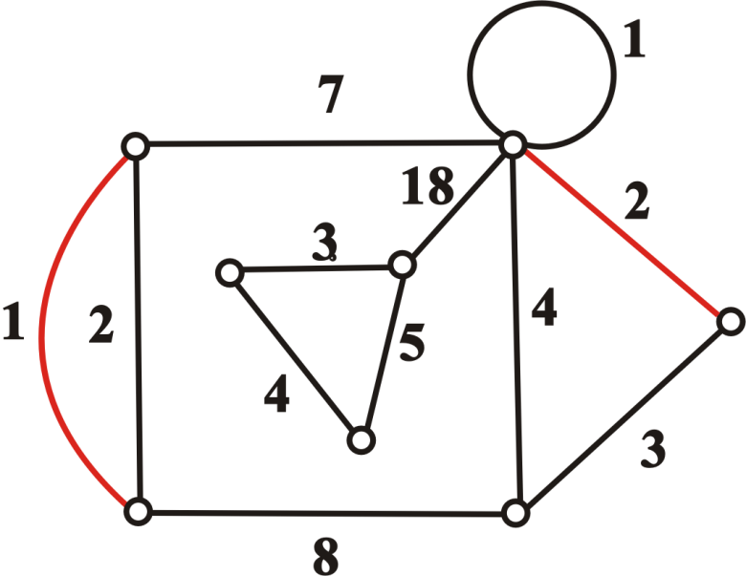
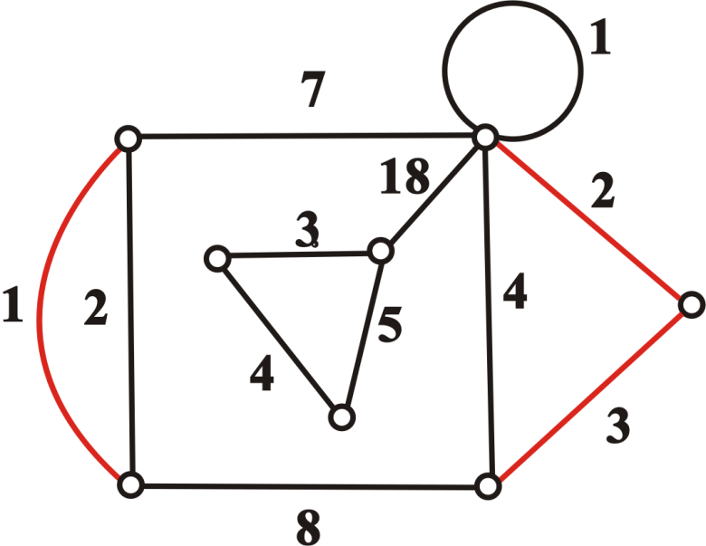
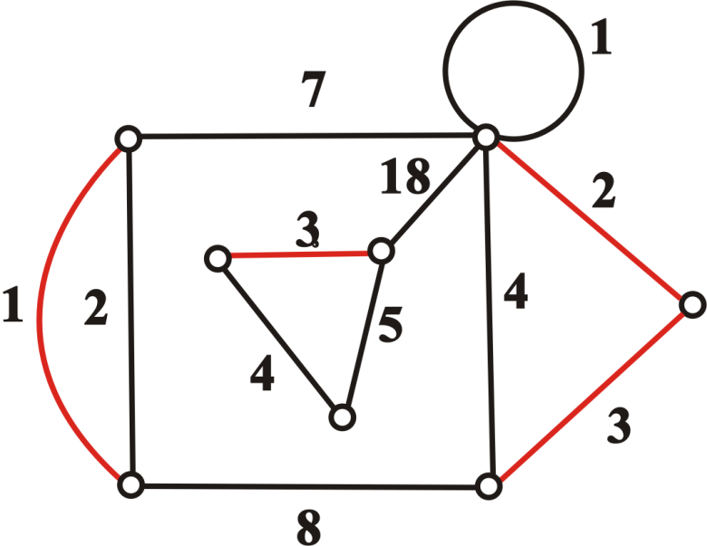
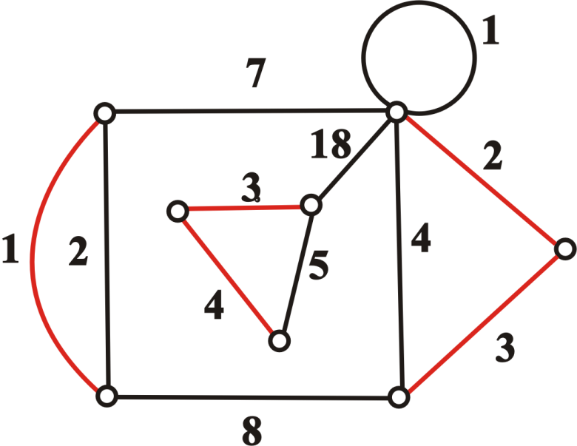
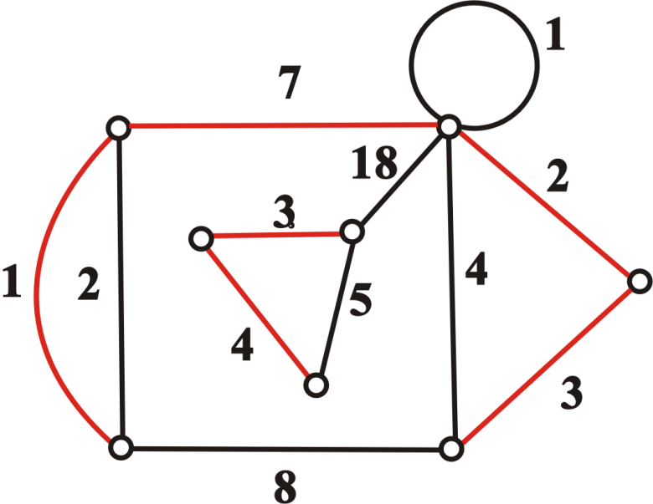
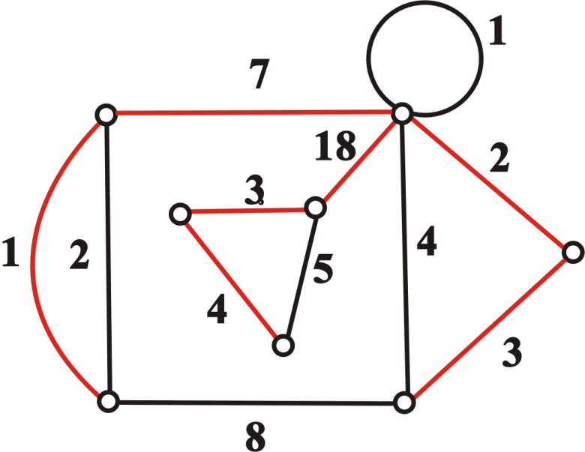
7.1.2 Spanning Trees
⤷ Kruskal’s MST Algorithm – Cycle-Avoidance Approach(e.g.)
Example: Find a minimum spanning tree of the graph.
W(T)=38
Notes:
生成树主要用于确保连通性和简化复杂性，而最小生成树主要用于在保持连通性的前提下，寻求成本最低的解决方案。
综上所述，最小生成树在生成树的基础上增加了对总边权重最小化的考虑，它在网络设计和优化问题中具有重要的应用价值。
图G的每一条边e附加一个实数w(e), 称作边e的权. 图G连
同附加在边上的权称作带权图, 记作G=<V,E,W>. 设H是G
的子图, H所有边的权的和称作H的权, 记作W(H).
最小生成树: 带权图G的所有生成树中权最小的生成树
避圈法 (Kruskal) ——求最小生成树的算法
设G是n阶无向连通带权图G.
(1) 按权从小到大排列边(环除外), 设W(e₁)≤W(e₂)≤…≤W(e_{m}).
(2) 令T←∅, i←1, k←0.
(3) 若e_{i}与T中的边不构成回路，则令T←T∪{e_{i}}, k←k+1.
(4) 若k<n-1, 则令i←i+1, 转(3).

Slide 40
7.1.2 Spanning Trees
⤷ Kruskal’s MST Algorithm – Cycle-Avoidance Approach(e.g.)
Example: A telecommunications company has a fiber-optic network coverage requirement as shown in the figure. The possible cable routes between buildings and their lengths (in meters) are given in the diagram.
Question: Under the condition that the entire network must be connected, how should the cable routes be selected to ensure that the total cable length is minimized?
Solution:
7
E
B
8
6
5
7
4
4
9
I
A
F
C
5
4
2
3
2
3
H
D
4
G
Total Length : 2+2+3+3+4+5+5+7=31(meters)
Notes:
例：通信企业有如下图所示的光纤网络覆盖需求，建筑物之间可以铺设光缆的线路及长度(单位:米)如图所示. 问:在确保网络全覆盖的条件下， 如何确定光缆铺设路线才能使光缆的总长度最短?

Slide 41
7.1 Undirected Trees • Brief summary
Objective :
Key Concepts ：

Slide 42
Discrete Mathematics 2025 Spring
魏可佶 kejiwei@tongji.edu.cn

Slide 43
Chapter 7: Trees and Their Applications
7.1 Undirected Trees
7.2 Rooted Trees and Their Applications
Notes:
图论树主要关注顶点的连接性和无环性，而数据结构树则更侧重于数据的组织、管理和操作效率。
7.1 无向树
7.2 根树及其应用

Slide 44
7.2 Rooted Trees and Their Applications
7.2.1 Rooted Trees and Their Classifications
7.2.2 Optimal Trees and the Huffman Algorithm
7.2.3 Optimal Prefix Codes
7.2.4 Traversals of Rooted Trees and Their Applications
Inorder Traversal, Preorder Traversal, and Postorder Traversal
Polish Notation and Reverse Polish Notation
Notes:
7.2.1 根树及其分类
7.2.2 最优树与哈夫曼算法
7.2.3 最佳前缀码
7.2.4 根树的行遍及其应用
中序行遍法、前序行遍法和后序行遍法
波兰符号法与逆波兰符号法

Slide 45
7.2.1 Rooted Trees and Their Classifications
⤷ Directed Tree vs. Rooted Tree
Directed Tree: A directed graph that becomes an undirected tree when edge directions are ignored.
Rooted Tree: A nontrivial directed tree in which exactly one vertex has in-degree 0 (the root), and all other vertices have in-degree 1.
Root: The vertex with in-degree 0 in a directed tree.
Leaf: A vertex with in-degree 1 and out-degree 0 in a directed tree.
Internal Vertex: A vertex with in-degree 1 and out-degree greater than 0 in a directed tree.
Branching Vertex: A general term referring to both the root and internal vertices.
Level of a Vertex v: The length of the path from the root to vertex v.
Height of the Tree: The maximum level among all vertices in the directed tree.
Notes:
有向树: 略去方向后为无向树的有向图
根树: 有一个顶点入度为0, 其余的入度均为1的非平凡的有向树
树根: 有向树中入度为0的顶点
树叶: 有向树中入度为1, 出度为0的顶点
内点: 有向树中入度为1, 出度大于0的顶点
分支点: 树根与内点的总称
顶点v的层数: 从树根到v的通路长度
树高: 有向树中顶点的最大层数

Slide 46
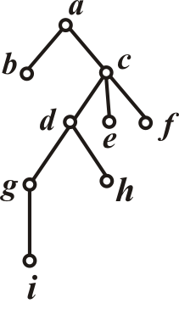
7.2.1 Rooted Trees and Their Classifications
⤷ Drawing a Rooted Tree(e.g.)
Example：(as shown in the diagram on the right):
a is the root.
b,e,f,h,I are the leaves.
c,d,g are internal vertices.
a,c,d,g are branching vertices.
a is at level 0; level 1 contains b,c; level 2 contains d,e,f; level 3 contains g,h; level 4 contains i.
The height of the tree is 4.
Notes:
根树的画法:树根放最上方,省去所有有向边上的箭头
例：右图中
a是树根
b,e,f,h,i是树叶
c,d,g是内点
a,c,d,g是分支点
a为0层;1层有b,c; 2层有d,e,f;
3层有g,h; 4层有i.
树高为4

Slide 47
7.2.1 Rooted Trees and Their Classifications
⤷ Viewing a Rooted Tree as a Family Tree
If vertex a is adjacent to vertex b, then b is called the child of a, and a is the parent of b.
If b and c are both children of the same vertex, they are called siblings.
If a≠b and a can reach b, then a is an ancestor of b, and b is a descendant of a.
Let v be a vertex in the rooted tree that is not the root. The subgraph induced by v and all its descendants is called the subtree rooted at v.
If a fixed order is assigned to the vertices at each level of a rooted tree, it is called an ordered tree.
Notes:
家族树和有序树都可以视为根树的特定类型或应用，但它们侧重点不同，家族树关注于血缘关系的表示，而有序树关注于节点之间顺序的维护。
家族树的特点和用途使其成为一种特殊的应用场景下的树结构，而不是计算机科学或图论中的一种"正规"分类。不过，理解家族树仍然可以帮助我们学习和理解树形结构的通用特性，如节点、边、层次关系等，以及如何利用这些结构来组织和处理复杂的关系数据。
注：①家族树和有序树可视为根树的特定类型或应用.②家族树关注于血缘关系的表示，有序树关注于节点之间次序的维护. ③家族树和有序树可帮助理解树中节点、边、层次结构，以及利用这些结构来组织和处理复杂的数据关系

Slide 48
7.2.1 Rooted Trees and Their Classifications
⤷ r-ary Tree and Ordered r-ary Tree
Rooted trees can be further classified based on the number of child nodes per parent, the order of child nodes, the regularity of the structure, and the completeness of the tree.
r-ary Tree: A rooted tree in which each branching vertex has at most r children.
r-ary Regular Tree: A rooted tree in which each branching vertex has exactly r children.
Complete r-ary Regular Tree: An r-ary regular tree in which all leaves are at the same level.
Ordered r-ary Tree: An r-ary tree in which a specific order is assigned to the children of each vertex.
Ordered r-ary Regular Tree: An ordered tree in which each branching vertex has exactly r ordered children.
Ordered Complete r-ary Regular Tree: An ordered r-ary regular tree in which all leaves are at the same level.
Notes:
根据根树中节点和子节点数、子节点的顺序性、树的规则性以及树的完全性对根树进行了细分.
r元树:根树的每个分支点至多有r个儿子
r元正则树: 根树的每个分支点恰有r个儿子
r元完全正则树: 所有树叶层数相同的r元正则树
r元有序树: 有序的r元树
r元正则有序树: 有序的r元正则树
r元完全正则有序树: 有序的r元完全正则树

Slide 49
7.2 Rooted Trees and Their Applications
7.2.1 Rooted Trees and Their Classifications
7.2.2 Optimal Trees and the Huffman Algorithm
7.2.3 Optimal Prefix Codes
7.2.4 Traversals of Rooted Trees and Their Applications
Inorder Traversal, Preorder Traversal, and Postorder Traversal
Polish Notation and Reverse Polish Notation
Notes:
7.2.1 根树及其分类
7.2.2 最优树与哈夫曼算法
7.2.3 最佳前缀码
7.2.4 根树的行遍及其应用
中序行遍法、前序行遍法和后序行遍法
波兰符号法与逆波兰符号法

Slide 50
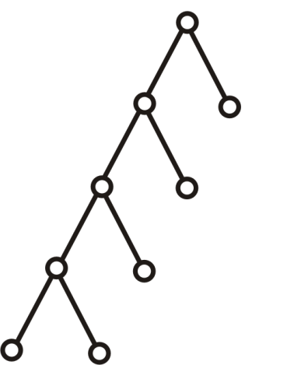
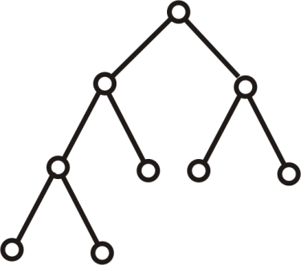
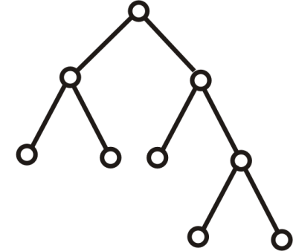
7.2.2 Optimal Trees and the Huffman Algorithm
⤷ Optimal Binary Tree
Definition7.1：Let T be a binary tree with t leaves v₁, v₂, …, v_{t}, and let the weights of the leaves be w₁, w₂, …, w_{t}.
The weight of tree T is defined as: , where l(v_{i}) is the level (depth) of leaf v_{i}.
Among all binary trees with t leaves and weights w₁, w₂, …, w_{t} ​, the one with the minimum total weight W(T), ) is called the optimal binary tree.
Example：
3
4
4
5
1
6
3
5
5
6
3
1
6
1
4
W(T₁)=47
W(T₂)=54
W(T₃)=43
Notes:
在设计和实现数据结构时，选择或设计一个最优的树结构可以大大提高程序的效率和性能。最优树和最优二叉树的计算和构建通常涉及复杂的算法，包括动态规划、贪心算法等。
定义：设2元树T有t片树叶v₁, v₂, …, v_{t}, 树叶的权分别为
w₁, w₂, …, w_{t}, 称 为T的权, 记作W(T), 其中
l(v_{i})是v_{i}的层数. 在所有有t片树叶, 带权w₁, w₂, …, w_{t} 的 2元
树中, 权最小的二叉树称为最优二叉树

Slide 51
7.2.2 Optimal Trees and the Huffman Algorithm
⤷ Static Huffman Coding Algorithm
Huffman Algorithm: Constructing the Optimal Binary (Huffman) Tree.
Given real numbers w₁, w₂, …, w_{t} ​:
①Create t leaves, each assigned a weight of w₁, w₂, …, w_{t} respectively.
②Among all vertices with in-degree 0 (not necessarily leaves), select the two with the smallest weights. Create a new branching node with these two as its children. The weight of the new node is the sum of its two children's weights.
③Repeat step ② until there is only one vertex with in-degree 0 remaining.
The total weight W(T) is the sum of the weights of all branching nodes. The resulting binary tree is the optimal binary tree, having the minimum weighted path length.
Notes:
最优二叉树通过确保频率（或权重）较高的树叶在树的较低层，而频率较低的树叶在较高层，从而减少整体的加权路径长度。
当树叶表示编码字符、权重w₁, w₂, …, w_{t}度表示编码字符出现的频率时，产生的最优二叉树就是哈夫曼树；
哈夫曼(Huffman)算法
给定实数w₁, w₂, …, w_{t}
① 作t片树叶, 分别以w₁, w₂, …, w_{t}为权.
② 在所有入度为0的顶点(不一定是树叶)中选出两个权最小的顶点, 添加一个新分支点, 以这2个顶点为儿子, 其权等于这2个儿子的权之和.
③ 重复②, 直到只有1个入度为0 的顶点为止
W(T)等于所有分支点的权之和，生成的最优二叉树其加权路径长度最小

Slide 52
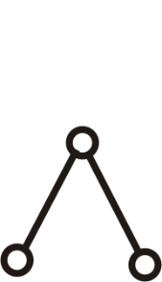
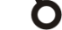
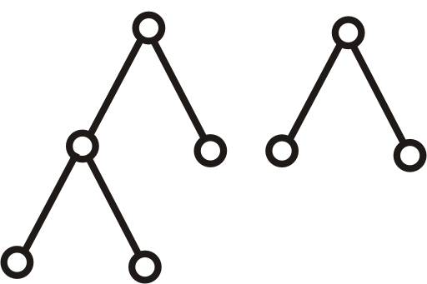
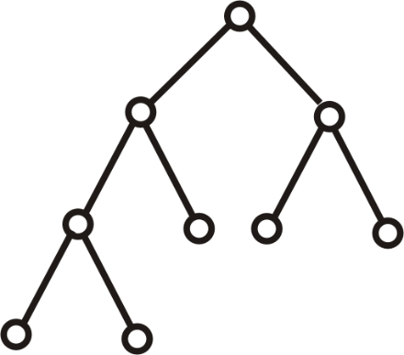
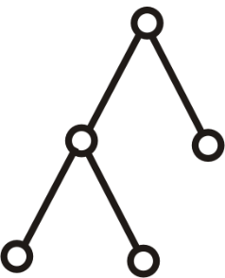
7.2.2 Optimal Trees and the Huffman Algorithm
⤷ Static Huffman Coding Algorithm(e.g.)
Example: Find the optimal binary tree with weights 1, 3, 4, 5, and 6, and compute its total weight.
Solution: Steps (a) through (e) show the computation process using the Huffman algorithm.
4
1
3
4
5
6
(a)
1
3
4
5
6
(b)
19
8
8
11
8
11
W(T)=4+8+11+19=42
4
4
4
4
4
5
6
5
6
4
5
6
1
3
1
3
(c)
(d)
1
3
(e)
Notes:
例： 求以1,3,4,5,6为权的最优2叉树, 并计算它的权
解： (a)到(e)是哈夫曼算法的计算过程

Slide 53
7.2 Rooted Trees and Their Applications
7.2.1 Rooted Trees and Their Classifications
7.2.2 Optimal Trees and the Huffman Algorithm
7.2.3 Optimal Prefix Codes
7.2.4 Traversals of Rooted Trees and Their Applications
Inorder Traversal, Preorder Traversal, and Postorder Traversal
Polish Notation and Reverse Polish Notation
Notes:
7.2.1 根树及其分类
7.2.2 最优树与哈夫曼算法
7.2.3 最佳前缀码
7.2.4 根树的行遍及其应用
中序行遍法、前序行遍法和后序行遍法
波兰符号法与逆波兰符号法

Slide 54
7.2.3 Optimal Prefix Codes
⤷ Prefix Codes and Binary Prefix Codes
Definition7.2:
Let β =α₁α₂…α_{n-1}α_{n} be a string of length n, and let α₁α₂…α_{j}（1≤ j ≤ n）be a prefix of β （with length j ）.
If no two distinct strings β_{i}, β_{j} (i ≠ j) in a non-empty set B= {β₁, β₂, …, β_{m}} are prefixes of one another, then B is called a prefix code.
A prefix code that uses only two symbols (e.g., 0 and 1) is called a binary prefix code.
Examples :
{0,10,110, 1111}, {10,01,001,110} are binary prefix codes.
{0,10,010, 1010} is not a prefix code.
Notes:
定义：设β =α₁α₂…α_{n-1}α_{n}是长度为n的符号串, α₁α₂…α_{j}（1≤ j ≤ n）为β （长度为j ）的前缀。
若非空符号串集B= {β₁, β₂, …, β_{m}}中任何两个β_{i}, β_{j}互(i ≠ j)互不为前缀, 则称B为前缀码。
只出现两个符号(如0与1)的前缀码称作二元前缀码
例： {0,10,110, 1111}, {10,01,001,110}是2元前缀码
{0,10,010, 1010} 不是前缀码

Slide 55
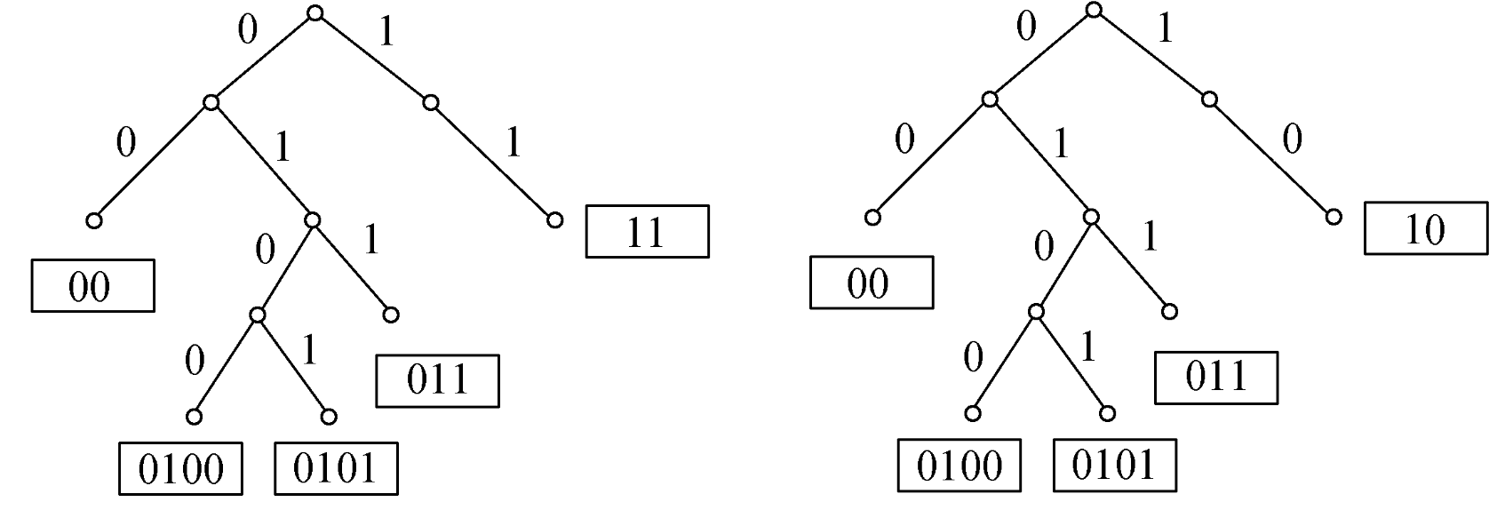
7.2.3 Optimal Prefix Codes
⤷ Generating Binary Prefix Codes Using a Binary Tree
A binary tree can generate a set of binary prefix codes:
①For each branching node, if it has two associated edges, label the left edge with 0 and the right edge with 1.
②If a branching node has only one associated edge, you may label it with either 0 (interpreted as left) or 1 (interpreted as right).
③For each leaf, record the sequence of digits along the path from the root to that leaf. The resulting strings form a binary prefix code.
Examples :
Prefix Code ：
{00, 11, 011, 0100 , 0101}， {00, 10, 011, 0100 , 0101}
Notes:
一棵2叉树产生一组二元前缀码:
①对每个分支点, 若关联2条边, 则给左边标0, 右边标1;
②若只关联1条边, 则可以给它标0(看作左边), 也可以标1(看作右边).
③将从树根到每一片树叶的通路上标识的数字组成的字符串记在树叶处, 所得的字符串构成一个前缀码.
前缀码：{00, 11, 011, 0100 , 0101}， {00, 10, 011, 0100 , 0101}

Slide 56
7.2.3 Optimal Prefix Codes
⤷ Examples of Binary Prefix Code Applications
Example: In communication, suppose the frequency (%) of octal digits is given as follows: 0: 30, 1: 20, 2: 15, 3: 10, 4: 10, 5: 5, 6: 5,7: 5.
Using binary prefix codes, find the binary prefix code that transmits the digits with the fewest number of binary bits (this is called the optimal prefix code).
Also, calculate the total number of binary digits needed to transmit 10,000 octal digits following the given frequency distribution using the optimal prefix code.
The total number of binary digits required if a fixed-length code (of length 3) is used for each octal digit instead.
Notes:
例：在通信中,设八进制数字出现的频率(%)如下:
0: 30, 1: 20, 2: 15, 3: 10, 4: 10, 5: 5, 6: 5, 7: 5
采用2元前缀码, 求传输数字最少的2元前缀码 (称作最佳
前缀码), 并求传输10000个按上述比例出现的八进制数字需
要多少个二进制数字？若用等长的 (长为3) 的码字传输需
要多少个二进制数字?
解：① 用Huffman算法求以频率(乘以100)为权的最优2元树.
设 w₁=5,w₂=5,w₃=5,w₄=10,w₅=10,w₆=15,w₇=20,w₈=30

Slide 57
7.2.3 Optimal Prefix Codes
⤷ Examples of Binary Prefix Code Applications
Solution：
① Use the Huffman algorithm to construct the optimal binary tree, treating the frequencies (multiplied by 100) as the weights.
Let: w₁=5,w₂=5,w₃=5,w₄=10,w₅=10,w₆=15,w₇=20,w₈=30.
② Construct the Huffman tree.
Notes:
例：在通信中,设八进制数字出现的频率(%)如下:
0: 30, 1: 20, 2: 15, 3: 10, 4: 10, 5: 5, 6: 5, 7: 5
采用2元前缀码, 求传输数字最少的2元前缀码 (称作最佳
前缀码), 并求传输10000个按上述比例出现的八进制数字需
要多少个二进制数字？若用等长的 (长为3) 的码字传输需
要多少个二进制数字?
解：① 用Huffman算法求以频率(乘以100)为权的最优2元树.
设 w₁=5,w₂=5,w₃=5,w₄=10,w₅=10,w₆=15,w₇=20,w₈=30

Slide 58
7.2.3 Optimal Prefix Codes
⤷ Examples of Binary Prefix Code Applications
Solution：
③ Assign codes. For characters with the same frequency, their codes or fixed-length codes can be interchanged without affecting the validity or optimality of the encoding.
Digit | 0 | 1 | 2 | 3 | 4 | 5 | 6 | 7
Frequency | 30% | 20% | 15% | 10% | 10% | 5% | 5% | 5%
Huffman Code | 01 | 11 | 001 | 100 | 101 | 0001 | 00001 | 00000
Code Length | 2 | 2 | 3 | 3 | 3 | 4 | 5 | 5
Fixed-Length (Length 3) Code | 000 | 001 | 010 | 011 | 100 | 101 | 110 | 111
Notes:
例：在通信中,设八进制数字出现的频率(%)如下:
0: 30, 1: 20, 2: 15, 3: 10, 4: 10, 5: 5, 6: 5, 7: 5
采用2元前缀码, 求传输数字最少的2元前缀码 (称作最佳
前缀码), 并求传输10000个按上述比例出现的八进制数字需
要多少个二进制数字？若用等长的 (长为3) 的码字传输需
要多少个二进制数字?
解：① 用Huffman算法求以频率(乘以100)为权的最优2元树.
设 w₁=5,w₂=5,w₃=5,w₄=10,w₅=10,w₆=15,w₇=20,w₈=30

Slide 59
7.2.3 Optimal Prefix Codes
⤷ Examples of Binary Prefix Code Applications
Solution：
④Calculate the number of binary digits required to transmit 10,000 octal digits according to the given frequency distribution：
Huffman encoding (optimal prefix code):
W(T)=(3000+2000)*2+(1500+1000+1000)*3+500*4+(500+500)*5=27500.
Fixed-length encoding (length 3): 10000*3=30000.
Bits saved by using the optimal prefix code: 30000-27500=2500 ，approximately 8.33% .
Notes:
例：在通信中,设八进制数字出现的频率(%)如下:
0: 30, 1: 20, 2: 15, 3: 10, 4: 10, 5: 5, 6: 5, 7: 5
采用2元前缀码, 求传输数字最少的2元前缀码 (称作最佳
前缀码), 并求传输10000个按上述比例出现的八进制数字需
要多少个二进制数字？若用等长的 (长为3) 的码字传输需
要多少个二进制数字?
解：① 用Huffman算法求以频率(乘以100)为权的最优2元树.
设 w₁=5,w₂=5,w₃=5,w₄=10,w₅=10,w₆=15,w₇=20,w₈=30

Slide 60
7.2 Rooted Trees and Their Applications
7.2.1 Rooted Trees and Their Classifications
7.2.2 Optimal Trees and the Huffman Algorithm
7.2.3 Optimal Prefix Codes
7.2.4 Traversals of Rooted Trees and Their Applications
Inorder Traversal, Preorder Traversal, and Postorder Traversal
Polish Notation and Reverse Polish Notation
Notes:
7.2.1 根树及其分类
7.2.2 最优树与哈夫曼算法
7.2.3 最佳前缀码
7.2.4 根树的行遍及其应用
中序行遍法、前序行遍法和后序行遍法
波兰符号法与逆波兰符号法

Slide 61
7.2.4 Traversals of Rooted Trees and Their Applications
⤷ Preorder, inorder, and postorder of an ordered rooted tree
Traversing (Touring) a Rooted Tree: Visiting each vertex of a rooted tree exactly once.
Traversal methods for a binary ordered tree:
(1) Inorder traversal: Left subtree → Root → Right subtree
(2) Preorder traversal: Root → Left subtree → Right subtree
(3) Postorder traversal: Left subtree → Right subtree → Root
When the binary ordered tree is not a full (regular) tree, the left or right subtree may be absent.
Notes:
行遍(周游)根树: 对根树每个顶点访问一次且仅访问一次.
行遍2叉有序树的方式：
① 中序行遍法: 左子树、根、右子树
② 前序行遍法: 根、左子树、右子树
③ 后序行遍法: 左子树、右子树、根
当2叉有序树不是正则树时, 左子树或右子树可缺省
例: 右图的行遍结果为：
中序行遍: b a (f d g) c e
前序行遍: a b (c (d f g) e)
后序行遍: b ((f g d) e c) a
*带下划线的是(子)树根, 一对括号内是一棵子树

Slide 62
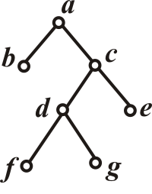
7.2.4 Traversals of Rooted Trees and Their Applications
⤷ Preorder, inorder, and postorder of an ordered rooted tree(e.g.)
Example: The traversal results of the tree on the right are:
(1) Inorder traversal: b a (f d g) c e
(2) Preorder traversal: a b (c (d f g) e)
(3) Postorder traversal: b ((f g d) e c) a
Note: Underlined nodes are (sub)tree roots, and each pair of parentheses encloses a subtree.
Notes:
行遍(周游)根树: 对根树每个顶点访问一次且仅访问一次.
行遍2叉有序树的方式：
① 中序行遍法: 左子树、根、右子树
② 前序行遍法: 根、左子树、右子树
③ 后序行遍法: 左子树、右子树、根
当2叉有序树不是正则树时, 左子树或右子树可缺省
例: 右图的行遍结果为：
中序行遍: b a (f d g) c e
前序行遍: a b (c (d f g) e)
后序行遍: b ((f g d) e c) a
*带下划线的是(子)树根, 一对括号内是一棵子树

Slide 63
7.2.4 Traversals of Rooted Trees and Their Applications
⤷ Expression Tree Construction Rules
① Place an operator at each branching node.
② A binary operator node has two children. The operation applies to the subexpressions represented by the left and right subtrees. By convention, the minuend or dividend is placed in the left subtree.
③ A unary operator node has only one child. The operation applies to the subexpression represented by the subtree rooted at that child.
④ Numbers and variables are placed at the leaves of the tree.
Notes:
①每一个分支点放一个运算符.
②二元运算符所在的分支点有2个儿子, 运算对象是以这2个儿子为根的根子树表示的子表达式, 并规定被减数和被除数放在左子树上;
③一元运算符所在的分支点只有一个儿子, 运算对象是以这个儿子为根的根子树表示的子表达式.
④数字和变量放在树叶上.
二叉有序正则树：“平衡的二叉搜索树”（如AVL树或红黑树）
例：右图是表示算式 ((b+(c+d))∗a)÷((e∗f)−(g+h)∗(i∗j))的2叉有序树
该2叉有序树的中序行遍结果是原算式

Slide 64
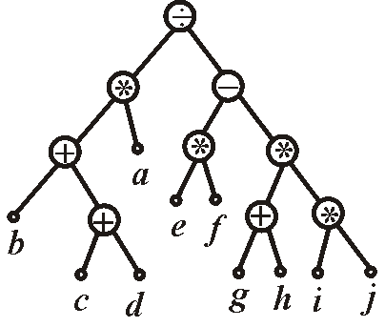
7.2.4 Traversals of Rooted Trees and Their Applications
⤷ Expression Tree Construction Rules(e.g.)
Example:
The diagram on the right is a binary ordered tree representing the expression ((b+(c+d))∗a)÷((e∗f)−(g+h)∗(i∗j))
The inorder traversal of this binary ordered tree yields the original expression.
Notes:
①每一个分支点放一个运算符.
②二元运算符所在的分支点有2个儿子, 运算对象是以这2个儿子为根的根子树表示的子表达式, 并规定被减数和被除数放在左子树上;
③一元运算符所在的分支点只有一个儿子, 运算对象是以这个儿子为根的根子树表示的子表达式.
④数字和变量放在树叶上.
二叉有序正则树：“平衡的二叉搜索树”（如AVL树或红黑树）
例：右图是表示算式 ((b+(c+d))∗a)÷((e∗f)−(g+h)∗(i∗j))的2叉有序树
该2叉有序树的中序行遍结果是原算式

Slide 65
7.2.4 Traversals of Rooted Trees and Their Applications
⤷ Polish and reverse Polish notations of a rooted tree
Polish Notation (Prefix Notation): Traverse the binary ordered tree representing the expression using preorder traversal, and omit all parentheses.
Reverse Polish Notation (Postfix Notation): Traverse the binary ordered tree using postorder traversal, and omit all parentheses.
Example: The Polish notation and Reverse Polish notation for the expression shown in the diagram on the right are:
Polish Notation (Prefix):
÷∗+b+cda−∗ef∗+gh∗ij
Reverse Polish Notation (Postfix):
bcd++a∗ef∗gh+ij∗∗− ÷
Notes:
波兰符号法和逆波兰符号法都能清晰地表示节点之间的父子关系和操作顺序，使得树的构建和遍历变得更加直观和简单。
两种符号法广泛应用于表达式求值、编译器设计、以及算法实现等领域，因为它们提供了一种简洁、高效的方式来处理和计算表达式。
波兰符号法(前缀符号法):按前序行遍法访问表示算式的2叉有序树, 并舍去所有括号.
逆波兰符号法(后缀符号法): 按后序行遍法访问表示算式的2叉有序树,并舍去所有括号
例：右图的波兰符号法和逆波兰符号法表示结果为：
波兰符号法：÷∗+b+cda−∗ef∗+gh∗ij
逆波兰符号法：bcd++a∗ef∗gh+ij∗∗− ÷
*计算机处理方式：对波兰符号法表示的算式，从根节点开始，首先遇到操作符，然后是其操作数。对逆波兰符号法表示的算式，从叶节点开始计算，逐步向上直至根节点.

Slide 66
7.2.4 Traversals of Rooted Trees and Their Applications
⤷ How computers process Polish and reverse Polish notation
Computer Processing Method:
For an expression represented in Polish notation, computation starts from the root node—the operator is encountered first, followed by its operands.
For an expression in Reverse Polish notation, computation begins from the leaf nodes and proceeds upward step by step until reaching the root node.
Polish Notation (Prefix):
÷∗+b+cda−∗ef∗+gh∗ij
Reverse Polish Notation (Postfix):
bcd++a∗ef∗gh+ij∗∗− ÷
Notes:
波兰符号法和逆波兰符号法都能清晰地表示节点之间的父子关系和操作顺序，使得树的构建和遍历变得更加直观和简单。
两种符号法广泛应用于表达式求值、编译器设计、以及算法实现等领域，因为它们提供了一种简洁、高效的方式来处理和计算表达式。
波兰符号法(前缀符号法):按前序行遍法访问表示算式的2叉有序树, 并舍去所有括号.
逆波兰符号法(后缀符号法): 按后序行遍法访问表示算式的2叉有序树,并舍去所有括号
例：右图的波兰符号法和逆波兰符号法表示结果为：
波兰符号法：÷∗+b+cda−∗ef∗+gh∗ij
逆波兰符号法：bcd++a∗ef∗gh+ij∗∗− ÷
*计算机处理方式：对波兰符号法表示的算式，从根节点开始，首先遇到操作符，然后是其操作数。对逆波兰符号法表示的算式，从叶节点开始计算，逐步向上直至根节点.

Slide 67
7.2 Rooted Trees and Their Applications • Brief summary
Objective :
Key Concepts ：

Slide 68
Chapter 7: Trees and Their Applications • Brief summary
7.1 Undirected Trees
7.2 Rooted Trees and Their Applications
Notes:
图论树主要关注顶点的连接性和无环性，而数据结构树则更侧重于数据的组织、管理和操作效率。
7.1 无向树
7.2 根树及其应用

