Slide 1
Hackathon 42KL
Lead: rbutarbu
Members: hetan ; iazmi

Slide 2

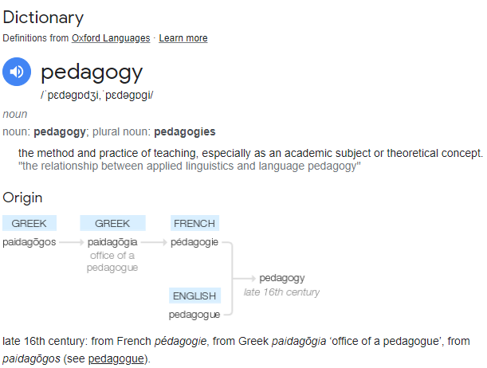



What is Pedagogy?!

