Slide 1
Why we moved
Leave the license. Do not copy the virtual machines.
CLOUDATHON@UH 2026 · TEAM 14 · COUNTERGUIDE
License
It renews at several times the old cost. The data-center lease ends Q4 2027.
We do not renew. This app is Fargate, Aurora, and S3.
Small team
Too few people to migrate hundreds of VMs by hand, or to staff a multi-year rebuild.
Five CloudFormation stacks. The same team runs them again.
Managed work
Patching on-prem servers is slow. That delay already caused security incidents.
No guest OS to patch. The service scales on CPU, not by hand.
The application
A small change rebuilt everything. Scaling was manual. Single points of failure.
Each tier ships alone, across two Availability Zones.
Remote customers: CloudFront at the edge. No latency number claimed.
Notes:
AnyCompany is a Houston retailer. IT is in third-party colocation, on an on-premises virtualization platform. Two clocks: the data-center lease ends in Q4 2027, and the virtualization license renews at several times the previous cost. Leadership will not renew, and will not reproduce the current operating model in the cloud.
The platform team is small. It cannot migrate hundreds of virtual machines by hand, and it cannot staff a multi-year modernization program. Managed services and automation do the work the team does not have the headcount for.
CounterGuide is the one application that proves the pattern. Fargate instead of virtual machines. No guest operating system to patch. Target tracking instead of manual scaling. Each tier deploys on its own. Two Availability Zones, so the single NAT and the single-AZ database are gone. CloudFront is the edge for remote customers. Do not quote a latency number.

Slide 2
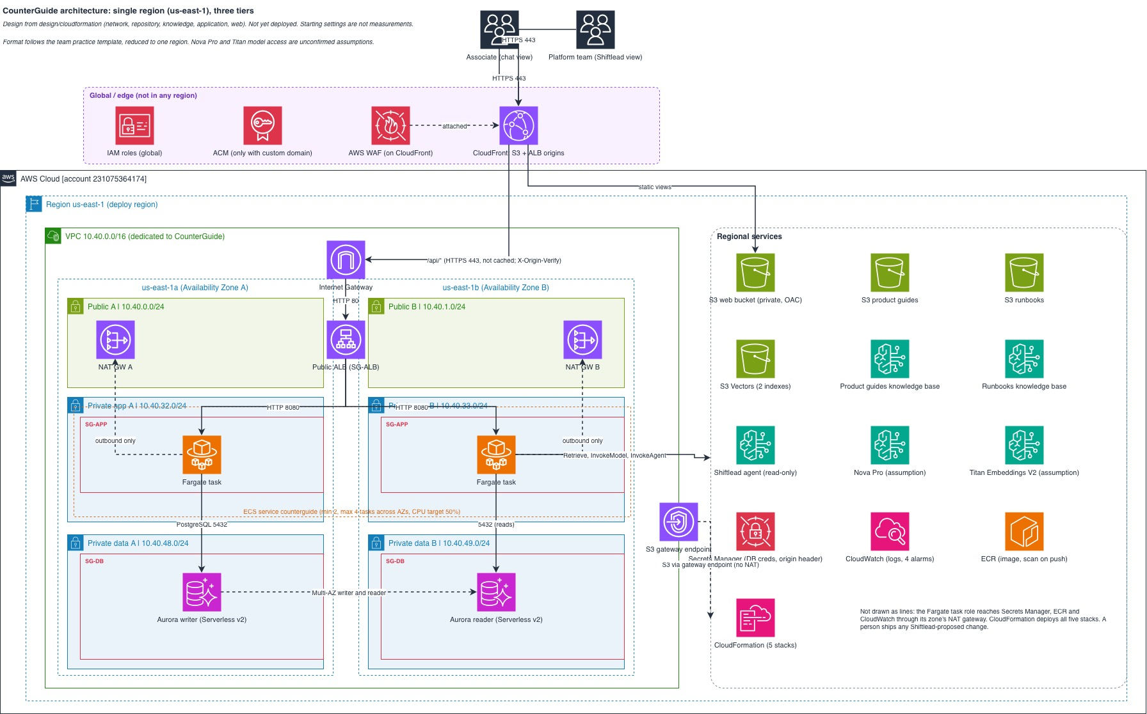
Architecture diagram
Notes:
This slide is the diagram. When the image is on the slide, walk one path and stop.
Browsers talk only to CloudFront. The two views, Guide chat and Shiftlead, come from private S3. /api/* is not cached. It goes to the load balancer, then to a healthy Fargate task. That task is the only component that calls Aurora and Bedrock.
Guide chat retrieves from the product knowledge base and reads the catalog. If retrieval is empty, it says so. Shiftlead is a Bedrock Agent on the operations runbooks. When it selects a tool, Bedrock returns control to the task, and the task does the read. The agent names the tier and a next action. A person ships the change in CloudFormation. No automatic remediation.

Slide 3
Three tiers. One application.
Web
S3 and CloudFront
· Private bucket, CloudFront, WAF
· Guide chat and the Shiftlead view
· The browser holds no secrets
· A page change is a bucket write
Application
ECS on Fargate
· Two tasks, two zones, one ALB
· Only this tier reaches the data
· Answers from guides and catalog
· Shiftlead proposes. A person ships.
· New task is healthy before drain
Data
Aurora and knowledge bases
· Aurora PostgreSQL Serverless v2
· Writer and reader, two zones
· Catalog and the request log
· A guides KB and a runbooks KB
· Password is in Secrets Manager
One VPC · two zones · NAT per zone · security groups chained · private tasks and Aurora
Notes:
Guide chat and Shiftlead stay inside CounterGuide. Not a fourth tier. Not a second application.
Web is a private S3 bucket on CloudFront, with the AWS managed common rule set on WAF. WAF is the filter. CloudFront is the edge for remote customers. Price class 100. Assumption only: US edge locations in that class still serve those customers. No latency number. No custom domain in this proof of concept, so the CloudFront hostname is the name.
Application is one ECS service on Fargate. At least two tasks, one subnet in each Availability Zone, no public IP. Availability zone rebalancing is on. Target tracking starts at 50 percent CPU. That is a starting setting, not a measured baseline. Deployment minimum healthy percent is 100 and maximum is 200. The load balancer drains a task only after the replacement passes the health check. Aurora, the site, and both knowledge bases stay up during that rollout.
Guide chat retrieves before it answers. Empty retrieval is an honest miss, not an answer from general model knowledge. Shiftlead is one Bedrock Agent. Return control. The task performs the read. The task role cannot change infrastructure.
Data is Aurora PostgreSQL Serverless v2. Writer in the first zone, reader in the second, not public. RDS generates the master password into Secrets Manager. No template contains the password. Two knowledge bases, two private buckets. A guide re-ingest does not publish the site. A catalog write does not start ingestion.
Network replaces the single NAT with one NAT gateway per zone. Data subnets have no internet route. The load balancer accepts the CloudFront origin-facing prefix list only, and only with the origin-verify header.

Slide 4
Proof of concept and cost
LIVE
https://d6v32wosjtbse.cloudfront.net
Shiftlead is on /platform.html
What a reviewer can do now
Ask for a safe battery pack. The answer cites the documents.
Ask for a beginner RC kit. Real SKUs. Loose AA cells refused.
Ask something outside the guides. The chat says it is not there.
Five CloudFormation stacks. Not built in the console.
The next server is the same pattern, not a new design.
IF LEFT RUNNING
$210–$228
per month, list price
7 Nov 2026 · estimate, not a bill
What drives it
Two NAT gateways and public IPv4
Load balancer, Fargate, Aurora minimum
Two knowledge bases
The next application
Reuses this network. Adds a service, a schema, and two knowledge bases.
Another NAT pair only if it gets its own VPC.
Notes:
Show Guide chat from the CloudFront link if there is time. Save the product-page failure for the last slide.
Three things on the live site: a cited battery answer, a beginner RC kit that returns real catalog SKUs and refuses loose AA cells, and an out-of-scope question where retrieval finds nothing and the chat says so.
Deployed from design/cloudformation: network, repository, knowledge, application, web. Infrastructure as code is the source of truth.
Cost is about $210 to $228 per month in public list price as of 7 Nov 2026, if the highly available stack is left running. That is an estimate, not a quote, and not a measurement of the workshop account bill. Drivers: two NAT gateways, public IPv4, the load balancer, Aurora minimum ACUs, Fargate, and two knowledge bases.
Fleet control, say this: the next application reuses the VPC. It adds one service, one database schema, and two knowledge bases. It does not get a second NAT pair unless a later decision gives it a separate VPC. Do not justify the design with the proof-of-concept footprint alone.

Slide 5
Break the product page
Shiftlead names the tier. Then it stops.
WHAT’S NEXT
1 Simulate
Record simulated product-page errors.
Rows are marked simulated. No AWS resource changes.
2 Ask
Why is the product page erroring?
That question is already in the box.
3 Check
It names the data tier and the checks it ran.
It proposes the next action. It does not apply it.
https://d6v32wosjtbse.cloudfront.net/platform.html
Then clear the simulated rows. A real fix still ships in CloudFormation.
Notes:
This is the live test.
Open the platform page. Demo controls, then Record simulated product-page errors. That writes failed product-page rows into the request log. Say that they are simulated and that nothing in AWS was changed.
Ask: Why is the product page erroring?
Expect Shiftlead to name the data tier, list the read-only checks it ran (alarms, load-balancer target health, ECS service, Aurora, knowledge-base ingestion, recent request-log rows), and propose a next action. The page shows the proposal. The agent does not apply it. No automatic remediation. No account-wide troubleshooting.
Clear the simulated rows before you leave the page. If asked who ships a real change: a person, through CloudFormation.

