Slide 1
3rd PRAGMA Workshop Tutorial
Programming on the Grid using GridRPC
National Institute of
Advanced Industrial Science and Technology
Yoshio Tanaka

Slide 2
Tutorial Goal
Understand “how to develop” Grid applications using GridRPC
Ninf-G is used as an sample GridRPC system

Slide 3
Outline
What is GridRPC?
  Overview
  What’s going on?
Ninf-G
  Overview and architecture
  How to install Ninf-G
  How to build remote libraries (server side ops)
  How to call remote libraries (client side ops)
  Examples
  Ongoing work and future plan
  Demonstration
    Weather Forecasting Portal on the ApGrid Testbed

Slide 4
Overview of Grid RPC

Slide 5
Some Significant Grid Programming Models/Systems
Data Parallel
  MPI - MPICH-G2, Stampi, PACX-MPI, MagPie
Task Parallel
  GridRPC – Ninf, Netsolve, Punch…
Distributed Objects
  CORBA, Java/RMI/xxx, …
Data Intensive Processing
  DataCutter, Gfarm, …
Peer-To-Peer
  Various Research and Commercial Systems
    UD, Entropia, Parabon, JXTA, …
Others…

Slide 6
Grid RPC System (1/5)
A simple RPC-based programming model for the Grid
  Utilize remote resources
  Clients makes calls with data to be computed
  Task Parallelism (synch. and asynch. calls)
Key property: EASE OF USE
Data
Server
Client
Result
Notes:
Network enabled server may be the simplest form of global computing
A Server serves computation, namely computation resource and computation program
A Client ask for a server to do the computation, and send data for computation.
Server will do some computation and returns the result.
There are already several implementations of network enabled server. Such as our ninf, netsolve from utk, RCS from ETH, Switzerland .

Slide 7
GridRPC System (2/5)
RPC System “tailored” for the Grid
  Medium to Coarse-grained calls
    Call Duration < 1 sec to > week
  Task-Parallel Programming on the Grid
    Asynchronous calls, 1000s of scalable parallel calls
  Large Matrix Data & File Transfer
    Call-by-reference, shared-memory matrix arguments
  Grid-level Security (e.g., Ninf-G with GSI)
  Simple Client-side Programming & Management
    No client-side stub programming or IDL management
  Server Job monitoring and control
  Other features…

Slide 8
GridRPC System (3/5)
Grid RPC can be effectively used as a programming abstraction in situations including
  Utilize resources that are available on a specific computer on the Grid
    Binary programs, libraries, etc.
  Execute compute/data intensive routines on large servers on the Grid
  Parameter Sweep Studies using multiple servers on the Grid
  General and scalable Task-Parallel Programs on the Grid

Slide 9
Grid RPC System (4/5)
Some characteristics
  Very simple RPC API
  Existing libs and apps into Grid components
  IDL embodying call info, minimal client-side management
double A[n][n],B[n][n],C[n][n]; /* Data Decl.*/
dmmul(n,A,B,C); /* Call local function*/
grpc_function_handle_default(&hdl, “dmmul”);
grpc_call(hdl,n,A,B,C); /* Call server side routine*/
Notes:
Here is the typical API of network enabled server.
The only thing client user have to do is just replace this function invocation by this one.
Here, I wrote that NES_call

Slide 10
Grid RPC System (5/5)
Programming Model middleware between “the Grid toolkit” and Application
  Bases for more complex form of global computing
Success stories of large computational problems happening
  Parameter sweeping
    Monte Carlo Simulation – MCell (Netsolve)
  Medium to Coarse-Grained multi simulations
    REXMC (Ninf), Weather Forecasting (Ninf-G)
  Fine to Medium-Grained Iterative Algorithms
    BMI, SDPA Apps (Ninf/Ninf-G)
  Network-enabled “generic”
  libraries
    SCLAPACK for Netsolve/Ninf/Ninf-G
Application
Grid RPC System
Lower-level Grid Systems
Notes:
Network enabled servesr may seem to be too primitive. But, it can serve as bases for more complex form of global computing such as parameter sweeping or mote carlo simulation
Another important role of the NES is the middleware between the grid and application.
Recently, some software for grid infrastructure are proposed, such as Legion and Globus.
However, sometimes to implement application directly on top of such grid infrastructure is too hard for application people.
NES can serve more friendly API for application people.

Slide 11
Sample Architecture and Protocol of GridRPC System – Ninf -
Server side
Client side
Server side setup
  Build Remote Library Executable
  Register it to the Ninf Server
Call remote library
  Retrieve interface information
  Invoke Remote Library Executable
  It Calls back to the client
IDL file
Numerical
Library
Client
IDL Compiler
Connect back
Interface
Reply
Invoke
Executable
Generate
Interface
Request
fork
Remote Library
Executable
Ninf Server
Register

Slide 12
GridRPC – What’s going on? -
Activities at the GGF
  Standard GridRPC API
    Proposed at the GGF APM RG
    In collaboration between Ninf team and NetSolve team
  GridRPC WG will be launched at GGF7
    Short term (18 months)
    Define Standard GridRPC API
    Develop reference implementation
System developments
  GridSolve, Ninf-G/G2
  Will propose to include these systems in NMI Software Package (October release?)

Slide 13
Ninf-G
Overview and Architecture

Slide 14
Ninf Project
Started in 1994
Collaborators from various organizations
  AIST
    Satoshi Sekiguchi, Umpei Nagashima, Hidemoto Nakada, Hiromitsu Takagi, Osamu Tatebe, Yoshio Tanaka,
    Kazuyuki Shudo
  University of Tsukuba
    Mitsuhisa Sato, Taisuke Boku
  Tokyo Institute of Technology
    Satoshi Matsuoka, Kento Aida, Hirotaka Ogawa
  Tokyo Electronic University
    Katsuki Fujisawa
  Ochanomizu University
    Atsuko Takefusa
  Kyoto University
    Masaaki Shimasaki

Slide 15
Brief History of Ninf/Ninf-G
1994
1997
2000
2003
Ninf project
launched
Ninf-G
development
Implement formal
spec. of GridRPC
Release Ninf
version 1
Standard GridRPC
API proposed
1st GridRPC WG
at GGF7
Start collaboration
with NetSolve team
Release Ninf-G
version 0.9
Release Ninf-G
version 1.0

Slide 16
What is Ninf-G?
A software package which supports programming and execution of Grid applications using GridRPC.
Ninf-G includes
  C/C++, Java APIs, libraries for software development
  IDL compiler for stub generation
  Shell scripts to
    compile client program
    build and publish remote libraries
  sample programs
  manual documents

Slide 17
Ninf-G: Features At-a-Glance
Ease-of-use, client-server, Numerical-oriented RPC system
No stub information at the client side
User’s view: ordinary software library
  Asymmetric client vs. server
Built on top of the Globus Toolkit
  Uses GSI, GRAM, MDS, GASS, and Globus-IO
Supports various platforms
  Ninf-G is available on Globus-enabled platforms
Client APIs: C/C++, Java

Slide 18
Sample Architecture Review
Client API
  Provides users easy to use API
Remote Library Executable
  Execute numerical operation
Ninf Server
  Provides library interface info.
  Invokes remote library executable
IDL compiler
  Compiles Interface description
  Generates 'stub main' for remote library executable
  Helps to link the executable
Ninf Register driver
  Registers remote library executable into the Server

Slide 19
Architecture of Ninf
Client side
Server side
IDL file
Numerical
Library
Client
IDL Compiler
Connect back
Interface
Reply
Invoke
Executable
Generate
Interface
Request
fork
Remote Library
Executable
Ninf Server
Register

Slide 20
Architecture of Ninf-G
Client side
Server side
IDL file
Numerical
Library
Client
IDL Compiler
Connect back
Interface
Request
Interface
Reply
Invoke
Executable
Globus-IO
Generate
fork
Remote Library
Executable
GRAM
GRIS
Interface Information
LDIF File
retrieve

Slide 21
Ninf-G
How to install Ninf-G

Slide 22
Getting Started
Globus Toolkit (ver.1 or 2) must be installed prior to the Ninf-G installation
  from source bundles
  all bundles (resource, data, info - server/client/SDK) (recommended)
  same flavor
Create a user ‘ninf’ (recommended)
Download Ninf-G
  http://ninf.apgrid.org/packages/
  Ninf-G is provided as a single gzipped tarball.
Before starting installation, be sure that Globus related env. variable is correctly defined (e.g. GLOBUS_LOCATION, GLOBUS_INSTALL_PATH)

Slide 23
Installation Steps (1/4)
Uncompress and untar the tarball.
% gunzip –c ng-latest.tgz | tar xvf –
This creates a directory “ng” which makes up the source tree along with its subdirectories.

Slide 24
Installation Steps (2/4)
Change directory to the “ng-1.0” directory and run configure script.
% cd ng-1.0
% ./configure
Example:
% ./configure --prefix=/usr/local/ng
  Notes for GT2.2 or later
    --without-gpt option is required if GPT_LOCATION is not defined.
  Run configure with --help option for detailed options of the configure script.

Slide 25
Installation Steps (3/4)
Compile all components and install Ninf-G
% make
% make install
Register the host information by running the following commands (required at the server side)
% cd ng-1.0/bin
% ./server_install
This command will create
${GLOBUS_LOCATION}/var/gridrpc/
and copies a required LDIF file
  Notes: these commands should be done as root (for GT2) or user globus (for GT1)

Slide 26
Installation Steps (4/4)
Add the information provider to GRIS (required at the server side)
  For GT1:
    Add the following line to
    ${GLOBUS_DEPLOY_PATH}/etc/grid-info-resource.conf
    0 cat ${GLOBUS_DEPLOY_PATH}/var/gridrpc/*.ldif
  For GT2:
    Add the following line to
    ${GLOBUS_LOCATION}/etc/grid-info-slapd.conf
    include ${GLOBUS_LOCATION}/etc/grpc.schema
    The line should be put just below the following line:
    include ${GLOBUS_LOCATION}/etc/grid-info-resource.schema
    Restart GRIS.
    % ${GLOBUS_LOCATION}/sbin/SXXGris stop
    % ${GLOBUS_LOCATION}/sbin/SXXGris start

Slide 27
Ninf-G
How to Build Remote Libraries
- server side operations -

Slide 28
Prerequisite
GRAM (gatekeeper) and GRIS are correctly configured and running
Following env. variables are appropriately defined:
  GLOBUS_LOCATION / GLOBUS_INSTALL_PATH
  NS_DIR
Add ${NS_DIR}/bin to $PATH (recommended)
Notes for dynamic linkage of the Globus shared libraries: Globus dynamic libraries (shared libraries) must be linked with the Ninf-G stub executables. For example on Linux, this is enabled by adding ${GLOBUS_LOCATION}/lib in /etc/ld.so.conf and run ldconfig command.

Slide 29
Ninf-G remote libraries
Ninf-G remote libraries are implemented as executable programs (Ninf-G executables) which
  contains stub routine and the main routine
  will be spawned off by GRAM
The stub routine handles
  communication with clients and Ninf-G system itself
  argument marshalling
Underlying executable (main routine) can be written in C, C++, Fortran, etc.

Slide 30
How to build Ninf-G remote libraries (1/3)
Write an interface information using Ninf-G Interface Description Language (Ninf-G IDL).
Example:
Module mmul;
Define dmmul (IN int n,
IN double A[n][n],
IN double B[n][n],
OUT double C[n][n])
Require “libmmul.o”
Calls “C” dmmul(n, A, B, C);
Compile the Ninf-G IDL with Ninf-G IDL compiler
% ns_gen <IDL_FILE>
ns_gen generates stub source files and a makefile (<module_name>.mak)

Slide 31
How to build Ninf-G remote libraries (2/3)
Compile stub source files and generate Ninf-G executables and LDIF files (used to register Ninf-G remote libs information to GRIS).
% make –f <module_name>.mak
Publish the Ninf-G remote libraries
% make –f <module_name>.mak install
This copies the LDIF files to ${GLOBUS_LOCATION}/var/gridrpc

Slide 32
How to build Ninf-G remote libraries (3/3)
Ninf-G IDL file
<module>.idl
GRAM
ns_gen
GRIS
_stub_foo.c
_stub_bar.c
_stub_goo.c
<module>.mak
_stub_foo
make –f <module>.mak
_stub_bar
_stub_goo
<module>::foo.ldif
Library program
libfoo.a
<module>::bar.ldif
<module>::goo.ldif

Slide 33
Ninf-G IDL Statements (1/2)
Module module_name
  specifies the module name.
CompileOptions “options”
  specifies compile options which should be used in the resulting makefile
Library “object files and libraries”
  specifies object files and libraries
FortranFormat “format”
  provides translation format from C to Fortran.
  Following two specifiers can be used:
    %s: original function name
    %l: capitalized original function name
  Example:
  FortranFormat “_%l_”;
  Calls “Fortran” fft(n, x, y);
  will generate function call
  _FFT_(n, x, y);
  in C.

Slide 34
Ninf-G IDL Statements (2/2)
Globals { … C descriptions }
  declares global variables shared by all functions
Define routine_name (parameters…)
[“description”]
[Required “object files or libraries”]
[Backend “MPI”|”BLACS”]
[Shrink “yes”|”no”]
{{C descriptions} |
Calls “C”|”Fortran” calling sequence}
  declares function interface, required libraries and the main routine.
  Syntax of parameter description:
  [mode-spec] [type-spec] formal_parameter [[dimension [:range]]+]+

Slide 35
Syntax of parameter description (detailed)
mode-spec: one of the following
  IN: parameter will be transferred from client to server
  OUT: parameter will be transferred from server to client
  INOUT: at the beginning of RPC, parameter will be transferred from client to server. at the end of RPC, parameter will be transferred from server to client
  WORK: no transfers will be occurred. Specified memory will be allocated at the server side.
type-spec should be either char, short, int, float, long, longlong, double, complex, or filename.
For arrays, you can specify the size of the array. The size can be specified using scalar IN parameters.
  Example:
  IN int n, IN double a[n]

Slide 36
Sample Ninf-G IDL (1/2)
Matrix Multiply
Module matrix;
Define dmmul (IN int n,
IN double A[n][n],
IN double B[n][n],
OUT double C[n][n])
“Matrix multiply: C = A x B“
Required “libmmul.o”
Calls “C” dmmul(n, A, B, C);

Slide 37
Sample Ninf-G IDL (2/2)
ScaLAPACK (pdgesv)
Module SCALAPACK;
CompileOptions “NS_COMPILER = cc”;
CompileOptions “NS_LINKER = f77”;
CompileOptions “CFLAGS = -DAdd_ -O2 –64 –mips4 –r10000”;
CompileOptions “FFLAGS = -O2 -64 –mips4 –r10000”;
Library “scalapack.a pblas.a redist.a tools.a libmpiblacs.a –lblas –lmpi –lm”;
Define pdgesv (IN int n, IN int nrhs, INOUT double global_a[n][lda:n], IN int lda,
INOUT double global_b[nrhs][ldb:n], IN int ldb, OUT int info[1])
Backend “BLACS”
Shrink “yes”
Required “procmap.o pdgesv_ninf.o ninf_make_grid.of Cnumroc.o descinit.o”
Calls “C” ninf_pdgesv(n, nrhs, global_a, lda, global_b, ldb, info);

Slide 38
Ninf-G
How to call Remote Libraries
- client side APIs and operations -

Slide 39
Prerequisite
should be able to submit jobs to the Globus Gatekeeper on servers
  has a user certificate
  User’s dn appears on grid-mapfile
  Run grid-proxy-init command before executing Ninf-G apps
Following env. variables are appropriately defined:
  GLOBUS_LOCATION / GLOBUS_INSTALL_PATH
  NS_DIR
Add ${NS_DIR}/bin to $PATH (recommended)

Slide 40
(Client) User’s Scenario
Write client programs using Ninf-G API
Compile and link with the supplied Ninf-G client compile driver (ns_client_gen)
Write a configuration file in which runtime environments can be described
Run grid-proxy-init command
Run the program

Slide 41
Ninf-G APIs
Two kinds of APIs
  Ninf API
    compatible with Ninf Ver.1
    simple but less functional
  GridRPC API
    Proposed at GGF for standardization
    recommended!

Slide 42
GRPC API (1) – Terminology -
Function Handle
  abstraction of serve-side function
Session ID
  Non-negative value to identify asynchronous RPC

Slide 43
GridRPC API (2) - Status Code -
code | value
GRPC_OK | 0 | SUCCESS
GRPC_ERROR | -1 | FAILURE

Slide 44
GridRPC API (3) - Error Code -
Code
GRPCERR_NOERROR | Not an error
GRPCERR_NOT_INITIALIZED | Not initialized
GRPCERR_SERVER_NOT_FOUND | Server is not found
GRPCERR_CONNECTION_REFUSED | Failed in connection to the server
GRPCERR_NO_SUCH_FUNCTION | Function not found
GRPCERR_AUTHENTICATION_FAILED | Failed in authentication
GRPCERR_RPC_REFUSED | RPC is refused
GRPCERR_COMMUNICATION_FAILED | Failed in communication
GRPCERR_PROTOCOL_ERROR | Invalid protocol
GRPCERR_CLIENT_INTERNAL_ERROR | Violation inside the client
GRPCERR_SERVER_INTERNAL_ERROR | Violation inside the server
GRPCERR_EXECUTABLE_INOPERATIVE | Executable is died
GRPCERR_SIGNAL_CAUGHT | Signal was occurred
GRPCERR_INVALID_ARGUMENT | Invalid argument
GRPCERR_STACK_OVERFLOW | Stack overflow
GRPCERR_FILE_READ | Error in reading a file
GRPCERR_FILE_WRITE | Error in writing a file
GRPCERR_UNKNOWN_ERROR | Unknown error

Slide 45
GridRPC API (4) - Initialize/Finalize -
int grpc_initialize( char * config_file_name);
  reads the configuration file and initialize client.
  Any calls of other GRPC APIs prior to grpc_initialize would fail
  Returns GRPC_OK (success) or GRPC_ERROR (failure)
int grpc_finalize();
  Frees resources (memory, etc.)
  Any calls of other GRPC APIs after grpc_finalize would fail
  Returns GRPC_OK (success) or GRPC_ERROR (failure)

Slide 46
GridRPC API (5) – Function Handles -
int grpc_function_handle_default (
grpc_function_handle_t * handle, char * func_name);
  Initializes a function handle for the function using default host and port.
  func_name should be “module_name/routine_name”.
  Returns GRPC_OK (success) or GRPC_ERROR (failure)
int grpc_function_handle_init (
grpc_function_handle_t * handle,
char * host_name, int port, char * func_name);
  Initializes a function handle for the function along with the specified host and port.
  func_name should be “module_name/routine_name”.
  Returns GRPC_OK (success) or GRPC_ERROR (failure)
int grpc_function_handle_destruct (
grpc_function_handle_t * handle);
  Destructs the function handle
  Returns GRPC_OK (success) or GRPC_ERROR (failure)
grpc_function_handle_t *grpc_get_handle (
int sessionId);
  Returns a function handle used in the session specified by sessionID.

Slide 47
GridRPC API (6) - RPC -
int grpc_call ( grpc_function_handle_t *, ...);
  Invokes a blocking RPC using the specified function handle.
  The rest of the arguments should be the same sequence with the Ninf-G remote executable.
  Return GRPC_OK (success) or GRPC_ERROR (failure)
int grpc_call_async (
grpc_function_handle_t *, ...);
  Invokes a non-blocking RPC using the specified function handle.
  The rest of the arguments should be the same sequence with the Ninf-G remote executable.
  Return the sessionID (success) or GRPC_ERROR (failure)

Slide 48
GridRPC API (7) - RPC using stack -
grpc_arg_stack * grpc_arg_stack_new ( int size );
  Allocates an argument stack.
  Returns a pointer to the stack. Null is returned on allocation error.
int grpc_arg_stack_push_arg (
grpc_arg_stack* argStack, void *arg);
  Pushes an argument to the stack.
  Returns GRPC_OK (success) or GRPC_ERROR (failure)
void * grpc_arg_stack_pop_arg (
grpc_arg_stack* argStack);
  Pops an argument from the stack.
  Returns a pinter to the argument. Null is returned on error.
int grpc_arg_stack_destruct ( grpc_arg_stack *argStack );
  Free the stack.
  Returns GRPC_OK (success) or GRPC_ERROR (failure).
int grpc_call_arg_stack (
grpc_function_handle_t *handle, grpc_arg_stack *argStack );
  Performs blocking RPC, which corresponds to grpc_call().
int grpc_call_arg_stack_async (
grpc_function_handle_t *handle, grpc_arg_stack *argStack );
  Performs non-blocking RPC, which corresponds to grpc_call_async().

Slide 49
GridRPC API (8) - Wait Functions -
int grpc_wait (int sessionID);
  Waits outstanding RPC specified by sessionID
  Returns GRPC_OK (success) or GRPC_ERROR (failure)
int grpc_wait_and (int * idArray, int length);
  Waits all outstanding RPCs specified by an array of sessionIDs
  Returns GRPC_OK if the wait for all RPCs are succeeded, otherwise GRPC_ERROR is returned.
int grpc_wait_or ( int * idArray, int length, int * idPtr);
  Waits any one of RPCs specified by an array of sessionIDs.
  Session ID of the finished RPC is store in the third argument.
  Returns GRPC_OK if the finished RPC is suceeded, otherwise GRPC_ERROR is returned.
int grpc_wait_all ( );
  Waits until all outstanding RPCs are completed.
  Returns GRPC_OK if all the sessions are succeeded, otherwise GRPC_ERROR is returned.
int grpc_wait_any ( int * idPtr);
  Waits any one of outstanding RPCs.
  Session ID of the finished RPC is store in the argument.
  Returns GRPC_OK if the finished RPC is suceeded, otherwise GRPC_ERROR is returned.

Slide 50
GridRPC API (9) - Session Control -
int grpc_probe (int sessionID);
  probes the job specified by SessionID whether the job has been completed.
  Returns 1 if the job is done and 0 is returned if the job is still running. Returns GRPC_ERROR if the probe is failed.
int grpc_cancel (int sessionID);
  Cancel outstanding RPC specified by sessionID.
  Returns GRPC_OK (success) or GRPC_ERROR (failure)
  Returns GRPC_OK if the RPC is already done.

Slide 51
GridRPC API (10) – Error Functions -
int grpc_get_last_error ( );
  Returns error code of the last GridRPC API call
int grpc_get_error (int sessionID);
  Returns error code of the session specified by sessionID.
  Returns -1 if the specified session is not found.
void grpc_perror (char * str);
  Concatenates the argument and error string of the last GridRPC API call and returns the string.
char * grpc_error_string (int error_code);
  Returns the error string of the error code.

Slide 52
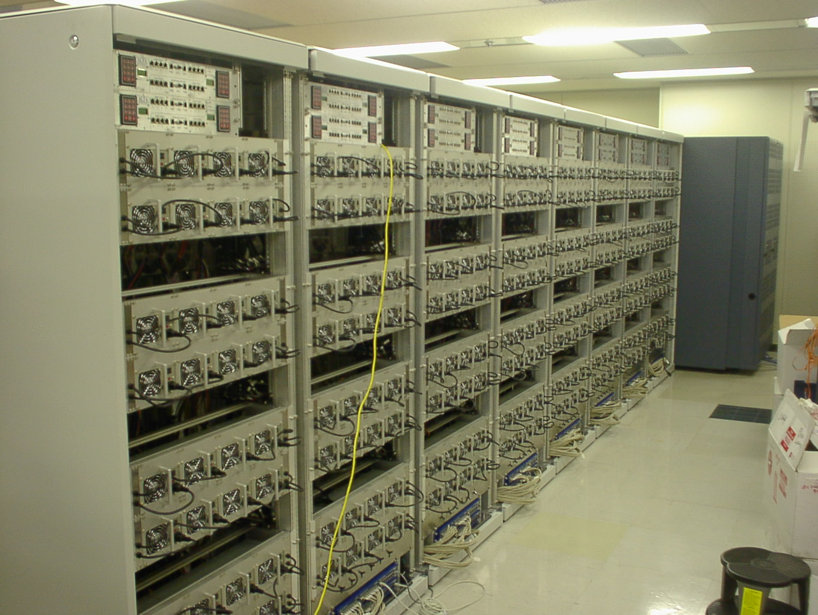

Data Parallel Application
Call parallel libraries (e.g. MPI apps).
Backend “MPI” or
Backend “BLACS”
should be specified
in the IDL
Parallel Computer
Parallel Numerical Libraries
Parallel Applications

Slide 53
Task Parallel Application
Parallel RPCs using asynchronous call.
Server
Server
Server
Server

Slide 54
Task Parallel Application
Asynchronous Call
Waiting for reply
Client
ServerA
ServerB
grpc_call_async(...);
grpc_call_async
grpc_call_async
grpc_wait_all
grpc_wait(sessionID);
grpc_wait_all();
grpc_wait_any(idPtr);
grpc_wait_and(idArray, len);
grpc_wait_or(idArray, len, idPtr);
grpc_cancel(sessionID);
Various task parallel programs spanning clusters are easy to write
Notes:
We also have asynchronous call API.
Ninf_call_async immediately returns with session ID.
And with the ID, you can wait the result of the call.
Using this API, we can invoke several calls in parallel.
We have another API for parallel execution , called transaction.
It specifies a certain program region as a transaction, and execute all ninf_calls in the region in parallel.
Data dependency among the ninf_calls is automatically detected, and the ninf_calls scheduled properly.

Slide 55
How the server can be specified?
Server is determined when the function handle is initialized.
  grpc_function_handle_init();
    hostname is given as the second argument
  grpc_function_handle_default();
    hostname is specified in the client configuration file which must be passed as the first argument of the client program.
Notes: Ninf-G Ver.1 is designed to focus on GridRPC core mechanism and it does not support any brokering/scheduling functions.

Slide 56
Automatic file staging
Ninf-G provides "Filename" type
Local file is automatically shipped to the server
Server side output file is forwarded to the client
grpc_function_handle_default (
&handle, “plot/plot”);
grpc_call (&handle,
“input.gp”,
“output.ps”);
Module plot;
Define plot (IN filename src,
OUT filename out)
{ char buf[1000];
sprintf(buf, “gnuplot %s > %s,
src, out);
system(buf);}
inputfile
Server
Client
Program
outputfile

Slide 57
Compile and run
Compile the program using ns_client_gen command.
% ns_client_gen –o myapp app.c
Before running the application, generate a proxy certificate.
% grid-proxy-init
When running the application, client configuration file must be passed as the first argument.
% ./myapp config.cl [args…]

Slide 58
Client Configuration File (1/2)
Specifies runtime environments.
Available attributes:
  host
    specifies client’s hostname (callback contact)
  port
    specifies client’s port number (callback contact)
  serverhost
    specifies default server’s hostname
  ldaphost
    specifies hostname of GRIS/GIIS
  ldapport
    specifies port number of GRIS/GIIS (default: 2135)
  vo_name
    specifies Mds-Vo-Name for querying GIIS (default: local)
  jobmanager
    specifies jobmanager (default: jobmanager)

Slide 59
Client Configuration File (2/2)
Available attributes (cont’d):
  loglevel
    specifies log leve (0-3, 3 is the most detail)
  redirect_outerr
    specifies whether stdout/stderr are redirect to the client side (yes or no, default: no)
  forkgdb, debug_exe
    enables debugging Ninf-G executables using gdb at server side (TRUE or FALSE, default: FALSE)
  debug_display
    specifies DISPLAY on which xterm will be opened.
  debug_xterm
    specifies absolute path of xterm command
  debug_gdb
    specifies absolute path of gdb command

Slide 60
Sample Configuration File
# call remote library on UME cluster
serverhost = ume.hpcc.jp
# grd jobmanager is used to launch jobs
jobmanager = jobmanager-grd
# query to ApGrid GIIS
ldaphost = mds.apgrid.org
ldapport = 2135
vo_name = ApGrid
# get detailed log
loglevel = 3

Slide 61
Ninf
Examples

Slide 62
Examples
Ninfy the existing library
  Matrix multiply
Ninfy task-parallel program
  Calculate PI using a simple Monte-Carlo Method

Slide 63
Matrix Multiply
Server side
  Write an IDL file
  Generate stubs
  Register stub information to GRIS
Client side
  Change local function call to remote library call
  Compile by ns_client_gen
  write a client configuration file
  run the application

Slide 64
Matrix Multiply - Sample Code -
void mmul(int n, double * a,
double * b, double * c) {
double t;
int i, j, k;
for (i = 0; i < n; i++) {
for (j = 0; j < n; j++) {
t = 0;
for (k = 0; k < n; k++){
t += a[i * n + k] * b[k * n + j]; }
c[i*N+j] = t;
}}}
The matrix do not itself embody size as type info.

Slide 65
Matrix Multiply- Server Side (1/3) -
Write IDL file describing the interface information (mmul.idl)
Module mmul;
Define mmul(IN int N,
IN double A[N*N],
IN double B[N*N],
OUT double C[N*N])
“Matrix Multiply: C = A x B"
Required "mmul_lib.o"
Calls "C" mmul(N, A, B, C);

Slide 66
Matrix Multiply - Server Side (2/3) -
Generate stub source and compile it
> ns_gen mmul.idl
> make -f mmul.mak
ns_gen
mmul.idl
mmul.mak
_stub_mmul.c
cc
_stub_mmul
mmul_lib.o
mmul::mmul.ldif

Slide 67
Matrix Multiply - Server Side (3/3) -
Regisgter stub information to GRIS
dn: GridRPC-Funcname=mmul/mmul, Mds-Software-deployment=GridRPC-Ninf-G, __ROOT_DN__
objectClass: GlobusSoftware
objectClass: MdsSoftware
objectClass: GridRPCEntry
Mds-Software-deployment: GridRPC-Ninf-G
GridRPC-Funcname: mmul/mmul
GridRPC-Module: mmul
GridRPC-Entry: mmul
GridRPC-Path: /usr/users/yoshio/work/Ninf-G/test/_stub_mmul
GridRPC-Stub:: PGZ1bmN0aW9uICB2ZXJzaW9uPSIyMjEuMDAwMDAwIiA+PGZ1bmN0aW9
PSJtbXVsIiBlbnRyeT0ibW11bCIgLz4gPGFyZyBkYXRhX3R5cGU9ImludCIgbW9kZV90eXBl
PSJpbiIgPgogPC9hcmc+CiA8YXJnIGRhdGFfdHlwZT0iZG91YmxlIiBtb2RlX3R5cGU9Imlu
IiA+CiA8c3Vic2NyaXB0PjxzaXplPjxleHByZXNzaW9uPjxiaV9hcml0aG1ldGljIG5hbWU9
> make –f mmul.mak install

Slide 68
Matrix Multiply - Client Side (1/3) -
Modify source code
main(int argc, char ** argv){
grpc_function_handle_t handle;
…
grpc_initialize(argv[1]);
…
grpc_function_handle_default(&handle, “mmul/mmul”);
…
if (grpc_call(&handle, n, A, B, C) == GRPC_ERROR) {
…
}
…
grpc_function_handle_destruct(&handle);
grpc_finalize();
}

Slide 69
Matrix Multiply - Client Side (2/3) -
Compile the program by ns_client_gen
Generate a proxy certificate
Write a client configuration file
> ns_client_gen -o mmul_ninf mmul_ninf.c
> grid-proxy-init
serverhost = ume.hpcc.jp
ldaphost = ume.hpcc.jp
ldapport = 2135
jobmanager = jobmanager-grd
loglevel = 3
redirect_outerr = no

Slide 70
Matrix Multiply - Client Side (3/3) -
Generate a proxy certificate
Run
> grid-proxy-init
> ./mmul_ninf config.cl

Slide 71
Task Parallel Programs
(Compute PI using Monte-Carlo Method)
Generate a large number of random points within the square region that exactly encloses a unit circle (1/4 of a circle)
  PI = 4 p

Slide 72
Compute PI - Server Side -
pi.idl
pi_trial.c
Module pi;
Define pi_trial (
IN int seed,
IN long times,
OUT long * count)
"monte carlo pi computation"
Required "pi_trial.o"
{
long counter;
counter = pi_trial(seed, times);
*count = counter;
}
long pi_trial (int seed, long times) {
long l, counter = 0;
srandom(seed);
for (l = 0; l < times; l++) {
double x =
(double)random() / RAND_MAX;
double y =
(double)random() / RAND_MAX;
if (x * x + y * y < 1.0)
counter++;
}
return counter;
}

Slide 73
Compute PI - Client Side-
#include "grpc.h"
#define NUM_HOSTS 8
char * hosts[] =
{"host00", "host01", "host02", "host03",
"host04", "host05", "host06", "host07"};
grpc_function_handle_t handles[NUM_HOSTS];
main(int argc, char ** argv){
double pi;
long times, count[NUM_HOSTS], sum;
char * config_file;
int i;
if (argc < 3){
fprintf(stderr,
"USAGE: %s CONFIG_FILE TIMES \n",
argv[0]);
exit(2);
}
config_file = argv[1];
times = atol(argv[2]) / NUM_HOSTS;
/* Initialize */
if (grpc_initialize(config_file)
!= GRPC_OK){
grpc_perror("grpc_initialize");
exit(2);
}
/* Initialize Function Handles */
for (i = 0; i < NUM_HOSTS; i++)
grpc_function_handle_init(&handles[i],
hosts[i], port, "pi/pi_trial");
for (i = 0; i < NUM_HOSTS; i++)
/* Asynchronous RPC */
if (gprc_call_async(&handles[i], i,
times, &count[i]) == GRPC_ERROR){
grpc_perror("pi_trial");
exit(2);
}
/* Wait all outstanding RPCs */
if (grpc_wait_all() == GRPC_ERROR){
grpc_perror("wait_all");
exit(2);
}
/* Display result */
for (i = 0, sum = 0; i < NUM_HOSTS; i++)
sum += count[i];
pi = 4.0 *
( sum / ((double) times * NUM_HOSTS));
printf("PI = %f\n", pi);
/* Finalize */
grpc_finalize();
}

Slide 74
Ongoing and Future Work
Towards the release of Ninf-G Ver.2

Slide 75
Planned Additional Features
Get stub information without using LDAP
Initialize multiple function handles with one GRAM call
Callback from remote executable to the client
  heatbeat
  visualize
  debugging
  …
statefull stubs (remote object)
revise the structure of client configuration file
  multiple servers
  jobmanager for each server
  multiple ldapserver
  …

Slide 76
Ninf-G
Demonstration

Slide 77
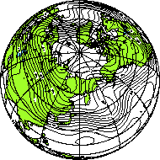
Weather Forecasting System
Goal
  Long term, global weather prediction
    Winding of Jet-Stream
    Blocking phenomenon of high atmospheric pressure
Barotropic S-Model
  Weather forecasting model proposed by Prof. Tanaka
  Simple and precise
  Modeling complicated 3D turbulence as a horizontal one
    200 sec for 100-days prediction/ 1 simulation (Pentium III machine)
  Keep high precision over long periods
    Taking a statistical ensemble mean
      ~50 simulations
    Introducing perturbation at every time step
    Typical parameter survey
Gridifying the program enables quick response
Notes:
The goal of our system is to make a long term, global weather prediction such as winding of Jet-stream and Blocking phenomenon of high atmospheric pressure.
The core part of the system is based on the Barototropic S-Model which is originally proposed by Prof. Tanaka at Tsukuba University.
This model simplifies complicated 3D turbulance flow as a horizontal one. So, computation time of 1 simulation is not so long. For example, it takes 200 sec for 100 days prediction on a Pentium III machine.
But at the same time, this model takes a statistical ensemble mean in order to keep high precision over the long period. In other words, It executes several tenth of simulations while introducing perturbation for each simulation.
As this perturbation can be calculated independently, this is a typical parameter survey. So if we gridify the program, we can expect the quick response of the system.

Slide 78
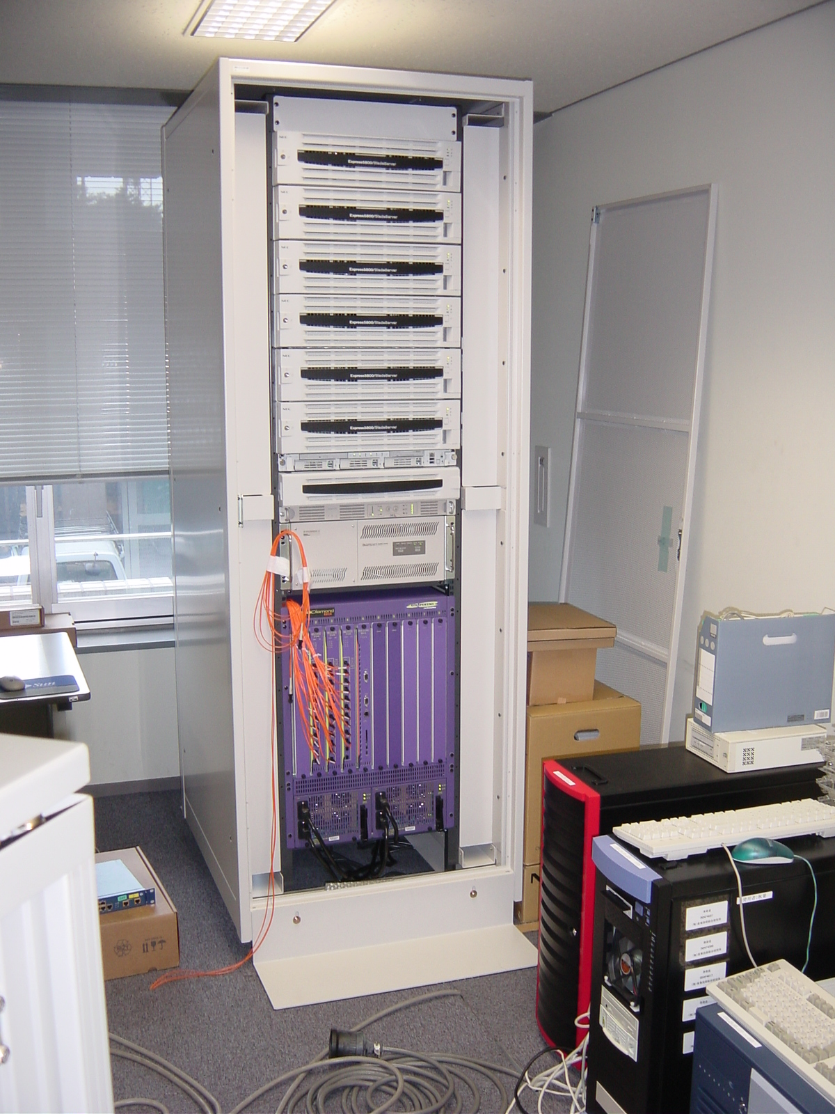
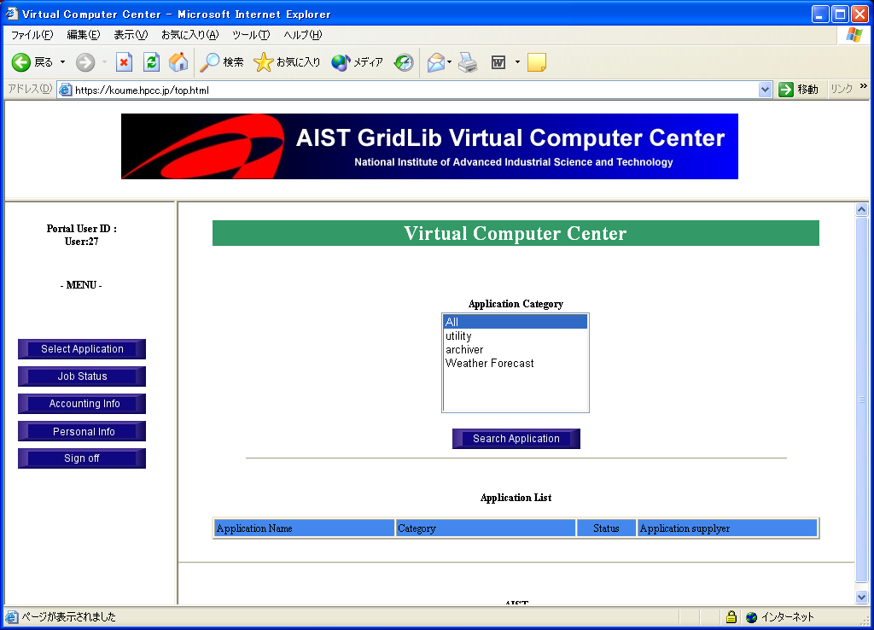
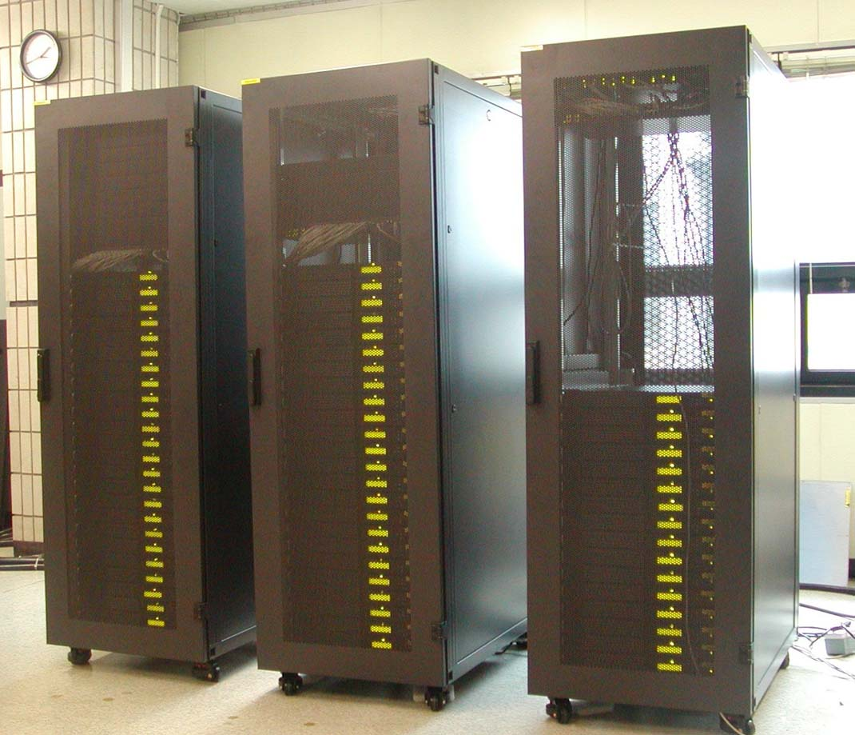


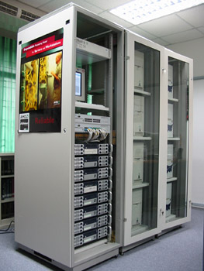
Ninfy the Program
Dividing a program into two parts as a client-server system
  Client:
    Pre-processing: reading input data
    Post-processing: averaging results of ensembles, visualizing results
  Server
    Weather forecasting simulation
Integrating the system by using grid-middle ware
  Ninf-g library: communication between C/S
  Grid lib portal: easy and secure access from a
  user’s machine
Ninf-g
S-model Program
Grid
Lib
Reading data
Solving Equations
Ninf-g
Solving Equations
Web browser
Solving Equations
Averaging results
Visualizing results
user
Ninf-g
Ninf-g
Notes:
In gridifying the program, we have divided the program into two parts as a client-server system.
The program consists of 4 parts, Reading data, solving equations, averaging results, and visualizing them.
We have extracted the solver parts and allocated the parts on back end servers.
Communication between client and servers are realized by Ninf-g library.
In addition, we have used Grid lib portal for realizing easy and secure access from a user’s machine.
(I’d like to talk about these two grid middle wares in brief.)

Slide 79
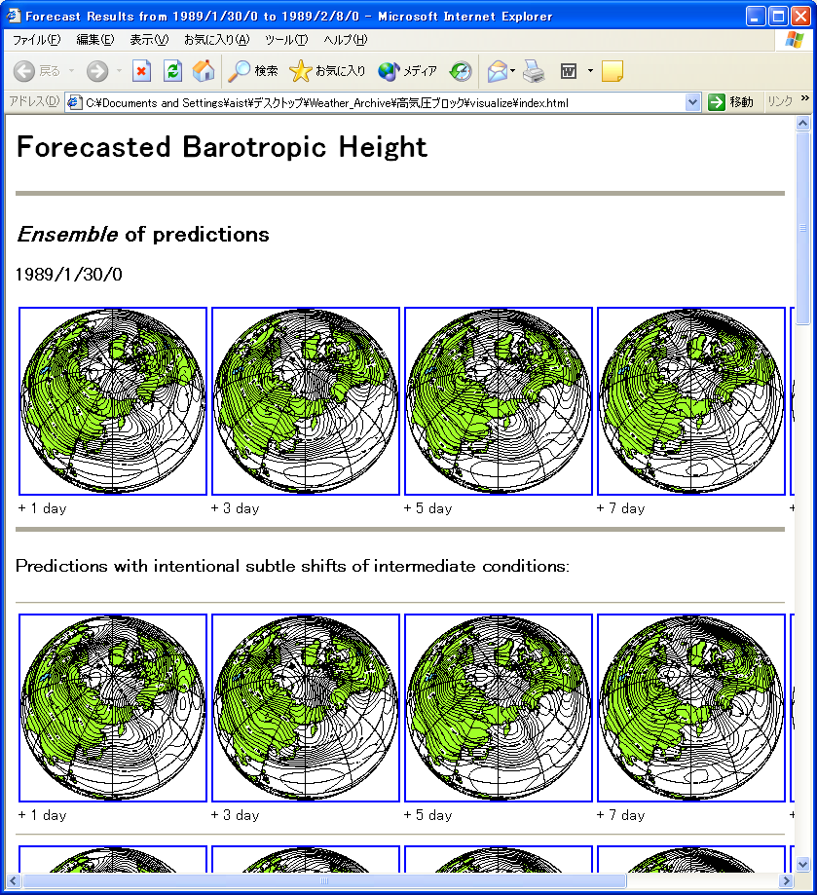

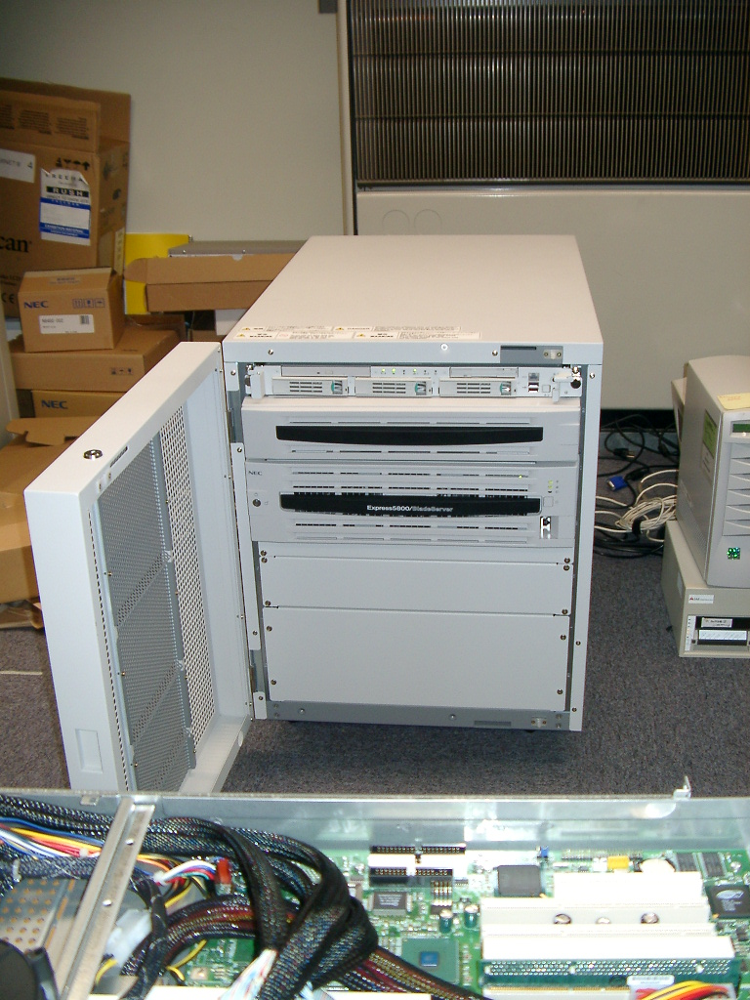
GO TO DEMO!
Weather forecast
Server program
APGrid
client auth.
64cpu Cluster
AIST, Japan
GridLib Portal Core
SignOn/SignOff
Job Control
submission/query
/cancel
HTTP server
+
Servlet
(Apache + Tomcat)
user
Weather forecast
client program
Weather forecast
Server program
Job Queuing
Manager
&
Signing Server
globusrun
64cpu Cluster
KISTI, Korea
JDBC Interface
(TCP/IP)
Call Remote server prog using Ninf-G
ram
Accounting
DB
(Postgress)
Weather forecast
Server program
accounting
information
22cpu Cluster
KU, Thailand
Notes:
Here is the software architecture of the integrated system.
As explained before, the system consists of Grid lib portal, client/server program for weather forecasting and Ning-G library.
A user can accesses to the Grid Lib portal and set the initial parameter such as prediction period, the number of simulations, and target computers.
Job queuing manager issues globusrun command to invoke the client program, which calls server program using Ninf-g.
When the simulation terminates, results are retrieved by the client and translated into the visualized data.
Finally, the data is downloaded to the client through Grid lib portal.
Currently this system is implemented on the APGrid testbed, namely Grid lib portal and the client program is on the linux cluster in AIST Japan.
Backend servers consists of 3 machines in different sites, AIST Japan, KISTI Korea and KU Thailand.

Slide 80
Acknowledgement
All users of Ninf-G
ApGrid participants, especially for
  KISTI (Sangwan, …)
  KU (Sugree, …)
  SDSC (Mason, …)

Slide 81
For More Info
GridRPC Tutorial at GGF7
  GridRPC: Ninf-G and NetSolve
    Hidemoto Nakada (AIST) and Keith Seymour (UTK)
    March 4 (Tue) 13:30 – 17:30
    March 7 (Fri) 13:30 – 17:30
Ninf home page
  http://ninf.apgrid.org
GGF APM WG home page
  http://www.globalgridforum.org/
Contacts
  ninf@apgrid.org

