Slide 1
Ninf-G: Grid RPC system based on the Globus Toolkit
Yoshio Tanaka (AIST, Japan)
Most slides: by courtesy of Hidemoto Nakada (AIST/TITECH)

Slide 2
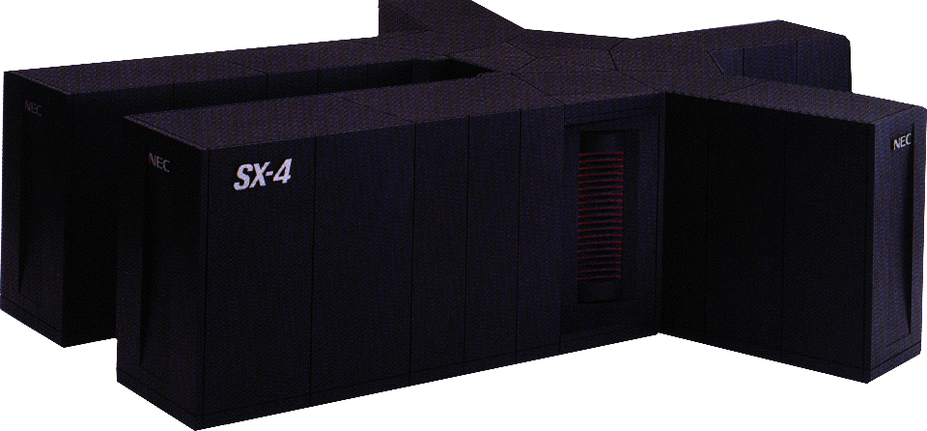

GridRPC(1/2)
RPC on the Grid
  simple and ease-of-use programming interface
  suitable for task-parallel programs
    c.f. MPI for data parallel programs
  GridRPC based middleware for
  applications/portals
  Discuss in GGF APM WG
server
client
arguments
results

Slide 3
GridRPC (2/2)
Programming Model middleware between “the Grid” and Application
  Bases for more complex form of global computing
Success stories of large computational problems happening
  Parameter sweeping
    Monte Carlo Simulation – MCell (Netsolve)
  Coarse-Grained Iterative Algorithms
    Fork-Join per iteration
    SCRM-SDPA App (Ninf)
  Network-enabled “generic”
  libraries
    SCLAPACK for Netsolve/Ninf
Application
Grid RPC
Lower-level Grid Systems

Slide 4
Ninf-G: Ninf on Globus
Ninf: Grid RPC system
  Ver.1 is released in ‘96
  Ninf protocol and authentication using SSL
  stable and used for application and research
Ninf-G: Ninf implementation using the Globus Toolkit
  Provide GridRPC core package
    leave other functions such as security, scheduling, and resource management for Globus.
  Grid RPC package in the Globus toolkit
  Can be used for evaluation of other Globus-based package

Slide 5
Outline
Ninf overview
Ninf original implementation
Ninf-G implementation
How to use Ninf-G
Preliminary Evaluation
Todo

Slide 6
Brief History of Ninf
The first design paper (Jun.’94)
A proto implementation (Sep.’94) w/PVM
Paper POOMA’95 at Santa Fe (Mar.’95)
ETL Cray J90 installed as Ninf server Sep.’95
The Metaserver introduced Feb.’96
The v.1.0 released Jun.’96
Ninf/Netsolve Collaboration, Fall ’97
Extensive Tools Development Early ’98~, v.1.2
Ninf v.2.0 Development ’00~
GridRPC and Grid Data Farm 2000~
Ninf-G (Ninf on Globus) 2001~

Slide 7
Ninf - a Grid RPC system
Easy to use Grid system for Scientific Computing
  Very simple RPC API
  Existing libs and apps into GridRPC components
    Legacy library written in Fortran / C can be published as Grid Component
    File interfaced application also can be published
double A[n][n],B[n][n],C[n][n]; /* Data Decl.*/
dmmul(n,A,B,C); /* Call local function*/
ninfy
Ninf_call(“dmmul”,n,A,B,C); /* Call server side routine*/
Notes:
Grid RPC is a Easy to use grid system fo rscientific computing
It has very simple RPC API
This code segment demonstrate the simplisity
this line is calling matrix multiply as a local function
To make it RPC, only you have to do is just rewrite this line into this.
It so easy.
Now, The arguments automatically shipped to the server and the caliculation is done on the server side
, results come back and are automatically stored in the arguments
For the RPC component, existing libs and applications can be used
It is also very easy to make libs and apps into RPC component.

Slide 8
Ninf - a Grid RPC System (cont.)
Easy to publish existing library
  Just write an IDL file and compile it
Interface Information
  library function’s name, and its alias (Define)
  arguments’ access mode, data type (mode_in, out, inout, ...)
  required library for the routine (Required)
  computation order (CalcOrder)
  source language (Calls)
Define dmmul(mode_in int n,
mode_in double A[n][n], mode_in double B[n][n],
mode_out double C[n][n])
“ description “
Required “libXXX.o”
CalcOrder n^3
Calls “C” dmmul(n,A,B,C);
Notes:
To publish ext libs , only you have to do is write an information description file for the library
As you can see, it is very strait forward. Its just like C prottotye except for the I/O mode

Slide 9
Ninf-G - an implementation on top of globus toolkit
What we expect with globus
  Security Inf. (including CA management)
  Resource Management
  …
What we will provide
  Easy to use Grid Tool
    Even simpler than MPI-G
    For non-computer scientist, using globus is too complicated
  Building blocks for programming Grid application

Slide 10
Ninf implementation overview
Client API
  Provides users easy to use API
Remote Library Executable
  Execute numerical operation
Ninf Server
  Provides library interface info.
  Invokes remote library executable
IDL compiler
  Compiles Interface description
  Generates 'stub main' for remote library executable
  Helps to link the executable
Ninf Register driver
  Registers remote library executable into the Server

Slide 11
Ninf architecture and protocol
Server side
Client side
Server side setup
  Make Remote Library Executable
  Register it to the Ninf Server
Use remote library
  Retrieve interface information
  Invoke Remote Library Executable
  It Calls back to the client
IDL file
Numerical
Library
Client
IDL Compiler
Connect back
Interface
Reply
Invoke
Executable
Generate
Interface
Request
fork
Remote Library
Executable
Ninf Server
Register

Slide 12
Ninf-G - basic design
Replace Ninf Server functions with MDS and GRAM
  Retrieves interface information using MDS (GRIS)
    Automatic generation of LDIF file
  Invokes Remote library Executable using GRAM

Slide 13
Ninf - Original
Client side
Server side
IDL file
Numerical
Library
Client
IDL Compiler
Connect back
Interface
Reply
Invoke
Executable
Generate
Interface
Request
fork
Remote Library
Executable
Ninf Server
Register

Slide 14
Ninf-G
Client side
Server side
IDL file
Numerical
Library
Client
IDL Compiler
Connect back
Interface
Request
Interface
Reply
Invoke
Executable
Generate
fork
Remote Library
Executable
GRAM
GRIS
Interface Information
LDIF File
retrieve

Slide 15
Registration to GRIS
Generate LDIF file
  Interface information is encoded in Base64
Put the file at ${globus-deploy-dir}/var/gridrpc
dn: rpcFuncname=perf/pingpong, sw=GridRPC hn=ninf.aist.go.jp, dc=gci, dc=jp, o=Grid
objectclass: GridRPCEntry
hn: ninf.aist.go.jp
rpcFuncname: perf/pingpong
module: perf
entry: pingpong
path: /home/ninf/tests/pingpong/_stub_pingpong
stub:: PGZ1bmN0aW9uICB2ZXJzaW9uPSIyMjEuMDAwMDAwIiA+PGZ1bmN0aW9uX25hbWUgbW9kdWxlPSJwZXJmIiBlbnRyeT0icGluZ3BvbmciIC8+IDxhcmcgZGF0YV90eXBlPSJpbnQiIG1vZGVf
…

Slide 16
Ninf-G Installation Steps
Install Globus toolkit
Untar, configure, make Ninf-G package
Make a directory (server side)
  ${globus-deploy-dir}/var/gridrpc
  Change the mode of the directory
Edit the GRIS setup file (server side)
  Add following line
0 cat ${localstatedir}/gridrpc/*.ldif

Slide 17
How to use Ninf-G
Server side
  Write an IDL file for the Remote library
  Compile it with IDL Compiler
  Run make on generated makefile
  Register the executable by make -f XXX.mak install
Client side
  Write a client program using Ninf API
  Compile and link with the supplied compile driver
  grid-proxy-init to generate proxy certificate
  Run the program

Slide 18
Preliminary Evaluation
Evaluate cost
  GRIS lookup
  GRAM invocation
Target program
  PingPong - no computation
Environment
  LAN: intra AIST: 100 base/T
  WAN: inter Titech - AIST:
    Fore: 200KB/sec
    Back: 600KB/sec

Slide 19
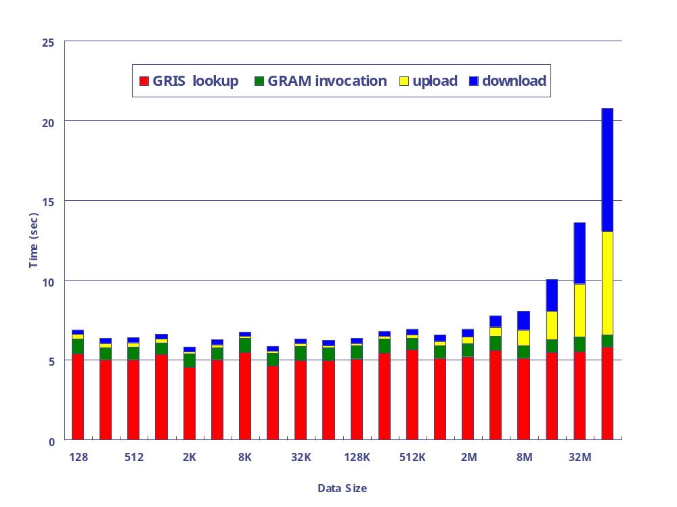
Result (LAN)
GRIS Lookup costs around 5 seconds
GRAM invocation costs around 1 second

Slide 20
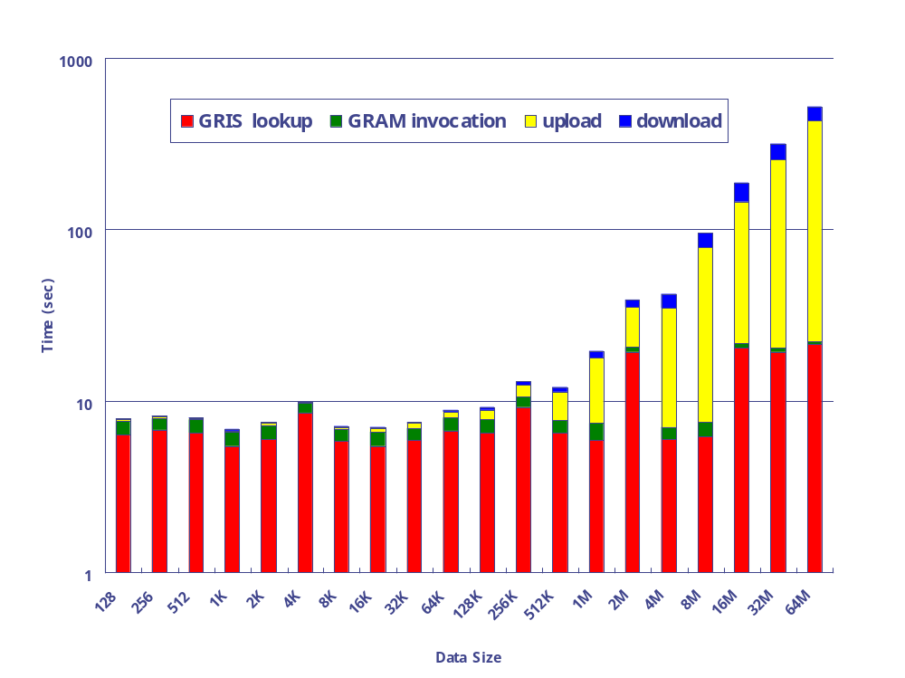
Result (WAN)
GRIS Lookup costs around 5-20 seconds
GRAM invocation costs around 4-6 second

Slide 21
Discussion
Lookup and invocation cost related with the network latency
GRIS lookup cost includes database update
  We need immediate update
  What we should do?
  Can we enforce GRIS update or 'push' information?
Lookup results are cached in client side
  Subsequent invocations for the same library do not require GRIS lookup
0 cat ${localstatedir}/gridrpc/*.ldif

Slide 22
Todo
Communication using Globus I/O
Develop a job manager for cluster system
Fault management
Java Client using CoG ?
Application Portals / ASP

Slide 23
Summary
Ninf-G is easy to use Grid system component
Implemented using GRIS and GRAM
Will be released 2001/4Q
We'd like to contribute Ninf-G to the globus package

