Slide 1
Ninf Tutorial
Hidemoto Nakada
Yoshio Tanaka
Osami Tatebe

Slide 2
Network Enabled Server (NES) (1)
A simple RPC-based programming model for the Grid
  Servers serve computation resources
    Network-enabled Libraries (and Apps)
  Clients makes calls with data to be computed
  Task Parallelism (synch. and asynch. calls)
Key property: EASE OF USE
Data
Server
Client
Result
Notes:
Network enabled server may be the simplest form of global computing
A Server serves computation, namely computation resource and computation program
A Client ask for a server to do the computation, and send data for computation.
Server will do some computation and returns the result.
There are already several implementations of network enabled server. Such as our ninf, netsolve from utk, RCS from ETH, Switzerland .

Slide 3
Network Enabled Server (2)
Some characteristics
  Very simple RPC API (prog API, browser API, etc.)
  Existing libs and apps into NES components
  IDL embodying call info, minimal client-side management
double A[n][n],B[n][n],C[n][n]; /* Data Decl.*/
dmmul(n,A,B,C); /* Call local function*/
NES_call(“dmmul”,n,A,B,C); /* Call server side routine*/
Notes:
Here is the typical API of network enabled server.
The only thing client user have to do is just replace this function invocation by this one.
Here, I wrote that NES_call

Slide 4
Network Enabled Server (3)
Programming Model middleware between “the Grid” and Application
  Bases for more complex form of global computing
Success stories of large computational problems happening
  Parameter sweeping
    Monte Carlo Simulation – MCell (Netsolve)
  Coarse-Grained Iterative Algorithms
    Fork-Join per iteration
    SCRM-SDPA App (Ninf)
  Network-enabled “generic”
  libraries
    SCLAPACK for Netsolve/Ninf
Application
Network Enabled Server
Lower-level Grid Systems
Notes:
Network enabled servesr may seem to be too primitive. But, it can serve as bases for more complex form of global computing such as parameter sweeping or mote carlo simulation
Another important role of the NES is the middleware between the grid and application.
Recently, some software for grid infrastructure are proposed, such as Legion and Globus.
However, sometimes to implement application directly on top of such grid infrastructure is too hard for application people.
NES can serve more friendly API for application people.

Slide 5
Examples of NES systems
Netsolve (UTK)
Ninf (ETL/TITECH)
Nimrod, Nimrod/G
Punch
RCS
CORBA-based sys. (several)
…etc.
Intermediary position between Grid Portals and Grid Components
(ease-of-use, automated programming interface on top of components)

Slide 6
Ninf: Features At-a-Glance
Ease-of-use, client-server, Numerical-oriented RPC system
User’s view: ordinary software library
  Asymmetric client vs. server
Transparent server discovery
Problem solved on an arbitrary network node running the Ninf server
Dynamic allocation of resources with metaserver
Data Access: NinfDB, WebAccess
Client APIs: Fortran, C/C++, Java, COM etc.

Slide 7
Brief History of Ninf
The first design paper (Jun.’94)
A proto implementation (Sep.’94) w/PVM
Paper POOMA’95 at Santa Fe (Mar.’95)
ETL Cray J90 installed as Ninf server Sep.’95
The Metaserver introduced Feb.’96
The v.1.0 released Jun.’96
Ninf/Netsolve Collaboration, Fall ’97
Extensive Tools Development Early ’98~, v.1.2
Ninf v.2.0, Globus Integration Development ’00~
GridRPC and DataFarm 2000~

Slide 8
Basic Ninf Client API
Ninf_call
Ninf_call(FUNC_NAME, ....);
FUNC_NAME = NAME | ninf://HOST:PORT/ENTRY_NAME
API for C, C++, Fortran, Java, Lisp, COM, Mathematica, ...
No client stub generation (c.f., CORBA)
double A[n][n],B[n][n],C[n][n]; /* Data Decl.*/
dmmul(n,A,B,C); /* Call local function*/
Ninf_call(“dmmul”,n,A,B,C); /* Call Ninf Func */
“Ninfy” via IDL descriptions

Slide 9
Ninf Interface Description
(Ninf IDL)
Define dmmul(long mode_in int n,
mode_in double A[n][n], mode_in double B[n][n],
mode_out double C[n][n])
“ description “
Required “libXXX.o”
CalcOrder n^3
Calls “C” dmmul(n,A,B,C);
IDL information:
  library function’s name, and its alias (Define)
  arguments’ access mode, data type (mode_in, out, inout, ...)
  required library for the routine (Required)
  computation order (CalcOrder)
  source language (Calls)

Slide 10
Ninf RPC Protocol
Two-phase, runtime exchange of interface info
  No client stub routines (cf. SunRPC)
  No modification of client program when server’s libs updated
  Client library stays relatively static
Client Program
Ninf library program
Client Library
Interface Info
Stub Program
Interface Info
Ninf Server
Interface Info
Interface Request
Interface Info.
Argument
Result

Slide 11
Architectural Layers of Ninf
NinfCalc+
ExcelNinf
Mathematica
...
Numerical Scientific Computing Progs.
Application
Mathematical
Libraries
Ninf Client
API
(F77, C, Java,…)
Ninf DB
Ninf
Computation
Server
NetSolve
Server
Programming Tool
Ninf MetaServer
NetSolve Adpter
Resource Manager
Service
Ninf Protocol
FTP
HTTP
TCP/IP
Hardware
Gigabit Net
LAN
WAN

Slide 12
Ninf MetaServer Architecture
MetaServer
Server
Directory Service
Server
Client Side
Load
Measurement
Scheduler
Probe
Server
Proxy
Client
Server Side
Data
Client
Client
Proxy
Throughput
Measurement

Slide 13
Client API (2) Client File Handling
"Filename" type is supported
Local file is automatically shipped to the server
Server side output file is forwarded to the client
Ninf_call("plot/plot", "inputfile", "outputfile");
inputfile
Server
Client
Program
outputfile

Slide 14
Ninf Client API(3)
- asynchronous calls -
Asynchronous Call
Waiting for reply
Client
ServerA
ServerB
Ninf_call_async(“FUNC”, ...);
Ninf_call_async
Ninf_call_async
Ninf_wait_all
Ninf_wait(ID);
Ninf_wait_all();
Ninf_wait_any();
Ninf_wait_and(IDList, len);
Ninf_wait_or(IDList, len);
Ninf_cancel(ID);
Various task parallel programs spanning clusters are easy to write
Notes:
We also have asynchronous call API.
Ninf_call_async immediately returns with session ID.
And with the ID, you can wait the result of the call.
Using this API, we can invoke several calls in parallel.
We have another API for parallel execution , called transaction.
It specifies a certain program region as a transaction, and execute all ninf_calls in the region in parallel.
Data dependency among the ninf_calls is automatically detected, and the ninf_calls scheduled properly.

Slide 15
Ninf Client API(4) - Callback -
Client
Server
Server side routine can call back clients
(ex.) Display of interim results of computation on servers to a client machine
Ninf_call
CallbcakFunc
void CallbackFunc(...){
.… /* define callback routine */
}
Ninf_call(“Func”, arg .., CallbackFunc);
/* call with pointer to the function */

Slide 16
Using Ninf to “Gridify” a Library/Application
(1)Write interface description to Gridify an app/library in Ninf IDL
  Ninf IDL file
(2)Run Ninf interface generator on server
  stub programs and Makefile
(3)Compile the library program and link with stub programs
  Ninf executables
(4)Register Ninf executables with Ninf server

Slide 17
Gridifying(2) Executable Generation and Registration
Ninf Clients
Ninf IDL file
Ninf_call("goo",...)
xxx.idl
Ninf_call("bar",...)
Ninf_call("foo",...)
Ninf_gen
stub main programs
Ninf Server
_stub_foo.c
_stub_bar.c
_stub_goo.c
module.mak
_stub_foo
stubs.dir
_stub_bar
Library program
yyy.a
stubs.alias
_stub_goo
Ninfserver.conf

Slide 18
Tutorial
計算ライブラリを用いるプログラムのNinf化
  行列乗算
ファイルインターフェイスプログラムのNinf化
  gnuplot
パラメータサーベイプログラムのNinf化
  複数サーバを用いた並列実行
  動的負荷分散
  モンテカルロによるPIの計算

Slide 19
Directoryの構成
tutorial
  mmul - 計算ライブラリを用いるプログラム
    server
    client
  gnuplot - ファイルインターフェイスプログラム
    server
    client
  pi - 複数サーバを用いたプログラムの並列実行
    server
    client

Slide 20
計算ライブラリを用いるプログラムのNinf化
  サーバ側
    IDLの準備とコンパイル
    サーバへの登録
  クライアント側
    ルーチン呼び出し部のNinf化
    Ninfccによるコンパイル

Slide 21
計算ライブラリを用いるプログラムのNinf化 – 準備
ライブラリインターフェイスの整備
  暗黙のグローバル変数を用いたインターフェイスを抽出しインターフェイスを整える
  引数配列のサイズがインターフェイスに明示的に登場するように変更
void mmul(int n, double * a,
double * b, double * c){
double t;
int i, j, k;
for (i = 0; i < N; i++) {
for (j = 0; j < N; j++) {
t = 0;
for (k = 0; k < N; k++){
t += a[i * n + k] *
b[k * n + j];
}
c[i*N+j] = t;
}
}
}

Slide 22
計算ライブラリを用いるプログラムのNinf化 – サーバ側
インターフェイス情報をIDLで記述
Module mmul;
Define mmul(IN int N,
IN double A[N*N],
IN double B[N*N],
OUT double C[N*N])
"matmul"
Required "mmul_lib.o"
Calls "C" mmul(N, A, B, C);

Slide 23
計算ライブラリを用いるプログラムのNinf化 – サーバ側
IDLのコンパイルとサーバ側実行時ファイルのMake
ninf_gen
mmul.idl
mmul.mak
_stub_mmul.c
cc
_stub_mmul
mmul_lib.o
> ninf_gen mmul.idl
> make -f mmul.mak

Slide 24
計算ライブラリを用いるプログラムのNinf化 – サーバ側
サーバへの起動とNinf Executableの登録
  設定ファイルに記述して起動
  起動後のサーバに動的に登録
stubs ./_stub_mmul
> ninf_serv_tcp mmul.conf
> ninf_serv_tcp
> ninf_register _stub_mmul

Slide 25
計算ライブラリを用いるプログラムのNinf化 – クライアント側
ソースプログラムの変更
  初期化ルーチンの挿入
  関数呼び出し部の置き換え
main(int argc, char ** argv){
argc = ninf_parse_arg(argc, argv);
:
mmul(N, A, B, C);
if (Ninf_call("mmul/mmul", N, A, B, C) != NINF_ERROR)
Ninf_perror("mmul");

Slide 26
計算ライブラリを用いるプログラムのNinf化 – クライアント側
コンパイル
  コンパイルドライバ ninfccを使用
実行
  サーバ名、ポート番号を引数で指定
> ninf_cc -o mmul_ninf mmul_ninf.c
> ./mmul_ninf -server hpc.etl.go.jp -port 3010

Slide 27
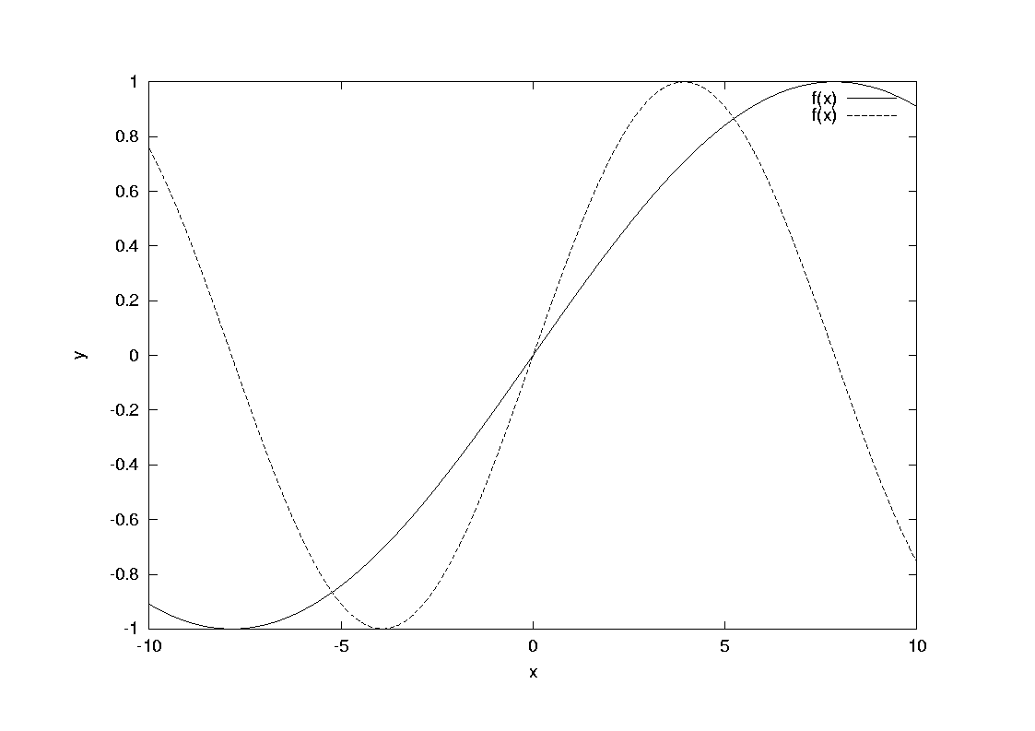
ファイルインターフェイスプログラムのNinf化
Gnuplotを使用
set terminal postscript
set xlabel "x" set ylabel "y"
plot f(x) = sin(x*a), a = .2, f(x), a = .4, f(x)
> gnuplot gplot > graph.ps

Slide 28
ファイルインターフェイスプログラムのNinf化 - サーバ側
IDLの記述とコンパイル
Module plot;
Define plot(IN filename plotfile, OUT filename psfile )
"invoke gnuplot"
{
char buffer[1000];
sprintf(buffer, "gnuplot %s > %s", plotfile, psfile);
system(buffer);
}
> ninf_gen plot.idl
> make -f plot.mak
> ninf_serv plot.conf

Slide 29
ファイルインターフェイスプログラムのNinf化 - クライアント側
main(int argc, char ** argv){
argc = Ninf_parse_arg(argc, argv);
if (Ninf_call("plot/plot", argv[1], argv[2]) == NINF_ERROR)
Ninf_perror("Ninf_call plot:");
}
> ninfcc -o plot_main plot_main.c
> ./plot_main gplot graph.ps
ローカルホストへでの実行
> ./plot_main -server hpc.etl.go.jp -port 3010 gplot graph.ps
電総研サーバでの実行

Slide 30
複数サーバを用いた並列実行
モンテカルロ法による円周率の計算
  Ｘ、Yの乱数を生成し、それが円の内部に入るかどうかをテスト、その確率から円の面積を逆算
  PI = 4 p

Slide 31
複数サーバを用いた並列実行
Module pi;
Define pi_trial(IN int seed, IN long times, OUT long * count)
"monte carlo pi computation"
Required "pi_trial.o"
{
long counter;
counter = pi_trial(seed, times);
*count = counter;
}

Slide 32
複数サーバを用いた並列実行
- 単純な Ninf化
if (Ninf_call("pi/pi_trial", 10, times, &count)
== NINF_ERROR){
Ninf_perror("pi_trial");
}
pi = 4.0 * ( count / (double) times);

Slide 33
複数サーバを用いた並列実行
- 複数サーバへの拡張
非同期呼び出し機構を用いて同時に複数のサーバを使用
  Ninf_call_async();
  Ninf_wait_all();
for (i = 0; i < NUM_HOSTS; i++){
char entry[100];
sprintf(entry, "ninf://%s:%d/pi/pi_trial",
hosts[i], port);
if (Ninf_call_async(entry, i, times, &count[i])
== NINF_ERROR){
Ninf_perror("pi_trial");
exit(2);
}
}
Ninf_wait_all();

Slide 34
複数サーバを用いた並列実行
- 複数サーバへの拡張
会場の計算機を用いた並列実行
> ninf_serv_tcp pi.conf -port 4000
user1 4000
user2 4000
user3 4000
:
hostfile
> ./parallel_pi hostfile 1000000

Slide 35
複数サーバを用いた並列実行
- 動的負荷分散
サーバ性能にばらつきがある場合には負荷の不均衡が生じうる
負荷を細分化しセルフスケジューリングを行って動的に負荷分散を行う
Ninf_wait_any で終了したサーバを検出

Slide 36
複数サーバを用いた並列実行
- 動的負荷分散
for (i = 0; i < NUM_HOSTS; i++){
sprintf(entry[i], "ninf://%s:%d/pi/pi_trial", hosts[i], port);
if ((ids[i] = Ninf_call_async(entry[i], rand(), times, &count[i])) == NINF_ERROR){
Ninf_perror("pi_trial");
exit(2);
}
}
while (1) {
int id = Ninf_wait_any(); /* WAIT FOR ANY HOST */
if (id == NINF_OK)
break;
for (i = 0; i < NUM_HOSTS; i++) /* FIND HOST */
if (ids[i] == id) break;
sum += count[i];
done += times;
if (done >= whole_times)
continue;
if ((ids[i] =
Ninf_call_async(entry[i], rand(), times, &count[i])) == NINF_ERROR){
Ninf_perror("pi_trial");
exit(2);
}
}

Slide 37
おわりに
Ninf の特徴
  使うのは（わりに）容易
  クラスタでの並列計算が容易に実現できる
Ninf2
  Globusとの関連を強化
  強固なセキュリティ
  グローバル環境

