Slide 1

Utilizing the MetaServer Architecture in the Ninf Global Computing System
Hidemoto Nakada, Hiromitsu Takagi,
Satoshi Matsuoka, Umpei Nagashima,
Mitsuhisa Sato and Satoshi Sekiguchi
URL: http://ninf.etl.go.jp
Notes:
Thank you, chairman.
This talk is titled .Utilizing the MetaServer Architecture in the Ninf Global Computing System.

Slide 2
Towards Global Computing Infrastructure
Rapid increase in speed and availability of network
→ Computational and Data Resources are collectively employed to solve large-scale problems.
Global Computing (Metacomputing, The “Grid”)
Ninf (Network Infrastructure for Global Computing)
  c.f., NetSolve, Legion, RCS, Javelin, Globus etc.
Notes:
Recently, rapid increase in speed and availability of network is now making it possible to collectively employ computational and data resources in the network to solve large-scale problems.
Such a system is called, high-performance global computing, or Metacomputing, or The 'Grid.
There have been several recent proposals of global computing infrastructure, including our Ninf which stands for Network Infrastructure for global computing.
Other systems are NetSolve, Legion, RCS, Javelin, Globus, and so on.

Slide 3
Scheduling for Global Computing
Dispatch computation to the Most Suitable Computation Server
Issues
  Server / Network Status dynamically change
  Status information is distributed globally
  Scheduling is inherently difficult
  What is the Most Suitable?
Notes:
One of the most important issue for global computing is scheduling or load balancing.
For efficient computation, to dispatch requests to the most suitable Computation server is essential.
But, Global Scheduling is very difficult, because
status of server and network change dynamically
gathering globally distributed information is difficult
Moreover, scheduling itself is inherently difficult, and definition of the most suitable server itself depends on the usage of the system.

Slide 4
Our Goals and Results
Clarify requirements for Global Computing Scheduler
Design a scheduling framework
MetaServer: a flexible scheduling framework
Preliminary Evaluation with simple scheduler
Notes:
Goals of this presentation are to clarify requirements for global computing scheduler,
And to show a clear, flexible scheduling framework.
We introduce our scheduling framework metaserver.
And show some preliminary evaluation results.
Note that, we do not treat the scheduling itself in this presentation.
We just provide the scheduling framework, so the scheduling policy is a still open problem.

Slide 5
Issues for Global Scheduling
Load imbalance comes from ignoring
  server status
  server characteristics
  communication issues
  computation characteristics
False load concentration
  Delay of load information propagation
Firewall
Notes:
Now, what is the problem for global scheduling.
Firstly, Load imbalance.
It comes from neglect of status or characteristics of the resources.
such as server status, server characteristics, communication issues, computation characteristics
If you concern all of these, false load concentration still may occur.
If the server load information does not propagate fast enough, obsolete load information are used and incurs false load concentration.
Moreover, there is a problem comes from Internet nature, Firewall.
It makes difficult to gather information for scheduling

Slide 6
Requirements for Global Scheduling
Gathering various Information
Server Status
  Load average, CPU time breakdown (system, user, idle)
Server Characteristics
  Performance, Number of CPU, Amount of Memory
Network Status
  Latency, Throughput
Computation Characteristics
  Calculation order, communication size
Notes:
Here, accounting these problems, we summarize requirements for global scheduling.
First of al Scheduling for global computing requires various information.
For the proper scheduling, these information are needed.
Server Status, it means load average and CPU time breakdown
Server Characteristics, performance, number of CPU, amount of memory
Network status, Latency and throughput
Computation characteristics, calculation order, communication size

Slide 7
Requirements for Global Scheduling(2)
Centralizing server load information
  To avoid false concentration of loads
  Atomic update
Monitoring server load
Throughput measurement from each client
  To reflect network topology
Simple client program
  Portability
Gathering information over firewalls
Notes:
Server Load Information have to be maintained in centralized way.
To avoid false concentration of loads, all the scheduler have to share the load information and
update it in an Atomic way.
Server load have to be monitored
Throughput to Servers have to be measured by each Client site to Reflect the Network Topology
the measured throughput cannot be shared because it depends on the location of the client site.
Client Program should be as simple as possible for portability.
And all these information have to be gathered over firewalls.

Slide 8
Related Work
The RPC system Scheduler (NetSolve’s Agent )
  NetSolve [Casanova and Dongarra, Univ. Tennessee]
  Load-balancing with Agent: can not share Load Information
Embedded Scheduling System (Prophet for Mentat)
  SPMD for LAN: No dynamic communication monitoring mechanism
Application level scheduler (AppLeS )
  Static Load distribution at Compile time
The global monitoring systems - NWS
Notes:
There have been several proposals for global computing scheduler.
NetSolve has a module called Agent which perform scheduling.
However, Agents cannot share server load information, therefore, false load concentration may occur.
As an embedded scheduling system, there is prophet for mentat.
It orients to Local area network, so it does not have dynamic network monitoring facility.
Also, There is Application level Scheduler APPLES.
It schedules using application level information, but the scheduling is performed at the compile time.
NWS, the Network Weather Service is an independent resource forecast system. It monitors resource status and predicts future status. It does not have any facility for scheduling.

Slide 9
Overview of Ninf
Ninf
Server
Remote high-performance routine invocation
Transparent view to the programmers
Automatic workload distribution
C Client
NumericalRoutine
NumericalRoutine
NumericalRoutine
Ninf
Server
Java
Client
MetaServer
NumericalRoutine
NumericalRoutine
NumericalRoutine
Mathematica
Client
Ninf
Server
NumericalRoutine
NumericalRoutine
NumericalRoutine
Notes:
Before talking about the metaserver, we’ d like to show Overview of the ninf system.
The Ninf system is a RPC system, which based on the client-server model.
It provides semi-transparent view for the client program to call remote numerical routines from Fortran, C, Java and other languages and systems, such as mathematica, and excel.
Center of the system, there lie modules called metaserver, which distributes workload automatically.

Slide 10
Ninf API
Client
Server
Ninf_call(FUNC_NAME, ....);
Ninf_call_async(FUNC_NAME, ....);
FUNC_NAME = ninf://HOST:PORT/ENTRY_NAME
Implemented for C, C++, Fortran, Java, Lisp …,Mathematica, Excel
Ninf_call
Client
ServerA
ServerB
Ninf_call_async
double A[n][n],B[n][n],C[n][n]; /* Data Decl.*/
dmmul(n,A,B,C); /* Call local function*/
Ninf_call(“dmmul”,n,A,B,C); /* Call Ninf Func */
Ninf_call_async
“Ninfy”
Notes:
The principal API is Ninf_call, a synchronous remote procedure call,
It provides very similar interface to the usual local function call.
For example, this matrix multiply statement can be ‘nified’ as like this.
We also have asynchronous API , Ninf_call_async

Slide 11
Our Answer for the Requirements
Centralized server load information
Server Load monitoring
Throughput measurement from each client
Simple Client program
Gathering information over firewalls
Centralized Directory Service
Scheduler near by the Directory Service
Server Monitor
Client Proxy
Server Proxy
Notes:
Now we show our answer for the requirements.
For the centerized server load information,we put
Directory service at the center of system
and scheduler near by the directory service
For Server Load monitoring
we provide server monitor module
To accomplish these two issues at the same time,
we adopted client proxy, which lies on the firewall of the client site and measures throughput on behalf of the site.
The measurement results are shared by all the client in the site.
To gather information from the server in the firewall, we provide server proxy.
Our metaserver consists of these all modules.

Slide 12
MetaServer Architecture
Directory
Service
Server Side
Server
Proxy
Client Side
MetaServer
Scheduler
Server
Probe
Module
Server
Proxy
Client
Server
Load
query
Schedule
query
Data
Client
Client
Proxy
Server
Proxy
Server
Throughput
Measurement
Notes:
This diagram shows the metaserver architecture.
There are clients here , and servers here.
These light yellow modules all construct the metaserver.
Directory service module is a kind of database, stores information about servers and functions supported by each server.
Server Probe Module monitors servers periodically, and update the directory service.
Client proxy periodically measures throughput and latency to the all the known servers.
When the Client proxy receives request from client,
it invoke a query for the scheduler with the network information.
Scheduler get the server load information from the directory service, and decide the most suitable server, and send back the server name to the client proxy.
then, Client proxy forwards the request to the assigned server.
Server proxy is just a forwarding proxy to go over the firewall. Its optional.

Slide 13
MetaServer Architecture
Directory
Service
Server Side
Server Load
Information
Server
Proxy
Client Side
MetaServer
Server Load
Information
Communication
Information
Scheduler
Server
Probe
Module
Server
Proxy
Client
Communication
Information
Server
Load
query
Schedule
query
Data
Client
Client
Proxy
Server
Proxy
Server
Throughput
Measurement
Notes:
This diagram shows the metaserver architecture.
There are clients here , and servers here.
These light yellow modules all construct the metaserver.
Directory service module is a kind of database, stores information about servers and functions supported by each server.
Server Probe Module monitors servers periodically, and update the directory service.
Client proxy periodically measures throughput and latency to the all the known servers.
When the Client proxy receives request from client,
it invoke a query for the scheduler with the network information.
Scheduler get the server load information from the directory service, and decide the most suitable server, and send back the server name to the client proxy.
then, Client proxy forwards the request to the assigned server.
Server proxy is just a forwarding proxy to go over the firewall. Its optional.

Slide 14
Information Gathering/Measurement
Server Status (Load average, CPU time breakdown)
  Server Probe module monitors
Server Characteristics (Performance, Number of CPU, Amount of Memory)
  NinfServer measures using linpack benchmark
  Number of CPU is taken from configuration file
  Amount of Memory is automatically detected
Network Status (Latency, Throughput)
  Client Proxy periodically measures.
Computation Characteristics (Calculation order, communication size)
  Declared in the Interface description.
  Computed using actual arguments.
Define dgefa (
INOUT double a[n][lda:n],
IN int lda, IN int n,
OUT int ipvt[n],
OUT int *info)
CalcOrder 2/3*(n^3)
Calls dgefa(a,n,n,ipvt,info);
Notes:
To summarize, Our metaserver gathers each information as follows
Server Status is monitored by Probe module. It periodically send queries to the servers and update Directory service.
Performance is measured by NinfServer itself when it startup. It runs linpack benchmark.
Number of CPU is taken from configuration file
Amount of Memory is automatically detected using some system calls.
NinfServer reports these information to the directory service at the start up time.
Network Status is measured by Client Proxy periodically.
Computation Characteristics is Declared in the Interface description. This is an example of ninf interface description. This calcorder stands for the calculation amount. Communication amount can be computed easily.
Client proxy compute these values and send it to the scheduler.

Slide 15
Preliminary Evaluation
Baseline Overhead
  EP (NAS Parallel Benchmark)
  Measure scheduling cost
Load Distribution Evaluation
  Density of States of a large molecule(DOS)
    Difficult to perform fair load-distribution
  Evaluate scheduling improvement
  Compared to static Cyclic distribution
Scheduling
Overhead
Overhead comes from
Load imbalance
Overall Overhead for parallel execution
Notes:
Now, we will show some preliminary evaluation results.
Firstly, we'll show the baseline cost of the metaserver load balancing, using EP from NAS Parallel Benchmarks, which generates pairs of gaussian random deviates.
The workload of EP can be divided into identical sized parts, therefore load imbalance never occurs.
And we used exactly identical workstations for parallel execution.
So, the observed overhead comes from scheduling itself, it does not include the load imbalance overhead.
Next, we’ll show the dynamic load balancing by the metaserver
For the purpose, we employed density of status of a large molecule, in short, “DOS”.
In contrast to the EP, this program has very bad characteristic for load distribution.
We performed dynamic load-balancing by metaserver and measured its performance.
We also tested static cyclic partitioning.

Slide 16
Evaluation Platform
LAN connected with 100base/TX Switch
DEC Alpha 333MHz x 32 for Computation Servers
Another DEC Alpha for MetaServer modules
Ultra SPARC for Client
Alpha
SPARC
MetaServer
Modules
Alpha
Alpha
Alpha
Client
Server
Server
Server
100Base/TX Switch
Notes:
As a benchmarking platform for our load balancing experiments,
we employed the 33-processor DEC Alpha WS Cluster (333Mhz)
interconnected by switched 100Base-TX network. One node executes
metaserver modules, while other nodes act as computation servers.
Client program run on an Ultra SPARC, which is also connected via 100base/TX

Slide 17
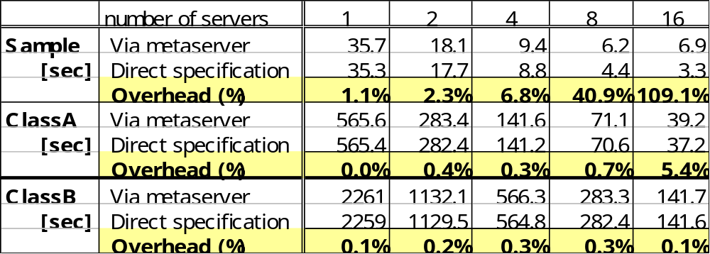
Baseline Overhead (EP)
Only measures scheduling cost
  Workloads are balanced perfectly
Overhead is negligible, especially for large sized problems
Notes:
First, we show the base line overhead.
This table shows the cost of scheduling cost of MetaServer .
We performed experiment by comparing the two cases:
automatic load balancing by the metaserver, and
user specified direct load balancing.
We performed experiment on three levels of different computation size: sample, class A and class B.
The workload is divided into identical size for each processor.
The yellow line shows the overhead ratio against the direct specification.
As you can see, The cost is negligible, especially for large sized problem.

Slide 18
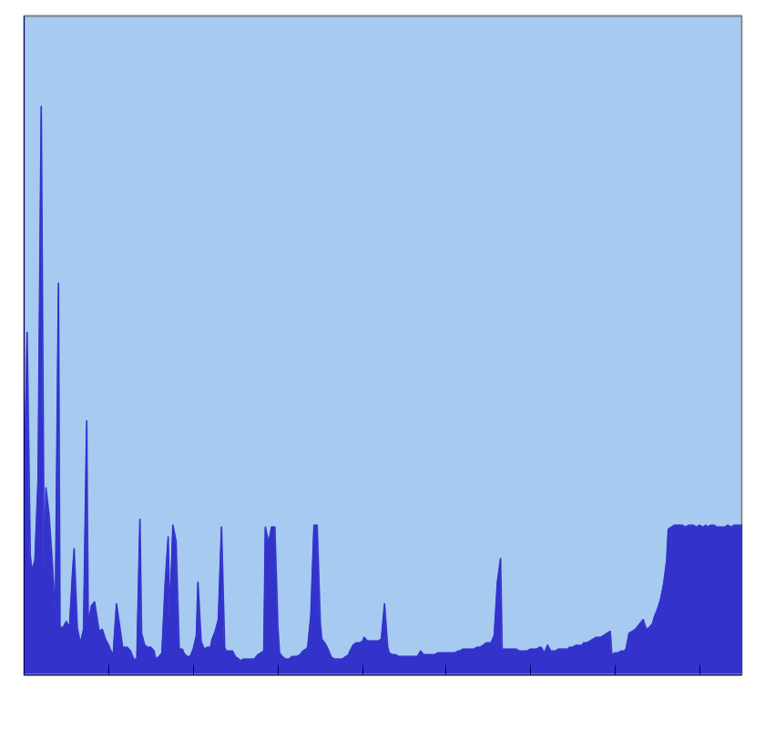
Load Distribution of DOS
Computes Density states of a large molecule
Computes degree of resonance for each frequency
Computation can be done independently
Load varies depending on frequency. Block / Cyclic distribution do not work well
Load
Frequency
Notes:
Now, Let me explain DOS.
As I mentioned before, it computes density status of a large molecule.
It models one molecule as a spring-connected kinetic system, and computes degree of resonance for each frequency.
Computation for each frequency can be done independently, so It may seem to be very suitable for parallel processing.
However, the workload for each frequency are varies drastically, depending on the degree of resonance for the frequency. This graph shows the frequency distribution of the workload .
Obviously, simple block or cyclic partitioning don’t work well.
Of course, you cannot predict this workload map, so cleaver static partitioning is impossible.

Slide 19
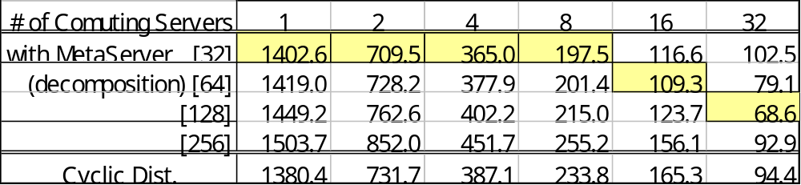
Dos Results
Execution Time [sec.]
With 256 frequencies.
Decompose into 32, 64,128,256 cyclic.
Compare with static Cyclic distribution
For each # of processor, the best decomposition number varies.
Notes:
The test was performed with 256 frequencies.
This table shows the results. Here, decomposition indicates the number of client-side decomposition of the 256 frequencies.
For example, if the decomposition were 32, then 32 ninf call are made, each computing for 8 frequencies.
We also compare the results with simple cyclic distribution, and dynamic load balancing using callbacks.
The yellow cells stand for best score in the column. As you see, optimal number of decomposition depends on the number of processor.
For 8 processor, 32 decomposition, for 16, 64, for 32, 128 decomposition gained the best score.
Increased number of decompositions results in better load balancing, but may not be optimal due to increased overhead. For this particular experiment, 4 decompositions per processor proved to be the optimal point.

Slide 20
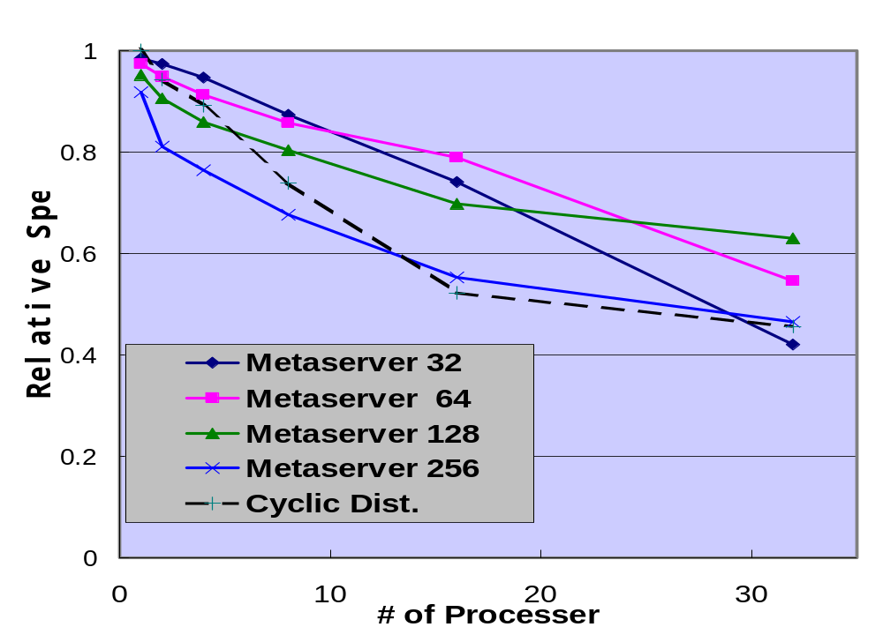
Dos Scheduling Result
MetaServer distributions gained better score than static cyclic distribution
Relative speed of DOS
Notes:
This graph shows execution speed of each case. The speeds are measured comparing with linear speedup.
X-axis stands for number of processor, and Y-axis shows the relative speed.
This bottom dotted line shows static cyclic distribution,
The benefit of dynamic metaserver load balancing proved to be advantageous over static cyclic distribution.

Slide 21
Conclusion
Requirement for global scheduling framework
  Gathering distributed, various information
  Centralizing load information
  Gathering information over firewalls
Ninf MetaServer Architecture
  Gathers distributed information periodically over firewall
  Provides scheduling framework
Preliminary Evaluations
  Scheduling cost is negligible
  Scheduling by MetaServer shows fairly good score
Notes:
Now, the conclusion.
We summarized requirement for scheduler for global computing.
Global Scheduling requires
gathering distributed, various information
centralized information server,
dynamic monitoring system, over the firewalls
And we introduced our metaserver.It provides a flexible scheduling framework, which meets the above requirements.
And we showed preliminary evaluation, where
scheduling cost proved to be negligible for large sized problem
Dynamic load balancing by MetaServer showed good score.

Slide 22
Future Work
Finding optimum scheduling policy for global computing
  Real system
    Practical, but cannot control experimental environment
  Simulator
    Based on queuing model
High-Performance vs. High-Throughput
  FLOP/s vs. FLOP/y
Notes:
As the future work, we are planning to study more about Scheduling Policy for Global computing.
Although the metaserver gives flexible framework for scheduling, the actual scheduling policy is still an open problem.
For this issue, we are taking two approaches.
One uses the metaserver and the real computers and networks.
It will be practical, but because of the unstable nature of the global network, we cannot control the experiment environment, so it is impossible to know the behavior for a certain desired situation.
To cope with it, we will take second approach, Simulator.
We already have queuing model based Simulator and will perform experiments with various setting.
Another important issue for scheduling policy is High-Throughput vs.. high-performance.
High-Throughput Computing aims to gain Floating operation per year, instead of per second.
We are going to study both of them.
Thank you for your attention.

Slide 23
Ninf RPC Protocol
Exchange interface information at run-time
  No need to generate client stub routines (cf. SunRPC)
  No need to modify a client program when server’s libraries are updated.
Client Program
Ninf Procedure
Client Library
Interface Info
Stub Program
Interface Info
Ninf Server
Interface Info
Interface Request
Interface Info.
Argument
Result

Slide 24
Ninf stub generator
Ninf Clients
Ninf Interface
Description File
Ninf_call("goo",...)
xxx.idl
Ninf_call("bar",...)
Ninf_call("foo",...)
Ninf_gen
stub main programs
Ninf Server
_stub_foo.c
_stub_bar.c
_stub_goo.c
module.mak
_stub_foo
stubs.dir
_stub_bar
stubs.alias
Libraries
_stub_goo
yyy.a
Ninfserver.conf

Slide 25
Direct Web Access
Ninf_call(“dmmul”, n,
”http://WEBSERVER/DATA”,
B, C);
B
Ninf
Computational
Server
B
Client
Program
Ninf Executable
C
C
Data
WEBSERVER

Slide 26
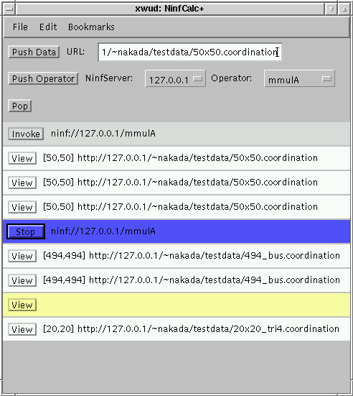
NinfCalc＋
Matrix
Workshop
Web Browser
WebServer
Matrix
Calc
Routine
NinfServer
WebServer
Data
Storage
NinfCalc+
San Jose
USA
Data
Storage
Japan

Slide 27


Ninf-NetSolve Collaboration
Ninf Server
NetSolve Server
NetSolve Server
Ninf Server
NetSolve Server
Ninf Server
Adapters
NetSolve Client
Ninf Client
Ninf client can use NetSolve server via adapter
NetSolve client can use Ninf server via adapter

Slide 28
Overview of Ninf
Other Global Computing Systems,
e.g., NetSolve via Adapters
Ninf DB
Server
Ninf Register
Meta
Server
Internet
Ninf
Computational
Server
Ninf Executable
Ninf Executable
Meta
Server
Meta
Server
Ninf Executable
Stub
Program
Ninf
Procedure
Ninf Client Library
:
Ninf_call(“linpack”, ..);
:
Ninf RPC
Ninf Stub
Generator
IDL File
Program

Slide 29
Callback
Client
Server
Ninf_call
Server side routine can callback client side routine
Ex. Display interim results, implement Master- worker model
CallbcakFunc
void CallbackFunc(...){
.… /* define callback routine */
}
Ninf_call(“Func”, arg .., CallbackFunc);
/* call with pointer to the function */

Slide 30
Load balancing by Callback
Master-Worker Execution
Callback routine works as the Master
Client
Load Request
Server Side
Routine
Callback
Routine
Load Dispatch
Server Side Routine
Server Side Routine
Efficient because
  Invokes Ninf_calls just the same number as the servers
    by MetaServer, client invokes number of decomposition
  No data buffering
Requires special technique
Notes:
Here, let me explain the load balancing technique by callback.
It is a little bit tricky technique, based on master -worker model.
Ninf provides callback facility, basically for displaying interim result.
This technique uses callback routine on the client as the Load distribution Master.
Each server-side routine works as a Slave and request workload using callback.
This method is efficient because
It invokes just the same number as the servers
No data buffering (in the metaserver)
However, it requires special programming technique, it makes code difficult to understand.

Slide 31
Ninf MetaServer Architecture
Directory Service
  Centralized Information Storage
Scheduler
  Updates information in the directory service.
Server Probe Module
  periodically monitors server status
Client Proxy
  Monitors Connection Status between each servers
  Queries to the scheduler with the connection information
Server Proxy (optional)
Notes:
Taking account these requirements, we designed our MetaServer Architecture
MetaServer consist of these modules
Directory Service
Scheduler
Server Probe Module
Client Proxy
Server Proxy

