Slide 1

Ninf Global Computing System
- Architecture, Features, and Performance -
Hidemoto Nakada, Atsuko Takefusa,
Hirotaka Ogawa, Kento Aida, Hiromitsu Takagi,
Satoshi Matsuoka, Umpei Nagashima,
Mitsuhisa Sato and Satoshi Sekiguchi
ElectroTechnical Laboratory, Japan
URL: http://ninf.etl.go.jp
Notes:
Thank you, chairman.
This talk is titled .Utilizing the MetaServer Architecture in the Ninf Global Computing System.

Slide 2
Towards Global Computing Infrastructure
Rapid increase in speed and availability of network
→ Computational and Data Resources are collectively employed to solve large-scale problems.
Global Computing (Metacomputing, The “Grid”)
Ninf (Network Infrastructure for Global Computing)
  c.f., NetSolve, Legion, RCS, Javelin, Globus etc.
Notes:
Recently, rapid increase in speed and availability of network is now making it possible to collectively employ computational and data resources in the network to solve large-scale problems.
Such a system is called, high-performance global computing, or Metacomputing, or The 'Grid.
There have been several recent proposals of global computing infrastructure, including our Ninf which stands for Network Infrastructure for global computing.
Other systems are NetSolve, Legion, RCS, Javelin, Globus, and so on.

Slide 3
Global Computing Technologies
Javelin, Ninflet
distribute.net
Ninf
Anonymous
Anonymity
Condor
RCS
Globus
PVM/MPI
ORBs
Specified
Local
Campus Wide
Global
Area
Notes:
-- Ninflet provides a general frAmework for parallel programming
using Java for metacomuting environments.
-- Design decision: server-based Ninflet execution
which leads to co-existence of flexibility, security, and robustness
at the expense of system installation requirements.
-- Notable features are checkpointing, migration, various parallel programming patterns.

Slide 4
Presentation Overview
Ninf Overview
MetaServer architecture
Some fancy facilities
Performance overview
Conclusion
Notes:
Here is outline of this presentation.
First of all, I’ll explain overview of our Ninf system.
Then, summarize requirements for global scheduling.
After that, I’ll introduce our metaserver system,
and its preliminary evaluation results.
Finally, I’ll give some concluding remarks.

Slide 5
Overview of Ninf
Ninf
Server
Remote high-performance routine invocation
Transparent view to the programmers
Automatic workload distribution
C Client
NumericalRoutine
NumericalRoutine
NumericalRoutine
Ninf
Server
Java
Client
MetaServer
NumericalRoutine
NumericalRoutine
NumericalRoutine
Mathematica
Client
Ninf
Server
NumericalRoutine
NumericalRoutine
NumericalRoutine
Notes:
Before talking about the metaserver, we’ d like to show Overview of the ninf system.
The Ninf system is a RPC system, which based on the client-server model.
It provides semi-transparent view for the client program to call remote numerical routines from Fortran, C, Java and other languages and systems, such as mathematica, and excel.
Center of the system, there lie modules called metaserver, which distributes workload automatically.

Slide 6
Ninf API
Client
Server
Ninf_call(FUNC_NAME, ....);
FUNC_NAME = ninf://HOST:PORT/ENTRY_NAME
Implemented for C, C++, Fortran, Java, Lisp …,Mathematica, Excel
Ninf_call
double A[n][n],B[n][n],C[n][n]; /* Data Decl.*/
dmmul(n,A,B,C); /* Call local function*/
Ninf_call(“dmmul”,n,A,B,C); /* Call Ninf Func */
“Ninfy”
Notes:
The principal API is Ninf_call.
It is synchronous remote procedure call,
For example, this matrix multiply statement can be ‘nified’ as like this.

Slide 7
Ninf RPC Protocol
Exchange interface information at run-time
  No need to generate client stub routines (cf. SunRPC)
  No need to modify a client program when server’s libraries are updated.
Client Program
Ninf Procedure
Client Library
Interface Info
Stub Program
Interface Info
Ninf Server
Interface Info
Interface Request
Interface Info.
Argument
Result

Slide 8
Ninf stub generator
Ninf Clients
Ninf Interface
Description File
Ninf_call("goo",...)
xxx.idl
Ninf_call("bar",...)
Ninf_call("foo",...)
Ninf_gen
stub main programs
Ninf Server
_stub_foo.c
_stub_bar.c
_stub_goo.c
module.mak
_stub_foo
stubs.dir
_stub_bar
stubs.alias
Libraries
_stub_goo
yyy.a
Ninfserver.conf

Slide 9
Ninf Interface Description (Ninf IDL)
Define dmmul(long mode_in int n,
mode_in double A[n][n], mode_in double B[n][n],
mode_out double C[n][n])
“ description “
Required “libXXX.o”
CalcOrder n^3
Calls “C” dmmul(n,A,B,C);
IDL information:
  library function’s name, and its alias (Define)
  arguments’ access mode, data type (mode_in, out, inout, ...)
  computation order declaration (CalcOrder)
  source language (Calls)

Slide 10
Ninf API(2) - asynchronous call -
Asynchronous Call
Client
ServerA
ServerB
Ninf_call_async(“FUNC”, ...);
Ninf_call_async
Wait arbitrary set of invocation
Ninf_call_async
Ninf_wait_all
Ninf_wait(ID);
Ninf_wait_all();
Ninf_wait_and(IDList, len);
Ninf_wait_or(IDList, len);
Ninf_cancel(ID);
Notes:
We also have asynchronous call API.
Ninf_call_async immediately returns with session ID.
And with the ID, you can wait the result of the call.
Using this API, we can invoke several calls in parallel.
We have another API for parallel execution , called transaction.
It specifies a certain program region as a transaction, and execute all ninf_calls in the region in parallel.
Data dependency among the ninf_calls is automatically detected, and the ninf_calls scheduled properly.

Slide 11
Ninf API(3) - Transaction-
Transaction - user specified cord region
  Aggregate invocation
  Dataflow execution
A
B
C
D
Ninf_transaction_start();
Ninf_call(“dmmul,n,A,B,C);
Ninf_call(“dmmul”,n,D,E,F);
Ninf_call(“dmmul”,n,C,F,G);
Ninf_transaction_end();
dmmul
dmmul
E
F
dmmul
G

Slide 12
Ninf API(4) Callback
Client
Server
Ninf_call
Server side routine can callback client side routine
Ex. Display interim results, implement Master- worker model
CallbcakFunc
void CallbackFunc(...){
.… /* define callback routine */
}
Ninf_call(“Func”, arg .., CallbackFunc);
/* call with pointer to the function */

Slide 13
Scheduling for Global Computing
Dispatch computation to the Most Suitable Computation Server
Issues
  Server / Network Status dynamically change
  Status information is distributed globally
  Scheduling is inherently difficult
  What is the Most Suitable?
Notes:
One of the most important issue for global computing is scheduling or load balancing.
For efficient computation, to dispatch requests to the most suitable Computation server is essential.
But, Global Scheduling is very difficult, because
status of server and network change dynamically
gathering globally distributed information is difficult
Moreover, scheduling itself is inherently difficult, and definition of the most suitable server itself depends on the usage of the system.

Slide 14
Our Goals and Results
Clarify requirements for Global Computing Scheduler
Design a scheduling framework
MetaServer: a flexible scheduling framework
Preliminary Evaluation with simple scheduler
Notes:
Goals of this presentation are to clarify requirements for global computing scheduler,
And to show a clear, flexible scheduling framework.
We introduce our scheduling framework metaserver.
And show some preliminary evaluation results.
Note that, we do not treat the scheduling itself in this presentation.
We just provide the scheduling framework, so the scheduling policy is a still open problem.

Slide 15
Issues for Global Scheduling
Load imbalance comes from ignoring
  server status
  server characteristics
  communication issues
  computation characteristics
False load concentration
  Delay of load information propagation
Firewall
Notes:
Now, what is the problem for global scheduling.
Firstly, Load imbalance.
It comes from neglect of status or characteristics of the resources.
such as server status, server characteristics, communication issues, computation characteristics
If you concern all of these, false load concentration still may occur.
If the server load information does not propagate fast enough, obsolete load information are used and incurs false load concentration.
Moreover, there is a problem comes from Internet nature, Firewall.
It makes difficult to gather information for scheduling

Slide 16
Requirements for Global Scheduling
Gathering various Information
Server Status
  Load average, CPU time breakdown (system, user, idle)
Server Characteristics
  Performance, Number of CPU, Amount of Memory
Network Status
  Latency, Throughput
Computation Characteristics
  Calculation order, communication size
Notes:
Here, accounting these problems, we summarize requirements for global scheduling.
First of al Scheduling for global computing requires various information.
For the proper scheduling, these information are needed.
Server Status, it means load average and CPU time breakdown
Server Characteristics, performance, number of CPU, amount of memory
Network status, Latency and throughput
Computation characteristics, calculation order, communication size

Slide 17
Requirements for Global Scheduling(2)
Centralizing server load information
  To avoid false concentration of loads
  Atomic update
Monitoring server load
Throughput measurement from each client
  To reflect network topology
Simple client program
  Portability
Gathering information over firewalls
Notes:
Server Load Information have to be maintained in centralized way.
To avoid false concentration of loads, all the scheduler have to share the load information and
update it in an Atomic way.
Server load have to be monitored
Throughput to Servers have to be measured by each Client site to Reflect the Network Topology
the measured throughput cannot be shared because it depends on the location of the client site.
Client Program should be as simple as possible for portability.
And all these information have to be gathered over firewalls.

Slide 18
Our Answer for the Requirements
Centralized server load information
Server Load monitoring
Throughput measurement from each client
Simple Client program
Gathering information over firewalls
Centralized Directory Service
Scheduler near by the Directory Service
Server Monitor
Client Proxy
Server Proxy
Notes:
Now we show our answer for the requirements.
For the centerized server load information,we put
Directory service at the center of system
and scheduler near by the directory service
For Server Load monitoring
we provide server monitor module
To accomplish these two issues at the same time,
we adopted client proxy, which lies on the firewall of the client site and measures throughput on behalf of the site.
The measurement results are shared by all the client in the site.
To gather information from the server in the firewall, we provide server proxy.
Our metaserver consists of these all modules.

Slide 19
MetaServer Architecture
Directory
Service
Server Side
Server
Proxy
Client Side
MetaServer
Scheduler
Server
Probe
Module
Server
Proxy
Client
Server
Load
query
Schedule
query
Data
Client
Client
Proxy
Server
Proxy
Server
Throughput
Measurement
Notes:
This diagram shows the metaserver architecture.
There are clients here , and servers here.
These light yellow modules all construct the metaserver.
Directory service module is a kind of database, stores information about servers and functions supported by each server.
Server Probe Module monitors servers periodically, and update the directory service.
Client proxy periodically measures throughput and latency to the all the known servers.
When the Client proxy receives request from client,
it invoke a query for the scheduler with the network information.
Scheduler get the server load information from the directory service, and decide the most suitable server, and send back the server name to the client proxy.
then, Client proxy forwards the request to the assigned server.
Server proxy is just a forwarding proxy to go over the firewall. Its optional.

Slide 20
Information Gathering/Measurement
Server Status (Load average, CPU time breakdown)
  Server Probe module monitors
Server Characteristics (Performance, Number of CPU, Amount of Memory)
  NinfServer measures using linpack benchmark
  Number of CPU is taken from configuration file
  Amount of Memory is automatically detected
Network Status (Latency, Throughput)
  Client Proxy periodically measures.
Computation Characteristics (Calculation order, communication size)
  Declared in the Interface description.
  Computed using actual arguments.
Define dgefa (
INOUT double a[n][lda:n],
IN int lda, IN int n,
OUT int ipvt[n],
OUT int *info)
CalcOrder 2/3*(n^3)
Calls dgefa(a,n,n,ipvt,info);
Notes:
To summarize, Our metaserver gathers each information as follows
Server Status is monitored by Probe module. It periodically send queries to the servers and update Directory service.
Performance is measured by NinfServer itself when it startup. It runs linpack benchmark.
Number of CPU is taken from configuration file
Amount of Memory is automatically detected using some system calls.
NinfServer reports these information to the directory service at the start up time.
Network Status is measured by Client Proxy periodically.
Computation Characteristics is Declared in the Interface description. This is an example of ninf interface description. This calcorder stands for the calculation amount. Communication amount can be computed easily.
Client proxy compute these values and send it to the scheduler.

Slide 21
System Bindings
Language Bindings
  C, C++, Fortran, Java, Lisp
  From Java Applets
System Bindings
  Mathematica, Excel
Callback based API for implementers Common Interface Module

Slide 22
Common Interface Module
C-API for Language such as Lisp
  Need to convert list to C array
  Garbage collection
Callback based interface
  Just one structure and few functions have to be implemented
    structure stores the pointer to the data
    function gets data from the pointer
    function puts data to the pointer

Slide 23
Ninf Client for Excel
A
B
C
D
E
F
1
Ninf Call using data on the Excel worksheet
Argument is specified by Area
2
2
1
2
1
0
3
3
4
0
1
4
5
1
2
6
3
4
Ninf_call(“dmmul”, 2, A, B, C)
Ninf Server
C= A x B

Slide 24
Excel bind implementation
Core routines in VC++
Wrapper in Visual Basic
Arguments are Excel “Range Objects”
Sub mmul()
Call setNinfServer("hpc.etl.go.jp", "3000")
Call ninf_call4("mmul", range("B1"), range("A2:B3"),
range(“D2:E3"), range(“G2:H3"))
End Sub

Slide 25
Excel Bind Implementation(2)
Call back based implementation using Common Interface Module
Implement just handler routines
Client Library automatically callbacks the routines and marshals the arguments
A
B
C
D
E
F
1
2
2
1
2
1
0
3
3
4
0
1
4
5
1
2
6
3
4
Main routine
Handler
Handler
Handler
Client for Excel
Callback
Ninf Client Library
Ninf_cim_main
Marshaling routine
Client side
Server side
Ninf Server
Ninf executable
“mmul”

Slide 26
Direct Web Access
URL can be used as an argument.
Directly retrieve data out of Web Server
Store interim results to a Web Server
Ninf_call(“dmmul”, n,
”http://WEBSERVER/DATA”,
B, C);
WEBSERVER
Data
Request
Ninf
Server
Client
Program
B
Ninf Executable
C

Slide 27
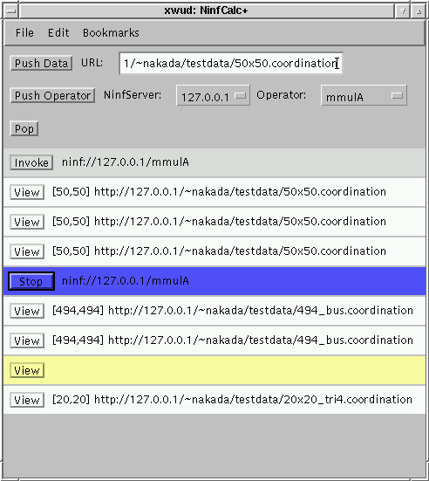
NinfCalc+
Applet in browser
Matrix Calculator uses Web server as storage
No data communication between client and server
Interactively control huge matrix calculation via thin line
Web Browser
Ninf
Server
Data
Storage
NinfCalc+

Slide 28


Ninf-NetSolve Collaboration
Ninf Server
NetSolve Server
NetSolve Server
Ninf Server
Ninf-Netsolve
Adapter
NetSolve Server
Ninf Server
Netsolve-Ninf
Adapter
NetSolve Client
Ninf Client
Ninf client can use NetSolve server via adapter
NetSolve client can use Ninf server via adapter

Slide 29
Performance Evaluation
Single-client LAN benchmark
  Baseline performance of Ninf
  Compare with local execution
Multi-client, Multi-site WAN benchmark
  To know influence of
    communication performance
    network topology
    client location

Slide 30
Program for performance measurement
Client program
Ninf RPC
Server program
gettimeofday();
Ninf_call(“linpack”,...);
gettimeofday()
ｌinpack(){
dgefa();
dgesl();
}
XDR
int ipiv[n]
double b[n]
int *info
double a[lda:n][n]
int lda, n
double b[n]
Linpack Benchmark (Double Precision)
  Comp:
  Comm:
3
2
2/3 n
+ 2 n
2
8 n
+ 20 n + O(1) [bytes]

Slide 31
Timing Chart
Ｎｉｎｆ_ｃａｌｌ（“ｌｉｎｐａｃｋ”,...）
Tsubmit
Tcomplete
Ninf Client
accept
Ninf Server
fork&exec
Tenqueue
Ninf
Executable
linpack(...);
Tdequeue
Waiting Time
Response Time
Ninf_call Elapsed Time

Slide 32
LAN Single-client Benchmarking Environment (at ETL)
Ethernet switch
100BASE full-duplex
Ethernet switch
100BASE-TX
100BASE-TX
x 16
....
100Mbps
FDDI
Clients
Servers
SC2000
40MHzx16 1GB
Solaris 2.4
Ultra 1/140
143MHz 96MB
Solaris 2.4
DEC Alpha cluster
333MHzx16 128MB
OSF1 V3.2 41
Cray J916
200Mflopsx4 512MB
unicos 8.0.4.2
SuperSPARC
(SMP)
UltraSPARC
(WS)
Alpha
(WS Cluster)
J90
(Vector-Parallel)

Slide 33
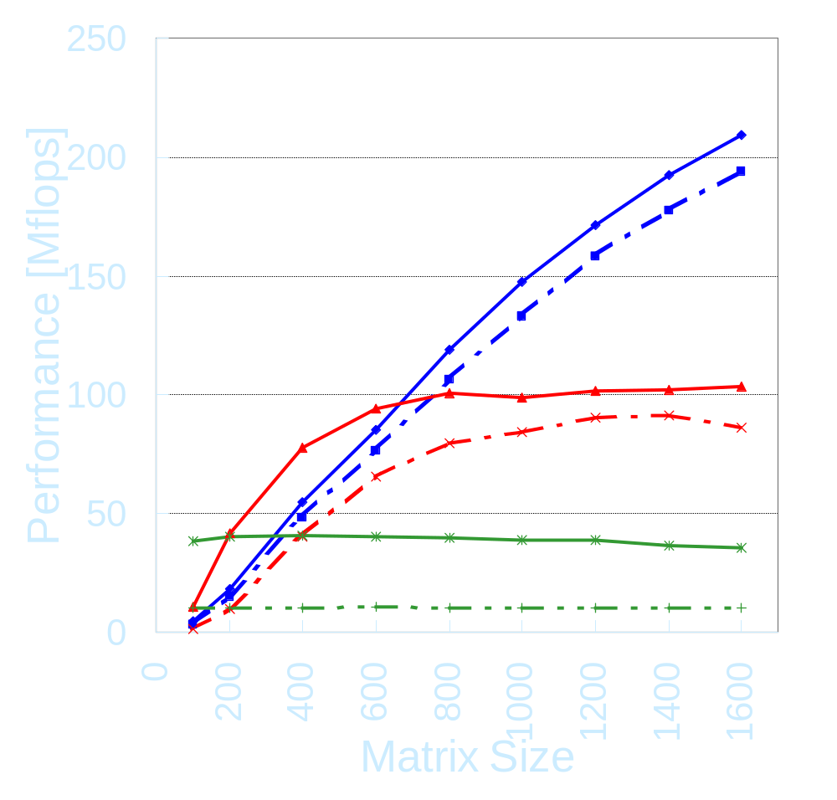
LAN Single Client Linpack Results
Ninf is faster than Local at n = 150～300
For Ninf_call to J90,
Ninf performance is not saturated.
  (J90’s Local achieves 600Mflops when n=1600)
→ Ninf performance quickly overtakes Local.
The effects of client machine’s performance difference are small.
Ninf: Ultra-J90
Ninf: Super-J90
Ninf: Ultra-Alpha
Ninf: Super-Alpha
Local: UltraSPARC
Local: SuperSPARC

Slide 34
WAN Multi-client Benchmarking Environment
Clients
Single-Site
Multi-Site
Internet
U-Tokyo [Ultra1]
(0.35MB/s, 20ms)
Server
Ocha-U [SS10,2PEx8]
(0.16MB/s, 32ms)
ETL
[J90,4PE]
OC-3
NITech [Ultra2]
(0.15MB/s, 41ms)
TITech [Ultra1]
(0.036MB/s, 18ms)

Slide 35
Multi-client Benchmarks (WAN)
A Model Client Program
Linpack is repeatedly called:
  Each client performs a Ninf_call on the interval of s seconds with probability p. → s = 3, p = 1/2 chosen.
  Number of clients : c , problem size : n.
  → c = 1, 2, 4, 8, 16, Linpack: n = 600, 1000, 1400
Parallel Processing on the server
  Linpack: 4PE ver. --- Data Parallel
  4PE Execution and Single Processing

Slide 36
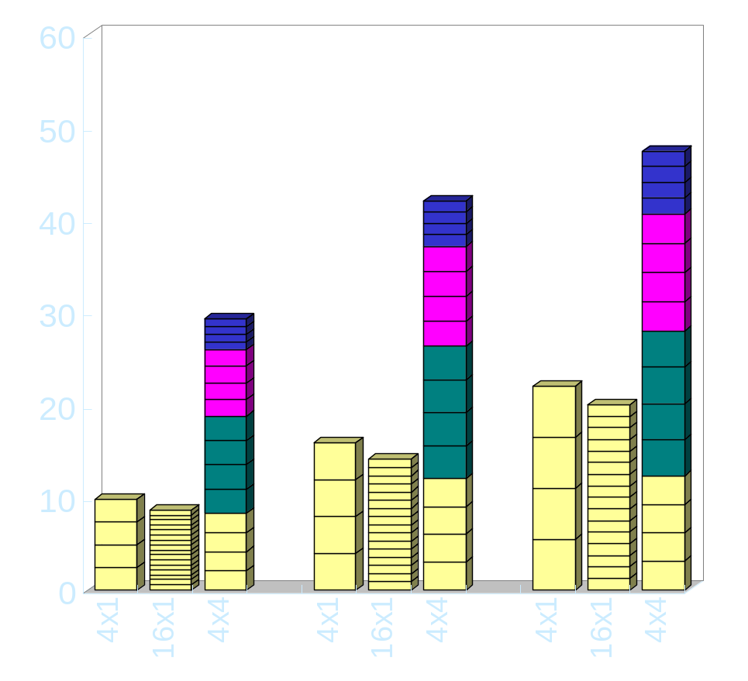
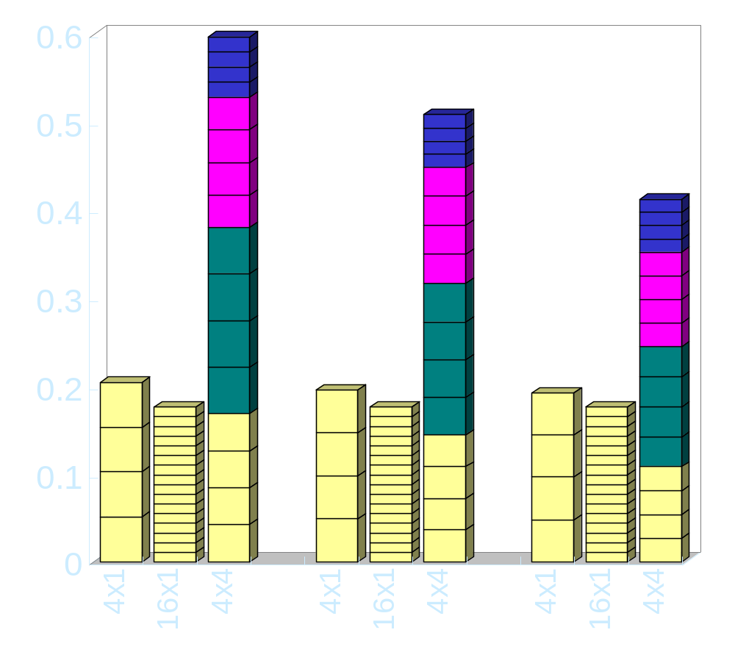
Single/Multi-site WAN Linpack Benchmark Results
Performance and Throughput (c = 16, 4PE ver.)
[Mflops]
Average Performance
[MB/s]
Communication Throughput
TITech
NITech
U-Tokyo
Ocha-U
600
1000
1400
600
1000
1400

Slide 37
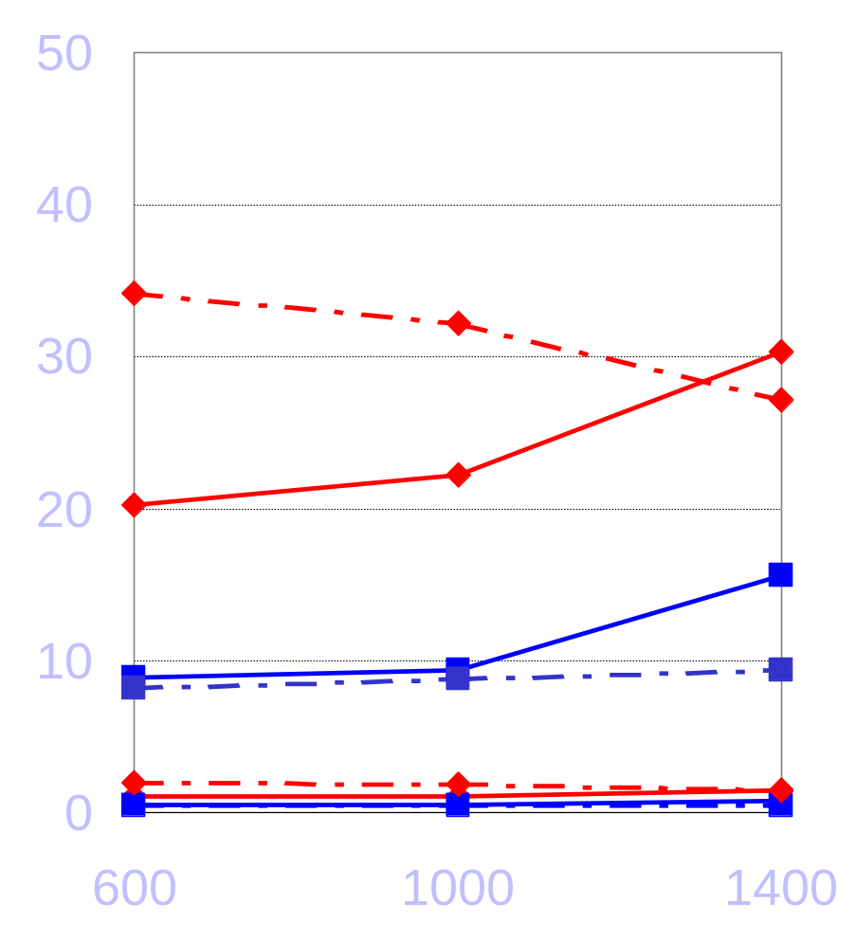
Single/Multi-site WAN Linpack Benchmark Results
CPU Utilization and Load Average
Utilization and Load are greater for multi-site.
c.f., single site.
The J90 server does not saturate for n and c.
  Network bandwidth saturation again the cause.
→ Utilization and Load alone are NOT suitable criteria for load balancing of global computing.
Single-site(c=4)
Multi-site(c=1x4)
Single-site(c=16)
Multi-sites(c=4x4)
Load Average
CPU Utilization [%]
CPU Utilization
10
Load Average
0
Matrix Size

Slide 38
Simulator for Global Computing
What information needed for scheduling?
How does it effect overall performance?
Real system: cannot control experimental environment
Simulator: setup arbitrary experimental environment
Notes:
2

Slide 39
高性能広域計算の実行の流れ
① スケジューラはサーバの情報をモニタする
② 計算要求が発生すると，クライアントは適切なサーバをスケジューラに問い合わせる
③ スケジューラはクライアントに適切なサーバを紹介する
④ 紹介されたサーバに計算要求を発行する
Scheduler
①
②
Server
③
Client
Internet
Server
Client
④
Server
Notes:
3

Slide 40
The Model of Ninf Simulator
(Queuing System)
λns
μns
λs
μs
Networks / Servers are represented as queues
Other Network traffic / Server loads are also represented as jobs
λnr
μnr
Client A
Server A
Client A’
Qns1
Qnr1
Qs1
Qns2
Server B
Qnr2
Client B
Client B’
Qns3
Qs2
Qnr3
Server C
Client C
Client C’
Qns4
Qnr4
Qs3

Slide 41
Related Work
The RPC based systems → use existing programming languages
  NetSolve [Casanova and Dongarra, Univ. Tennessee]
    The same basic API as Ninf_call (now interchangeable)
    load-balancing with a daemon process called Agent.
  RCS [Arbenz, ETH Zurich]
    PVM-based
The systems using parallel distributed language etc.
  Legion [Grimshaw, Univ. Virginia]
    An user distributes his programs written with the parallel object-oriented language Mentat.
  Javelin [Schauser et al., UCSB]
    High portability due to using Java and WWW.
The global scheduling systems - NWS, DQS
Toolkits: Globus [Argonne/USC]
Notes:
There have been several proposals of global computing infrastructure.
NetSolve have a module called Agent which perform scheduling.
However, Agents cannot share server load information, therefore, false load concentration may occur.
As an embedded scheduling system, there is prophet for mentat.
It orients to Local area network, therefore it does not have network monitoring facility.
Also, There is Application level Scheduler APPLES.
It schedules using application level information written in HAT, and Backend monitoring system NWS.
NWS, the Network Weather Service is an independent resource forecast system. It monitors resource status and predicts future status.

Slide 42
Conclusion
Ninf: global computing infrastructure
  RPC based, transparent view.
  MetaServer : a flexible scheduling framework
  Direct Web Access
  Simulator
Ninf platforms
  Server: Solaris1,2, DEC, UNICOS, Linux, FreeBSD
  Client: server platforms + Win32
Notes:
Now, the conclusion.
We summarize requirement for scheduler for global computing.
Global Scheduling requires
gathering distributed, various information
such as Server Characteristics, Server Loads, Communication Status, and Computation Characteristics.
And introduced our metaserver which provides flexible scheduling framework.
And our preliminary evaluation showed that
scheduling cost is negligible for large size problem
Dynamic load balancing by MetaServer showed fairly good score.

Slide 43
Future Work
Finding scheduling policy for Global Computing
  Simulator
  High-Performance vs. High-Throughput
    FLOP/s vs. FLOP/y
Security model
  Policy depends on the usage
More platform / language / systems
  Server for NT?
  Client for MatLab, AVS
Notes:
As the future work, we are planning to study more about Scheduling Policy for Global computing.
Although the metaserver gives flexible framework for scheduling, the actual scheduling policy is still an open problem.
For the issue, we are taking two approach.
One uses the metaserver and actual system.
We will perform experiments on the actual system.
However, because of the unstable nature of the global network, we cannot setup the experiment environment, so cannot know the behavior for arbitrary situation.
To cope with it, we will take second approach, Simulator.
We already have queuing model based Simulator and will perform experiments with arbitrary setting.
Another important issue for scheduling policy is High-Throughput vs.. high-performance.
High-Throughput Computing aims to gain Floating operation per year, instead of per second.
We are going to study both of them.

Slide 44
Overview of Ninf
Other Global Computing Systems,
e.g., NetSolve via Adapters
Ninf DB
Server
Ninf Register
Meta
Server
Internet
Ninf
Computational
Server
Ninf Executable
Ninf Executable
Meta
Server
Meta
Server
Ninf Executable
Stub
Program
Ninf
Procedure
Ninf Client Library
:
Ninf_call(“linpack”, ..);
:
Ninf RPC
Ninf Stub
Generator
IDL File
Program

