Slide 1
Evaluating Web Services Based Implementations of Grid RPC
Satoshi Shirasuna ¹⁾ Hidemoto Nakada ¹⁾²⁾
Satoshi Matsuoka ¹⁾³⁾ Satoshi Sekiguchi ³⁾
1) Tokyo Institute of Technology
2) National Institute of Advanced Industrial Science and Technology
3) National Institute of Informatics

Slide 2
GridRPC
RPC-based Grid middleware for scientific computing
  Ninf[AIST,TITECH], NetSolve[UTK]
  High-level abstractions
    Intuitive APIs
    Dynamic server-side IDL management
    Parallel programming with asynchronous calls
  Data support suitable for scientific computing
    IDL specialized for numerical computation
      Description of parameter dependencies
      Partial transmission of arrays

Slide 3
Interoperability of GridRPC Systems
Existing GridRPC systems employ their own protocols
Bridges are offered between some systems
  Ninf – NetSolve Bridge [Nakada, et al. ’97]
But, infeasible to make bridges between all systems
Need general solution

Slide 4
Web Service Technologies with XML-based Protocol
Standard methods to deploy services on Web infrastructure
Several specifications for Web services
  SOAP (Simple Object Address Protocol)
    Lightweight protocol for exchange of information in a distributed environment
  WSDL （Web Service Definition Language)
    Interface description language for Web services
OGSA will merge Web service technologies with Grid
  Could be the medium of interoperability of GridRPC
Important to evaluate whether Web service technologies can be used for scientific computing

Slide 5
Technical Problems
Technical Problems to apply Web service technologies to GridRPC
  Performance penalty caused by XML
  Expressibility of SOAP and WSDL as a base of GridRPC
    Target of Web services is business applications
    Whereas IDLs of GridRPC have functions specific to scientific applications
➔Need to evaluate these to construct GridRPC on Web service technologies

Slide 6

SOAP/WSDL Expressibility
GridRPC IDL vs. WSDL (1)
Client acquires interface information at run-time
Two-phase RPC call
  double A[n][n], B[n][n], C[n][n];
  grpc_call(“dmmul”, n, A, B, C);
Interface Request
(→HTTP Get)
Interface Info.
(→WSDL/HTTP)
GridRPC
Server
Arguments (→SOAP)
Result (→SOAP)
Interface Info
(IDL→WSDL)
GridRPC Client

Slide 7
SOAP/WSDL Expressibility
GridRPC IDL vs. WSDL (2)
Array size specification
  GridRPC IDLs support expression of array size using other arguments
  ➔ WSDL lacks the ability to express such dependencies
Subarrays, strides of arrays
  GridRPC IDLs support these various type of arrays
  SOAP can express these as partially transmitted arrays
  But, WSDL does not embody any specification
Need small extensions to WSDL to support scientific IDL
  Define dmmul(mode_in int n,
  mode_in double A[n][n], mode_in double B[n][n],
  mode_out double C[n][n])

Slide 8
Performance Problems
Effective bandwidth degradation
  Caused by increased data size
    XML-encoded data size is >10 times bigger than the original
    （especially big problem for array data）
Higher cost of serialization/deserialization
Protocol related problems
  Performance insufficiency caused by protocol specification
  <input2 xmlns: ns2=“http://schemas.xmlsoap.org/soap/encoding/”
  xsi:type=“ns2:Array” ns2:arrayType=“xsd:double[2,2]”>
  <item xsi:type=“xsd:double”>0.1234928508375589</item>
  <item xsi:type=“xsd:double”>0.1234928508375589</item>
  <item xsi:type=“xsd:double”>0.45336420225272667</item>
  <item xsi:type=“xsd:double”>0.8887406170881601</item>
  </input2>

Slide 9
Performance Evaluation
Investigate performance of various implementations
Matrix multiply
  2-dimentional double array
  Communication: O(n²), Calculation: O(n³)
  (array size: nxn)
Evaluation environment
  LAN
    PrestoII Cluster (Matsuoka laboratory, Titech)
    Connected with 100Base-T switch
    Pentium III 800MHz, 640MB memory
    Linux 2.2.19, IBM Java 1.3.0
  WAN
    Titech ←→ AIST (apx. 1Mbps)
    Sun Ultra-Enterprise, SPARC 333MHz x 6, 960MB Memory
    Solaris 5.7, Sun Java 1.3.0

Slide 10
1st Prototype
Naive implementation on top of Apache SOAP
  Exchanges interface information using WSDL
  Uses Apache SOAP server itself as a server
Client
Server
Client Application
Calculation Library
Ninf Client
Apache SOAP Server
Apache SOAP Client Library
Servlet Server
(Tomcat)
1. Interface Request (HTTP Get)
2. Interface Info. (WSDL) / HTTP
3. Parameters / SOAP
4. Result / SOAP

Slide 11
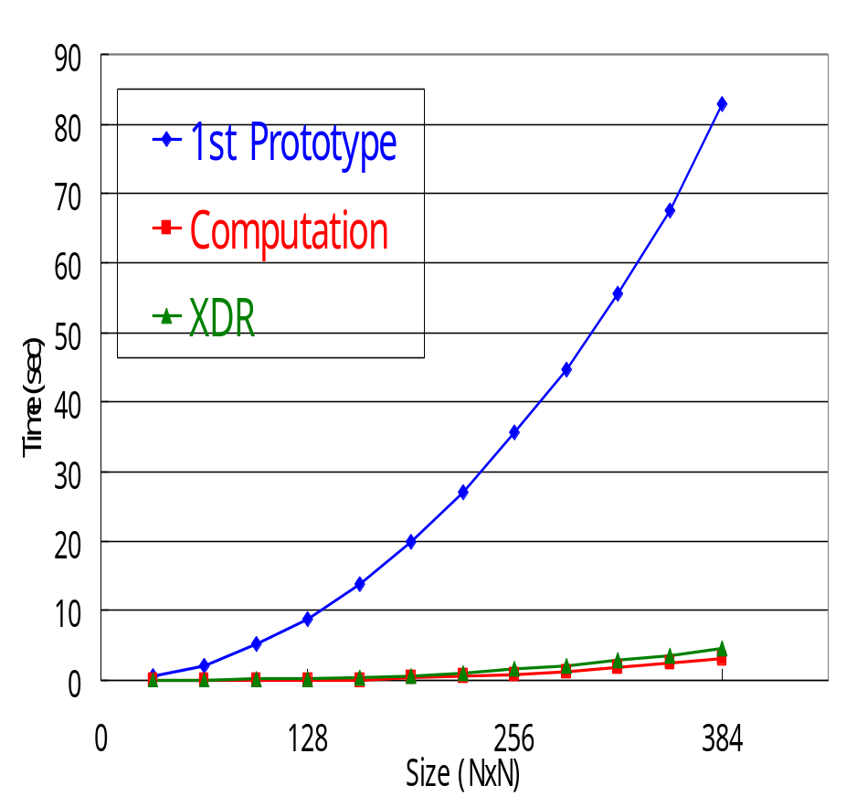
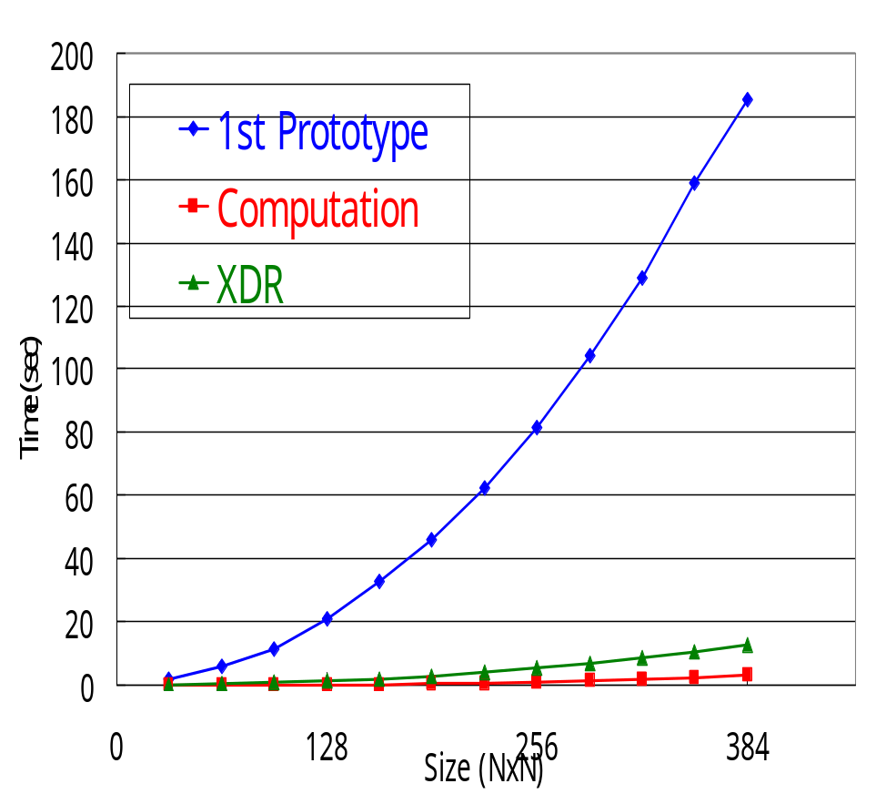
1st Prototype
Performance Evaluation
Terribly insufficient compared to the XDR-based implementation
LAN
WAN

Slide 12
Causes of the Overhead
Some part of the overhead is caused by SOAP
But, mainly implementation issue
  Apache SOAP uses DOM parser
    Need to receive the entire XML data before analysis
    Can not analyze data while receiving it
    Construct a DOM object tree in memory
    Increase memory usage
    Heavy overhead
Client
Server
Serialization
Sending
Receiving
Deserialization
Computation

Slide 13
2nd Prototype
Constructed to reduce the overhead of serialization/deserialization
  Embody customized SOAP parser based on SAX parser
    Improve deserialization speed
    Decrease memory usage
    Deserialize data while receiving it
Some new features, not supported by the 1st prototype
  Input/Output parameter support
  Multiple Output parameter support

Slide 14
2nd Prototype
System Architecture
Server
Client
Client Application
Calculation Library
Ninf Client
Ninf Server
SOAP
Deserializer
SOAP
Serializer
WSDL
Reader
WSDL
Module
SOAP
Deserializer
SOAP
Serializer
HTTP Client
Servlet Server
1. Interface Request (HTTP Get)
2. Interface Info. (WSDL) / HTTP
3. Parameters / SOAP
4. Result / SOAP

Slide 15
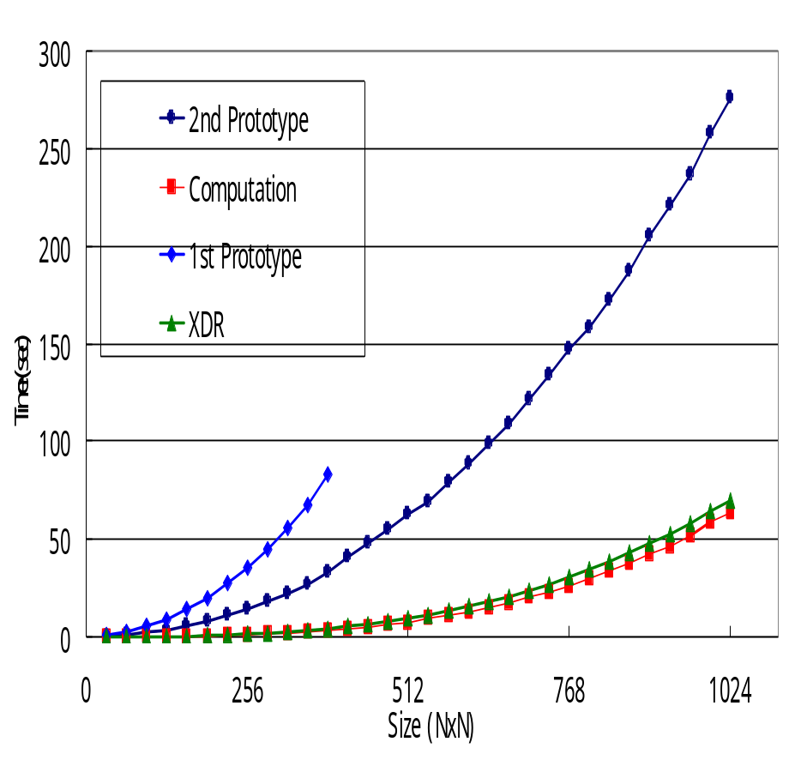
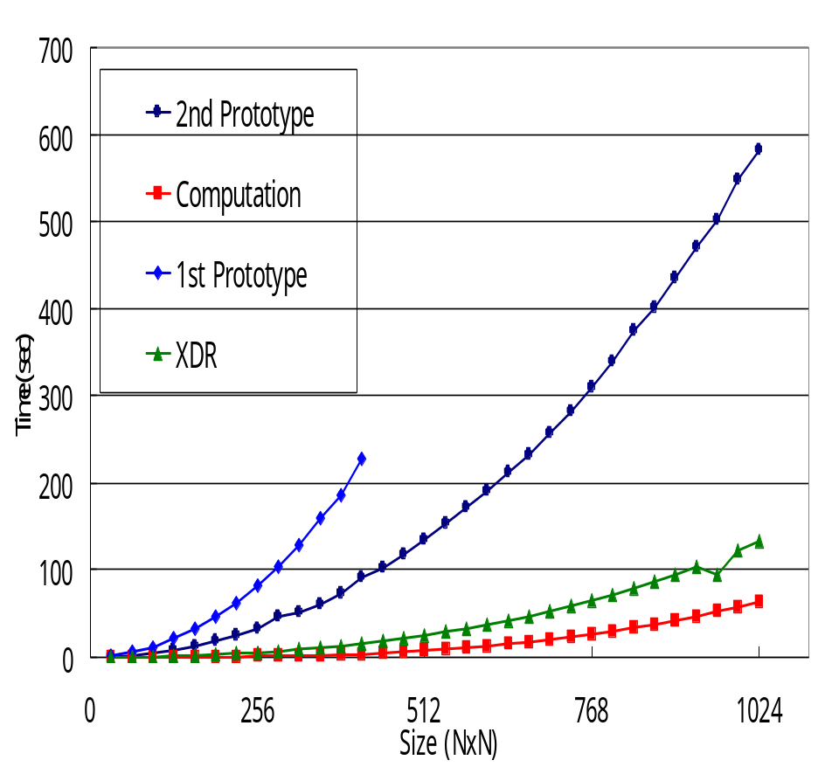
2nd Prototype
Performance Evaluation
Performance was improved
But, still have big overhead
LAN
WAN

Slide 16
Detailed Analysis (1)
Client
Server
Focus on the overhead prior to computation
Determine where the time is most spent
Measure the time to take for
  Serialization
  Wire transfer
  Deserialization
Overhead
Serialization
Sending
Receiving+
Deserialization
Computation
Receiving+
Deserialization
Serialization+
Sending

Slide 17
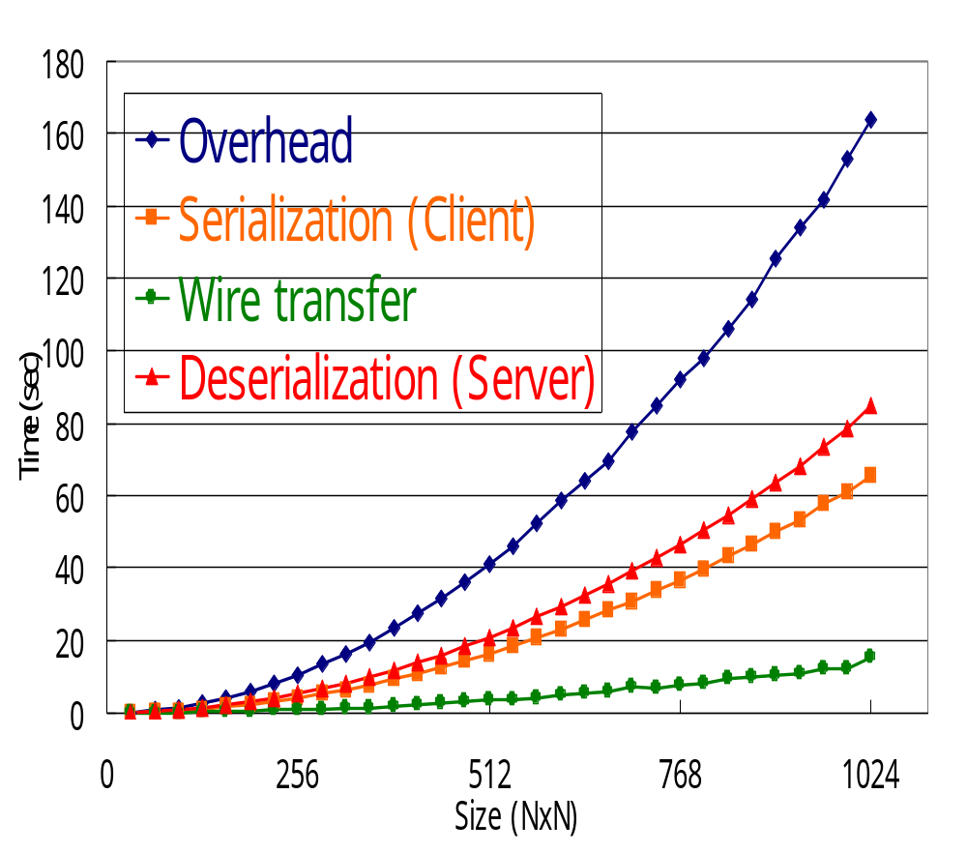
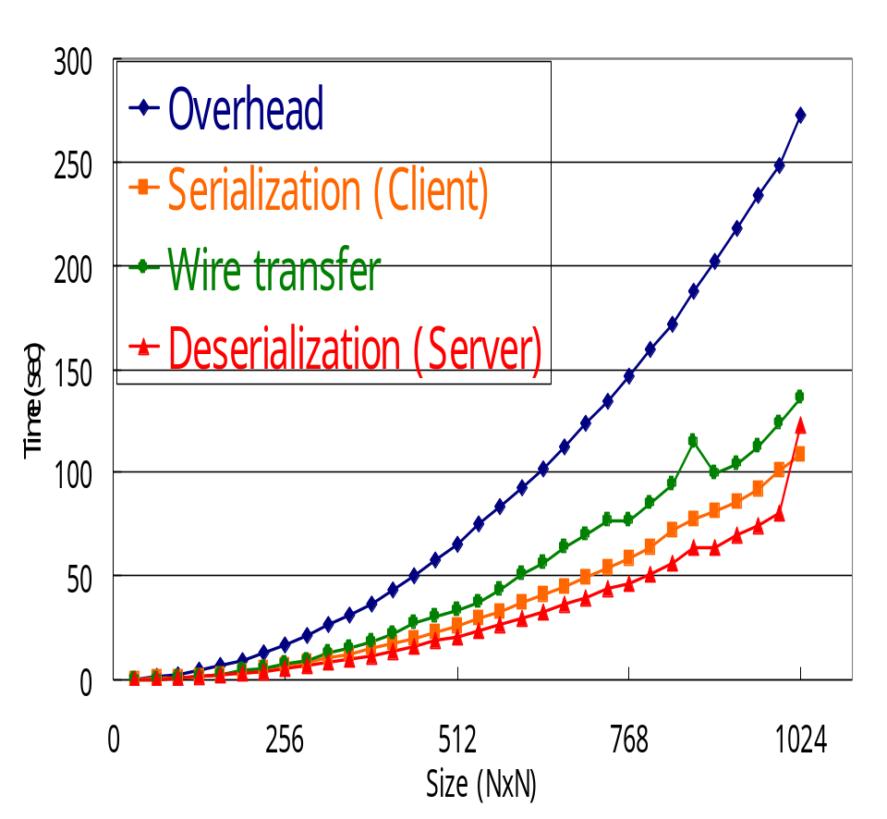
Detailed Analysis (2)
Cost of serialization/deserialization is relatively high
  In LAN, the overhead is almost sum of serialization/deserialization cost
Cost of wire-transfer is starting manifest in WAN
LAN
WAN

Slide 18
Optimization1: HTTP Content-Length Elimination (1)
Performance insufficiency caused by protocol
HTTP Content-Length header field
  Required for HTTP server to determine the end of a message
  Need to construct the entire SOAP message in memory first to calculate the message length
  ➔ Serialization(client) and
  deserialization(server) can
  not be pipelined
Client
Server
Serialization
Sending
Receiving+
Deserialization
Computation

Slide 19
Optimization1: HTTP Content-Length Elimination (2)
In SOAP, it is possible to determine the end of message by counting pairs of XML tags
→ Can omit Content-Length header to pipeline serialization(client), deserialization(server)
(but against RFC 1945, 2616)
Client
Server
Client
Server
Serialization
Serialization+
Sending
Receiving+
Deserialization
Sending
Receiving+
Deserialization
Computation
Computation

Slide 20
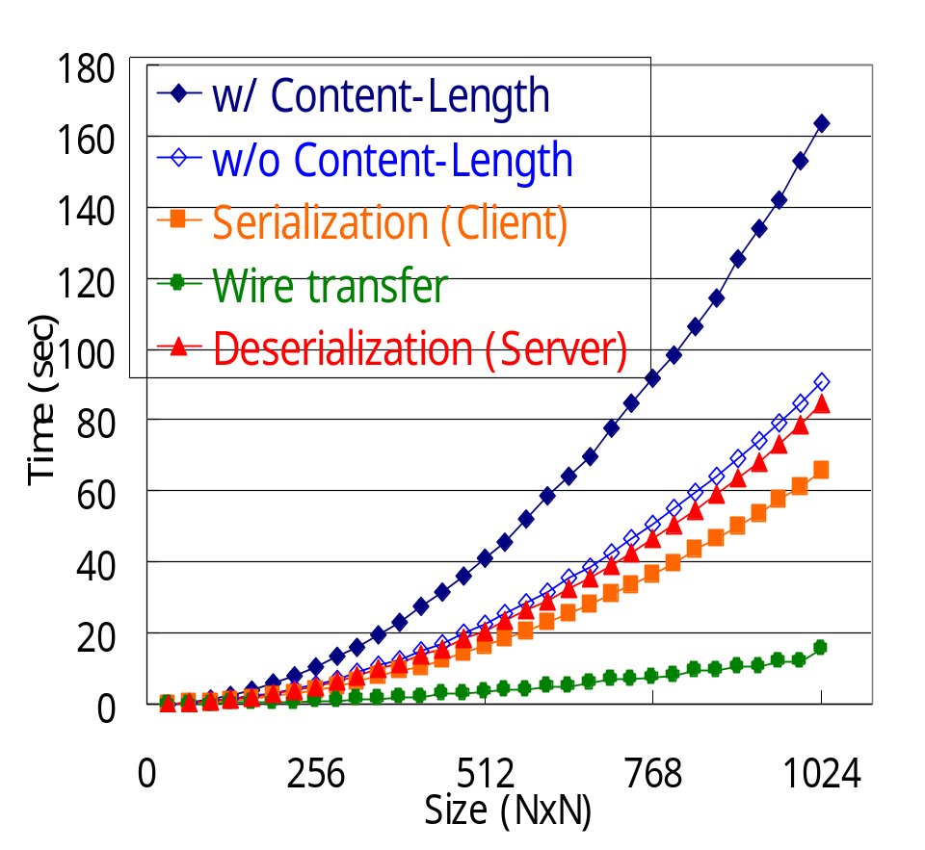
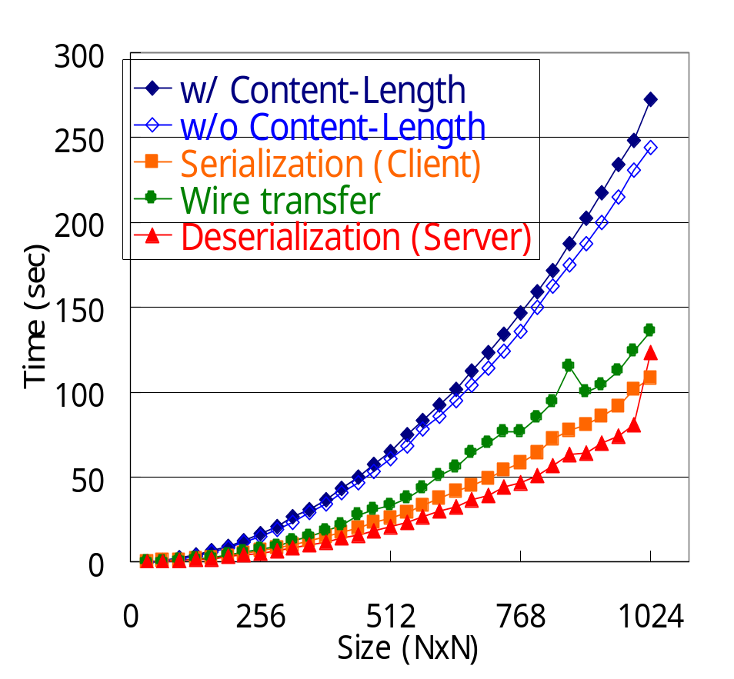
Optimization1: HTTP Content-Length Elimination (3)
In LAN, 55% of overhead is reduced
In WAN, 7% of overhead is reduced
LAN
WAN

Slide 21
Optimization1: HTTP Content-Length Elimination (4)
Evaluation shows the importance to omit Content-Length header
  Improve performance
  Also, reduce memory usage
RFC compliant schemes are necessary
  1. HTTP Chunked Transfer Coding
  2. Roughly estimate the length and fill with blanks
  ➔ Need to evaluate these methods

Slide 22
Optimization2:
Base64 Encoding (1)
Large-size arrays cause big overhead
  Increased message size
  Large number of XML tags
Apply base64 encoding for array data
  Treat whole array as binary data
  Information of array is expressed by GridRPC IDL, and dynamically exchanged
    e.g. size, range, stride
  ➔No need to express with SOAP message

Slide 23
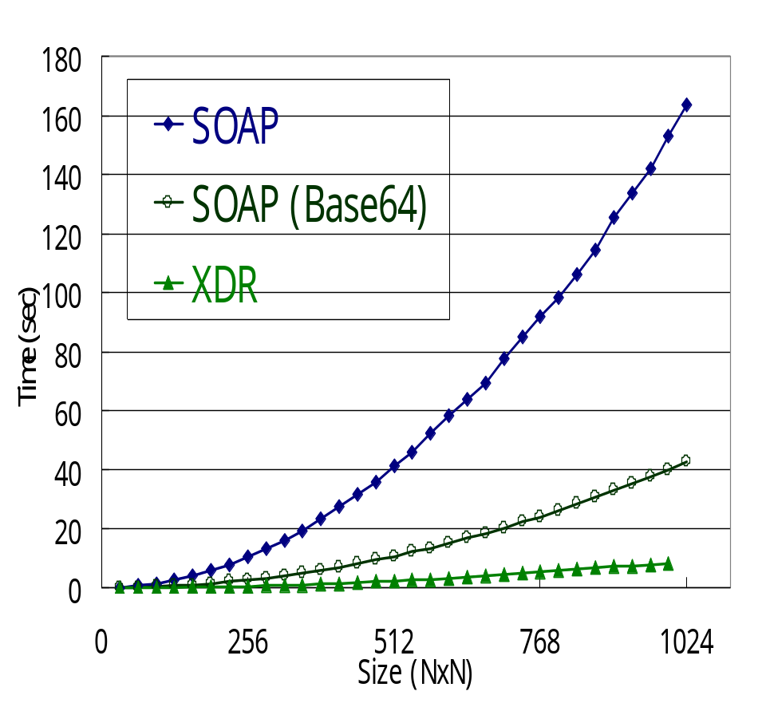
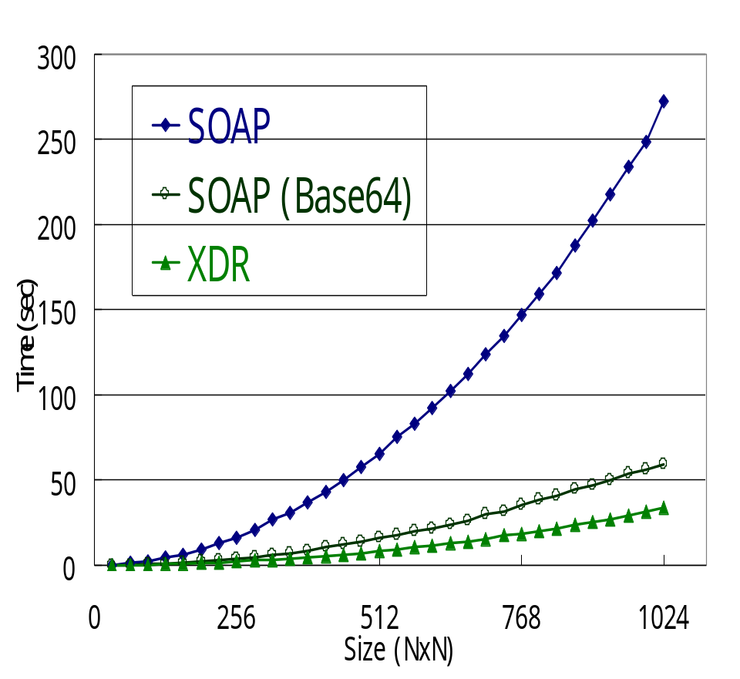
Optimization2:
Base64 Encoding (2)
75% of overhead was reduced,
both in LAN, and WAN
LAN
WAN

Slide 24
Optimization2:
Base64 Encoding (3)
Applying base64 encoding is effective
  Largely due to elimination of parsing overhead in deserialization by reduced number of XML tags
  Smaller message size also reduces wire-transfer cost

Slide 25
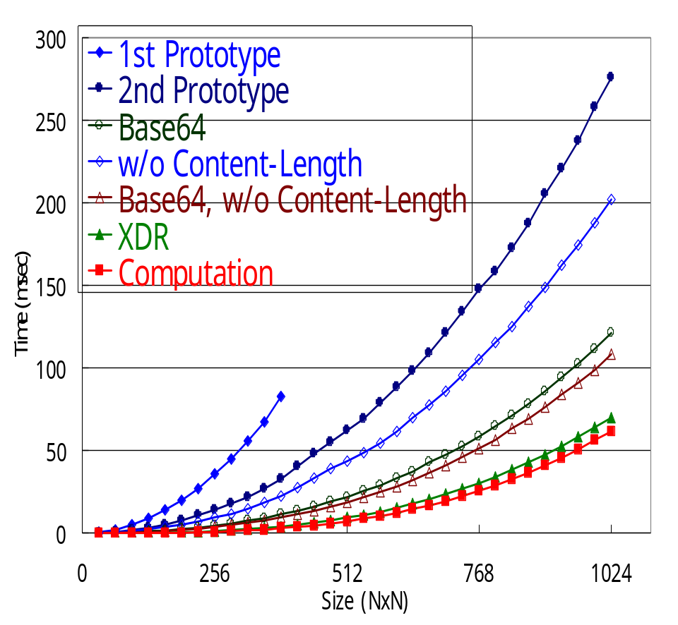
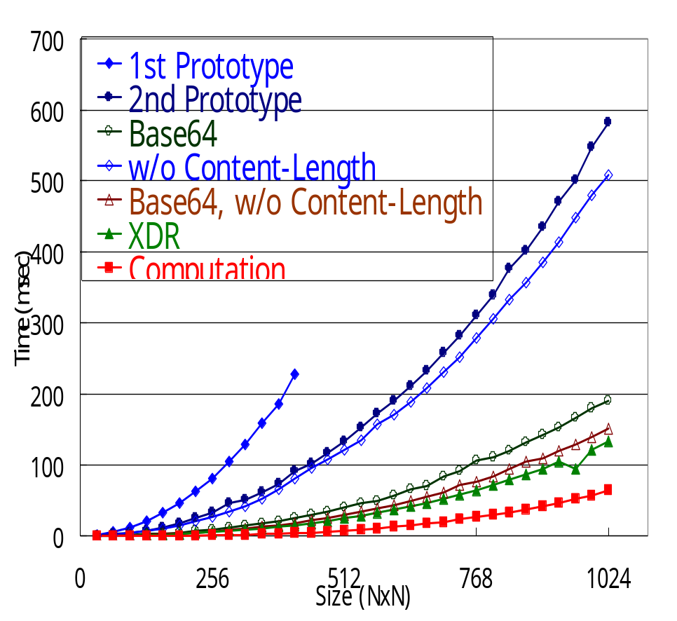
Performance Summary
Performance is significantly improved by applying optimizations
LAN
WAN

Slide 26
Summary
Investigated whether GridRPC could be implemented using Web service technologies
Significant speedup from the naive implementation
  Applying base64 encoding reduces deserialization cost
  Omitting HTTP Content-Length header field reduces overhead
➔Scientific higher level middleware can work with OGSA

Slide 27
Future work
Performance improvement
  RFC compliant way to omit HTTP Content-Length header field
  Development of an XML parser specialized for SOAP
    Run-time parser generation suitable for receiving messages using WSDL
  Implementation with C language for performance
Interoperability
  Further evaluation for interoperability
Adaptation to OGSA
  To evaluate how GridRPC works under OGSA
Computing portal using UDDI

Slide 30
SOAP/WSDL Expresibility(1)
Array size specification
  GridRPC IDLs support expression of array size using other arguments
  In order to enable pass arrays as reference
  ➔ WSDL lacks the ability to express such dependencies
  Define dmmul(mode_in int n,
  mode_in double A[n][n], mode_in double B[n][n],
  mode_out double C[n][n])
  Double A[n][n], B[n][n], C[n][n];
  Ninf_Call(“dmmul”, n, A, B, C);

Slide 31
SOAP/WSDL Expresibility(2)
Subarrays, strides of array
  GridRPC IDLs support these various type of arrays
  SOAP supports this functionality as partially transmitted arrays
  But, WSDL does not embody any specification
  A[size : lower_limit, upper_limit, stride]

Slide 32
SOAP/WSDL Expresibility(3)
Web Service based GridRPC systems use parameterOrder attribute of WSDL to denote the order of parameter
In WSDL, parameterOrder attribute is optional
➔GridRPC client can not know the order of parameters when it encounters WSDL without parameterOrder attribute
  …..
  <operation name = “dmmul”
  parameterOrder = “n A B C”>
  …..

