Slide 1
HPDC7
A Performance Evaluation Model for Effective Job Scheduling
in Global Computing Systems
  Kento Aida (Tokyo Institute of Technology)
  Atsuko Takefusa (Ochanomizu University)
  Hidemoto Nakada (Electrotechnical Laboratory)
  Satoshi Matsuoka (Tokyo Institute of Technology)
  Umpei Nagashima (National Institute of materials and Chemical Research)

Slide 2


Global Computing System
request
server
client
results
WAN
server
client
client
Computational and data servers in WAN are transparently employed to solve clients’ problems.
Proposed Global Computing Systems:
  Globus, Netsolve, Ninf, Legion, RCS, etc.

Slide 3
Job Execution in Global Computing
Scheduler
Server
(1)
(2)
Server
WAN
Client
Server
(3)
Client
(1) Scheduler collects load information.
(2) Client queries Scheduler about the suitable server.
(3) Client requests execution, transmits data to the designated server, and receives results.

Slide 4
Job Scheduling for Global Computing
Effective job scheduling scheme is required to achieve high-performance global computing!
Scheduling Systems
  AppLes, Netsolve agent, Nimrod, Ninf metaserver, Prophet, etc.
Scheduling Algorithm
  Effective algorithm has not been proposed.
  The performance of algorithm has not been evaluated sufficiently.

Slide 5
Performance Evaluation Methodology
Benchmarking on Real Systems
  practical measurement
  measurement on small scale systems
  a small number of replications
  partial solution
Performance Evaluation Model
  theoretical analysis and simulation
  effective solution to evaluate the performance of algorithm in general way

Slide 6
Performance Evaluation Model
Model for Locally Distributed System
  well studied
  embody only computational servers
Model for Global Computing System
  not established
  should embody both computational servers and networks between clients and servers
Performance evaluation model for job scheduling in global computing systems is required!

Slide 7
Requirement for the Model
Representation of Dynamic Behavior
  server behavior
    CPU performance
    congestion of jobs (→ response time)
  network behavior
    bandwidth
    congestion of data (→ comm. throughput)
Flexibility
  various topology among clients and servers

Slide 8
Proposed Performance Evaluation Model
Queueing Network
Global Computing System
  Qs computational servers
  Qns network from the client to the server
  Qnr network from the server to the client
Congestion on Servers and Networks
  other jobs
    jobs which are invoked from other processes and enter Qs
  other data
    data which are transmitted from other processes and enter Qns or Qnr

Slide 9
Example of Proposed Model
Site 1
Site 1’
Qns1
Server A
Qnr1
Client A
Client A’
λns
μns
Qs1
λnr
μnr
λs
μs
Qns2
Qnr2
Site 2’
Site 2
Server B
Client B
Client B’
Qns3
Qnr3
Qs2
Qns4
Server C
Qnr4
Client C
Client C’
Qs3

Slide 10
Clients
Job (Request) Invoked by a Client
  data transmitted to the server (Dsend)
  computation of job
  data transmitted from the server (Drecv)
Procedure to Invoke a Job
  decompose Dsend into logical packets
  transmit packets to Qns
Procedure to Receive Execution Results
  receive Drecv from Qnr

Slide 11
Parameter for Clients
Packet Transmission Rate
λpacket = Tnet / Wpacket
Tnet bandwidth of network
Wpacket logical packet size

Slide 12
Queue as Network (Qns)
other data
Qns
client
Qs
finite buffer single server queue
FCFS
service rate = Tnet / Wpacket
  A packet transmitted from the client are queued.
  A packet is retransmitted when buffer is full.
  → communication throughput
  A packet transmitted from the client leaves for Qs.
  Arrival rate of other data indicates congestion of network.

Slide 13
Parameter for Qns
Arrival Rate of Other Data
  Arrival is currently assumed to be Poisson.
λns_others = (Tnet / Tact -1) x λpacket
Tact actual throughput of network
Buffer Size of Queue
N = Tlatency x Tnet / Wpacket
Tlatency actual latency of network

Slide 14
Example
Simulated Condition
  bandwidth Tnet = 1.0 [MB/s]
  actual throughput Tact = 0.1 [MB/s]
  logical packet size Wpacket = 0.01 [MB]
Arrival Rate of Other Data
  λpacket = Tnet / Wpacket = 1.0 / 0.01 = 100
  λns_others = (Tnet / Tact - 1) x λpacket
  = (1.0 / 0.1 - 1) x 100
  = 900

Slide 15
Queues as Server (Qs)
other jobs
Qs
Qnr
Qns
single server queue
FCFS or others
service rate = Tser / Wc
(Tser : server performance, Wc : ave. comput. size)
  A job is queued after all associated data are transmitted from Qns.
  Queued job wait for its turn. → response time
  Data of results are decomposed into logical packets and the packet is transmitted to Qnr.
  Arrival rate of an other jobs indicates congestion on server.

Slide 16
Parameter for Qs
Arrival Rate of Other Jobs
  Arrival is currently assumed to be Poisson.
λs_others = Tser / Ws_others x U
Tser performance of server
Ws_others ave. computation size of other job
U actual utilization on server

Slide 17
Example
Simulated Condition
  performance of server Tser = 100 [MFlops]
  actual utilization U = 0.1
  ave. computation size Ws_others = 0.1 [MFlops]
Arrival Rate of Other Jobs
  λs_others = Tser / Ws_others x U
  = 100 / 0.1 x 0.1
  = 100

Slide 18
Queue as Network (Qnr)
other data
Qnr
client
Qs
finite buffer single server queue
FCFS
service rate = Tnet / Wpacket
  A packet transmitted from the Qs are queued.
  A packet is retransmitted when buffer is full.
  → communication throughput
  A packet leaves for the client.
  Arrival rate of other data indicates congestion of network.

Slide 19
Verification of Proposed Model
Comparison
  results in simulation on proposed model
  results in experiments on actual global computing system (Ninf system)
Clients
U-Tokyo [Ultra1]
(0.35MB/s, 20ms)
Server
Ocha-U [SS10,2PEx8]
(0.16MB/s, 32ms)
Internet
ETL
[J90,4PE]
NITech [Ultra2]
(0.15MB/s, 41ms)
TITech [Ultra1]
(0.036MB/s, 18ms)

Slide 20
Ninf System
Other System
Ninf DB
Server
Meta
Server
Internet
Meta
Server
Meta
Server
Ninf
Computational
Server
Ninf Client Library
:
Ninf_call(“linpack”, ..);
:
Ninf RPC
Program

Slide 21
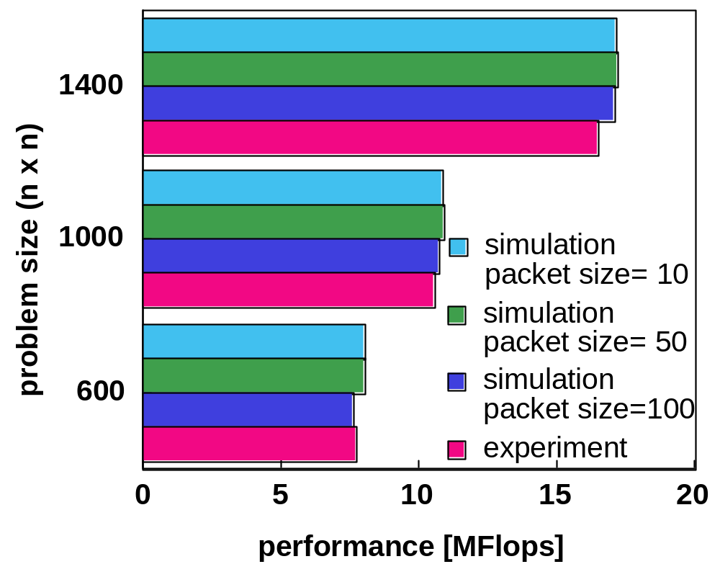
Performance of Client’s Jobs
client : WS in Ochanomizu Univ., server : J90 in ETL
clients’ Jobs
  Linpack (Comput. = O(2/3n³ + 2n²), comm.= 8n² + 20n + O(1))
Performance of clients’ jobs in the simulation closely match experimental results.
Effect of the different packet size is almost negligible.

Slide 22
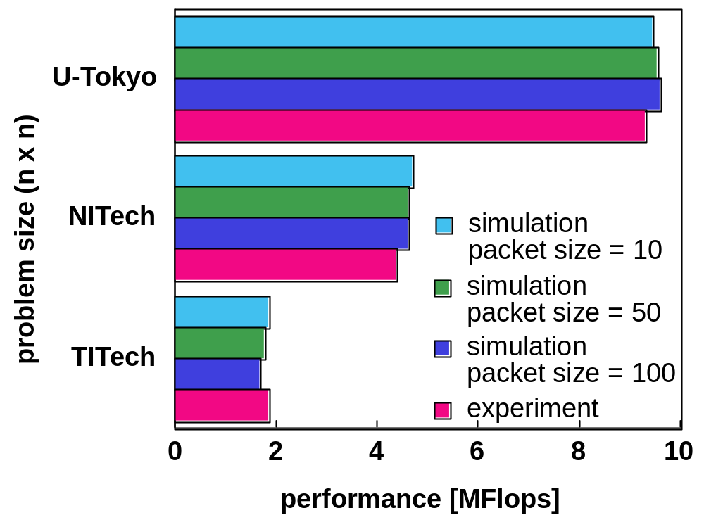
Performance of Client’s Jobs
clients : WS in U-Tokyo, NIT and TIT, server : J90 in ETL
clients’ Jobs
  Linpack (Comput. = O(2/3n³ + 2n²), comm.= 8n² + 20n + O(1))
Performance of jobs invoked by multiclients in the simulation closely match experimental results.
Effect of the different packet size is almost negligible.

Slide 23
Evaluation of Job Scheduling Schemes
Evaluation
  Evaluation of job scheduling schemes on imaginary environment in the simulation on proposed model
Job Scheduling Schemes
  RR round robin fashion
  LOAD server load
  LOTH server load + network load

Slide 24
Imaginary Environment
400Mops
utilization = 10[%]
100Mops
utilization = 10[%]
Server A
Server B
200KB/s
50KB/s
Client 1
Client 2
Client 3
Client 4

Slide 25
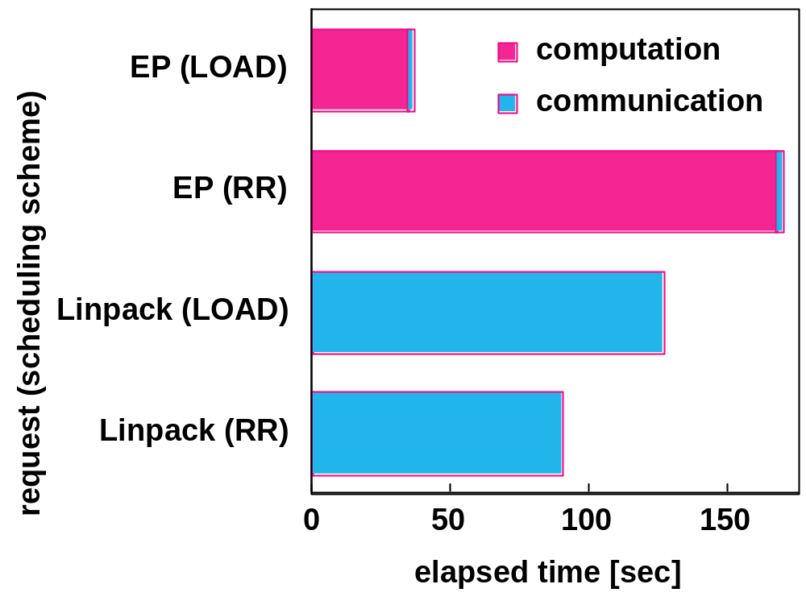
Job Scheduling Performance
client’s Jobs
  Linpack (Comput. = O(2/3n³ + 2n²), comm.= 8n² + 20n + O(1))
  EP (comput. = number of random number, comm. = O(1))
LOAD is effective for computation intensive jobs (EP), but is not effective for communication intensive jobs (Linpack).

Slide 26
Imaginary Environment
400Mops
utilization = 10[%]
40Mops
utilization = 10[%]
Server A
Server B
1.08MB/s
0.20MB/s
Client 1
Client 2
Client 3
Client 4

Slide 27
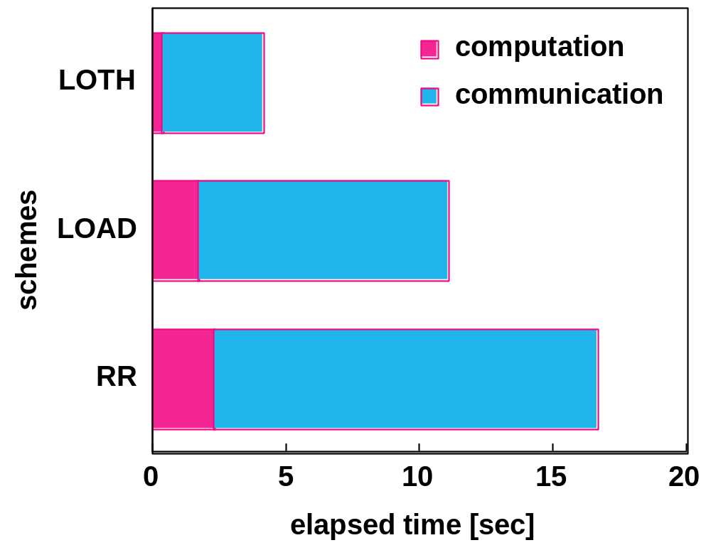
Job Scheduling Performance
client’s jobs
  Linpack (Comput. = O(2/3n³ + 2n²), comm.= 8n² + 20n + O(1))
LOAD caused network congestion and degraded performance.
LOTH showed best performance.
Both server load and network load should be employed.

Slide 28
Conclusions
Proposal
  performance evaluation model for job scheduling in global computing systems
Verification and Evaluation of the Model
  The proposed model could effectively simulate performance of clients’ requests in simple setup of an actual global computing system, Ninf system.
  Dynamic information of both server and network should be employed for job scheduling.
Future Work
  better modeling of changeability of network congestion

