Slide 1
Ninf Portal
An Automatic Generation Tool for Grid Portals
Toyotaro Suzumura *, Hidemoto Nakada † *
Masayuki Saito *, Satoshi Matsuoka *
Yoshio Tanaka †, Satoshi Sekiguchi †
* Tokyo Institute of Technology
† National Institute of Advanced Industrial Science

Slide 2
Outline
Grid Portal
Grid Portal Construction Toolkit
Ninf Portal Overview
Architecture
Dynamic Application Development Framework
Current Status and Conclusions

Slide 3
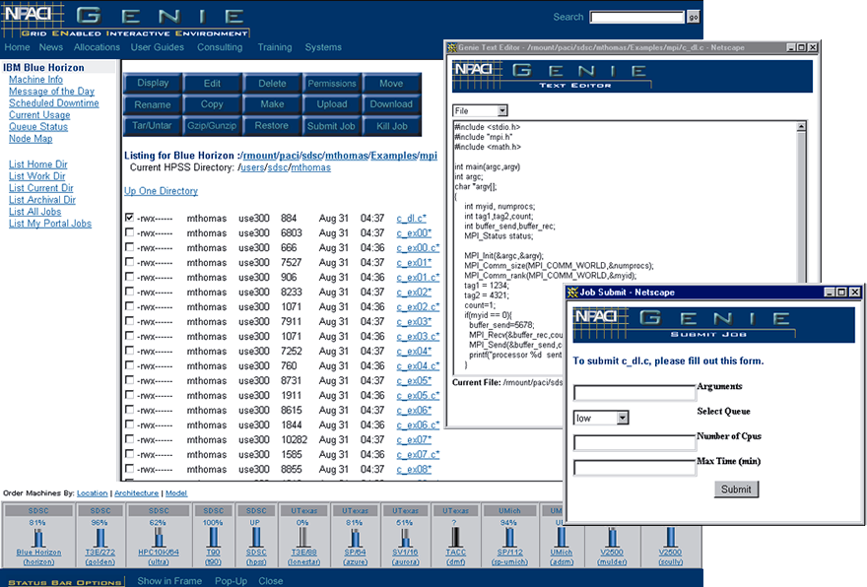
Grid Portal
Grid Portal is defined as a web based application server enhanced with necessary software to communicate with Grid services and resources
Becoming a popular interface to Grid resources (e.g. NPACI HotPage)
Uses standard web browser to create a nice GUI interface
HotPage

Slide 4
Supported Services
Single Sign-on
  access Grid resources after they once authenticate to the portal
  access the Grid at a location where their Grid credentials would not normally be available to them
Uploading and Downloading
  upload input data from a web browser
  download a result data
Information Service
  what resources and services are available on the Grid
Job Management
  execute, monitor, stop/cancel

Slide 5
Grid Portal Construction Toolkit
Facilitates the development of Grid portals, providing a basic set of services
Existing efforts
  GridPort （NPACI)
  Grid Portal Development Kit (NLANR)
  XCAT Science Portal （Indiana Univ.)

Slide 6
Problem
We still need to implement the following component
  HTML files as a user interface
  CGI programs for analyzing HTML forms
  Grid applications as backend

Slide 7
Ninf Portal
Grid Portal Construction Toolkit
Allows portal developers to build both the frontend and the backend in a straightforward way by
  automatically generating the portal frontend constituting of JSP and Servlets from an XML document
  providing Ninf-G system (RPC-style Grid system) to build Grid applications as the backend

Slide 8
Architecture
Grid Application
Web Frontend
IDL
FILE
Ninf-G
Server
JSP/Servlet
Ninf-G
Server
Web
browser
Ninf-G
Client
Ninf-G
Server
Web
Server
User
Servers

Slide 9
Web Frontend
A server that processes most requests by users
  Shows an entry page for the portal
  Assembles a list of arguments
  Launches a backend Grid application
  Handles input from users and displays results from the backend application
comprised of JSP and Servlets

Slide 10
Frontend Architecture
JSP
User Interface
HTML
Web
Browser
1．Access
MetaData
Java Code
3．Show UI
2．Store Metadata
Session
4．Submit
Data
5．Retrieve Metadata
Grid
Application
Data Handling
Servlet
launch
User
6．Show Result
Web Frontend

Slide 11
JSP and Session
Displays a user interface
Stores “metadata” into the session (i.e. cookie ) with Java codes
“Metadata” includes a variety of information on a Grid application such as
  General Information
    Name, Manufacturer, … , etc.
  Executable path
  Argument Information
    Data Type (Numeric, String , InputFile/OutputFile)
  Argument Format for launching a Grid application
  etc.

Slide 12
Frontend Architecture
JSP
User Interface
HTML
Web
Browser
1．Access
MetaData
Java Code
3．Show UI
2．Store Metadata
Session
4．Submit
Data
5．Retrieve Metadata
Grid
Application
Data Handling
Servlet
launch
User
6．Show Result
Web Frontend

Slide 13
Data Handling Servlet
A general-purpose Java servlet handling the following services
  Receiving data from a web browser
  Extracts metadata from the session, with which submitted data would be parsed
  launch a Grid application
  show results

Slide 14
Web Frontend Generator
Grid Application
IDL
JSP
User Interface
HTML
Web
Browser
1．Access
MetaData
Java Code
Web Frontend
Generator
3．Show UI
2．Store Metadata
Session
4．Submit
Data
5．Retrieve Metadata
Grid
Application
Data Handling
Servlet
launch
User
6．Show Result
Web Frontend

Slide 15
Grid Application IDL
Interface Description Language defined by XML which allows you to describe “Metadata”
<!ELEMENT Application (Information*, ArgumentFormat, Argument*)>
<!ELEMENT Information (name?,location?, manufacturer?,description?)>
<!ELEMENT name (#PCDATA)>
<!ELEMENT location (#PCDATA)>
<!ELEMENT manufacturer (#PCDATA)>
<!ELEMENT description (#PCDATA)>
<!ELEMENT ArgumentFormat (#PCDATA)>
<!ELEMENT Argument (type,info, method?,comment?)>
<!ELEMENT type (#PCDATA)>
<!ELEMENT info (#PCDATA)>
<!ELEMENT method (#PCDATA)>
<!ELEMENT description (#PCDATA)>

Slide 16
Sample Application
BMI (Bilinear Matrix Inequality) Eigenvalue Problem
  Minimizes the greatest eigenvalue of a bi-linear matrix function
  General framework for analysis and synthesis of control systems in a variety of industrial applications (e.g. helicopter, vehicle, robot arms)
  Grand challenge in the operations research

Slide 17
IDL Sample
<?xml version="1.0" encoding="shift_jis"?>
<!DOCTYPE application SYSTEM
"JSPGenerator.dtd">
<Application>
<!-- Application Information -->
<Information>
<name> BMI </name>
<location>
/home/suzumura/work/BMIClientC/BMISolver
</location>
<manufacturer>
Kento Aida
</manufacturer>
<appdescription>
BMI Application Portal
</appdescription>
</Information>
<ArgumentFormat>
-t $type $uploadfile
</ArgumentFormat>
<!-- ------- Arguments Information ------ -->
<!-- ------- first Argument ------- -->
<Argument>
<argname> uploadfile </argname>
<type>inputfile</type>
<info> InputFile </info>
<method> upload </method>
<description>
inputfile of data
</description>
</Argument>
<!-- ------- second Argument ------- -->
<Argument>
<argname> type </argname>
<type> string </type>
<info> type </info>
<description>
type of program
</description>
</Argument>
</Application>

Slide 18
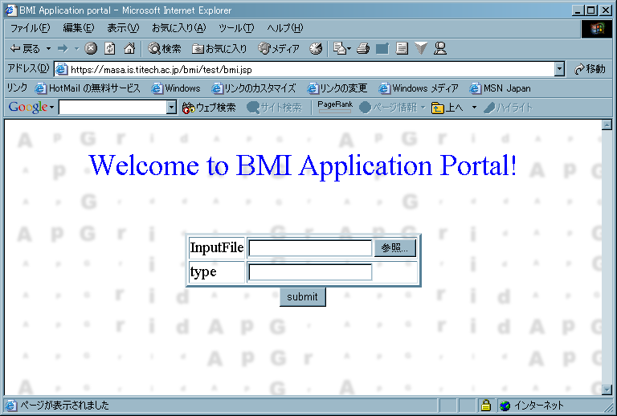
Generated JSP
<br> Welcome to BMI Application Portal! <br>
<form action="/bmi/servlet/DataHandlingServletl"
name="MyForm" method=post
ENCTYPE="multipart/form-data"
onSubmit="return checkData(this)">
<table border = 3 align = center> <tr>
<td>InputFile</td>
<td><input type = file name = arg0></td>
</tr> <tr>
<td>type</td>
<td><input type = text name = arg1></td>
</tr> </table>
<center>
<input type = submit align = center
value = "submit">
</center>
</form>
<%
int argnumber = 2;
String argformat = "-t $type $uploadfile";
String executablepath =
"/home/suzumura/work/BMIClientC/BMISolver";
String args[] = {"inputfile","string"};
String namerow[] = {"uploadfile","type"};
String filemethod[] = {"upload","null"};
MetaData metadata=
new Metadata(
argnumber, argformat, executablepath,
args, namerow, filemethod);
session.setAttribute(“metadata",metadata);
%>
Java Code
HTML Code

Slide 19
Building Grid applications via Ninf-G
Ninf/Ninf-G is an ongoing research projects by AIST/Titech
Offers network-based numerical library functionality via the use of RPC technology
Needs only a small modification when “gridifying” existing applications
Provides an asynchronous invocation method to exploit network-wide parallelism.
double A[n][n],B[n][n],C[n][n]; /* Data Declaration.*/
dmmul(n,A,B,C); /* Call local function*/
Ninf_call(“dmmul”,n,A,B,C); /* Call server side routine*/

Slide 20
Ninf-G IDL
Interface description Language designated to numerical applications
Interface Information
  library function’s name, and its alias (Define)
  arguments’ access mode, data type (mode_in, out, inout, ...)
  required library for the routine (Required)
  computation order (CalcOrder)
  source language (Calls)
complied by the Ninf-G interface generator to generate a stub program
Define dmmul(mode_in int n,
mode_in double A[n][n], mode_in double B[n][n],
mode_out double C[n][n])
“ description “
Required “libXXX.o”
CalcOrder n^3
Calls “C” dmmul(n,A,B,C);

Slide 21
Chunk of the Client Code
for(i = 0; i < nServer; i++){
sprintf(ninfURL[i],
"ninf://%s/BMI/BBRootCalc",
serverList[0]);
}
..... .....
for(i = 0; i < nServer; i++){
..... .....
pid[i] =
Ninf_call_async(
ninfURL[i],
xDIM, yDIM, nBlock, blockStruct, Sparse,
NonzeroElement, nData, Data, nodeData[i],
zValue, nBranch, nDepth, epsilon, nLeaf,
&nRemNodes[i], resultData[i], &zUpdate[i],
zValueData[i]);
..... .....
}
Setup a server name
call asynchronously

Slide 22
Authentication – MyProxy[NLANR]
Online credential repository
Manages a set of credentials and allows other hosts to retrieve them using username and passphrase
Great considerations of Security
    Secure Communication by GSI
    Not exposing any private keys
MyProxy and the Globus GSI delegation mechanism realizes “Single Sing-on” for allowing users to access multiple resources on the Grid, after they once authenticate to the portal

Slide 23
Work in progress
Users can just use applications prepared in advance by portal administrators
Difficult to prepare all kinds of applications
Dynamic Application Development Framework

Slide 24
Dynamic Application Development Framework
Allows you to develop your applications and their user interface dynamically on Grid portals
Enlarges a variety of Grid applications available from Grid portals.

Slide 25
Architecture
No applications I want. Then, let’s make it by myself !!
Repository
Ninf-G
Server
Application
Information
Application
Code
Application
Information
Application
Code
Upload
Ninf-G
Server
translate
Grid Application IDL
Web Frontend
Generator
execute
Ninf-G
Server
JSP
Web Browser
Grid Application
Data Handling
Servlet
Web Frontend

Slide 26
Application Code
Written by Ninf-G Jython API
  Portable
  Need not be compiled
  Use java security model
Simple and relatively short
  Just a glue code to make a call for Ninf-G remote libraries
  Complicated computation is handled by Ninf-G servers

Slide 27
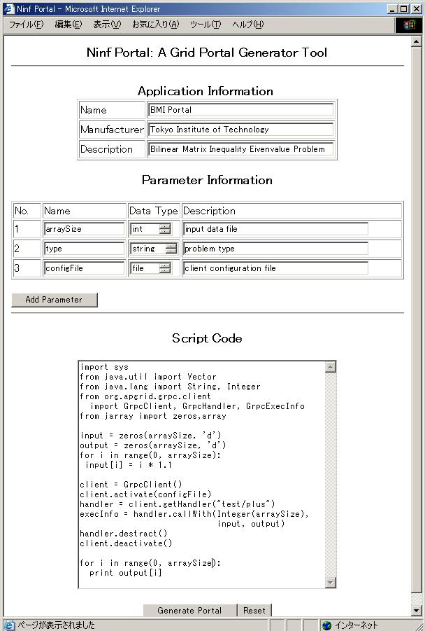
Screenshot
Application Code
Application Information
// Import libraries
import sys
from java.util import Vector
from java.lang import String, Integer
from org.apgrid.grpc.client import GrpcClient, GrpcHandler, GrpcExecInfo
from jarray import zeros.array
// Initializes data
arraySize=5
input = zeros(arraySize, ‘d’)
output = zeros(arraySize, ‘d’)
for I in range(0, arraySize)
input[I] = i x 1.1
// Initializes a client
client = GrpcClient()
client.activate()
// Initialize a handler
handler = client.getHandler(“test/pingpong”)
execInfo = handler.callWith(Integer(N), input, output)
// finalize
handler.destruct()
client.deactivate()

Slide 28
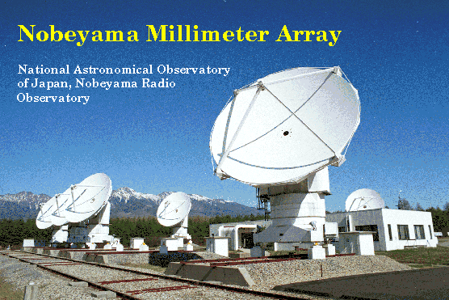
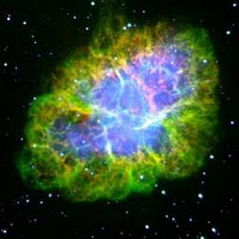

Current Status
Currently clearing up a source code for a distribution
Dynamic Application Development Framework will be demonstrated at SC2002 (Nov, 2002)
Collaboration with Japanese Virtual Observatory Project has just started

Slide 29
Conclusions
Proposed Ninf Portal which helps portal developers to build their portal in an intuitive and straightforward way
Alleviates the user’s burden by
  automatically generating JSP pages as portal frontend from an XML document
  utilizing Ninf-G to build Grid applications as backend
Working on Dynamic Application Development Framework

Slide 30
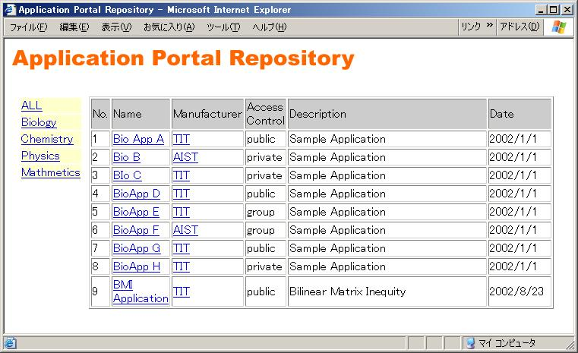
Screenshot (contd.)

