Slide 1
Implementation of Ninf using Globus Toolkit -- Ninf-G
Hidemoto Nakada
Yoshio Tanaka
Satoshi Sekiguchi

Slide 2
Outline
Grid RPC overview
Ninf original implementation
Ninf-G implementation
How to use Ninf-G
Preliminary Evaluation
Todo

Slide 3
Ninf - a Grid RPC system
Easy to use Grid system for Scientific Computing
  Very simple RPC API
  Existing libs and apps into GridRPC components
    Legacy library written in Fortran / C can be published as Grid Component
    File interfaced application also can be published
double A[n][n],B[n][n],C[n][n]; /* Data Decl.*/
dmmul(n,A,B,C); /* Call local function*/
Ninf_call(“dmmul”,n,A,B,C); /* Call server side routine*/
Notes:
Grid RPC is a Easy to use grid system fo rscientific computing
It has very simple RPC API
This code segment demonstrate the simplisity
this line is calling matrix multiply as a local function
To make it RPC, only you have to do is just rewrite this line into this.
It so easy.
Now, The arguments automatically shipped to the server and the caliculation is done on the server side
, results come back and are automatically stored in the arguments
For the RPC component, existing libs and applications can be used
It is also very easy to make libs and apps into RPC component.

Slide 4
Ninf - a Grid RPC System
Easy to publish existing library
  Just write an IDL file and compile it
Interface Information
  library function’s name, and its alias (Define)
  arguments’ access mode, data type (mode_in, out, inout, ...)
  required library for the routine (Required)
  computation order (CalcOrder)
  source language (Calls)
Define dmmul(mode_in int n,
mode_in double A[n][n], mode_in double B[n][n],
mode_out double C[n][n])
“ description “
Required “libXXX.o”
CalcOrder n^3
Calls “C” dmmul(n,A,B,C);
Notes:
To publish ext libs , only you have to do is write an information description file for the library
As you can see, it is very strait forward. Its just like C prottotye except for the I/O mode

Slide 5
Brief History of Ninf
The first design paper (Jun.’94)
A proto implementation (Sep.’94) w/PVM
Paper POOMA’95 at Santa Fe (Mar.’95)
ETL Cray J90 installed as Ninf server Sep.’95
The Metaserver introduced Feb.’96
The v.1.0 released Jun.’96
Ninf/Netsolve Collaboration, Fall ’97
Extensive Tools Development Early ’98~, v.1.2
Ninf v.2.0 Development ’00~
GridRPC and DataFarm 2000~

Slide 6
Ninf-G - an implementation on top of globus toolkit
What we expect with globus
  Security Inf. (including CA management)
  Large number of installation base
What we will provide
  Easy to use Grid Tool
    Even simpler than MPI-G
    For non-computer scientist, using globus is to complicated
  Building blocks for programming Grid application

Slide 7
Ninf implementation overview
Client API
  Provides users easy to use API
Remote Library Executable
  Execute numerical operation
Ninf Server
  Provides library interface info.
  Invokes remote library executable
IDL compiler
  Compiles Interface description
  Generates 'stub main' for remote library executable
  Helps to link the executable
Ninf Register driver
  Registers remote library executable into the Server

Slide 8
Ninf architecture and protocol
Server side
Client side
Server side setup
  Make Remote Library Executable
  Register it to the Ninf Server
Use remote library
  Retrieve interface information
  Invoke Remote Library Executable
  It Calls back to the client
IDL file
Numerical
Library
Client
IDL Compiler
Connect back
Interface
Reply
Invoke
Executable
Generate
Interface
Request
fork
Remote Library
Executable
Ninf Server
Register

Slide 9
Ninf-G - basic design
Replace Ninf Server functions with MDS and GRAM
  Retrieves interface information using MDS (GRIS)
    Automatic generation of LDIF file
  Invokes Remote library Executable using GRAM

Slide 10
Ninf - Original
Client side
Server side
IDL file
Numerical
Library
Client
IDL Compiler
Connect back
Interface
Reply
Invoke
Executable
Generate
Interface
Request
fork
Remote Library
Executable
Ninf Server
Register

Slide 11
Ninf-G
Client side
Server side
IDL file
Numerical
Library
Client
IDL Compiler
Connect back
Interface
Request
Interface
Reply
Invoke
Executable
Generate
fork
Remote Library
Executable
GRAM
GRIS
Interface Information
LDIF File
retrieve

Slide 12
Registration to GRIS
Generate LDIF file
  Interface information is encoded in Base64
Put the file at ${globus-deploy-dir}/etc/gridrpc
dn: rpcFuncname=perf/pingpong, sw=GridRPC hn=ninf.aist.go.jp, dc=gci, dc=jp, o=Grid
objectclass: GridRPCEntry
hn: ninf.aist.go.jp
rpcFuncname: perf/pingpong
module: perf
entry: pingpong
path: /home/ninf/tests/pingpong/_stub_pingpong
stub:: PGZ1bmN0aW9uICB2ZXJzaW9uPSIyMjEuMDAwMDAwIiA+PGZ1bmN0aW9uX25hbWUgbW9kdWxlPSJwZXJmIiBlbnRyeT0icGluZ3BvbmciIC8+IDxhcmcgZGF0YV90eXBlPSJpbnQiIG1vZGVf
…

Slide 13
Ninf-G Installation Steps
Install Globus toolkit
Untar, configure, make Ninf-G package
Make a directory
  ${globus-deploy-dir}/etc/gridrpc
  Change the mode of the directory
Edit the GRIS setup file
  Add following line
0 cat ${localstatedir}/gridrpc/*.ldif

Slide 14
How to use Ninf-G
Server side
  Write an IDL file for the Remote library
  Compile it wit IDL Compiler
  Run make on generated makefile
  Register the executable by make -f XXX.mak install
Client side
  Write a client program using Ninf API
  Compile and link with the supplied compile driver
  grid-proxy-init to generate proxy certificate
  Run the program

Slide 15
Demo

Slide 16
Preliminary Evaluation
Evaluate cost
  GRIS lookup
  GRAM invocation
Target program
  PingPong - no computation
Environment
  LAN: intra AIST: 100 base/T
  WAN: inter Titech - AIST:
    Fore: 200KB/sec
    Back: 600KB/sec

Slide 17
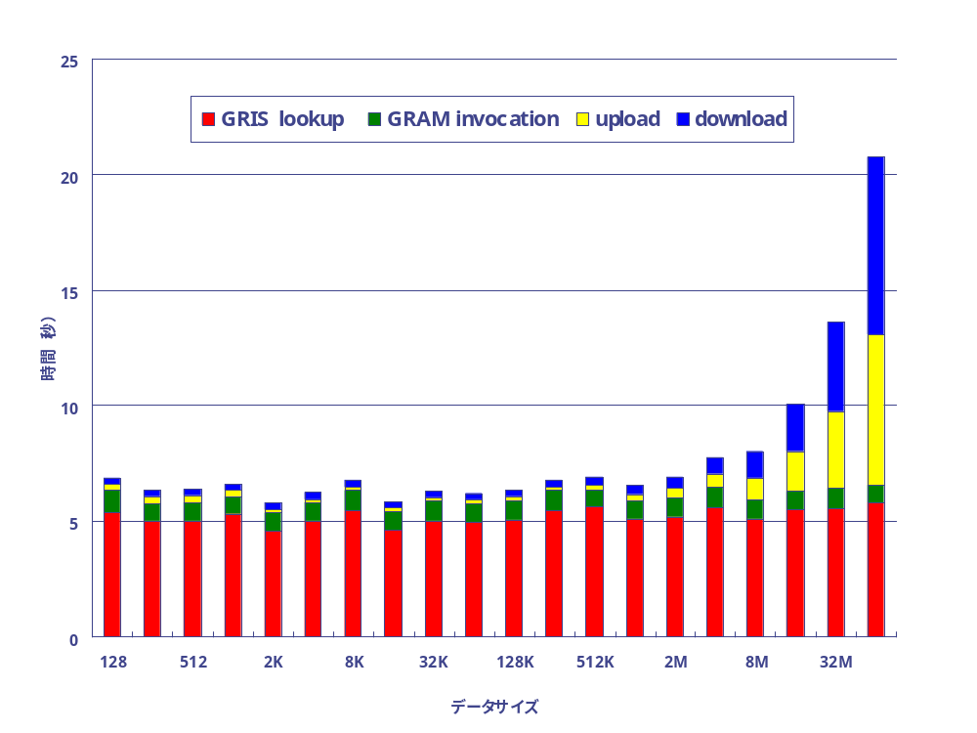
Result (LAN)
GRIS Lookup costs around 5 seconds
GRAM invocation costs around 1 second

Slide 18
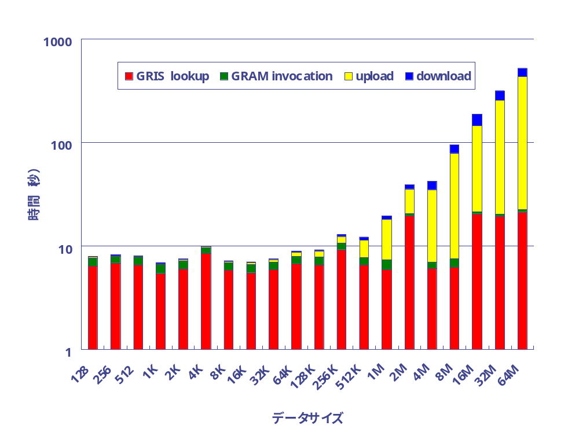
Result (WAN)
GRIS Lookup costs around 5-20 seconds
GRAM invocation costs around 4-6 second

Slide 19
Discussion
Lookup and invocation cost related with the network latency
GRIS lookup cost includes database update
  We need immediate update
  What we should do?
  Can we enforce GRIS update or 'push' information?
Lookup results are cached in client side
  Subsequent invocations for the same library do not require GRIS lookup
0 cat ${localstatedir}/gridrpc/*.ldif

Slide 20
Todo
Communication using Globus I/O
  Semantics of Globus I/O select() makes difficult to port it strait-forward
Fault management using Heart Beat Monitor
Java Client using CoG ?
  Will be done by 4Q, 2001 …

Slide 21
Summary
Ninf-G is easy to use Grid system component
Implemented using GRIS and GRAM
Will be released 2001/4Q
We'd love to contribute Ninf-G to the globus package

Slide 22
Protocol Porting
1. Interface Request
2. Interface Reply
Client
Server
3. Invoke Executable
4. Connect back
Executable
Ninf
Ninf-G
1. Interface Request
GRIS/GIIS
2. Interface Reply
Client
GRAM
Gatekeeper
3. Invoke Executable
4. Connect back
Executable

Slide 23
Ninf RPC Protocol
Two-phase, runtime exchange of interface info
  No client stub routines (cf. SunRPC)
  No modification of client program when server’s libs updated
  Client library stays relatively static
Client Program
Ninf library program
Client Library
Interface Info
Stub Program
Interface Info
Ninf Server
Interface Info
Interface Request
Interface Info.
Argument
Result

Slide 24
Ninf - GridRPC System(1)
A simple RPC-based programming model for the Grid
  Servers serve computation resources
    Network-enabled Libraries (and Apps)
  Clients makes calls with data to be computed
  Task Parallelism (synch. and asynch. calls)
Key property: EASE OF USE
Data
Server
Client
Result
Notes:
Network enabled server may be the simplest form of global computing
A Server serves computation, namely computation resource and computation program
A Client ask for a server to do the computation, and send data for computation.
Server will do some computation and returns the result.
There are already several implementations of network enabled server. Such as our ninf, netsolve from utk, RCS from ETH, Switzerland .

Slide 25
GridRPC (2)
Some characteristics
  Very simple RPC API
  Existing libs and apps into GridRPC components
  IDL embodying call info, minimal client-side management
double A[n][n],B[n][n],C[n][n]; /* Data Decl.*/
dmmul(n,A,B,C); /* Call local function*/
Ninf_call(“dmmul”,n,A,B,C); /* Call server side routine*/
Notes:
Here is the typical API of network enabled server.
The only thing client user have to do is just replace this function invocation by this one.
Here, I wrote that NES_call

Slide 26
GridRPC (3)
Programming Model middleware between “the Grid” and Application
  Bases for more complex form of global computing
Success stories of large computational problems happening
  Parameter sweeping
    Monte Carlo Simulation – MCell (Netsolve)
  Coarse-Grained Iterative Algorithms
    Fork-Join per iteration
    SCRM-SDPA App (Ninf)
  Network-enabled “generic”
  libraries
    SCLAPACK for Netsolve/Ninf
Application
Network Enabled Server
Lower-level Grid Systems
Notes:
Network enabled servesr may seem to be too primitive. But, it can serve as bases for more complex form of global computing such as parameter sweeping or mote carlo simulation
Another important role of the NES is the middleware between the grid and application.
Recently, some software for grid infrastructure are proposed, such as Legion and Globus.
However, sometimes to implement application directly on top of such grid infrastructure is too hard for application people.
NES can serve more friendly API for application people.

Slide 27
Examples of NES systems
Netsolve (UTK)
Ninf (ETL/TITECH)
Nimrod, Nimrod/G
Punch
RCS
CORBA-based sys. (several)
…etc.
Intermediary position between Grid Portals and Grid Components
(ease-of-use, automated programming interface on top of components)

Slide 28
Ninf - a Grid RPC system
Can be a building component of complex Grid application
Examples
  Ninf (AIST/ TITECH)
  NetSolve (U. Tennessee, UCSD)
Application
Grid RPC
Lower-level Grid Systems

Slide 29
Ninf: Features At-a-Glance
Ease-of-use, client-server, Numerical-oriented RPC system
User’s view: ordinary software library
  Asymmetric client vs. server
Transparent server discovery
Problem solved on an arbitrary network node running the Ninf server
Dynamic allocation of resources with metaserver
Data Access: NinfDB, WebAccess
Client APIs: Fortran, C/C++, Java, COM etc.

Slide 30
Basic Ninf Client API
Ninf_call
Ninf_call(FUNC_NAME, ....);
FUNC_NAME = NAME | ninf://HOST:PORT/ENTRY_NAME
API for C, C++, Fortran, Java, Lisp, COM, Mathematica, ...
No client stub generation (c.f., CORBA)
double A[n][n],B[n][n],C[n][n]; /* Data Decl.*/
dmmul(n,A,B,C); /* Call local function*/
Ninf_call(“dmmul”,n,A,B,C); /* Call Ninf Func */
“Ninfy” via IDL descriptions

