Slide 1
JiPANG: A Jini-based Computing Portal System
Toyotaro Suzumura*
Satoshi Matsuoka*
Hidemoto Nakada**
* Tokyo Institute of Technology
** Tokyo Institute of Technology / AIST
Notes:
Hello, My name is Toyotaro Suzumura, I am from Tokyo Institute of Technology in Japan.
I am here to present an overview of JiPANG, which is a Jini-based computing portal system.
---
overview

Slide 2
Overview
Computing Portals
Jini Technology
JiPANG Overview
JiPANG Architecture
JiPANG Toolkit
Example Grid Services
Future Work
Notes:
Let me give you a brief overview of what I’ll be talking about today.
First, I’ll define a computing portal then give you an overview of the Jini technology
which is the key building block in our system, JiPANG.
Second, I will cover the JiPANG system, the JiPANG architecture, and the JiPANG toolkit.
Next I will show you some examples of the Grid services that we have built with the JiPANG toolkit,
and finally explore what the future might hold for JiPANG.
---
computing portal

Slide 3
Computing Portals
Allows you to access multiple software infrastructure on the Grid with
Uniformity
ease-of-use and intuition
Transparency
Sharing Information
Entrance for WWW
WWW
Portal Site
Grids
Computing Portal
Sharing Information &
Computing Resources
Entrance for Grids
Notes:
First of all, I’d like to define “computing portals” and the requirements to be fulfilled.
As you know, the web is a framework for sharing computed and instrumented information over the Internet.
Portal sites give you the ability to enter the Web.
The Grid is an advanced infrastructure designed to enable the coordinated use of distributed high-end resources for scientific problem solving.
In considering the relationship between the web and the portal site, “computing portals” should
fulfill the following requirements in order to allow the users to access a complex set of Grid services.
The first thing is uniformity. They need to allow you to access multiple services on the Grid.
The second thing is ease-of-use. they need to provide a easy-of-use and intuitive interface to the user.
The third thing is transparency. Computing Portals need to cope with the dynamic features of the Grid
and need to hide the complexity.
Let’s see what some of the existing computing portals look like. (hit the button)
---
Framework
Instrumented
Coordinated – co-ordinated
Distributed – ri に強調

Slide 4
Existing Efforts (1/2)
CoG (ANL), GridPort(SDSC),
GPDK(NASA), etc.
Only allow users to access specific Grid systems or resources
Client
CoG/GridPort
Grids
Ninf
Legion
NetSolve
Globus
Notes:
Currently there are ongoing computing portal projects by CoG, GridPort, GPDK, just to name a few.
These existing efforts provides a very easy-to-use and intuitive interface to the users.
However, they only allow users to access specific Grid systems or resources. In other words,
they lack uniformity.
For example, if you use the CoG system, you can access one Grid system which is Globus, but not
all the others that are available such as Ninf, NetSolve, or Legion.

Slide 5
Existing Efforts (2/2)
Dependent on the portal system to be continuously updated along with each upgrade of the Grid system.
Utilizes HTML/XML, CGI, JavaScript, Java, etc.
  These software technologies are enough ?
  Would be a bottleneck for coping with the dynamicity of the Grid.
Notes:
Also, existing efforts are dependent on the portal system to be continuously updated along with each upgrade of the Grid system.
Those systems uses the software technologies as building block such as CGI, JavaScript, Java.
But, due to the continuous development of the Grid infrastructure and an increase in the number of available Grid services,
such updates will likely be frequent, and these technologies would be a bottleneck in coping with the dynamicity of the Grid.
What I’d like to propose today is our solution to some of these shortfalls. (hit)

Slide 6
Our Solution
Offers a uniform, transparent, and intuitive interface for accessing multiple services on the Grid.
Utilizes Java Jini technology
  Fits into the dynamic Grid environment
Client
JiPANG
Grids
Ninf
Globus
Legion
NetSolve
Notes:
We have developed a system called JiPANG, which is a computing portal system
which offers you a uniform, transparent, and intuitive interface for accessing multiple services on the Grid.
Using the example I stated earlier, with the JiPANG system
one can easily access any available Grid system, not just
one exclusively.
Also, to cope with the dynamic features on the Grid, we have
built the system on top of Jini technology.
Before explaining the overview of the JiPANG system, for those of you who may not be
familiar with Jini technology, let me give you a quick overview of this technology.

Slide 7
Jini Technology
Offers a variety of features necessary for building robust Grid systems
  Resource Discovery
  Dynamic Federations
  Distributed Leasing
  Distributed Event Management
Protocol Independent
Supports platform and OS heterogeneity
Code Migration
Notes:
The Grid community has recently given attention to Jini as an underlying building block
for systems and/or applications in a dynamic Grid environment.
Jini provides a variety of features necessary for building robust Grid systems such as
Resource Discovery, Dynamic Federations, Distributed Leasing, or Distributed Event
Management.
Also, Jini is protocol independent.
Most Grid systems utilize proprietary protocols to enable peer-to-peer or
client-server interaction. Jini encapsulates the protocol within the proxy object.
Jini also supports platform and OS heterogeneity, and code migration.

Slide 8
Jini Architecture
Jini Lookup Service
Proxy
Object
Register
(attributes, lease time)
Lookup
Download
Proxy
Object
Proxy
Object
Interact
Client
Service Provider
Notes:
Jini consists of three components, the Jini lookup service, the service provider, and the client.
The Jini Lookup Service is responsible for managing all the Jini services and
bootstrapping a Jini client and services by delivering a proxy corresponding to the
service.It uses the Java dynamic class loading mechanism via the network.
Any Java class information that is required to re-constitute the proxy will be dynamically loaded over
the network through the codebase annotation mechanism.
This is the chief mechanism that gives Jini its power.
The client does not initially require any fragments of service software.
This frees the users from having to update or install service software.
Up until now, Jini has been primarily known for their work in the distributed computing.
It appears that Jini provides a lot of useful features for the Grid as well as computing portals in general.
However, by itself there are some key features lacking in Jini when directly applied as an underlying building block
for the Grid.(hit)
-----
Appears に強調
However, のあとにポーズ

Slide 9
Deficiencies of Jini Alone as a Computing Portal Platform
Lack of Scalability
Jini lookup service is intended to be used in a LAN setting, not appropriate for managing a large number of Jini services spread over a Grid environment.
Search Inflexibility
Jini lookup service only allows one to search for a service with exact matching.
Requires extensive knowledge of Jini
In order to make a service Jini-aware, you first have to have a good working knowledge of Jini.
Security
Notes:
Some of the deficiencies of Jini when used alone as a computing portal are
lack of scalability, search inflexibility, a requirement for extensive knowledge of Jini, and security.
The Jini lookup service is intended to be used in a LAN setting, so it is not appropriate
for managing a large number of Jini services spread over a Grid environment.
Also, the Jini lookup service only allows one to search for a service with an exact match.
Also, before you can make a service Jini-aware, you first have to have a good working knowledge of Jini.
Also, security is one aspect that is not well covered with Jini.
Next I’d like to explain how our work cope with these issues.
-----
Next, I’d like to explain the JiPANG architecture and how JiPANG addresses these issues.
( I would like to address these issues by explaining the JiPANG architecture).
.

Slide 10
Our Solution (2)
Augments Jini technology
Lack of Scalability
  Leverage the combination of LDAP servers and a collection of Jini lookup services
  The LDAP Server publishes the remote references of all the Jini services on the Grid
Search Inflexibility
exploit the search capabilities of LDAP,
Tool support
provide helper tools to make your service Jini-aware
Security
introduce GSI(Grid Security Infrastracture)
Notes:
Our solution is to build the computing portal on top of Jini technology.
(As I mentioned, there are some deficiencies when using Jini alone so we have built a layer on top of Jini
to overcome those deficiencies. )
For lack of scalability, we use the combination of LDAP servers
and a collection of Jini lookup services.
Jini lookup services exist at arbitrary locations and manage a collection of registered services.
Meanwhile the LDAP server publishes the remote reference of all the Jini services on the Grid.
For search inflexibility, we use the search capabilities of LDAP, which offers very flexible searching
mechanism.
For tool support, we provide some helper tools to make your service Jini-aware in a easy way.
Next, I’d like to give you a brief overview of the JiPANG system, which is based on these ideas.
-------------------
as well as provides a set of tools that allow the user to search
and browse through the resources as they become available to the Grid.
One such tool is the JiPANG Browser

Slide 11
JiPANG System (1/2)
Jini-based Portal AugmentiNg Grids
A computing portal based on the Jini technology
Provides a uniform, consistent, and transparent access layer to a large variety of Grid services such as Ninf, NetSolve, Globus
Performs uniform higher-level management of computing resources and services on the Grid
Notes:
JiPANG stands for “Jini-based Portal AugmentiNg Grids”.
JiPANG is a computing portal based on Jini technology.
It provides a uniform, consistent, and transparent access layer to a large variety of Grid services such as Ninf, NetSolve, Globus
It also performs uniform higher-level management of the computing resources being managed by individual Grid systems

Slide 12
JiPANG System (2/2)
Users can immediately utilize the latest version of service software
  Installation of service software is not required
  Appropriate Grid systems and resources are automatically assigned to the user
Portable
  Written in pure Java
  Can be run on any platform which supports Java VM, even on PDA
Notes:
With the JiPANG system, users can immediately utilize the latest version of service software.
Installation of service software is not required. This is in contrast to an existing Grid systems
like Ninf or Globus.
( that requires complex service software before you can use the service. )
Also, in JiPANG, appropriate Grid systems and resources are automatically assigned to the user.
JiPANG is written in pure Java, so that it can be run on any platforms which support Java VM,
even on PDA.

Slide 13
JiPANG Architecture (1)
Built on top of Jini
All entities on the Grid including computing resources and services are represented as Jini services.
Jini features become available
  Code Migration
  Fault Tolerance
  Service Federation
  Service/Resource Discovery
  Distributed Event Management
Notes:
Next, Let me explain the JiPANG architecture/
The JiPANG is built on top of Jini to overcome Jini’s deficiencies as I mentioned earlier.
In the JiPANG system, all entities on the Grid, including computing resources and services, are represented as Jini services.
Each entity is registered with a nearby Jini lookup service, so that Jini features
such as fault tolerance and federation become available.
---
What we have done in JiPANG is to take the best attributes of Jini and applied them to
the Grid environment. Let me explain the JiPANG architecture.

Slide 14
JiPANG
Architecture(2)
Site B
Jini Lookup
Active
Idle
Grid
service
Grid
service
Manager
join
delete
Notify events
Jini Lookup
Manager
Proxy
Store metadata
Comm.
Download
Proxy
LDAP
query
Client
request
Service
Broker
results
results
Notes:
The JiPANG architecture consists of the following components: the JiPANG Grid Service, the Jini Lookup Service,
the JiPANG Manager, the LDAP Server, the Service Broker, and the Client.

Slide 15
JiPANG Grid Services
Site B
Jini Lookup
Active
Idle
Grid
service
Grid
service
Manager
join
delete
Notify events
Jini Lookup
Manager
Proxy
Store metadata
Comm.
Download
Proxy
LDAP
query
Client
request
Service
Broker
results
results
Notes:
A Jipang Grid service is a full-fledged Jini service that provides the actual Grid service to the user.
By the use of Jini and the higher-level support provided by the JiPANG toolkit,
it is possible to create all kinds of services for existing Grid systems, tools, and applications.

Slide 16
Jini Lookup Service
Site B
Jini Lookup
Active
Idle
Grid
service
Grid
service
Manager
join
delete
Notify events
Jini Lookup
Manager
Proxy
Store metadata
Comm.
Download
Proxy
LDAP
query
Client
request
Service
Broker
results
results
Notes:
The Jini lookup service is the actual component that handles the management of the registered services.
Jipang Grid Services are registered with the Jini lookup service running at each organization.

Slide 17
JiPANG Manager
Site B
Jini Lookup
Active
Idle
Grid
service
Grid
service
Manager
join
delete
Notify events
Jini Lookup
Manager
Proxy
Store metadata
Comm.
Download
Proxy
LDAP
query
Client
request
Service
Broker
results
results
Notes:
The JiPANG manager, which runs along side the Jini lookup service, is responsible for reflecting the information
stored in the lookup service into the LDAP server and waits for notifications from
the lookup service for such events as additions, deletions, and modifications of service.

Slide 18
LDAP Serverw
Site B
Jini Lookup
Active
Idle
Grid
service
Grid
service
Manager
join
delete
Notify events
Jini Lookup
Manager
Proxy
Store metadata
Comm.
Download
Proxy
LDAP
query
Client
request
Service
Broker
results
results
Notes:
LDAP server is used to publish the location and attributes of all JiPANG services.
This component allow the users to search for their desired service in a faster and
more flexible manner than directly employing Jini lookup services.

Slide 19
Service Broker
/ Client
Site B
Jini Lookup
Active
Idle
Grid
service
Grid
service
Manager
join
delete
Notify events
Jini Lookup
Manager
Proxy
Store metadata
Comm.
Download
Proxy
LDAP
query
Client
request
Service
Broker
results
results
Notes:
Next, the service broker is the component to select the “best service”,
allowing the user to specify the minimum parameters of interest.
When an appropriate service is finally selected, the service broker downloads the
service proxy object based on the metadata received from LDAP server
and deploys it within the client’s side of Java VM.

Slide 20
Service Hierarchical Tree
Jini Lookup Services and their associated services are organized as entries in a hierarchical tree within the LDAP server.
The location of an entry is based on organizational structures and other entries it is associated with.
The collection of services registered with a service are located at its sibling nodes.
LUS
O=JiPANG
Grid Service
dc=edu
dc=jp
dc=gov
dc=ac
dc=utk
dc=anl
dc=titech
dc=is
dc=mcs
lookup=zeus
jini://uva.is.titech.ac.jp/
lookup=uva
lookup=host1
NWS
Ninf
Net
Solve
Globus
Legion
Notes:
Jini Lookup services and their associated services are organized as entries in a hierarchical tree
within the LDAP server.
The location of an entry is based on organizational structures and other entries it is associated with.
The collection of services registered with a lookup service is located at its sibling nodes.

Slide 21
The JiPANG Toolkit
Provides uniform access to the Grid services
Allows the service provider to create such services in an easy manner
Consists of three subcomponents
  Service Toolkit
  Client Toolkit
  Browser
Notes:
The JiPANG Toolkit provides the user with uniform access to the Grid services,
and allows the service provider to create such services in an easy manner.
The toolkit consists of three subcomponents, the service toolkit,
the client toolkit and the browser.

Slide 22
Service Toolkit
Several command-line utilities.
Allows the Grid service provider to facilitate service registration into JiPANG without knowledge of Jini
Examples:
  jipang_register <filename>
  Register a service proxy object with the lookup service as specified in the XML-based configuration file
  jipang_delete Delete a service
  jipang_lease_renew Renew the lease
  jipang_service_info <distinguished name of service>
Notes:
The service toolkit allows the Grid service provider to facilitate service registration into
the JiPANG system without knowledge of Jini. It consists of several command-line utilities.
The slide shows several examples of commands.
One of those commands is called “jipang_register”.
This command allows the service provider to register the service proxy object with the lookup
service as specified in the XML-based configuration file.
Let me give you an example of the configuration file.

Slide 23
Service Configuration File
<JipangService>
<lookup host=“uva.is.titech.ac.jp" port="4160" />
<!-- Proxy class Info -->
<proxy>
<class>org.jipang.grid.ninf.NinfProxy</class>
<param type="java.lang.String">matsulab.is.titech.ac.jp</param>
<param type="java.lang.String">3030</param>
</proxy>
<!-- ServiceInfo -->
<serviceInfo>
<name>Ninf</name>
<manufacturer>Toyotaro Suzumura</manufacturer>
<vendor>Tokyo Institute of Technology</vendor>
<version>1.0</version>
<model>new</model>
<serialNumber>1.1.1</serialNumber>
</serviceInfo>
…..
Notes:
Here is an example of a file which registers a Ninf service with JiPANG
You can see a variety of information regarding the service such as proxy class information, service name,
vendor name, and so on. Such information is automatically converted into a set of attributes associated with the service.

Slide 24
Client Toolkit
A set of Java class libraries
Allows users to access to a collection of services registered within JiPANG from their program
Can be used to create a front-end application for a class of Grid services such as application-specific portals
The User does not require prior knowledge of the location of the service, nor install any client packages.
Notes:
The client toolkit is a set of Java classes that allows users to access
a collection of services registered within the JiPANG system from their Java program.
Alternatively, the service provider can use the toolkit to create a front-end application
for a class of Grid services.
With this API, a user does not need any prior knowledge of the location of the service,
and does not need to install any client packages.

Slide 25
Client Toolkit: sample APIs
public Vector searchService(String serviceName, String filter, String baseDN);
Returns an array of service information that satisfies the search condition
public Object getProxy(String dn);
Obtains the service proxy object whose distinguished name is registered in the LDAP server from a corresponding Jini lookup service
Notes:
Here is sample APIs provided by this toolkit.
The first method takes three arguments:
the service name, a character representing filtering conditions
in the LDAP format, and a base distinguished name, and then it
returns an array of service information that satisfies the search condition.
This API encapsulates the process of querying the LDAP server with a set of attributes and retrieves appropriate services that match the criteria.
The second method obtains the service proxy object whose distinguished name is
registered in the LDAP server from a corresponding Jini lookup service.

Slide 26
Client Toolkit – sample program
/** create a client instance */
JipangClient client = new JipangClient();
/** specify a service Distringuished Name */
String dn = “service=Gram,lookup=matsulab-lus,
dc=is,dc=titech,dc=ac,dc=jp”;
/** retrieve a service proxy */
proxy = (GlobusGramInterface) client.getProxy(dn);
/** call a method on the proxy */
String rsl = "&(executable=/bin/sleep)(directory=/tmp)(arguments=15)";
JipangGramJob job = new JipangGramJob(rsl);
proxy.gramRequest(contact, job);
Notes:
Here is a sample program using JiPANG’s client toolkit to access Globus Gram service.
This program creates a JiPANG client object, specifies a service Distinguished Name
to be used, retrieves a service proxy, and calls a method on the proxy.

Slide 27
JiPANG Browser
Java GUI Application
Based on an exisiting LDAP Browser built by Globus CoG Team
a JiPANG Grid service by itself
Allows users to explore a variety of services stored in the JiPANG system, searching for a desired service
Can be customized so that application-specific browsing and features can be integrated
Allows users to launch services including GUI services directly
Notes:
The JiPANG Browser allows users to search for a variety of services stored in the JiPANG LDAP server.
The browser can be customized so that application-specific browsing and features can be integrated. We have developed the browser based on an existing LDAP Browser
built by a Globus CoG team.
The key features of the browser are that the browser itself is a JiPANG Grid service,
and that users can launch services such as GUI services directly from the Browser.
----
ここまで

Slide 28
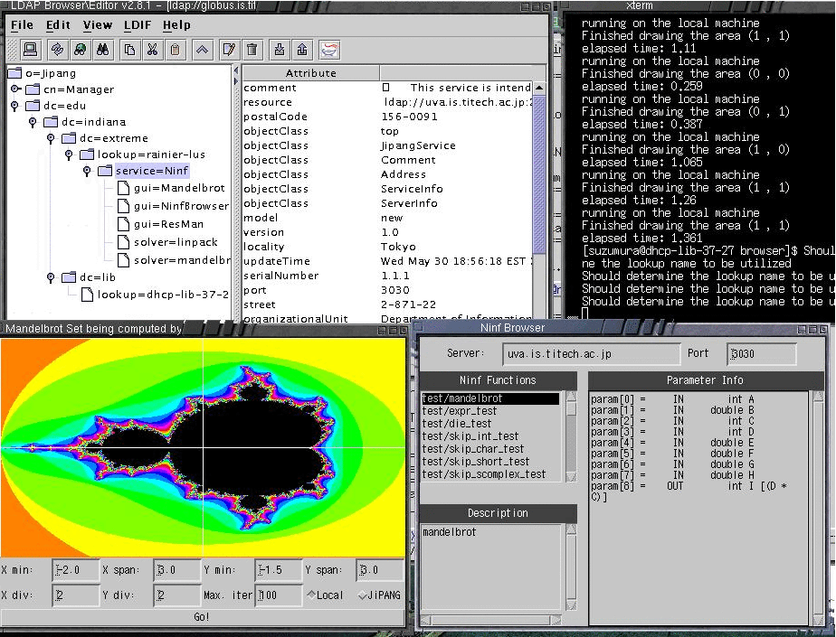
JiPANG Browser Screenshot
Notes:
This figure shows a screenshot of the browser in action, with the registered GUI services
popped up in front of the user. If the service has it own GUI interface as a front-end,
Users can start to use the service very easily and intuitively.

Slide 29
Example JiPANG Grid Services
GridRPC Service
Instrumentation Service
Globus Services
Visualization Service
File Transfer Service
Data Mining Service
… etc
Notes:
So far I mentioned that the JiPANG Service Toolkit allows you to build any Grid services you need, and
you can come up with any service like GridRPC service, Instrumetation Service, Visualization Service,
File Transfer Service, Data Mining Service, and so on.
we have built the prototype example Grid services using JiPANG such as GridRPC service and Instrumentation
Service and Globus Service.

Slide 30
GridRPC Service (1/2)
Provides remote library access and task-parallel programming model on the Grid
Abstracts out the differences between a class of GridRPC systems such as Ninf and NetSolve
GridRPCInterface
Ninf
NetSolve
Neos
JavaRMI
Notes:
GridRPC service provides remote library access and a task-parallel programming model on the Grid.
Representative systems are Ninf and NetSolve. The JiPANG service implementing the interface
called “GridRPCInterface” shown below deals with the interaction with remote computational
servers in a portable, transparent manner.

Slide 31
GridRPC Service (2/2)
public interface GridRPCInterface extends JipangInterface {
/* set an argument */
void setArg(Vector args);
/* submit a job with arbtrary Grid service */
JipangExecInfo jipangCall(String problem);
}
A Chunk of a sample program
String dn = “service=Ninf,lookup=uva-lus,
dc=is,dc=titech,dc=ac,dc=jp”
GridRPCClient client = new GridRPCClient(dn);
client.setArg(input1);
client.setArg(input2);
client.setArg(output);
JipangExecInfo execInfo = client.jipangCall(“problemX”);
System.out.println(execInfo.toString());
Notes:
Here is a GridRPC Interface consisting of two methods, one for setting arguments, and the other for submitting a problem into the GridRPC service.
Below is a chunk of a sample program. In this program,
the user simply writes one application using “jipangCall”, and the latest version of the proxy object, would be
downloaded on-the-fly in the client’s Java VM.

Slide 32
Network Instrumentation Service
Provides accurate forecasts of dynamically changing performance characteristics on the Grid
Currently provides a proxy to the Network Weather Service(NWS)
public interface NetworkWeatherInterface
extends JipangInterface {
/* retrieve a time series of forecast collections for the experiment *’/
public String[] getForecasts(String sourceMachine, String destinationMachine,
String experimentName, int atMost) throws JipangException;
/* contacts the chosen memory and stores measurements
which has been generated from #experimentName# */
public void putMeasurements(String sourceMachine, String destinationMachine,
String experimentName, String measures) throws JipangException;
}
Notes:
The instrumentation service we have developed is a proxy to the Network Weather Service(NWS),
It provides accurate forecasts of dynamically changing performance characteristics
from a distributed set of metacomputing resources.
By specifying the query, appropriate NWS instrumentation data as well as forecasts
can be retrieved, irrespective of the client location. Also, other instrumentation services can be utilized
with the same set of APIs as is done for GridRPC.

Slide 33
Globus Service
Provides interfaces to the low-level Globus services and applications interfaces (RSL, GRAM, MDS, GASS, GSI-FTP, GARA)
Allows construction of thin-client software, for which Globus services can be dynamically installed
Frees the client users from maintaining Globus himself
public interface GlobusGramInterface extends GlobusInterface{
// ping
public void gramPing (String resourceManagerContact)
throws JipangException;
// ping
public void gramPing (PrivateKey key, X509Certificate[] certs,
X509Certificate[] trustedCertificates,
String resourceManagerContact)
throws JipangException;
}
Notes:
The Java Commodity Grid Toolkit(CoG Kit) for Globus provides a rich set of classes for Java programmers
to access basic Globus services. By using CoG we have built a Jini service that publishes most of Globus
services. An advantage of using Globus services in this style is that, it allows construction of thin-client
software, for which Globus services can be dynamically installed or updated as well as loaded at the time of
use.
We currently have defined a set of APIs to provide interfaces to the low-level Globus services and application
interfaces such as RSL, GRAM, MDS, GSI, and so on.

Slide 34
Integration with the existing efforts ?
MyProxy
JiPANG
GridPort
GPDK
XCAT
Globus
GridFTP
Ninf
Notes:
I mentioned earlier that the existing efforts such as GridPort, GPDK, only allows
you to access a specific Grid system, but these provides very useful features
using CGI technology such as authentication to the Grids, file browsing, monitoring resource information, and
so on. So it is possible to integrate the JiPANG system with the existing computing portal systems, and
use the JiPANG system as a background to access multiple services on the Grid.

Slide 35
Conclusion
Propose a Jini-based Computing Portal System which gives you a uniform, transparent, ease-of-use interface to multiple Grid services
The resulting infrastructure will allow integration of a large number of future Grid services on the network accessible in a portable, uniform way by Grid application developers
Notes:
In conclusion, we propose a Jini-based Computing Portal System
which gives a uniform, transparent,
ease-of-use interface to multiple Grid services
The resulting infrastructure will allow integration of a large number of future Grid services on the network
accessible in a portable, uniform way by Grid application developers

Slide 36
Future Work
Enhanced development and documentation work
Build more layers on top to allow easier application development
  Some of the Globus service may be too low level as client software
Provides application-level interfaces as is done with the Punch systems
Integrate the standardization efforts of the Grid security model (i.e. GSI) into JiPANG
Notes:
For future work, there is much work to be done. Firstly, enhanced development and documentation work is necessary to make more Grid services available to the client users. Some of the Globus services may be too low level as a client service, and we need to build more layers on top to allow easier application development.
We need to gain experience in application-level service provisions as is done with the Punch systems.

Slide 37
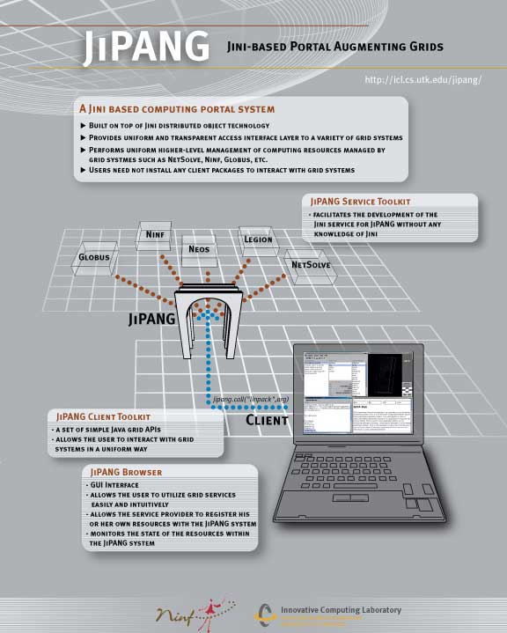
More Information
See:http://ninf.is.titech.ac.jp/jipang/
Notes:
If you would like to know more information concerning JiPANG, we have created a web
page, and put some publications on it, so please check it out.
It’s been an honor for me to speak to you today. Thank you so much for your attention.
Now I’d like to answer any questions you might have.

