Slide 1

Ninf : A global computing infrastructure
Satoshi Sekiguchi， Hidemoto Nakada,
Osami Tatebe, Hiromitsu Takagi
ElectroTechnical Laboratory, Japan
URL: http://ninf.etl.go.jp
Notes:
Thank you, chairman.
This talk is titled .Utilizing the MetaServer Architecture in the Ninf Global Computing System.

Slide 2
Our Position in the World-Wide-Programming
We provide infrastructure to execute programs in world wide environment

Slide 3
Motivation
Background:
  High speed wide area network
  Sharing information (www,...)
Demands:
  Sharing computational resources
    supercomputer, workstation clusters
    updated, well-maintained libraries
  Metacomputing
    use distributed computers as one large computer system

Slide 4
Ninf Project
To establish a computation sharing infrastructure
Brief history
  Started in ‘94
  basic concept is proposed in POOMA’95 at Santa Fe
  presentations at SC’96, HPCN’97,SC’97,SC’98
Collaborators from various organizations
  Satoshi MATSUOKA, Kento AIDA (Tokyo Inst. Tech.)
  Umpei NAGASHIMA (National Institute of Materials and Chemical Research.)
  Mitsuhisa SATO (Real World Computing Partnership)

Slide 5
Outline
Motivation
Ninf overview
  Ninf API programming interface
  Ninf IDL(Interface description)
Applications
Characteristic Features
Collaborations
Concluding remarks and future work

Slide 6
Ninf Overview
Client-server based system with Ninf Remote Procedure Call (RPC).
Provides access to numerical libraries / constant database on remote servers
Transparent view for users
  Transparent programming interface
  No stub required at the client side
  Automatic resource allocation

Slide 7
Ninf Overview
Ninf
Computational
Server
Ninf DB
Server
Ninf Executable
MetaServer
Internet
Stub
Main
Numerical
Routine
makes available multiple remote Computing and DB servers
Client Library for Fortran, C and Java.
Ninf Client Library
:
Ninf_call(linpack, ..);
:
Program

Slide 8
Ninf API
Client
Server
Ninf_call(FUNC_NAME, ....);
FUNC_NAME = ninf://HOST:PORT/ENTRY_NAME
Implemented for C, C++, Fortran, Java, Lisp …,Mathematica, Excel
Ninf_call
double A[n][n],B[n][n],C[n][n]; /* Data Decl.*/
dmmul(n,A,B,C); /* Call local function*/
Ninf_call(“dmmul”,n,A,B,C); /* Call Ninf Func */
“Ninfy”
Notes:
The principal API is Ninf_call.
It is synchronous remote procedure call,
For example, this matrix multiply statement can be ‘nified’ as like this.

Slide 9
Ninf RPC Protocol
Ease to Use
  No specific stub routine required at the client side
  c.f. Sun RPC require client stub routine
Exchange interface information at run-time
Use Sun XDR for data transfer

Slide 10
Ninf RPC Protocol
Two phase protocol
Client Program
Ninf Procedure
Client Library
Interface Info
Stub Program
Interface Info
Ninf Server
Interface Info
Interface Request
Interface Info.
Argument
Result

Slide 11
Ninf stub generator
Ninf Clients
Ninf Interface
Description File
Ninf_call("goo",...)
xxx.idl
Ninf_call("bar",...)
Ninf_call("foo",...)
Ninf_gen
stub main programs
Ninf Server
_stub_foo.c
_stub_bar.c
_stub_goo.c
module.mak
_stub_foo
stubs.dir
_stub_bar
stubs.alias
Libraries
_stub_goo
yyy.a
Ninfserver.conf

Slide 12
Ninf Interface Description (Ninf IDL)
ANSI-C like definition with I/O mode specifier
Array sizes are specified by scalar arguments
  c.f. sequence structure of CORBA
Define dmmul(
mode_in int n,
mode_in double A[n][n],
mode_in double B[n][n],
mode_out double C[n][n])
“ description “
Required “libXXX.o”
CalcOrder n^3
Calls “C” dmmul(n,A,B,C);

Slide 13
Selected Beneficial Applications (1)
Remote computing library service
  high quality (fast, accurate, reliable) libraries are ready to use as runnable modules
  functions rarely used, but are important
  avoiding tedious effort in installing software packages

Slide 14
Selected Beneficial Applications (2)
Remote database service containing numerical constants for high performance computing
  well maintained database accessible with the Ninf_call
  avoiding error at copying data from tables

Slide 15
Selected Beneficial Applications (３)
Parallel Execution over distributed computers
  Asynchronous Call
  Macro Data-flow specified by “Transaction”
Application
  Parameter-sensitive search on Workstation clusters
  Utilize heterogeneous supercomputers
    Vector machine and MPP

Slide 16
Ninf API(2) - asynchronous call -
Asynchronous Call
Client
ServerA
ServerB
Ninf_call_async(“FUNC”, ...);
Ninf_call_async
Wait arbitrary set of invocation
Ninf_call_async
Ninf_wait_all
Ninf_wait(ID);
Ninf_wait_all();
Ninf_wait_and(IDList, len);
Ninf_wait_or(IDList, len);
Ninf_cancel(ID);
Notes:
We also have asynchronous call API.
Ninf_call_async immediately returns with session ID.
And with the ID, you can wait the result of the call.
Using this API, we can invoke several calls in parallel.
We have another API for parallel execution , called transaction.
It specifies a certain program region as a transaction, and execute all ninf_calls in the region in parallel.
Data dependency among the ninf_calls is automatically detected, and the ninf_calls scheduled properly.

Slide 17
Ninf API(3) - Transaction-
Transaction - user specified cord region
  Aggregate invocation
  Dataflow execution
A
B
C
D
Ninf_transaction_start();
Ninf_call(“dmmul”,n,A,B,C);
Ninf_call(“dmmul”,n,D,E,F);
Ninf_call(“dmmul”,n,C,F,G);
Ninf_transaction_end();
dmmul
dmmul
E
F
dmmul
G

Slide 18
Characteristic Features
Resource Allocation Module
  MetaServer Architecture
Bindings
  Excel Bind
MPI support
Direct WWW access
  Ninf Calc+

Slide 19
Resource allocation for Global Computing
Dispatch computation to the Most Suitable Computation Server
Issues for selecting server
  Server / Network Status dynamically change
  Status information is distributed globally
MetaServer Architecture
  Measure / gather resource status information and store it in Resource Database
  Perform scheduling using information in the Database
Notes:
One of the most important issue for global computing is scheduling or load balancing.
For efficient computation, to dispatch requests to the most suitable Computation server is essential.
But, Global Scheduling is very difficult, because
status of server and network change dynamically
gathering globally distributed information is difficult
Moreover, scheduling itself is inherently difficult, and definition of the most suitable server itself depends on the usage of the system.

Slide 20
MetaServer Architecture
Client Side
Server Side
Resource
Database
Scheduler
Server
Monitor
Server
Proxy
Client
Server
Schedule
query
Client
Client
Proxy
Load
query
Server
Data
Server
Proxy
Throughput
Measurement
Server
Server
Notes:
This diagram shows the metaserver architecture.
There are clients here , and servers here.
These light yellow modules all construct the metaserver.
Directory service module is a kind of database, stores information about servers and functions supported by each server.
Server Probe Module monitors servers periodically, and update the directory service.
Client proxy periodically measures throughput and latency to the all the known servers.
When the Client proxy receives request from client,
it invoke a query for the scheduler with the network information.
Scheduler get the server load information from the directory service, and decide the most suitable server, and send back the server name to the client proxy.
then, Client proxy forwards the request to the assigned server.
Server proxy is just a forwarding proxy to go over the firewall. Its optional.

Slide 21
Bindings
Language Bindings
  C, C++, Fortran, Java, Lisp
  From Java Applets
System Bindings
  Mathematica, Excel

Slide 22
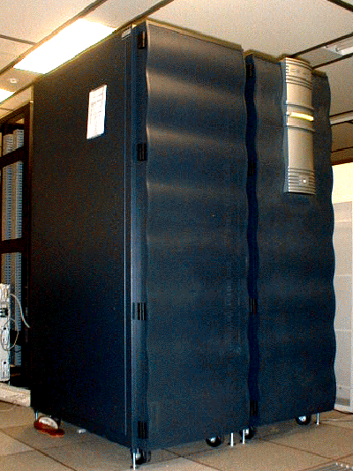

Ninf Client for Excel
Ninf Call using data on the Excel worksheet
Argument is specified by Area
Turns excel into visualization tool for super computers
A
B
C
D
E
F
1
2
2
1
2
1
0
3
3
4
0
1
4
5
1
2
6
3
4
Ninf_call(“dmmul”, N, A, B, C)
Ninf Server

Slide 23

MPI Support
Use MPI connected Workstation/PC Clusters as Ninf Servers
Users are not aware that MPI is running
Client
Ninf
Server
MPI

Slide 24
Direct Web Access
Compute data on the web
URL can be used as an argument.
Directly retrieve data out of Web Server
Store interim results to a Web Server
Ninf_call(“dmmul”, n,
”http://WEBSERVER/DATA”,
B, C);
WEBSERVER
Data
Request
Ninf
Server
Client
Program
B
Ninf Executable
C

Slide 25
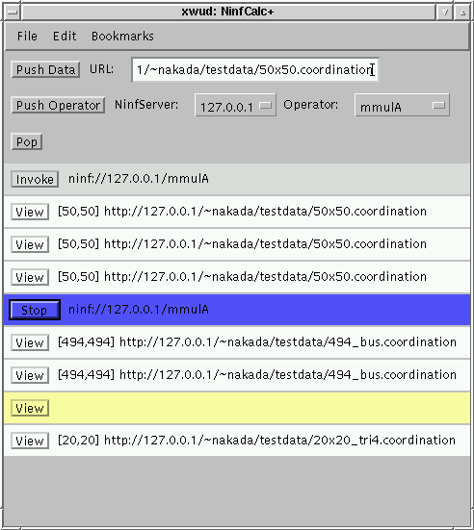
NinfCalc+
Applet in browser
Matrix Calculator uses Web server as storage
No data communication between client and server
Interactively control huge matrix calculation via thin line
Web Browser
Ninf
Server
Data
Storage
NinfCalc+

Slide 26
Collaborations
With UTK - NetSolve Project
  bridging two systems
With ANL/USC - Globus Project
  Ninf on Globus
With UCSD - NWS Project
  Using NWS as a part of Ninf
With ANU
  Feasibility Study using ANU-Japan link
With ETH - RCS Project

Slide 27
NetSolve Collaboration
NetSolve (UTK)
  A Network enabled server project similar to Ninf
Bridging with NetSolve
  Users can use libraries on both systems
NetSolve World
NetSolve
Server
NetSolve
Client
Ninf-NetSolve
Adapter
Agent
NetSolve-Ninf
Adapter
Scheduler
Ninf
Client
Client
Proxy
Ninf
Server
Ninf World

Slide 28
Collaboration with Globus
Globus (ANL/USC)
  a toolkit for global computing
    Communication, Security, Name service, etc.
  Ninf Implementation on Globus
    verify feasibility of Globus as toolkit
    identify requirements for global computing

Slide 29
Collaboration with NWS
NWS - Network Weather Service
  Measures and predicts network resource usage
Planning to use NWS as a part of Ninf System
  Use the forecasted resource usage information for scheduling

Slide 30
Concluding Remarks
Ninf is one of the ongoing projects for world-wide computing infrastructure development in high performance / quality computing
Ninf on a high speed network enables global parallel computing for high performance computation.
Even for a low speed network, Ninf provides quality services including high quality remote libraries and up-to-date scientific constant database

Slide 31
Project Status
Running a Ninf Sever at Electrotechnical Lab., Japan for experiments.
Ninf Libraries for Cray J90 Ninf Server including LibSci and other numerical libraries are installed
Version 1.2 is available
  server: Solaris 2.x for SPARC, Linux, freeBSD, Cray UNICOS J90, Digital Unix for Alpha, IRIX 6.x
  client: server + Win32
  downloadable from http://ninf.etl.go.jp

Slide 32
Future Work
Authentication and accounting
  Planning to use SSL
Fault tolerance
Experiments of global wide-area network computing
Enrollments: More contents , more platforms, ... and more users ...

Slide 33
Ninf API(4) Callback
Client
Server
Ninf_call
Server side routine can callback client side routine
Ex. Display interim results, implement Master- worker model
CallbcakFunc
void CallbackFunc(...){
.… /* define callback routine */
}
Ninf_call(“Func”, arg .., CallbackFunc);
/* call with pointer to the function */

Slide 34
Related Work
The RPC based systems → use existing programming languages
  NetSolve [Casanova and Dongarra, Univ. Tennessee]
    The same basic API as Ninf_call (now interchangeable)
    load-balancing with a daemon process called Agent.
  RCS [Arbenz, ETH Zurich]
    PVM-based
The systems using parallel distributed language etc.
  Legion [Grimshaw, Univ. Virginia]
    An user distributes his programs written with the parallel object-oriented language Mentat.
  Javelin [Schauser et al., UCSB]
    High portability due to using Java and WWW.
The global scheduling systems - NWS, DQS
Toolkits: Globus [Argonne/USC]
Notes:
There have been several proposals of global computing infrastructure.
NetSolve have a module called Agent which perform scheduling.
However, Agents cannot share server load information, therefore, false load concentration may occur.
As an embedded scheduling system, there is prophet for mentat.
It orients to Local area network, therefore it does not have network monitoring facility.
Also, There is Application level Scheduler APPLES.
It schedules using application level information written in HAT, and Backend monitoring system NWS.
NWS, the Network Weather Service is an independent resource forecast system. It monitors resource status and predicts future status.

Slide 35
Simulator for Global Computing
What information needed for scheduling?
How does it effect overall performance?
Real system: cannot control experimental environment
Simulator: setup arbitrary experimental environment
Notes:
2

Slide 36
The Model of Ninf Simulator
(Queuing System)
λns
μns
λs
μs
Networks / Servers are represented as queues
Other Network traffic / Server loads are also represented as jobs
λnr
μnr
Client A
Server A
Client A’
Qns1
Qnr1
Qs1
Qns2
Server B
Qnr2
Client B
Client B’
Qns3
Qs2
Qnr3
Server C
Client C
Client C’
Qns4
Qnr4
Qs3

Slide 37
Scheduling for Global Computing
Dispatch computation to the Most Suitable Computation Server
Issues
  Server / Network Status dynamically change
  Status information is distributed globally
  Scheduling is inherently difficult
  What is the Most Suitable?
Notes:
One of the most important issue for global computing is scheduling or load balancing.
For efficient computation, to dispatch requests to the most suitable Computation server is essential.
But, Global Scheduling is very difficult, because
status of server and network change dynamically
gathering globally distributed information is difficult
Moreover, scheduling itself is inherently difficult, and definition of the most suitable server itself depends on the usage of the system.

Slide 38
Issues for Global Scheduling
Load imbalance comes from ignoring
  server status
  server characteristics
  communication issues
  computation characteristics
False load concentration
  Delay of load information propagation
Firewall
Notes:
Now, what is the problem for global scheduling.
Firstly, Load imbalance.
It comes from neglect of status or characteristics of the resources.
such as server status, server characteristics, communication issues, computation characteristics
If you concern all of these, false load concentration still may occur.
If the server load information does not propagate fast enough, obsolete load information are used and incurs false load concentration.
Moreover, there is a problem comes from Internet nature, Firewall.
It makes difficult to gather information for scheduling

Slide 39
Requirements for Global Scheduling
Gathering various Information
Server Status
  Load average, CPU time breakdown (system, user, idle)
Server Characteristics
  Performance, Number of CPU, Amount of Memory
Network Status
  Latency, Throughput
Computation Characteristics
  Calculation order, communication size
Notes:
Here, accounting these problems, we summarize requirements for global scheduling.
First of al Scheduling for global computing requires various information.
For the proper scheduling, these information are needed.
Server Status, it means load average and CPU time breakdown
Server Characteristics, performance, number of CPU, amount of memory
Network status, Latency and throughput
Computation characteristics, calculation order, communication size

Slide 40
Information Gathering/Measurement
Server Status (Load average, CPU time breakdown)
  Server Probe module monitors
Server Characteristics (Performance, Number of CPU, Amount of Memory)
  NinfServer measures using linpack benchmark
  Number of CPU is taken from configuration file
  Amount of Memory is automatically detected
Network Status (Latency, Throughput)
  Client Proxy periodically measures.
Computation Characteristics (Calculation order, communication size)
  Declared in the Interface description.
  Computed using actual arguments.
Define dgefa (
INOUT double a[n][lda:n],
IN int lda, IN int n,
OUT int ipvt[n],
OUT int *info)
CalcOrder 2/3*(n^3)
Calls dgefa(a,n,n,ipvt,info);
Notes:
To summarize, Our metaserver gathers each information as follows
Server Status is monitored by Probe module. It periodically send queries to the servers and update Directory service.
Performance is measured by NinfServer itself when it startup. It runs linpack benchmark.
Number of CPU is taken from configuration file
Amount of Memory is automatically detected using some system calls.
NinfServer reports these information to the directory service at the start up time.
Network Status is measured by Client Proxy periodically.
Computation Characteristics is Declared in the Interface description. This is an example of ninf interface description. This calcorder stands for the calculation amount. Communication amount can be computed easily.
Client proxy compute these values and send it to the scheduler.

Slide 41
Program for performance measurement
Client program
Ninf RPC
Server program
gettimeofday();
Ninf_call(“linpack”,...);
gettimeofday()
ｌinpack(){
dgefa();
dgesl();
}
XDR
int ipiv[n]
double b[n]
int *info
double a[lda:n][n]
int lda, n
double b[n]
Linpack Benchmark (Double Precision)
  Comp:
  Comm:
3
2
2/3 n
+ 2 n
2
8 n
+ 20 n + O(1) [bytes]

Slide 42
Ninf Components
Ninf Computation Server
  Ninf Executables, Ninf RPC, Ninf IDL, etc.
Ninf Metaserver
Ninf Numerical Constant Database
  Ninf Queries
Ninf Language Bindings
  Fortran, C, C++, Lisp, Java, Mathematica, NEO, ...
Ninf Tools
  GUI frontend NinfCalc+, Simulators, etc...
Ninf MPP server API

Slide 43
Towards Global Computing Infrastructure
Rapid increase in speed and availability of network
→ Computational and Data Resources are collectively employed to solve large-scale problems.
Global Computing (Metacomputing, The “Grid”)
Ninf (Network Infrastructure for Global Computing)
  c.f., NetSolve, Legion, RCS, Javelin, Globus etc.
Notes:
Recently, rapid increase in speed and availability of network is now making it possible to collectively employ computational and data resources in the network to solve large-scale problems.
Such a system is called, high-performance global computing, or Metacomputing, or The 'Grid.
There have been several recent proposals of global computing infrastructure, including our Ninf which stands for Network Infrastructure for global computing.
Other systems are NetSolve, Legion, RCS, Javelin, Globus, and so on.

Slide 44
Ninf: a Global Network Computing Infrastructure
Ninf Remote Procedure Calls to use “Computational Components” for High-Performance/Quality Global Network Computing
User
Global High-speed
Wide-area Network
Ninf Client
Ninf RPC
Ninf Server
Ninf Server
Ninf Server
Ninf Server
Ninf Server
Ninf Libraries
(Ninf Executables)
Global Computational Resources

Slide 45
Performance Evaluation
Single-client LAN benchmark
  Baseline performance of Ninf
  Compare with local execution

Slide 46
LAN Single-client Benchmarking Environment (at ETL)
Ethernet switch
100BASE full-duplex
Ethernet switch
100BASE-TX
100BASE-TX
x 16
....
100Mbps
FDDI
Clients
Servers
SC2000
40MHzx16 1GB
Solaris 2.4
Ultra 1/140
143MHz 96MB
Solaris 2.4
DEC Alpha cluster
333MHzx16 128MB
OSF1 V3.2 41
Cray J916
200Mflopsx4 512MB
unicos 8.0.4.2
SuperSPARC
(SMP)
UltraSPARC
(WS)
Alpha
(WS Cluster)
J90
(Vector-Parallel)

Slide 47
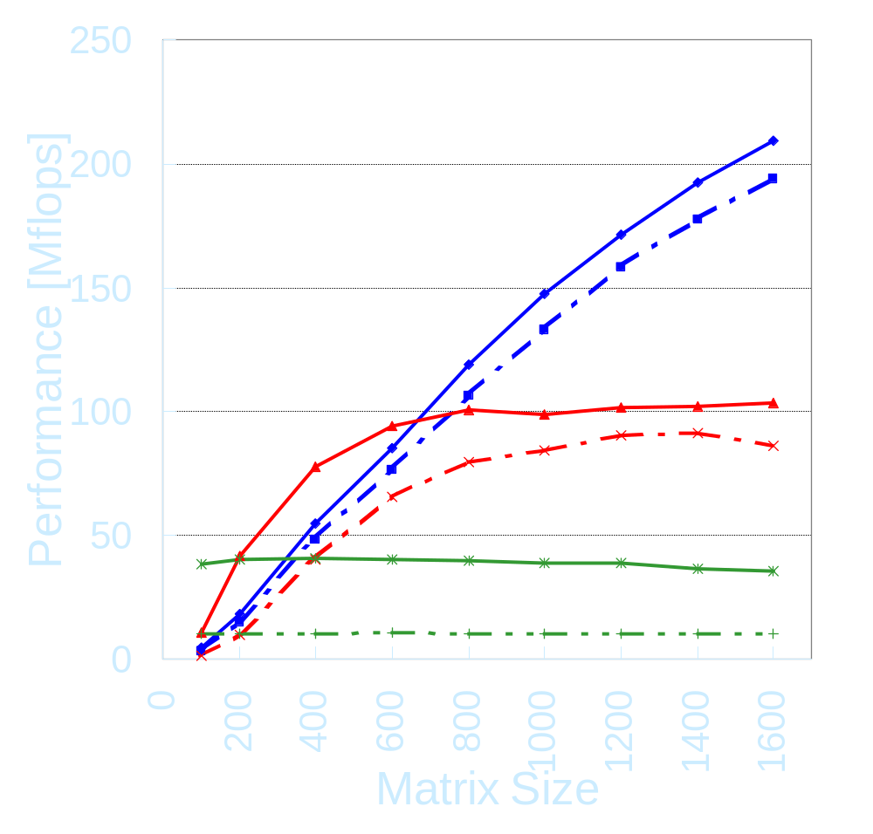
LAN Single Client Linpack Results
Ninf is faster than Local at n = 150～300
For Ninf_call to J90,
Ninf performance is not saturated.
  (J90’s Local achieves 600Mflops when n=1600)
→ Ninf performance quickly overtakes Local.
The effects of client machine’s performance difference are small.
Ninf: Ultra-J90
Ninf: Super-J90
Ninf: Ultra-Alpha
Ninf: Super-Alpha
Local: UltraSPARC
Local: SuperSPARC

Slide 48
Overview of Ninf
Other Global Computing Systems,
e.g., NetSolve via Adapters
Ninf DB
Server
Ninf Register
Meta
Server
Internet
Ninf
Computational
Server
Ninf Executable
Ninf Executable
Meta
Server
Meta
Server
Ninf Executable
Stub
Program
Ninf
Procedure
Ninf Client Library
:
Ninf_call(“linpack”, ..);
:
Ninf RPC
Ninf Stub
Generator
IDL File
Program

Slide 49
Ninf: Features At-a-Glance
Client-server RPC base system
User’s view: ordinary software library
Needless to know physical server locations
Problem solved on an arbitrary computer in a Ninf server
Dynamic allocation of machine by metaservers
Asynchronous RPC for parallel computing

Slide 50

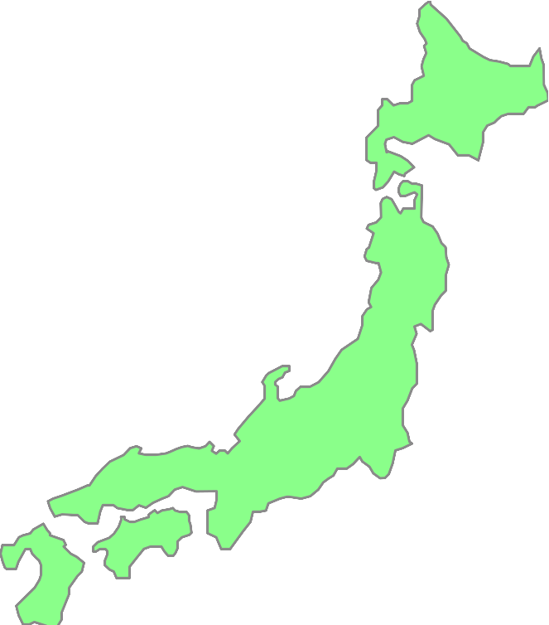
Ninf-NetSolve Collaboration
Ninf Server
NetSolve Server
NetSolve Server
Ninf Server
Ninf-NetSolve
Adapter
NetSolve Server
Ninf Server
NetSolve-Ninf
Adapter
NetSolve Client
Ninf Client
Ninf client can use NetSolve server via adapter
NetSolve client can use Ninf server via adapter

