Slide 1
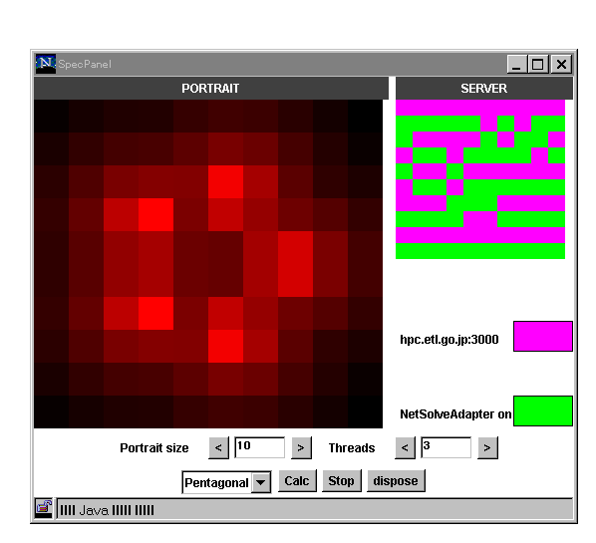
Ninf Project Team (ETL, TIT, WCP, NIMC)
Metaserver Architechture
Dispatches a task to the most suitable server
Client Side
Resource
Database
Server Side
Centralized Resource Database, which stores Information about Servers and Networks
Load measurement by Server Monitor
Throughput measurement from each client site
Pluggable scheduling / predicting algorithm
Client
Scheduler
Server
Monitor
Server
Proxy
Server
Client
Client
Proxy
Schedule
query
Load
query
Server
Data
Server
Proxy
Throughput
Measurement
Server
Server
Bridging with Netsolve
Netsolve
Server
Netsolve World
Netsolve
Client
Ninf client can invoke libraries on NetSolve Servers
NetSolve client can invoke libraries on Ninf Servers
The adapters convert
  Function representation
  Invocation Protocol
  Function Management Protocol
  Data transfer format
Ninf-Netsolve
Adapter
Agent
Netsolve-Ninf
Adapter
Scheduler
Ninf
Client
Client
Proxy
Ninf
Server
Ninf World
A demonstration of the adapter
Calculate spectral portrait of a matrix using Ninf and Netsolve server
Backend server is selected automatically based on its load
The colors in the right window represents allocated servers
Future work
Specification of common formats for
  Function representation ( c.f. HTML, XML)
  Data marshaling and transfer
  invocation protocol (c.f. HTTP)
  Management protocol
Clear separation from scheduling, monitoring module
  cf. NWS, HBM ( Globus )
Contact:
Web page: http://ninf.etl.go.jp
Mail to: ninf@etl.go.jp

