Slide 1
Features at a glance
Ninf is one of the ongoing projects for world-wide computing infrastructure development in high performance / quality computing
Client-Server RPC based system
User’s view: ordinary software libraries
  Needless to know physical server locations
  Problems solved on an arbitrary computer in a Ninf System
  Dynamic allocation of server by MetaServer
Asynchronous RPC for parallel computing
Generic client routines for ease-to-use
Provides remote-accessible high-quality numerical libraries and special functions runnable on high performance computers
Defines the API for client programmers to build global parallel computing systems
Generates wrappers for private routines to match the interfaces with standard packages
Current Status
Current version is available on the Web (http://ninf.etl.go.jp).
Various client APIs callable from C, C++, Java, Lisp (Scheme), etc. on Solaris, Digital Unix, Unicos, Free BSD, Win32.
Other Global Computing Systems,
e.g., NetSolve via Adapters
Java Client
MetaServer
Ninf
Computational
Server
Excel Client
Numerical routine
Numerical routine
Numerical routine
register
C/Fortran Client
Ninf
Computational
Server
Ninf Executable
Ninf Executable
Ninf Client Library
Ninf Executable
:
Ninf_call(“linpack”, ..);
:
Ninf DB
Server
Stub
Program
Numerical
routine
DB
Program
Ninf Stub
Generator
IDL File

Slide 2
The MetaServer Architecture
Resource allocation accounting various information
Computation
Characteristics
Network Information
Scheduler
Resource
Database
Server Characteristics
Server Load Information
Centralized Resource Database, which stores Information about Servers and Networks
Load measurement by Server Monitor
Throughput measurement from each client site
Pluggable scheduling / predicting algorithm
Client Side
Resource
Database
Server Side
Client
Scheduler
Server
Monitor
Server
Proxy
Server
Client
Client
Proxy
Schedule
query
Load
query
Server
Data
Throughput
Measurement
Server
Proxy
Server
Server

Slide 3
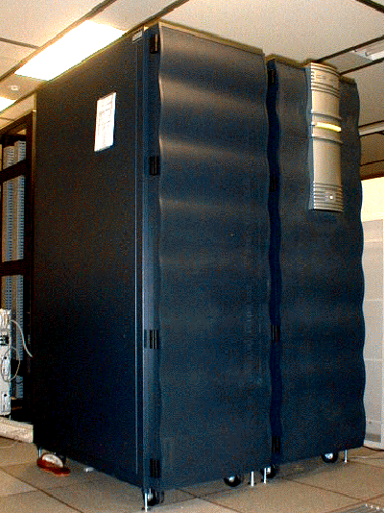

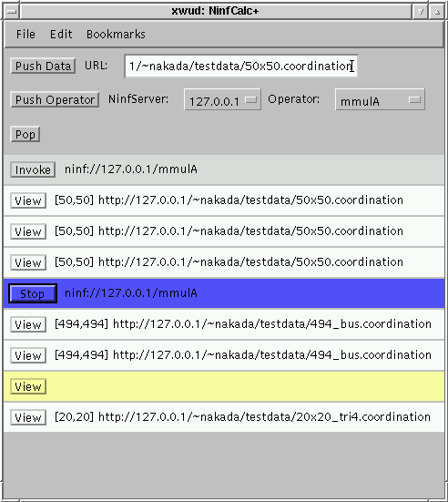

Excel Ninf
A fancy frontend interface on your spread sheet allows to steal CPU time of monster machines as a backend of your PC
1
A
B
C
D
E
F
2
2
1
2
1
0
3
3
4
0
1
4
5
1
2
6
3
4
Ninf_call(“dmmul”, N, A, B, C)
Ninf Server
Web-based intterface to contorol Huge computation via thin-line
NinfCalc
Matrix Calculator uses Web server as storage
No data communication between client and server
Web Browser
Ninf
Server
Data
Storage
NinfCalc
MPI support
Use MPI connected Workstation/PC Clusters as Ninf Servers
Client
Ninf
Server
Users are not aware of that MPI is running.
MPI

Slide 4
Bridging with Netsolve
Netsolve World
Netsolve
Server
Netsolve
Client
Ninf client can call Netsolve server and vice-versa.
Ninf-Netsolve
Adapter
Agent
Netsolve-Ninf
Adapter
Scheduler
Ninf
Client
Client
Proxy
Ninf
Server
Ninf World
Demo. of Cooperation with Netsolve
Client invokes several requests in parallel
Some of requests will be processed by Netsolve Server.
Netsolve
Server
Agent
Netsolve
Server
Ninf-Netsolve
Adapter
Scheduler
Netsolve
Server
Ninf
Client
Client
Proxy
Ninf
Server
Ninf
Server
Ninf
Server

Slide 5
TUKUBA

