Slide 1
Bridging with Netsolve
Ninf client can invoke libraries on NetSolve Servers
NetSolve client can invoke libraries on Ninf Servers
Issues
Function representation
  c.f. HTML, XML
Data format
  common data format have to be specified
Invocation protocol
  c.f. HTTP
Clear separation from scheduling, monitoring module
Netsolve World
Netsolve
Server
Netsolve
Client
Agent
Ninf-Netsolve
Adapter
Netsolve-Ninf
Adapter
Scheduler
Ninf
Client
Client
Proxy
Ninf
Server
Ninf World

Slide 2
Demo. with NetSolve
UTK
Agent
Client invokes several requests in parallel
Some of requests will be processed by Netsolve Server.
Netsolve
Server
Ninf-Netsolve
Adapter
SC98
Booth
Ninf-Netsolve
Adapter
Agent
Scheduler
Netsolve
Server
Ninf
Client
Client
Proxy
Ninf
Server
Ninf
Server
Ninf
Server
Japan

Slide 3
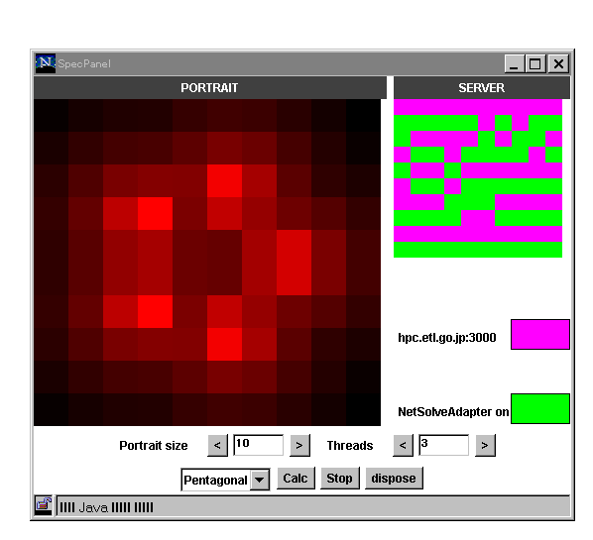
Spectral Portrait
Calculate spectral portrait of a matrix using Ninf and Netsolve server
Backend server is selected automatically based on its load.

