Slide 1
A Study of Deadline Scheduling for Client-Server Systems on the Computational Grid
Atsuko Takefusa, JSPS/TITECH
Henri Casanova, UCSD
Satoshi Matsuoka, TITECH/JST
Francine Berman, UCSD/SDSC
http://ninf.is.titech.ac.jp/bricks/

Slide 2
The Computational Grid
A promising platform for the deployment of HPC applications
A crucial issue is Scheduling
  Most scheduling works aims at improving execution time of a single application
  E.g., AppLeS, APST, AMWAT, MW, performance surface, stochastic scheduling, etc.
Notes:
The computational Grid is a promising platform for the deployment of high-performance computing applications and many Grid software systems have been developed such as Ninf, NetSolve, Globus, Legion.
A crucial issue for the efficient deployment of HPC applications on the Grid is that of scheduling.
Most scheduling works addressing Grid environments aim at improving execution time of a single application executed on behalf of a single user.

Slide 3
NES: Network-enabled Server
A Grid software which provides service on the network (a.k.a. GridRPC)
  e.g. Ninf, NetSolve, Nimrod
Client-server architecture
RPC-style programming model
Many high-profile applications from science and engineering are amenable:
  Molecular biology, genetic information, operations research
Scheduling in multi-client multi-server scenario?
Notes:
Also, a number of projects have addressed the idea of software as a service on the network. These systems have been traditionally called “Network-enabled Server”s.
These systems usually implement client-server architectures and provide users with an RPC-style programming model.
Many high-profile applications from science and engineering are amenable to this programming model.
These applications consist of a large number of independent tasks.
An important issue is then the question of scheduling in this multi-client multi-server scenario where several applications compete for the access to NES resources.

Slide 4
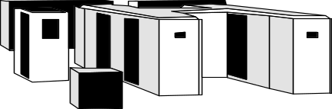
Scheduling for NES
Resource economy model (E.g. [Zhao and Karamcheti ’00], [Plank ’00], [Buyya ’00])
  Grid currency allow owners to “charge” for usage
Choice?
$$$$$$$$$$
$
→No actual economical model is available
Nimrod [abramson ’00] presents a study of deadline-scheduling algorithm
  Users specify deadlines for the task of their apps. and can spend more to get tighter deadlines
Notes:
One obvious aspect of this problem is that of a resource economy model such as those.
These are proposal of distributed resource sharing agreements, G-commerce which proposed an auction-based economy model, and Nimrod economy model.
The expectation is that as the Grid becomes more pervasive, the notion of a Grid currency will allow resource owners to “charge” for resource usage.
However, at this time, these works are mostly speculative and no actual economical model is available or agreed-upon.
Nimrod presents a study of a deadline-scheduling algorithm for a particular economy model on the IPDPS 2000 paper.
And deadline-scheduling is clearly the right strategy in our multi-client multi-server scenario.
Deadline scheduling allows that ---.

Slide 5
Our Approach
Each request comes with a deadline requirement
Deadline-scheduling algorithm under simple economy model
  The Goal:
  Minimize the over all occurrences of deadline misses
  Low resource cost
Simulation on Bricks
  A performance evaluation system for Grid scheduling
Notes:
Given the current lack of consensus on Grid economy models, we take a more general approach:
We assume that each request comes with a deadline requirement and our goal to minimize the overall occurrences of deadline misses and the resource cost.
We use the Bricks simulation framework for evaluation purposes.

Slide 6
Outline
Overview of Bricks and the improvement
  More scalable and realistic simulations
Deadline-scheduling algorithm
  Load Correction mechanism
  Fallback mechanism
Experiments in multi-client multi-server scenarios on Bricks
  Resource load, resource cost, conservatism of prediction, efficacy of our deadline-scheduling
Notes:
We first talk about overview of Bricks and the improvement that would allow for more scalable and realistic simulations of Grid environments.
Next, we give a simple deadline-scheduling algorithm, which aims at minimizing deadline misses, and then augment it with “Load Correction” and “Fallback” mechanisms, which could improve the performance of the algorithm in our context.
Then, we focus on multi-user scenarios and investigate the relationship between resource load, resource cost, conservatism of performance prediction, and the efficacy of several variants of our deadline-scheduling.
We present experimental results from thousands of simulation runs on Bricks.

Slide 7
Bricks: A Performance Evaluation System
A simulation framework to evaluate
  Scheduling algorithms
  Scheduling framework components
  (e.g. predictors)
Bricks provides
  Reproducible and controlled evaluation environments
  Flexible setups of simulation environments (Grid topology, resource model, client model)
  Evaluation environment for external Grid components (e.g., NWS forecaster[HPDC99])

Slide 8
The Bricks Architecture
Scheduling Unit
Predictor
NetworkPredictor
ServerPredictor
Scheduler
ResourceDB
NetworkMonitor
ServerMonitor
Client
Network
Server
Network
Client
Network
Server
Client
Network
Network
Server
Network
Client
Server
Grid Computing Environment
Notes:
Here is the Bricks architecture.
Bricks consists of the Grid Computing Environment and the Scheduling Unit and they coordinate to simulate the behavior of Grid systems.
The Grid Computing Environment represents a simulation environment and consists of clients, servers, and networks.
Client represents a user of a Grid system and invokes Grid computing tasks.
Server represents a computational resources and Network represents a network interconnecting a client and a server. In the Bricks simulation, Network and Server are represented using queues.
The Scheduling Unit consists of these canonical Grid scheduling modules such as scheduler, predictor, resource monitors, and resource database.
Each component of Bricks is replacable to other Java-written component or existing modules implementing glue interfaces and a user can specify various simulation environments flexibly.
But a problem with the first version of Bricks had been its scalability.

Slide 9
A Hierarchical Network Topology on Bricks
Local Domain
Client
Client
Server
Server
Client
Server
Server
Server
WAN
Client
Client
Client
LAN
Server
Client
Network
Client
Client
Server
Network
Client
Server
Server
Client
Server
Notes:
In order to investigate characteristics of a variety of scheduling algorithms in a more scalable and realistic Grid setting, we extended Bricks to incorporate the scalable network model as shown on this slide.
Each network between a client and a server consists of intermediate nodes and network queues which represents different bandwidth networks such as LAN and WAN.

Slide 10
Deadline-Scheduling
$
Deadline
Server 1
$$$$$
Server 2
$$
Server 3
Job execution time
Deployed NES scheduling → Greedy
  assigns the requests to the server that completes it the earliest
Deadline-scheduling:
  Aims at meeting user-supplied job deadline specifications
Notes:
Currently, deployed NES systems such as NetSolve and Ninf use the following scheduling algorithm.
For each incoming request, the scheduler assigns ---. This is an aggressive approach which does not take into account possible deadline requirements from the user. We call this algorithm “Greedy”.
NES systems become more widely deployed on the Computational Grid, so that it becomes necessary to fully support the notion of deadline which aims at meeting user-supplied job deadline specifications.
In this study, we give a simple deadline scheduling algorithm.

Slide 11
A Deadline Scheduling Algorithm
1 Estimate job processing timeTsi on each serverSi：
  Tsi = Wsend/Psend + Wrecv/Precv + Ws/Pserv (0 ≤ i < n)
  Wsend, Wrecv, Ws: send/recv data size, and logical comp. cost
  Psend, Precv, Pserv: estimated send/recv throughput, and performance
2 Compute Tuntil deadline:
  Tuntil deadline = Tdeadline - now
Server 1
Comp.
Send
Recv
Server 2
Server 3
Estimated job execution time
now
Deadline
Tuntil deadline
Notes:
Now I’ll explain a simple on-line deadline scheduling algorithm. This algorithm is invoked at every job arrival:
First, the scheduler estimates the job processing time T_si, on each available server S_I as follows. W… denotes to the data sizes transmitted from …and from …, and logical computation “cost” and P… denote predicted network throughputs and the server performance, respectively.
Secondly, the scheduler computes T_{until deadline} as follows. Where T_{deadline} is the job’s deadline specification and now is the current time.

Slide 12
A Deadline Scheduling Algorithm (cont.)
3 Compute target processing time Ttarget:
  Ttarget = Tuntil deadline x Opt (0 < Opt ≤ 1)
4 Select suitable server Si:
  Conditions：MinDiff=Min(Diff si) where Diff si=Ttarget–Tsi≥0
  Otherwise Min(|Diff|)
Tuntil deadline
Ttarget
now
Server 1
Comp.
Send
Recv
Server 2
Server 3
Estimated job execution time
Notes:
Next, the scheduler computes the target processing time T_{target} as follows.
In this equation, Opt is a parameter that denotes the expected accuracy of performance prediction in the simulated Grid environment. In general, schedulers use predictions provided by systems such as NWS and the predictions contain some errors. Opt allows to specify how conservative the algorithm is.
Setting Opt to 1 means that one has high confidence in the predictions. And the lower Opt scheduler should be more conservative to select faster resources at a higher cost.
Finally, the scheduler selects a suitable server i, which satisfies these conditions.

Slide 13
Factors in Deadline Scheduling Failures
Accuracy of predictions is not guaranteed
Monitoring systems do not perceive load change instantaneously
Tasks might be out-of-order in FCFS queues
↔Previous scheduling decisions will lead to an increase in load
↔ Server can estimate whether it will be able to complete the task by the deadline
→ Load Correction: Use corrected load values
Fallback: Push a scheduling functionality
to server
Notes:
As I mentioned, the scheduler computes estimations using measured load or predictions of resources, but the accuracy is not guaranteed.
Also, monitoring systems ---.
In addition, we assume that the servers are used in a First Comes First Served fashion, so it may be the case that tasks are out-of-order in server’s queues, with respect to what the scheduler intended.
On the other hand, Grid scheduling components possess additional knowledge about the usage of resources. For example, we expect that previous scheduling decisions might have been make that will lead to an increase in load of given resources.
And, it may be possible that once the input data has reached the server that server can estimate whether it will be able to complete the task by the requested deadline.
In order to improve the performance of the deadline algorithm in our context, we propose the following mechanisms, Load Correction and Fallback:
The Load Correction mechanism uses corrected load values and the Fallback mechanism is to push some of scheduler’s functionalities to the server themselves.

Slide 14
A Load Correction Mechanism
Modify a load prediction from monitoring system, LoadSi, as follows:
  LoadSi corrected = LoadSi + Njobs Si x pload
  Njobs Si: the number of scheduled and not-finished jobs on the server Si
  Pload (= 1): arbitrary value that determines the magnitude
Predictor
NetworkPredictor
ServerPredictor
Corrected prediction
Scheduler
ResourceDB
NetworkMonitor
ServerMonitor
Notes:
The idea of Load Correction is to modify a load prediction from the monitoring system as follows to obtain a corrected load value:
Where N_{jobs Si} is the number of jobs that have been scheduled by our scheduler,
pload is an arbitrary value that determines the magnitude of the correction.
Our experiments use pload = 1, because CPU-bound tasks usually add 1 to the CPU load.

Slide 15
A Fallback Mechanism
Server can estimate whether it will be able to complete the task by the deadline
The condition that task scheduling fails at a server:
  Tuntil deadline < Tsend + ETexec + ETrecv &&
  Nmax. fallbacks ≥ Nfallbacks
  Tsend : Comm. duration (send)
  ETexec, ETrecv: Estimated comm. (recv) and comp. duration
  Nfallbacks, Nmax. fallbacks : Total/Max. number of fallbacks
Scheduler
Server
Client
Fallback
Server
Notes:
The other mechanism is fallback.
Once input data for a task has reached a server, that server can estimate whether it will be able to complete the task by the requested deadline as follows:
If the server determines that the task will not meet the deadline, then it can notify the corresponding client that will then re-submit the task to the system untill the total number of fallbacks achieves the maximum value user specified.

Slide 16
Experiments
Experiments in multi-client multi-server scenarios on Bricks
  Resource load, resource cost, conservatism of prediction, efficacy of our deadline-scheduling
Performance criteria:
  Failure rate: percentage of requests that missed deadline
  Resource cost: avg. resource cost over all requests
    cost = machine performance
    e.g. select 100 Mops/s and 300 Mops/s servers
    → cost=200
Notes:
Now, I’ll explain evaluation of a deadline scheduling algorithms.
We assume --- and investigate the relationship between ---.
The performance criteria in the experiments are the failure rate and the resource cost.
The failure rate is defined as the ---, and the resource cost is that average resource cost over all requests for the same simulation runs.
In this simulations, we suppose resource cost equals machine performance.
For example, if one scheduler selects 100 and 300 Mops/s servers whose resource costs are 100 and 300 for 2 different requests, the resource cost of the scheduling algorithm is 200.

Slide 17
Scheduling Algorithms
Greedy: Deployed NES scheduler
Deadline (Opt = 0.5, 0.6, 0.7, 0.8, 0.9)
Load Correction (on/off)
Fallback (Nmax fallbacks = 0/1/2/3/4/5)
Notes:
we compare the performance of Greedy and Deadline scheduling algorithms.
Greedy is the algorithm supported by the deployed NES systems. And deadline is the proposed algorithm whose Opt parameters are fixed to those values for each simulation.
We also investigate the impact of Load Correction and Fallback varying the maximum number of fallbacks.

Slide 18
Configurations of the Bricks Simulation
Grid Computing Environment (≅75 nodes, 5 Grids)
  # of local domain: 10, # of local domain nodes: 5-10
  Avg. LAN bandwidth: 50-100[Mbits/s]
  Avg. WAN bandwidth: 500-1000[Mbits/s]
  Avg. server performance: 100-500[Mops/s]
  Avg. server Load: 0.1
Characteristics of client jobs
  Send/recv data size: 100-5000[Mbits]
  # of instructions: 1.5-1080[Gops]
  Avg. intervals of invoking:
  60(high load), 90(medium load), 120(low load) [sec]
Notes:
The configurations of the Bricks simulations are as those:
The number of nodes on each simulated Grid is about 75 nodes and the average intervals of invoking jobs at clients during the simulations are fixed to 60, 90, and 120[sec].
60[sec] means load of the Grid environment is high and 120[sec] means lower load environment.

Slide 19
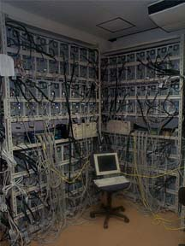
Simulation Environment
The Presto II cluster:
66PE at Matsuoka Lab., Tokyo Institute of Technology.
  Dual Pentium III 800MHz
  Memory: 640MB
  Network: 100Base/TX
Use APST[Casanova ’00] to deploy Bricks simulations
24 hour simulation x 2,500
(1 sim. takes 30-60 [min]
by Sun JVM 1.3.0+HotSpot)
Notes:
We performed the Bricks simulations on the Presto II cluster at Matsuoka lab., Tokyo Institute of Technology.

Slide 20
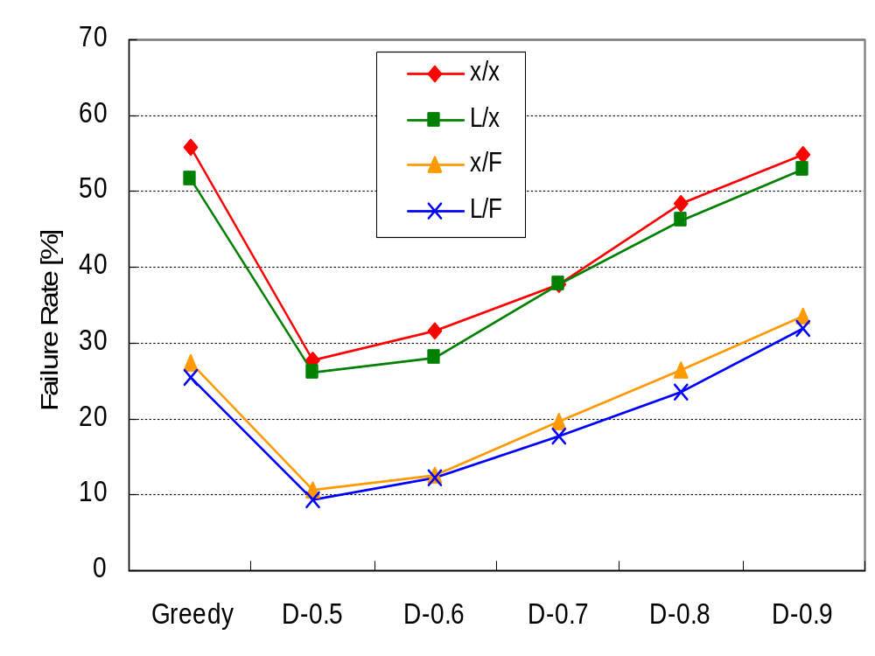
Comparison of Failure Rate
(load: medium)
Deployed NES scheduler
Fallback leads to
dramatic reductions
Load Correction
is NOT useful
Notes:
This is the comparison of the Failure Rate, the first performance metric, for the Greedy and the Deadline algorithms with different values of Opt denoted by D and the Opt values on the X axis.
These are results in medium load situation.
Four versions of each scheduling algorithm were used: with or without the Load Correction and with or without Fallback. L means Load Correction and F means Fallback. So Greedy and x/x is the result of deployed NES scheduler.
This graph shows the fallback mechanism leads to dramatic reductions of the failure rate for all scheduling algorithms and the Load Correction mechanism leads only to marginal failure rate improvements.
Therefore, the Load correction mechanism may not be useful for NES systems in scenario with large numbers of clients and servers.
Of course, deadline leads to better failure rates when Opt is small.

Slide 21
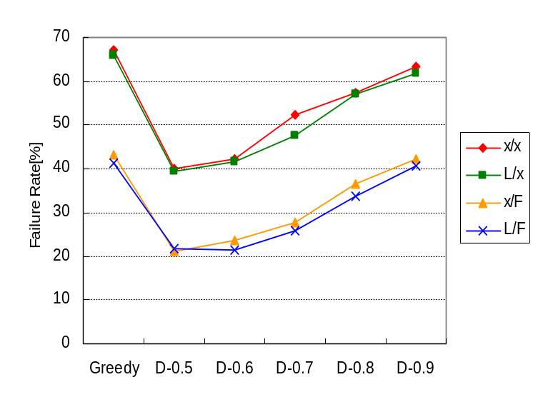
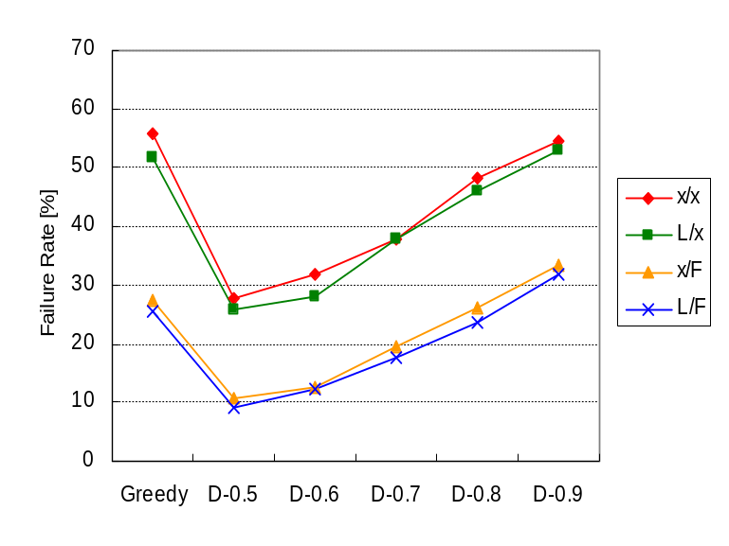
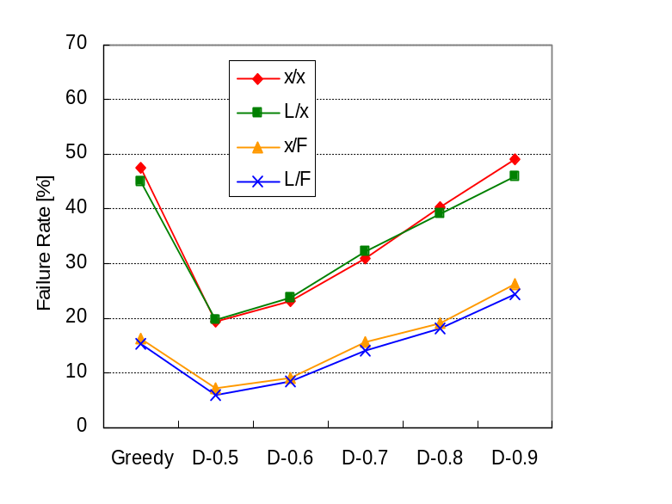
Comparison of Failure Rate
(Load: high, medium, low)
High
Medium
Low
“Low” load reduces failure rate
All show similar characteristics
Notes:
These are the failure rate in different loads, high, medium, and low situations.
These graphs show lower load situations make the failure rate less for all of algorithms.
However, each scheduling algorithms under different situation has similar characteristics, as I mentioned on the previous slide. So we will give you the results of the medium case on the following slides.

Slide 22
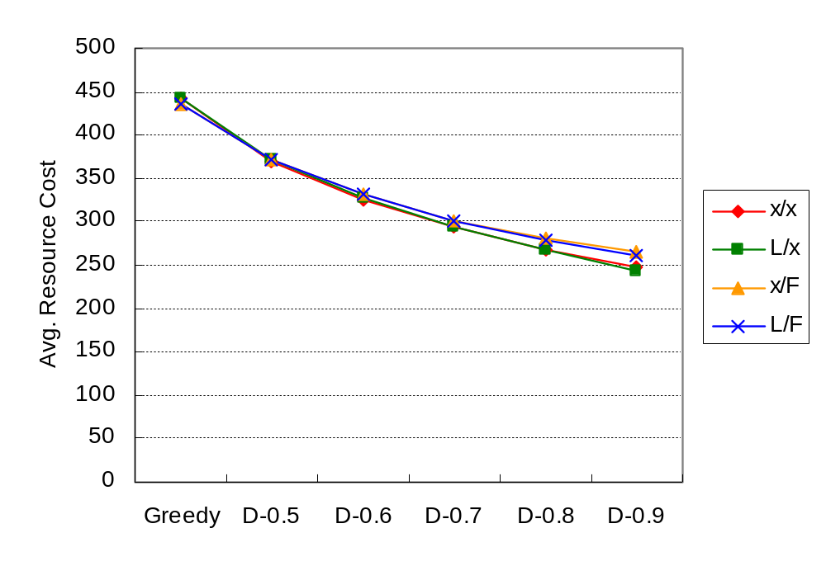
Comparison of Resource Cost
Greedy leads to
higher costs
Conservative Deadline is preferable
Costs decrease when the
algorithm becomes less conservative
Trade-off between failure-rate and cost
by adjusting conservatism of Deadline
Notes:
This is the comparison of the average resource cost over all requests.
The vertical axis indicates the average resource cost.
This graph shows the Greedy algorithm leads to higher costs than the deadline algorithms and the costs decrease where Opt increases and the algorithm becomes less conservative.
The main result here is that even a conservative deadline scheduling algorithm is preferable to what is currently being implemented within NES systems.
Using the results of the failure rates and costs, it is possible to make a trade-off between failure-rate and cost by adjusting the level of conservatism of the deadline algorithm.

Slide 23
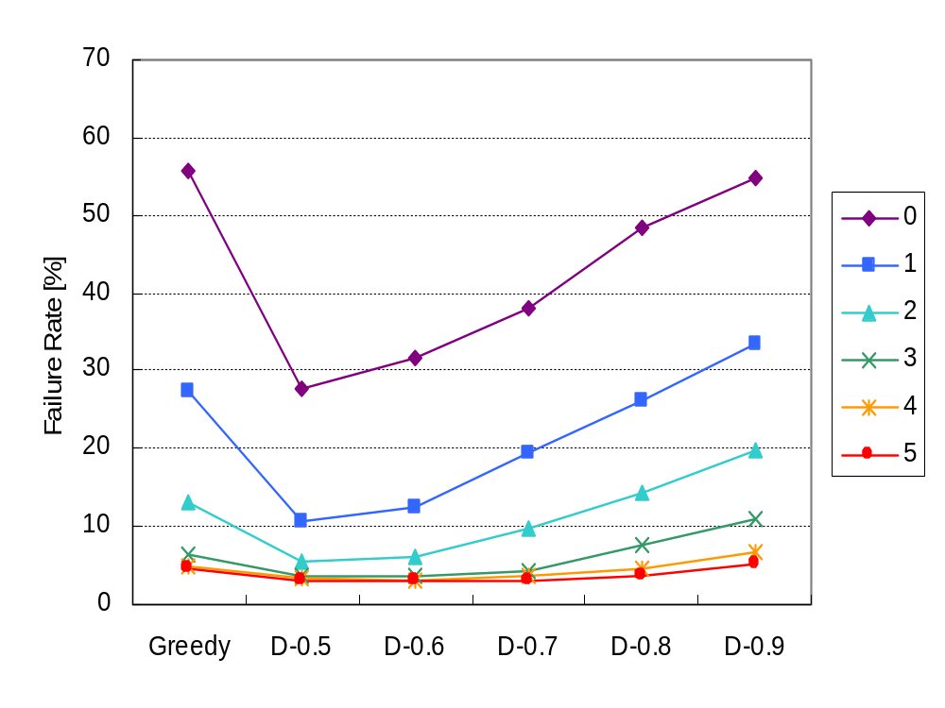
Comparison of Failure Rate
(x/F, Nmax. fallbacks = 0,1,2,3,4,5)
Multiple fallbacks cause
significant improvement
Notes:
This graph indicates experiments with no Load Correction and different values for the maximum number of allowed fallbacks from 0 to 5.
From this graph, you can see that multiple fallbacks cause much improvement for all the scheduling algorithms.

Slide 24
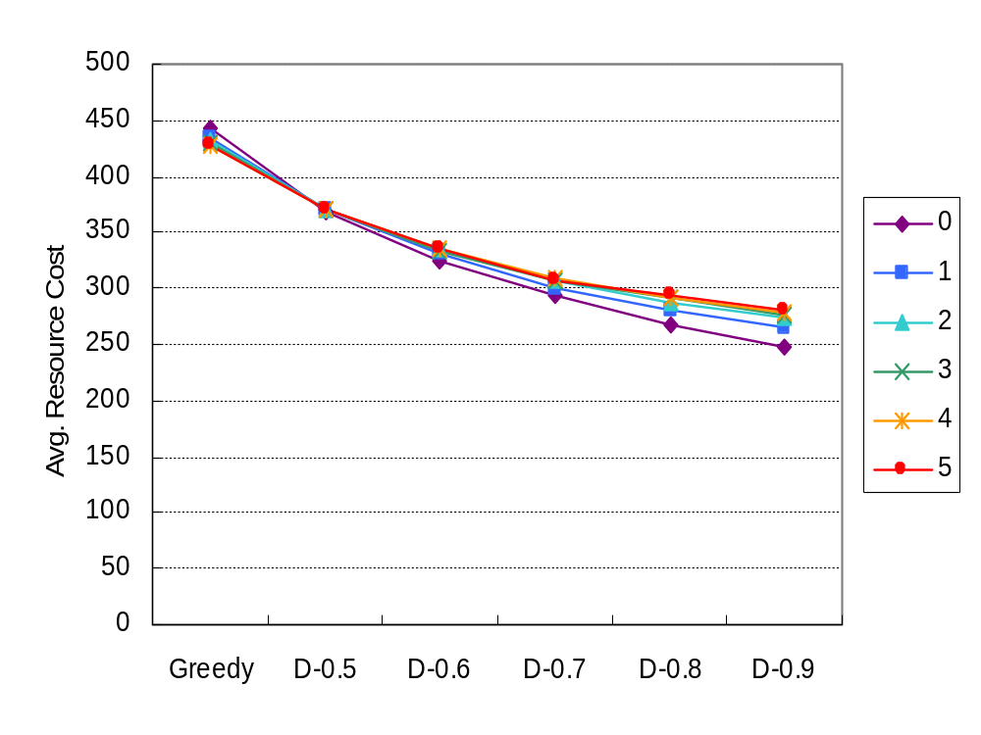
Comparison of Resource Cost
(x/F, Nmax. fallbacks = 0,1,2,3,4,5)
Multiple fallbacks leads to
“small” increases in costs
NES systems should allow for multiple fallbacks
as a part of their standard mechanisms
Notes:
This is the comparison of resource cost for different Nmax fallbacks.
This graph shows that allowing for multiple fallbacks leads to small increases in resource costs.
The main results here is that scheduler which are part of NES systems ---.

Slide 25
Related Work
Economy model:
  Nimrod [abramson ’00]
    Uses a self-scheduler
    Targets parameter sweep apps. from a single user
Grid performance evaluation systems:
  MicroGrid [Song ’00]
    Emulates a virtual Globus Grid on actual cluster
    Not appropriate for large scale experiments
  Simgrid [Casanova ’01]
    A trace-based discrete event simulator
    Provides primitives for simulation of application scheduling
    Lacks the network-modeling feature Bricks provides
Notes:
Related work is as follows:
Nimrod is an NES system for parameter sweep applications uses a self-scheduler that allocates tasks into lower priority and performance servers at first, collects execution results for the next scheduling, and then makes all tasks meet the application deadline. Experiments in actual environments showed that the scheduler tends to select high priority resources as the deadlines get closer. By contrast to our work, scheduling in Nimrod targets parameter sweep applications from a single user.
Also, there are Grid performance evaluation systems.

Slide 26
Conclusions
Proposed deadline scheduling algorithms and Load Correction and Fallback mechanisms
Investigated performance in multi-client multi-server scenarios on the improved Bricks
The experiments showed
  It is possible to make a trade-off between failure-rate and cost by adjusting the level of conservatism
  Load Correction may not be useful
  Future NES systems should use deadline scheduling with multiple fallbacks

Slide 27
Future Work
Make Bricks support more sophisticated economy models
Investigate their feasibility
Implement the deadline scheduling algorithm within actual NES systems
(starting with Ninf: http://ninf.apgrid.org/)

Slide 28
Grid Computing Environment
Client
  Represents user of the Grid system
  Invokes Grid computing Jobs
    Amount of data transmitted to/from server,
    # of executed instructions
Server
  Represents computational resources
Network
  Represents the network interconnecting
  the Client and the Server
Predictor
Scheduler
ResourceDB
NetworkMonitor
ServerMonitor
Represented using queues
Network
Client
Network
Server

Slide 29
Scheduling Unit
Network/ServerMonitor
Measures/monitors network/server status on the Grid
ResourceDB
Serves as scheduling-specific database, storing the values of various measurements.
Predictor
Reads the measured resource information from ResourceDB, and predicts availability of resources.
Scheduler
Allocates a new task invoked by a client
on suitable server machine(s)
Predictor
Scheduler
ResourceDB
NetworkMonitor
ServerMonitor
Network
Client
Network
Server

Slide 30
Overview of Grid Computing Simulation with Bricks
Scheduling Unit
NetworkPredictor
Predictor
ServerPredictor
Query predictions
Predictions
Perform Predictions
Scheduler
ResourceDB
Query available servers
Store observed information
Inquire
suitable server
NetworkMonitor
ServerMonitor
Return
scheduling info
Monitor periodically
Invoke task
Send the task
Network
Client
Server
Network
Execute task
Return results
Grid Computing Environment

Slide 31
A Hierarchical Network Topology on Bricks
Local Domain
Client
Client
Server
Server
Client
Server
Server
Server
WAN
Client
Client
Client
trace
LAN
Server
Client
Network
Client
Client
Server
Network
Client
Server
Server
Client
Server

Slide 32
Simulation of Background Load
Extraneous data/job model [IJHPCA ’00]
Congestion represented by adjusting the amount of arrival data/jobs from other nodes/users
Trace model [HPDC ’99]
Bandwidth/performance at each step = trace data such as observed parameters of real environment.
Need to specify only several parameters
Greater accuracy requires larger simulation cost
Network/Server behaves as if real network/server
Simulation cost lower than the previous model
Need to accumulate the measurements
Notes:
Now I give the simulation of background load on the network and the server.
This load is generated by applications and users outside our system and not known to our scheduler such as what would be experienced on a real Grid.
Currently, there are 2 major model families supported by Bricks.
The first family is the model that assumes extraneous data/jobs.
Background resource congestion is ---
The second is the model using observed parameters.
Bandwidth or performance at each step is determined by the observed parameters of the real environment.
In the first family, one needs to specify only several parameters before the simulation, but specifying smaller packets will result in greater accuracy at the expense of larger simulation cost.
In the second one, --- as if it were a real network or server and ---, but ---.
These are serious problem to conduct large scale experiments.

Slide 33
Simulation Environments
Extraneous job model for servers
  with Poisson inter-arrival time
Trace model for network links
  Paxson’s self-similar network traffic traces [Paxson ’97]
    Generates various realistic network traffic
    Requires a small set of parameters
Notes:
Therefore, all the simulation results in this study use the --- and the ---.
We took advantage of Paxson’s self-similar network traffic traces for all network simulations.
Network arrival processes are much more faithfully modeled using statistically self-similar process instead of traditional Poisson processes.
And this method makes it possible to generate a variety of realistic network traffic with a relatively small set of parameters as input.
We didn’t have access to a wide variety of high-quality traces for modeling server load. Therefore, we opted for the extraneous job model and generated series of random extraneous requests.

Slide 34
Deadline-Scheduling
Deployed NES scheduler assigns the requests to the server that completes it the earliest.
  →Greedy algorithm
NES will support the notion of deadline
  Aims at meeting user-supplied job deadline specifications
Deadline Scheduling
  A Load Correction mechanism
  A Fallback mechanism
Notes:
Currently, deployed NES systems such as NetSolve and Ninf use the following scheduling algorithm.
For each incoming request, the scheduler assigns ---. This is an aggressive approach which does not take into account possible deadline requirements from the user. We call this algorithm Greedy.
NES systems become more widely deployed on the Computational Grid, so that it becomes necessary to fully support the notion of deadline which aims at meeting user-supplied job deadline specifications.
In this study, we give a simple deadline scheduling algorithm and augment it with --- and --- mechanisms, which could improve the performance of the algorithm in our context.

