Slide 1
A Study of Deadline Scheduling for Client-Server Systems on the Computational Grid
Atsuko Takefusa, JSPS/TITECH
Henri Casanova, UCSD/SDSC
Satoshi Matsuoka, TITECH/JST
Francine Berman, UCSD/SDSC
http://ninf.is.titech.ac.jp/bricks/

Slide 2
The Computational Grid
A promising platform for the deployment of HPC applications
A crucial issue is Scheduling
  Most scheduling works aim at improving execution time of a single application
  E.g., AppLeS, APST, AMWAT, MW, performance surface, stochastic scheduling, etc.

Slide 3
NES: Network-enabled Server
Grid software which provides a service on the network (a.k.a. GridRPC)
  e.g. Ninf, NetSolve, Nimrod
Client-server architecture
RPC-style programming model
Many high-profile applications from science and engineering are amenable:
  Molecular biology, genetic information, operations research
Scheduling in multi-client multi-server scenario?

Slide 4
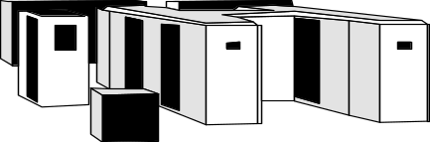
Scheduling for NES
Resource economy model (E.g. [Zhao and Karamcheti ’00], [Plank ’00], [Buyya ’00])
  Grid currency allow owners to “charge” for usage
Choice?
$$$$$$$$$$
$
→No actual economical model is implemented
Nimrod [abramson ’00] presents a study of deadline-scheduling algorithm
  Users specify deadlines for the task of their apps. and can spend more to get tighter deadlines

Slide 5
Our Approach
Our goal is to minimize
  The overall occurrences of deadline misses
  The resource cost
Each request comes with a deadline requirement
Deadline-scheduling algorithm under simple economy model
Simulation on Bricks
  A performance evaluation system for Grid scheduling

Slide 6
The Rest of the Talk
Overview of Bricks and its improvement
  More scalable and realistic simulations
A Deadline-scheduling algorithm for multi-client/server NES systems
  Load Correction mechanism
  Fallback mechanism
Experiments in multi-client multi-server scenarios with Bricks
  Resource load, resource cost, conservatism of prediction, efficacy of our deadline-scheduling

Slide 7
Bricks: A Grid Performance Evaluation System [HPDC ’99]
A Grid simulation framework to evaluate
  Scheduling algorithms
  Scheduling framework components
  (e.g. predictors)
Bricks provides
  Reproducible and controlled Grid evaluation environments
  Flexible setups of simulation environments (Grid topology, resource model, client model)
  Evaluation environment for external Grid components (e.g., NWS forecaster)

Slide 8
The Bricks Architecture [HPDC ’99]
Scheduling Unit
Predictor
NetworkPredictor
ServerPredictor
Scheduler
ResourceDB
NetworkMonitor
ServerMonitor
Network
Network
Client
Network
Server
Client
Network
Network
Server
Network
Client
Server
Grid Computing Environment

Slide 9
A Hierarchical Network Topology on the improved Bricks
Local Domain
Client
Client
Server
Server
Client
Server
Server
Server
WAN
Client
Client
Client
LAN
Server
Client
Network
Client
Client
Server
Network
Client
Server
Server
Client
Server

Slide 10
Deadline-Scheduling
$
Deadline
Server 1
$$$$$
Server 2
$$
Server 3
Job execution time
Many NES scheduling strategies → Greedy
  assigns requests to the server that completes it the earliest
Deadline-scheduling:
  Aims at meeting user-supplied job deadline specifications

Slide 11
A Deadline-Scheduling Algorithm for multi-client/server NES
1 Estimate job processing timeTsi on each server Si：
  Tsi = Wsend/Psend + Wrecv/Precv + Ws/Pserv (0 ≤ i < n)
  Wsend, Wrecv, Ws: send/recv data size, and logical comp. cost
  Psend, Precv, Pserv: estimated send/recv throughput, and performance
2 Compute Tuntil deadline:
  Tuntil deadline = Tdeadline - now
Server 1
Comp.
Send
Recv
Server 2
Server 3
Estimated job execution time
now
Deadline
Tuntil deadline

Slide 12
A Deadline-Scheduling Algorithm (cont.)
3 Compute target processing time Ttarget:
  Ttarget = Tuntil deadline x Opt (0 < Opt ≤ 1)
4 Select suitable server Si:
  Conditions：MinDiff=Min(Diff si) where Diff si=Ttarget–Tsi≥0
  Otherwise Min(|Diff|)
Tuntil deadline
Ttarget
now
Server 1
Comp.
Send
Recv
Server 2
Server 3
Estimated job execution time

Slide 13
Factors in Deadline-Scheduling Failures
Accuracy of predictions is not guaranteed
Monitoring systems do not perceive load change instantaneously
Tasks might be out-of-order in FCFS queues

Slide 14
Ideas to improve schedule performance
Scheduling decisions will result in an increase in load of scheduled nodes
Server can estimate whether it will be able to complete the task by the deadline
→ Load Correction: Use corrected load values
Fallback: Push a scheduling functionality
to server

Slide 15
The Load Correction Mechanism
Modify load predictions from monitoring system, LoadSi, as follows:
  LoadSi corrected = LoadSi + Njobs Si x pload
  Njobs Si: the number of scheduled and unfinished jobs on the server Si
  Pload (= 1): arbitrary value that determines the magnitude
Predictor
NetworkPredictor
ServerPredictor
Corrected prediction
Scheduler
ResourceDB
NetworkMonitor
ServerMonitor

Slide 16
The Fallback Mechanism
Server can estimate whether it will be able to complete the task by the deadline
Fallback happens when:
  Tuntil deadline < Tsend + ETexec + ETrecv &&
  Nmax. fallbacks ≥ Nfallbacks
  Tsend : Comm. duration (send)
  ETexec, ETrecv: Estimated comm. (recv) and comp. duration
  Nfallbacks, Nmax. fallbacks : Total/Max. number of fallbacks
Scheduler
Server
Re-submit
Client
Fallback
Server

Slide 17
Experiments
Experiments in multi-client multi-server scenarios with Bricks
  Resource load, resource cost, conservatism of prediction, efficacy of our deadline-scheduling
Performance criteria:
  Failure rate: Percentage of requests that missed their deadline
  Resource cost: Avg. resource cost over all requests
    cost = machine performance
    E.g. select 100 Mops/s and 300 Mops/s servers
    → Resource cost=200

Slide 18
Scheduling Algorithms
Greedy: Typical NES scheduling strategy
Deadline (Opt = 0.5, 0.6, 0.7, 0.8, 0.9)
Load Correction (on/off)
Fallback (Nmax fallbacks = 0/1/2/3/4/5)

Slide 19
Configurations of the Bricks Simulation
Grid Computing Environment (≅75 nodes, 5 Grids)
  # of local domain: 10, # of local domain nodes: 5-10
  Avg. LAN bandwidth: 50-100[Mbits/s]
  Avg. WAN bandwidth: 500-1000[Mbits/s]
  Avg. server performance: 100-500[Mops/s]
  Avg. server Load: 0.1
Characteristics of client jobs
  Send/recv data size: 100-5000[Mbits]
  # of instructions: 1.5-1080[Gops]
  Avg. intervals of invoking:
  60(high load), 90(medium load), 120(low load) [min]

Slide 20
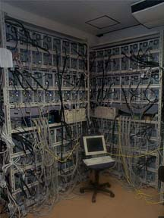
Simulation Environment
The Presto II cluster:
128PEs at Matsuoka Lab., Tokyo Institute of Technology.
  Dual Pentium III 800MHz
  Memory: 640MB
  Network: 100Base/TX
Use APST[Casanova ’00] to deploy Bricks simulations
24 hour simulation x 2,500 runs
(1 sim. takes 30-60 [min]
with Sun JVM 1.3.0+HotSpot)

Slide 21
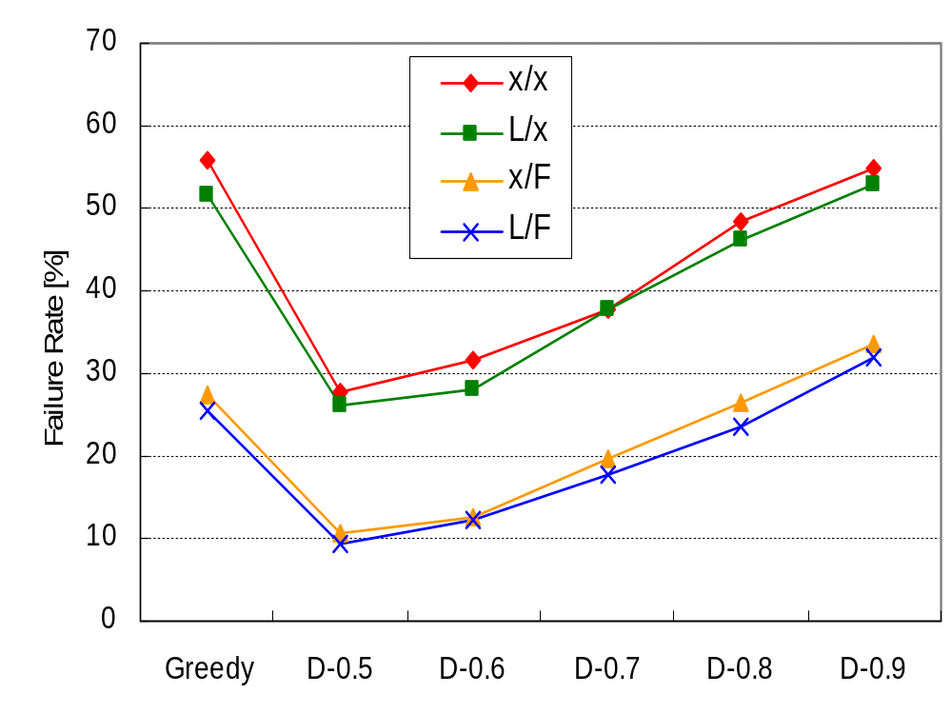
Comparison of Failure Rates
(load: medium)
Typical NES scheduling
Fallback leads to
significant reductions
Load Correction
is NOT useful

Slide 22
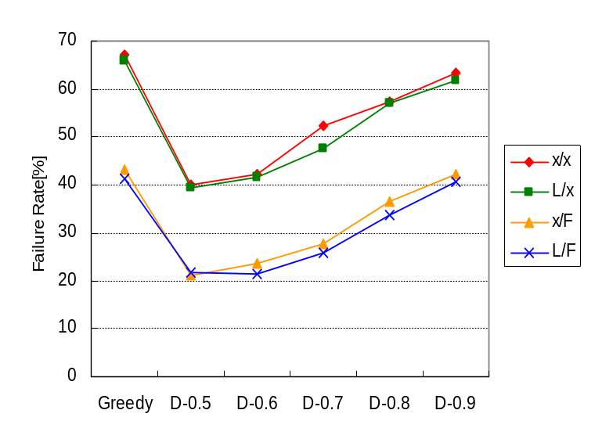
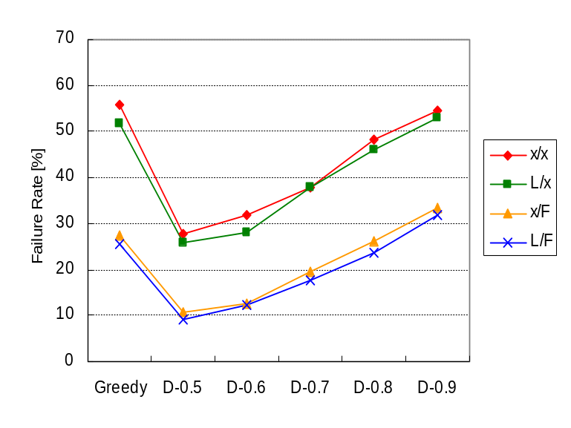
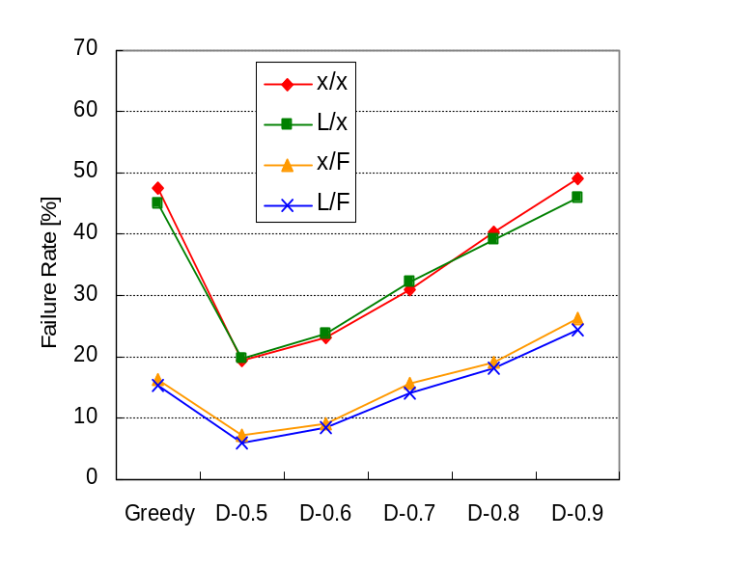
Comparison of Failure Rates
(Load: high, medium, low)
High
Medium
Low
“Low” load leads to improved failure rates
All show similar characteristics

Slide 23
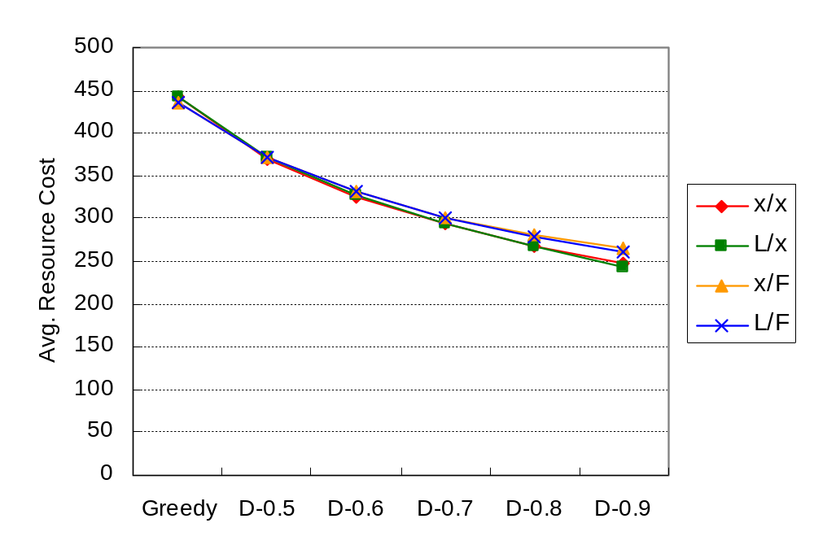
Comparison of Resource Costs
Greedy leads to
higher costs
Even conservative Deadline is descent
c.f. Greedy
Costs decrease when the
algorithm becomes less conservative
Trade-off between failure-rate and cost
by adjusting conservatism of Deadline

Slide 24
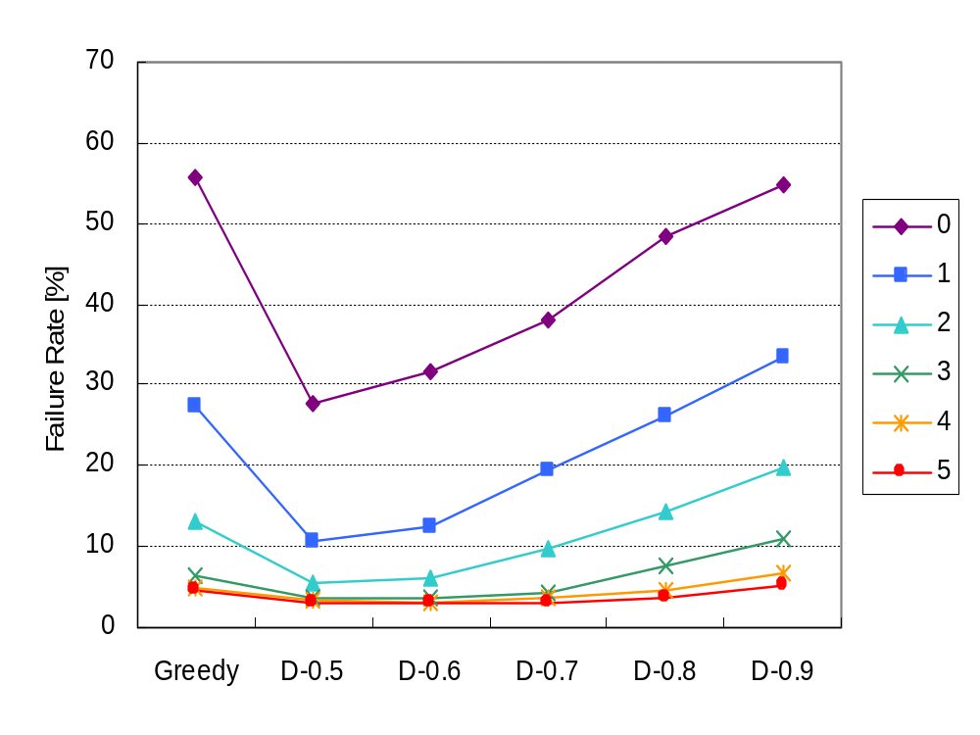
Comparison of Failure Rates
(x/F, Nmax. fallbacks = 0-5)
Multiple fallbacks cause
significant improvement

Slide 25
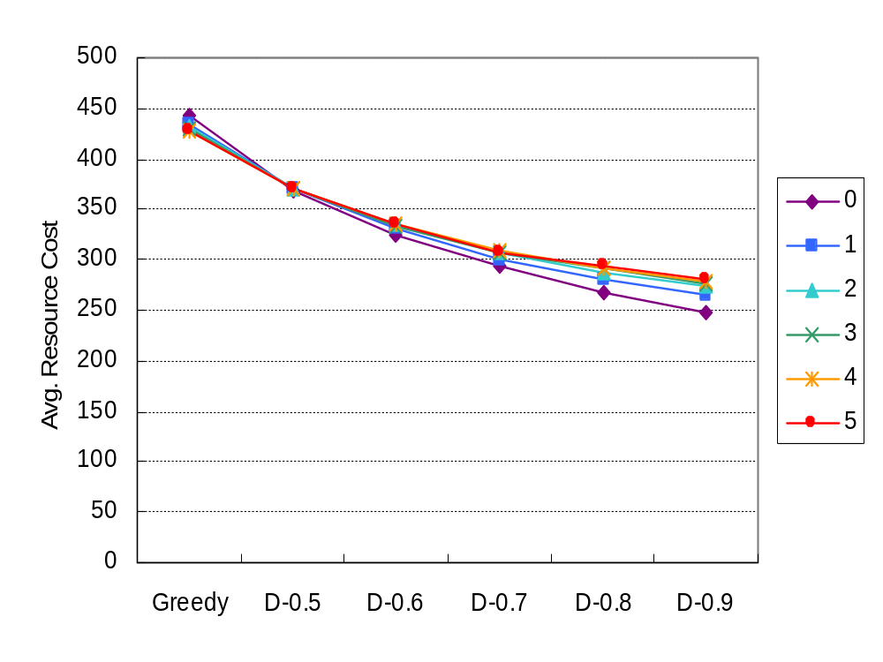
Comparison of Resource Costs
(x/F, Nmax. fallbacks = 0-5)
Multiple fallbacks lead to
“small” increases in costs
NES systems should facilitate multiple fallbacks
as a part of their standard mechanisms

Slide 26
Related Work
Economy model:
  Nimrod [abramson ’00]
    Uses a self-scheduler
    Targets parameter sweep apps. from a single user
Grid performance evaluation systems:
  MicroGrid [Song ’00]
    Emulates a virtual Globus Grid on an actual cluster
    Not appropriate for large numbers of experiments
  Simgrid [Casanova ’01]
    A trace-based discrete event simulator
    Provides primitives for simulation of application scheduling
    Lacks the network-modeling feature Bricks provides

Slide 27
Conclusions
Proposed a deadline-scheduling algorithm for multi-client/server NES systems, and Load Correction and Fallback mechanisms
Investigated performance in multi-client multi-server scenarios with the improved Bricks
The experiments showed
  It is possible to make a trade-off between failure-rate and resource cost by adjusting conservatism
  Load Correction may not be useful
  Future NES systems should use deadline-scheduling with multiple fallbacks

Slide 28
Future Work
Make Bricks support more sophisticated economy models
Investigate their feasibility and improve our deadline-scheduling algorithms
Implement the deadline-scheduling algorithm within actual NES systems
(starting with Ninf: http://ninf.apgrid.org/)

