Slide 1
Performance Analysis of Scheduling and Replication Algorithms on Grid Datafarm Architecture for High-Energy Physics Applications
Atsuko Takefusa (Ochanomizu Univ.)
Osamu Tatebe (AIST)
Satoshi Matsuoka (TITECH/NII)
Youhei Morita (KEK)

Slide 2
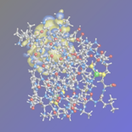
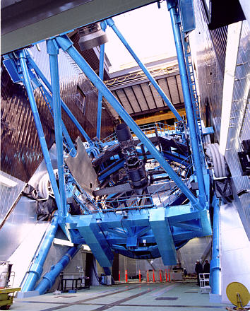
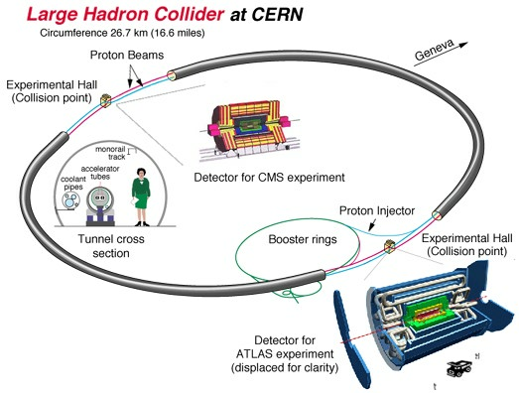
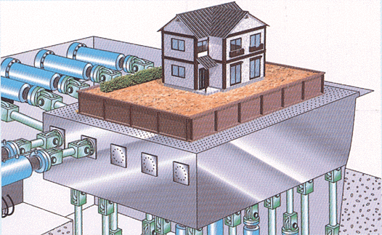
Peta-scale Data Intensive Computing
Large-scale data intensive
computer science and data mining
  HEP, particle physics
    CERN Large Hadron Collider(LHC)
    Experiment (2007)
  Astronomical observatory,
  life information engineering, etc.
Large-scale business DB
  e-Japan, e-commerce
  Dataware house
  Search engine
Subaru Telescope
CERN LHC
Data Grid
3D Earthquake Simulator

Slide 3
Technical Issues with the Data Grid
Techniques of high speed access and data processing, and safe sharing for distributed equipments, machines, humans, or visualization devices
  Scalable parallel I/O bandwidth
    > 100GB/s, > 1TB/s (intra-/inter-system)
  Scalable computing power
    > 1TFLOPS, > 10TFLOPS
  Certification, Sharing controlled data/program, limitation of accesses
System monitoring and management
Fault tolerance / dynamic re-allocation / recovering data and computing

Slide 4

Grid Datafarm：
Grid Virtual File System
http://datafarm.apgrid.org/
/grid
Virtual file system
  Access using hierarchical virtual path name
  Hierarchical access control
Data replica management
  Fault tolerance and load balancing
  e.g. OGSA Data Replication Service, Giggle
High speed file transfer
  File transfer and remote file access
  e.g. GridFTP
ggf
jp
aist
gtrc
file1
file2
file3
pub
file1
file2
/a/b/file3
/a/b/file1
/a/b/file2
/b/file1
/c/file3
/d/file1
/pub/
gsiftp://aist.go.jp/
http://u-tokyo.ac.jp/
ftp://soumu.go.jp/

Slide 5
Grid Datafarm：
Data Parallel Support
http://datafarm.apgrid.org/
Scalability enabled over TB/sec local I/O Bandwidth
  File Affinity Scheduling for distributed data over the Grid
  Local file view – Grid parallel I/O API
Virtual File System
Compute /
I/O node

Slide 6
Performance Analysis on Scheduling and Replication Algorithm on Grid Datafarm
Assuming Grid Datafarm architecture
Realistic assumptions of job processing for CERN LHC experiments starting in 2007
Experiments on the Bricks Grid simulator
Comparison of Data Grid models
  MONARC-style hierarchical model
  vs. centralized data storage model
Comparison of scheduling/replication algorithms
  Owner Computes + background replication
  vs. MCT + on-demand replication

Slide 7

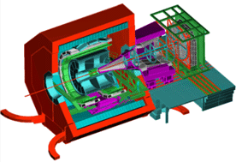
Data Grid Application:
CERN LHC Experiment
~2000 physicists from 35 countries
LHC perimeter 26.7km
ATLAS
detector
40m x 20m
7000 tons
Detector for
LHCb experiment
Collect data
from collisions
of particles
truck
Detector for ALICE experiment

Slide 8
Data Grid Application:
CERN LHC Experiment
Analyze data in different levels of hierarchy
RAW→ESD (Large)
  Frequency:2-4/year
  Input:1PB, Output:100TB
  Comp:1000GSpecInt95*sec
ESD→AOD (Medium)
  Frequency:1/month
  Input:100TB, Output:10TB
  Comp: 25GSpecInt95*sec
AOD→TAG (Small)
  Frequency:1/4 hours
  Input:10TB, Output:0.1TB
  Comp:5GSpecInt95*sec
RAW
Calorimeter- digital
value
reconstruction
Calorimeter reconstruction
algorithm
Event Summary
Data (ESD)
Reconstructed info
Pseudo physical info.
Analysis
Group analysis
Calorimeter energy
Calorimeter reconstruction
algorithm
Analysis Object
Data (AOD)
Physical information
Event selection
Electron identification
algorithm
Individual analysis
TAG
Collection of only
relevant information

Slide 9
Simulation Model: Job Processing
A typical job for each of the job classes, Large, Medium, or Small is handled as follows:
  A user (physicist) at the client machine invokes a job
  The DataGrid scheduler selects a suitable set of servers
  Each server loads the data fragment required by
  the job, over the Grid if non-local
  Each server processes individual portions of the job that the server is assigned to
  The servers send the output to specified storages
  (The client receives only statistical data → negligible)
The time duration to process a job is given as:
ResponseTime = Read + Process + Write
read
input
process
output
write

Slide 10
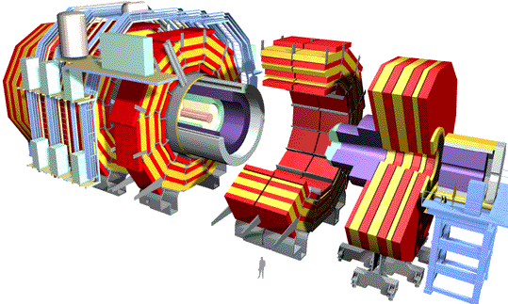
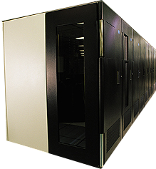

MONARC-style Multi-tier Center Computing Model for LHC
1 TIPS = 25,000 SpecInt95
PC (1999) = ~15 SpecInt95
~PBytes/sec
Online System
~100 MBytes/sec
Offline Farm
~20 TIPS
Bunch crossing per 25 nsecs.
100 triggers per second
Event is ~1 MByte in size
Tier 0
~100 MBytes/sec
~622 Mbits/sec or Air Freight
CERN Computer Center >20 TIPS
HPSS
Tier 1
France Regional Center
US Regional Center
Germany Regional Center
Japan Regional Center
HPSS
HPSS
HPSS
HPSS
~2.4 Gbits/sec
Tier 2
Tier2 Center ~1 TIPS
Tier2 Center ~1 TIPS
Tier2 Center ~1 TIPS
Tier2 Center ~1 TIPS
Tier2 Center ~1 TIPS
Tier 3
~622 Mbits/sec
Institute ~0.25TIPS
Physicists work on analysis “channels”.
Each institute has ~10 physicists working on one or more channels
Data for these channels should be cached by the institute server
Institute
Institute
Institute
Physics data cache
100 - 1000 Mbits/sec
Tier 4
Workstations

Slide 11
Simulation Model:
Data Grid Architectures
Central Model
  All the jobs are processed at a single site
  Advantages: performance, manageability
Tier Model (MONARC-style multi-tier center model)
  Jobs are processed in different levels of the hierarchy
    Must facilitate suitable scheduling and replication policies
  Advantages: lower power consumption and cost per site
read
(a) process on
owner server
read
process
write
process
write
process on
owner server
read
(b) make replica and
process on a
different server
process
…
write
Central model
Tier model

Slide 12
Scheduling and Replication Algorithms for Tier Model
Central Model: file affinity scheduling (disk owner-computes rule)
Tier Model: must facilitate scheduling and replication policies
  On-line scheduling algorithms
  →On-demand replication
  Replication algorithms
  →Background replication

Slide 13
On-line Scheduling Algorithms
On-line Data Grid Scheduler determines DataSourceHost (I/O host), ComputeHost (computation host), DataDestinationHost (I/O host)
Greedy(MCT: Minimum Completion Time)
  Scheduler assigns the job to the host that completes it the earliest
OwnerComputes
  Scheduler selects a ComputeHost that owns the input data and completes the job earliest
LoadBound-Read/-Write
  Scheduler select a ComputeHost with MCT from the host group which satisfies:
  Performanceestimated > Performancespecified
  Performanceestimated = ProcessorPerformance / (LoadAverage+1)
  (Scheduler generates replica at the Read/Write time
  if I/O host != computation host)

Slide 14
Background Replication Algorithm
Replica Manager periodically collect status of hosts and trigger replica creation and migration at its discretion
LoadBound-Replication:
  Compute Perfestimated for all the hosts
  Perfestimated = Perf / (LoadAvg + 1)
  If Perfspecified ＞ Perfestimated ,
  the Replica Manager creates a replica with the largest AccessRate and migrate from the host with the min. Perfestimated to the host with the max.
    AccessRate = Naccesses / (Tcurrent – Tstored)
Aggressive-Replication:
  The Replica Manager always generates a replica of all the data generated by each job to the host with the max. Perfestimated

Slide 15
Replica Elimination Algorithm
If the disk space for a job turns out to be insufficient, or some x % of hosts do not embody some y % of available disk space within the entire DataGrid, “replica Elimination” is performed
Select data that have replicas within the Grid
Sort all the selected data by the last recently used (LRU) time
Compute Access Rate ARelim for the first N data on the list
ARelim = Naccesses / (Tcurrent – Tstored) / Ncopies
(N_{Copies} : # of replicas)
Select and eliminate replica for data with min. ARelim
while maintaining the following condition:
TotalDiskSize × Compactness > AvailableDiskSize
(Compactness determines the frequency of elimination)
If the condition 4 is not satisfied, return to step 3 for the next N data
(N = 10, x=80, y=90, Naccesses=10, Compactness=0.9 in our simulations)

Slide 16
Evaluation on Bricks
Evaluation on the Bricks Grid simulator
Investigate the performance of our simulation scenarios for the LHC experiment:
  Grid Datafarm Architecture
  Central Model vs. Tier Model
  12 different policies: 4 scheduling algorithms x 3 replication algorithms
  Data access localities (random, time locality)
Compare
  Response time

Slide 17
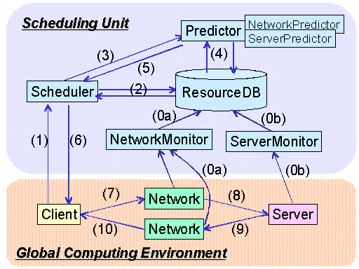
Bricks Grid Simulator
Java based discrete event simulator
Represents the behaviors of network and server using queues
Provides a typical Grid scheduling modules
Flexible settings of simulation environment
  Grid topologies
  (e.g. hierarchical network)
  Behaviors of Server and network
  Client model
Allows to evaluate
various scheduling algorithms
on dynamic Grid environment
http://grid-team.is.titech.ac.jp/bricks/

Slide 18
Data Grid Extension of the Bricks Grid Simulator
Provides Replica Manager as a Scheduling Unit module
Provides Replica Catalog
Provides disk management mechanism
Represents local disk I/O overheads using queues:
Host A
Host B
Processor A
Processor B
read data
process job
Network A to B
Disk A
Disk B
Network B to A
write results

Slide 19
Evaluation on Bricks
Evaluation on the Bricks Grid simulator
Investigate the performance of our simulation scenarios for the LHC experiment:
  Grid Datafarm Architecture
  Central Model vs. Tier Model
  12 different policies: 4 scheduling algorithms x 3 replication algorithms
  Data access localities (random, time locality)
Compare
  Response time

Slide 20
Experimental Environment for the Grid Datafarm System
Each data required for a single job is fragmented over nodes on the Grid
Parallel I/O and parallel processing
Each job is allocated to a single site and processed on
the site
Tier0
Compute/
I/O node
Tier1
Tier2

Slide 21
Simulation Settings: Environment
Model | Disk [PB] | Performance [MSpecInt95] | # of Nodes on the Site | Total I/O Bandwidth
Central | 2 | 0.5-1.8 | 10000 | 1[TB/sec]
Tier | T0 (x1): 2 | 0.6/0.5/0.4 | 10000 | 1[TB/sec]
 | T1 (x4): 1 | 0.3/0.25/0.2 | 5000 | 500[GB/sec]
 | T2 (x16): 0.1 | 0.03/0.025/0.02 | 500 | 50[GB/sec]
Similar in settings to the GriPhyN simulation[Grid2001] for Tier Model
Queuing theory indicates
  Est. avg. response time in Central Model is 38.575-1.337 [hours]
  Central Model with under 0.453318[MSpecInt95] saturates and cannot process LHC jobs
WAN and Local I/O bandwidth are set to 10[Gbps] and 100[MB/sec]
On Grid Datafarm architecture aggregation local I/O bandwidth is:
Total I/O Bandwidth = Local I/O Bandwidth × # of nodes on the site

Slide 22
Simulation Settings: Job
Job | # events / Job | Comp. Size [GSI95*sec] | Frequency (Avg.) | Input [TB] | Output [TB]
Large: RAW→ESD | 1G | 1000 | 1/4 [月] | 1000 | 100
Medium: ESD→AOD |  | 25 | 1/1 [月] | 100 | 10
Small: AOD→TAG |  | 5 | 1/4[時間] | 10 | 0.1
Actual parameters for LHC in the MONARC Report2
All the initial data(1PBx1, 100TBx2, 10TBx4) are stored in the Tier0 site and the total # of data is increasing during the simulations
1 year simulation x 10 for each algorithms
Executed simulation on the Presto III cluster (Dual Athlon MP 1900+, 768MB memory, 256 nodes) at TITECH

Slide 23
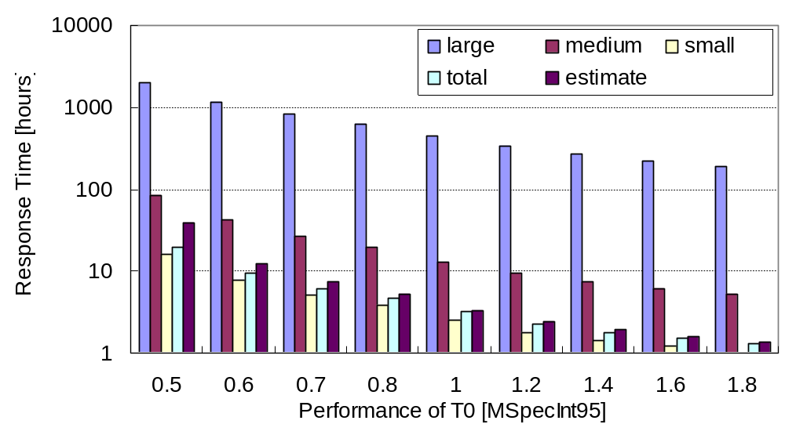
Central Model: Avg. Response Time
(Queuing Theory)
Avg. response time drastically increases
as the site performance decreases
2.8GHz Pentium 4 x 10⁴

Slide 24
Combinations of Scheduling and Replication Algorithms for Tier Model
Scheduling Algorithms (on-demand replication)
  Greedy
  OwnerComputes
  LoadBound-Read
  LoadBound-Write
Replication Algorithms (Backgroung replication)
  LoadBound-Replication
  Aggressive-Replication
  DoNothing (no background replication)
4 Scheduling x 3 Replication = 12

Slide 25
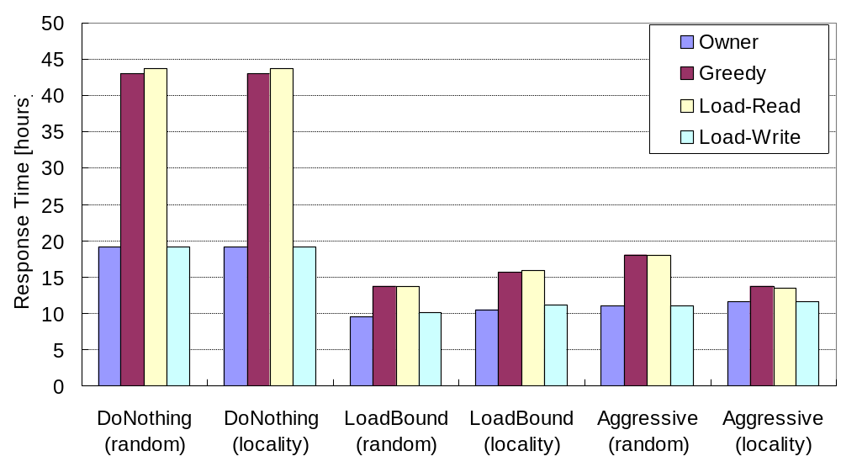
Tier Model: Avg. Response Time
(T0, T1, T2) = (0.5,0.25,0.025)
Scheduling Algorithms
OwnerComputes+
LoadBound-Replication
exhibit the best performance
Background replication
(LoadBound/Aggressive-Replication)
exhibit improved performance
Replication Algorithms (Access Pattern)

Slide 26
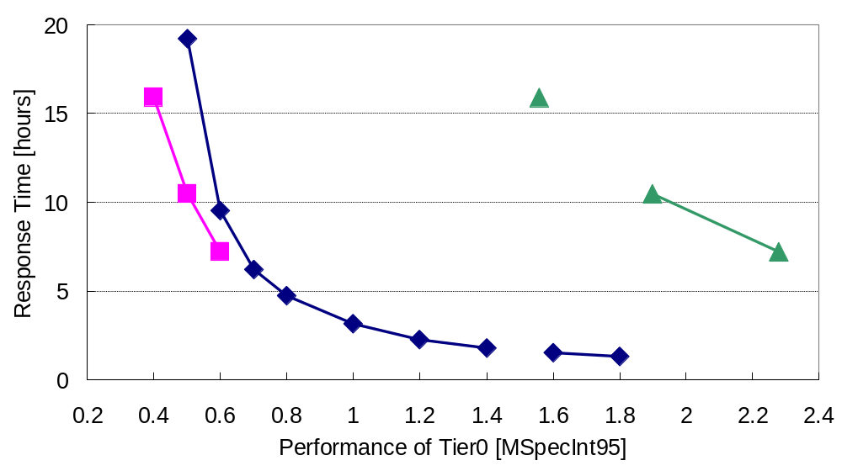
Comparison of Central Model vs. Tier Model
Central w/ 0.453318[MSpecInt95] saturates
Tier
Owner+
LoadRep
(Total)
Tier w/replication achieves
higher performance
while each tier being
smaller than central
Tier
Owner+
LoadRep
Central
Central is effective
2.8GHz Pentium 4 x 10⁴

Slide 27
Related Work: A Study of GriPhyN Simulation[HPDC-11, ‘02]
GriPhyN [Univ. of Chicago et al]
  Targets the CERN LHC experiment
  Construct Globus-based peta-scale virtual Data Grid
Simulation study for scheduling and replication for DataGrid
  Propose External Scheduler, Local Scheduler, and Dataset Scheduler for DataGrid scheduling and replication
  Evaluated External and Dataset Scheduling Algorithms
    JobDataPresent (OwnerComputes) + replication shows improved performance
  Not assume the actual parameters for the LHC experiment
  (small job granularity, shorter duration, # of “original” data is NOT increasing)
↔ Our study: Experiments on Grid Datafarm architecture
w/ actual parameters for the CERN LHC

Slide 28
Conclusions
Evaluate the performance of DataGrid system models by using the Bricks Grid simulator, newly enhanced with Data Grid
  Affinity scheduling enabled over TB/sec local I/O bandwidth on the Grid Datafarm architecture
Compare Central vs. MONARC-style Tier Model, assuming the Grid Datafarm architecture:
  Central Model is effective and could be constructed in a feasible fashion at this point
  In Tier Model, Background replication algorithms proves to be effective
  Tier Model achieves higher performance while each tier being smaller than Central

Slide 29
Future Work
Propose effective replica elimination algorithm
Propose suitable scheduling and replication algorithms and evaluate on large-scale actual environments

