Slide 1
Overview of a Performance Evaluation System for Global Computing Scheduling Algorithms
A. Takefusa^{*1}, S. Matsuoka^{*2} ,
H. Nakada^{*3} , K. Aida^{*2} , U. Nagashima^{*4}
^{*1}Ochanomizu Univ., ^{*2}TITECH, ^{*3}ETL，^{*4}NIMC
http://ninf.is.titech.ac.jp/bricks/

Slide 2

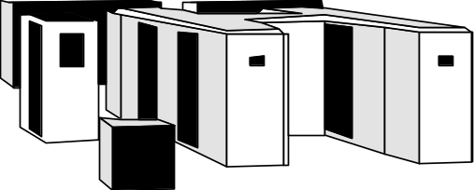
Global Computing System
High performance global computing using computational and data resources
Effective use of resources
  Resource monitoring and prediction
  Task scheduling
Scheduling Framework
client
server
task
result
client
WAN
server
client

Slide 3
Evaluation of Scheduling in Global Computing
Unrealistic to compare scheduling algorithms w/physical benchmarks
  Reproducible large scale benchmarks are too difficult under various
  Networks - topology, bandwidth, congestion, variance
  Servers - architecture, performance, load, variance
Validity of scheduling framework modules have not been well-investigated.
  Benchmarking cost of monitor / predictor under real environment HIGH

Slide 4
A Performance Evaluation System: Bricks
Performance evaluation system for
  Global computing scheduling algorithms
  Scheduling framework components
  (e.g., sensors, predictors)
Bricks provides
  Reproducible and controlled evaluation environments
  Flexible setups of simulation environments
  Evaluation environment for existing global computing components (e.g., NWS)

Slide 5
Outline
Overview of the Bricks system
The Bricks architecture
Incorporating existing global computing components (ex. NWS)
Bricks experiments

Slide 6
Overview of Bricks
Consists of simulated Global Computing Environment and Scheduling Unit.
Allows simulation of various behaviors of
  resource scheduling algorithms
  programming modules for scheduling
  network topology of clients and servers
  processing schemes for networks and servers (various queuing schemes)
  using the Bricks script.
Makes benchmarks of existing global scheduling components available

Slide 7
The Bricks Architecture
Scheduling Unit
Predictor
NetworkPredictor
ServerPredictor
Scheduler
ResourceDB
NetworkMonitor
ServerMonitor
Network
Client
Server
Network
Global Computing Environment

Slide 8
Global Computing Environment
Client
  represents user of global computing system
  invokes global computing Tasks
    Amount of data transmitted to/from server,
    # of executed instructions
Server
  represents computational resources
Network
  represents the network interconnecting
  the Client and the Server
Predictor
Scheduler
ResourceDB
NetworkMonitor
ServerMonitor
Represented using queues
Network
Client
Network
Server

Slide 9
Queuing Model-based Global Computing Simulation [NASA Workshop 98]
Other Tasks
Other Data
Other Data
Site1
Server A
Site1’
Q_{ns1}
Q_{nr1}
Client A
Client A’
λ_{ns}
μ_{ns}
Q_{s1}
λ_{nr}
μ_{nr}
λ_{s}
μ_{s}
Q_{ns2}
Q_{nr2}
Site2
Server B
Site2’
Client B
Client B’
Q_{ns3}
Q_{nr3}
Q_{s2}
Q_{ns4}
Server C
Q_{nr4}
Client C
Client C’
Q_{s3}

Slide 10
Communication/Server Models using queues in Bricks
Extraneous data/jobs generation
Congestion represented by adjusting the amount of arrival data/jobs from other nodes/users [NASA Workshop98]
Observed parameters
Bandwidth/performance at each step = observed parameters of real environment.
Need to specify only several parameters
Greater accuracy requires larger simulation cost
Network/Server behaves as if real network/server
Simulation cost lower than the previous model
Need to accumulate the measurements

Slide 11
Scheduling Unit
NetworkMonitor/ServerMonitor
measures/monitors network/server status in global computing environments
ResourceDB
serves as scheduling-specific database, storing the values of various measurements.
Predictor
reads the measured resource information from ResourceDB, and predicts availability of resources.
Scheduler
allocates a new task invoked by a client
on suitable server machine(s)
Predictor
Scheduler
ResourceDB
NetworkMonitor
ServerMonitor
Network
Client
Network
Server

Slide 12
Overview of Global Computing Simulation with Bricks
Scheduling Unit
NetworkPredictor
Predictor
ServerPredictor
Query predictions
Predictions
Perform Predictions
Scheduler
ResourceDB
Query available servers
Store observed information
Inquire
suitable server
NetworkMonitor
ServerMonitor
Returns
scheduling info
Monitor periodically
Invoke task
Sends the task
Network
Client
Server
Network
Execute task
Return results
Global Computing Environment

Slide 13
Incorporating External Components
Scheduling Unit module replacement
  Replaceable with other Java scheduling components
  Components could be external --- in particular, real global computing scheduling components
  →allowing their validation and benchmarking under simulated and reproducible environments
Bricks provides the Scheduling Unit SPI.

Slide 14
Scheduling Unit SPI
interface ResourceDB {
void putNetworkInfo();
void putServerInfo();
NetworkInfo getNetworkInfo();
ServerInfo getServerInfo();
}
interface NetworkPredictor {
NetworkInfo getNetworkInfo();
}
interface ServerPredictor {
ServerPredictor getServerInfo();
}
interface Scheduler {
ServerAggregate selectServers();
}
NWS
Persistent
State
NWS
Sensor
NWS Forecaster
NWS API
NWS Adapter
NWSResource
DB
NWSNetwork
Predictor
NWSServer
Predictor
Monitor
Scheduler
Bricks Scheduling Unit SPI
Bricks Global Computing Environment Part

Slide 15
Case study
NWS[UCSD] integration into Bricks
  monitors and predicts the behavior of global computing resources
  has been integrated into several systems, such as AppLeS, Globus, Legion, Ninf
  Orig. C-based API
→ NWS Java API development
→ NWS run under Bricks

Slide 16
The NWS Architecture
Persistent State （→Replace ResourceDB）
is storage for measurements
Name Server
manages the correspondence between the IP/domain address for each independently-running modules of NWS
Sensor （→Network/ServerMonitor）
monitors the states of networks/servers
Forecaster （→ Replace Predictor）
predicts availability of
the resources
Sensor
Persistent State
Persistent State
Forecaster
Forecaster
Name Server
Sensor
Sensor

Slide 17
Integrating NWS into Bricks
NWS
Persistent State
NWS Forecaster
queries NWS Forecaster
for info
NWS Java API
NWS
Ｂｒｉｃｋｓ
NWSAdapter
Scheduling Unit
Predictor
NWSNetworkPredictor
store info into NWS
NWSServerPredictor
Scheduler
NWSResourceDB
Orig. NWS modules
queries Predictor for
availability info
store observed info
NetworkMonitor
ServerMonitor
NWS Proxy Components
monitor periodically
Global Computing Environment

Slide 18
Bricks Experiments
The experiments conducted by running NWS under a real environment vs. Bricks environment
  Whether can Bricks provide
  A simulation environment for global computing with reproducible results?
  A benchmarking environment for existing global computing components?
Experiment Procedure
  1. Actual measurement: Have NWS modules measure and predict parameters real wide-area environment
  2. Simulation: Drive Bricks under the NWS measurements, and have NWS Forecaster make predictions under Bricks simulation

Slide 19
Overview of Experiments
NWS Forecaster
1. Actual environment
2. Bricks simulated environment
NWS Sensor
at TITECH
NWS Sensor
at ETL
Observed
bandwidth
Predicted
information
1
2
NWS Forecaster
Predicted
information
Scheduler
NWS Persistent State
Monitor
Observed
bandwidth
Network
Client
Server
Network

Slide 20
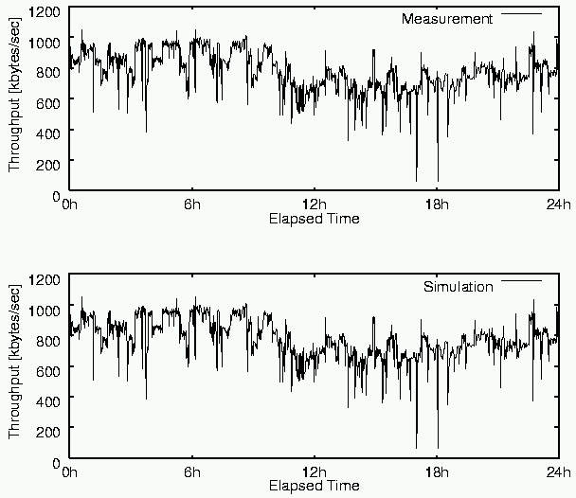
Bricks Experimental Results 1:
Comparison of Observed Bandwidth
Under real environment(24hours)
The Bandwidth measured under Bricks is quite similar to that for the real environment
real environment
Under Bricks simulated environment(24hours)
Bricks
NWS:
TITECH ⇔ ETL
network monitoring: 60[sec]
network probe :300[KB]
Bricks:
cubic spline interpolation

Slide 21
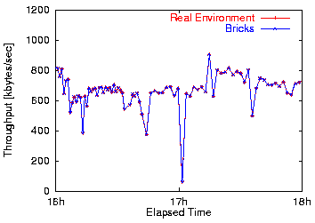
Bricks Experimental Results 1:
Comparison of Observed Bandwidth
real environment
2 hours comparison
Bricks
Bandwidths measured under real environment and Bricks coincide well

Slide 22
Overview of Experiments
NWS Forecaster
1. Actual environment
2. Bricks simulated environment
NWS Sensor
at TITECH
NWS Sensor
at ETL
Observed
bandwidth
Predicted
information
1
2
NWS Forecaster
Predicted
information
Scheduler
NWS Persistent State
Monitor
Observed
bandwidth
Network
Client
Server
Network

Slide 23
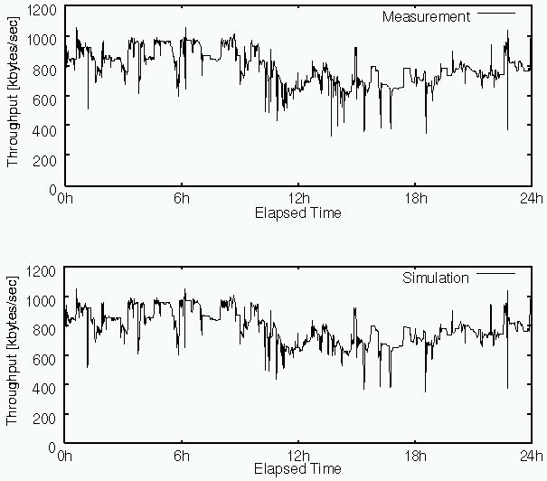
Bricks Experimental Results 2:
Comparison of Predicted Bandwidth
Under real environment(24hours)
real environment
The NWS Forecaster functions and behaves normally under Bricks
Under Bricks (24hours)
Bricks

Slide 24
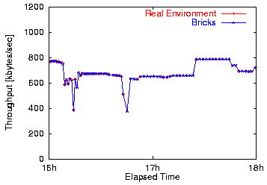
Bricks Experimental Results 2:
Comparison of Predicted Bandwidth
実環境
real environment
2 hours comparison
of predicted bandwidth
by the NWS Forecaster
Bricks
Bricks
The both predictions are very similar.
→
Bricks provides existing global computing components with a benchmarking environment

Slide 25
Related Work
Osculant Simulator[Univ. of Florida]
  evaluates Osculant: bottom-up scheduler for heterogeneous computing environment
  makes various simulation settings available
WARMstones [Syracuse Univ.]
  is similar to Bricks, although it seems not have been implemented yet?
  provides an interface language(MIL) and libraries based on the MESSIAHS system to represent various scheduling algorithms
  has not provided a benchmarking environment for existing global computing components
→Bricks provides SPI

Slide 26
Conclusions
We proposed the Bricks performance evaluation system for global computing scheduling
  Bricks provides multiple simulated reproducible benchmarking environments for
    Scheduling algorithms
    Existing global computing components
Bricks experiments showed
  Bricks could perform accurate simulation
  The NWS Forecaster behaved normally under Bricks
  → Evaluation of existing global computing components now possible

Slide 27
Future Work
Simulation model needs to be more sophisticated and robust
  Task model for parallel application tasks
  Server model for various server machine architectures(e.g., SMP，MPP) and scheduling schemes(e.g., LSF)
Component integration (e.g., direct support for IP)
Investigation of various scheduling algorithms
  On parallel simulation cluster

Slide 28
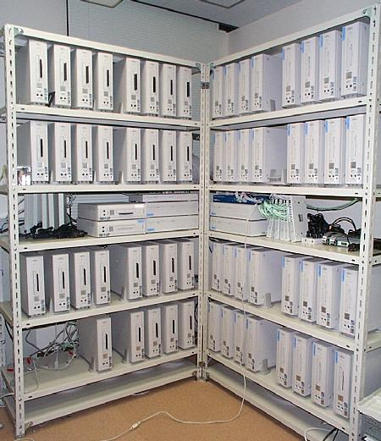
Cluster
64PE cluster at Matsuoka Lab., TITECH
  Pentium II 350MHz
  Memory: 128MB
  NIC: Intel EtherExpress Pro 10/100
Parallel simulations of global computing environments

Slide 29
Acknowledgments
The NWS team
  Rich Wolski [UTK]
  Jim Hayes, Fran Berman [UCSD]
The Ninf team
  Satoshi Sekiguchi [ETL]
  Mitsuhisa Sato [RWCP]
  Many others [ETL, TITECH]

