Slide 1
Performance Analysis of DataGrid Systems for High Energy Physics Applications
竹房あつ子 (お茶の水女子大学)，
Golnaz Bahmanyar (東京工業大学)，
建部修見 (産業技術総合研究所)，
松岡聡 (東京工業大学)

Slide 2
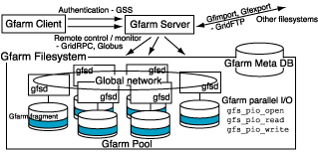
DataGrid
A framework to process/manage T~Pbyte-scale data
Ensures data management, job allocation, replication
DataGrid projects:
  Gfarm [KEK, AIST/TACC,
  TITECH, U-Tokyo]
    Parallel I/O, SPMD
    Owner Computes Rules
  GriPhyN [ANL]
    Peta-scale Virtual-Data Grids
  EU DataGrid [CERN]
  PPDG (Particle Physics DataGrid) [US]

Slide 3
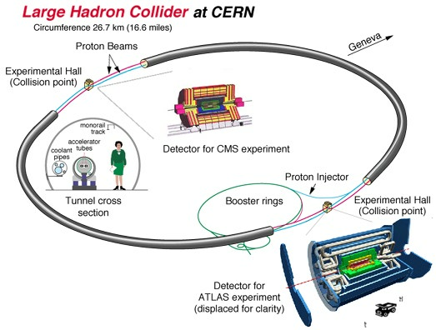

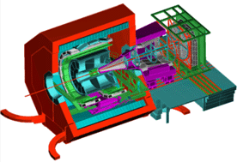
Example: Large Hadron Collider Accelerator at CERN
~2000 physicists from 35 countries
ATLAS Detector
40mx20m
7000 Tons
Detector for
LHCb experiment
LHC
Perimeter 26.7km
Truck
Detector for ALICE experiment

Slide 4
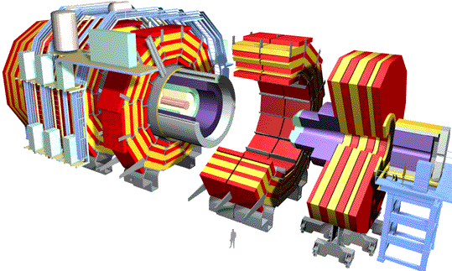
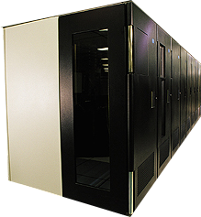

MONARC Hierarchical
Computing Model for LHC
1 TIPS = 25,000 SpecInt95
PC (1999) = ~15 SpecInt95
~PBytes/sec
Online System
~100 MBytes/sec
Offline Farm
~20 TIPS
Bunch crossing per 25 nsecs.
100 triggers per second
Event is ~1 MByte in size
Tier 0
~100 MBytes/sec
~622 Mbits/sec or Air Freight
CERN Computer Center >20 TIPS
HPSS
Tier 1
France Regional Center
Germany Regional Center
Italy Regional Center
US Regional Center
HPSS
HPSS
HPSS
HPSS
~2.4 Gbits/sec
Tier 2
Tier2 Center ~1 TIPS
Tier2 Center ~1 TIPS
Tier2 Center ~1 TIPS
Tier2 Center ~1 TIPS
Tier2 Center ~1 TIPS
Tier 3
~622 Mbits/sec
Institute ~0.25TIPS
Physicists work on analysis “channels”.
Each institute has ~10 physicists working on one or more channels
Data for these channels should be cached by the institute server
Institute
Institute
Institute
Physics data cache
100 - 1000 Mbits/sec
Tier 4
Workstations

Slide 5
DataGrid Research Issues
Tier 1
Validity of tier-model
  Performance
  Manageability
  Electric power
  Cost, etc.
Job allocation and replication
  GriPhyN analyzed various replication/caching strategies using different access patterns in simulations [Ranganathan and Foster, ‘02]
    Fast Spread Saves bandwidth
    Cascading yields faster response
    “download” case only
central
site
Tier 2
Tier 3
…
Tier 4

Slide 6
DataGrid Application Scenario:
High Energy Physics Data Analysis
RAW
Calorimeter- digital
value
Collect data from collision of particles and analyze the data
Analyze data in different levels of hierarchy
  RAW→ESD
    2-4 times/year
  ESD→AOD
    once/month
  AOD→TAG
    once/4 hours
reconstruction
Calorimeter reconstruction
algorithm
Event Summary
Data (ESD)
Reconstructed info
Pseudo physical info.
Analysis
Group analysis
Calorimeter energy
Calorimeter reconstruction
algorithm
Analysis Object
Data (AOD)
Physical information
Event selection
Electron identification
algorithm
Individual analysis
TAG
Collection of only
relevant information

Slide 7
Simulation Model: Job processing
A typical job in HEP experiments will
be handled as bellow:
  A user (a physicist) at the client machine
  invokes a job
  The DataGrid scheduler selects a suitable
  set of servers
  Each server loads the data fragment required
  for the job, over the Grid if non-local
  Each server processes individual portion of the job
  The servers send the output to specified storages
  (The client receives only statistical information →negligible)
The time duration is given as:
read
data fragment
process
result
write
T_response=T_read+T_process+T_write

Slide 8
Simulation Model:
DataGrid Architectures
Two models for simulation
  Central model: Processing is done at one central site
  Tier model: Processing is done at different hierarchy levels of regional centers (the MONARC style)
    DataGrid systems must facilitate suitable scheduling and replication policies
read
process on
owner server
process
write
read
process
write
process on
owner server
make replica and
process on a
different server
read
process
…
write
Central model
Tier model

Slide 9
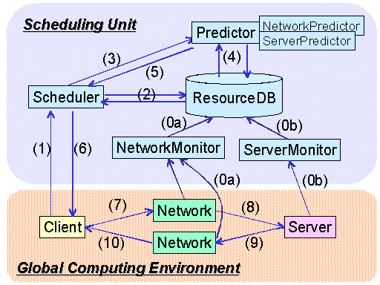
Bricks Grid Simulator
A discrete event simulator written in Java
Network and Server are represented using “queues”
Provide canonical Grid scheduling modules
Provide flexible setups of simulation environments
  Grid topology
  (e.g. hierarchical network topology)
  Resource model
  Client model
Various scheduling analysis
under dynamic environment is
possible
http://grid-team.is.titech.ac.jp/bricks/

Slide 10
DataGrid Extension of Bricks
Storage representation:
  The solid lines: a job workflow for the “owner computes case”
  The solid+dotted lines: a job workflow when data required for a job is not stored locally on the compute processor
Provide Replica Manager as a Scheduling Unit module
Host A
Host B
Processor A
Processor B
read data
process job
Network A to B
Disk A
Disk B
Network B to A
write results

Slide 11
Scheduling and Replication Policies for Tier Model
Owner Computes Rules in Central Model
Various scheduling and replication strategies in Tier Model
  Scheduling Policies: on-demand replication
  Replication Policies: background replication
  Criteria:
    Compute server performance
    Load average
    # of accesses
    # of copies (replicas)
    Available disk size

Slide 12
The 8 Combinations of Scheduling and Replication Policies
Scheduling Policies | Replication Policies | ComputeHost Selection | Timing of Replication | Object of Replica Creation | Destination of Replica
Greedy | - | MCT | Read | Input Data | Compute Host
Owner Computes | - | Owner + MCT | - | - | -
LoadBound-Read | - | MCT + Load | Read | Input Data | Compute Host
LoadBound-Write | - | MCT + Load | Write | Output Data | Arbitrary
AccessBound-Read | - | MCT + # Access | Read | Input Data | Compute Host
AccessBound-Write | - | MCT + #Access | Write | Output Data | Arbitrary
Owner Computes | LoadBound- Replication | MCT | Anytime | Input Data / Arbitrary | Compute Host / Arbitrary
Owner Computes | AccessBound-Replication | MCT | Anytime | Input Data / Arbitrary | Less Access Host

Slide 13
Replica Elimination
If the storage space for a job turns out to be insufficient, or some x% of hosts do not embody some y% of available storage space within the entire DataGrid, “replica elimination” is performed:
Select data that have replicas within the DataGrid environment.
Sort all the selected data by the last recently used (LRU) time.
Calculate AccessRateForCompaction as follows:
AccessRateForCompaction = Naccesses / (Tcurrent – Tstored) / Ncopies
Ncopies indicates the # of replicas within the environment.
Select and eliminate replica for data with minimum AccessRate from the first N data while maintaining the following condition:
TotalDiskSize ×Compactness > AvailableDiskSize
If not satisfied, return to Step 3 for the next N data.
In our simulation, Naccesses is set to 10.

Slide 14
Evaluation
Investigate the performance of our simulation scenarios:
  Assume actual HEP application scenario
  Central model vs. Tier model
  The policies for scheduling/replication in Tier Model
  Use the Bricks Grid simulation framework
Compare:
  Response time
  Network bandwidth
  Computation load
  Distribution of data fragment required

Slide 15
Simulation Settings / Environment
 | Storage | Performance | Cluster Nodes
Central Model | 2 PB | 0.5-1.8 M SI95 | 10000
Tier Model | T0: 2PB | 0.6/0.5/0.4 M SI95 | 10000
 | T1: 1PB x 4 | 0.3/0.25/0.2 M SI95 | 5000
 | T2: 100TB x 16 | 0.03/0.025/0.02 M SI95 | 500
similar in settings to the GriPhyN simulation study.
Est. avg. response time in Central Model is 38.575-1.337 [hours]
Queuing theory indicates Central Model with 0.4 [MSI95] saturates and cannot process LHC jobs.
WAN and local I/O bandwidth are set to 10[Gbps] and 100[MB/sec], assuming viable technology level in 2006.
Assume parallel I/O and parallel processing and each job does not cross site boundaries

Slide 16
Simulation Settings / Job
Job | Process on ATLAS | # events / Job | Comp. size [GSI95*sec] | Frequency(Avg.) | Input size [TB] | Output size [TB]
Large | RAW→ESD | 1G | 1000 | 1/4 [months] | 1000 | 100
Medium | ESD→AOD |  | 25 | 1/1 [months] | 100 | 10
Small | AOD→TAG |  | 5 | 1/4 [hours] | 10 | 0.1
Analyzed the jobs running different levels of analysis in the actual LHC experiments
Initially all data (1000TBx1, 100TBx2, 10TBx4) resides at Tier 0 in all the scenarios
Conduct thousands of 1-year simulations using the Presto IV cluster (Dual Athlon MP 1900+, 768MB memory, 256 nodes) at TITECH

Slide 17
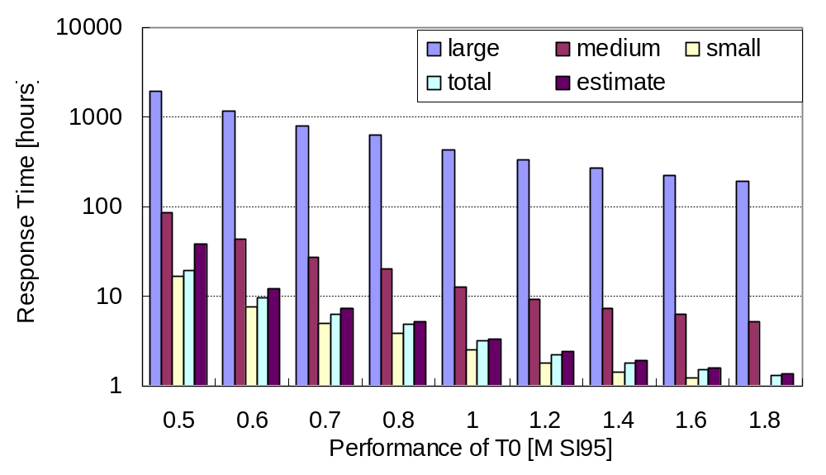
Central Model Response Time

Slide 18
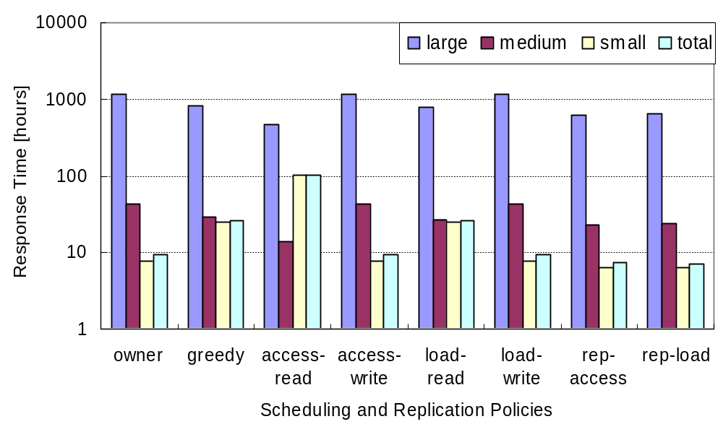
Tier Model Response Time
(T0, T1, T2) = (0.6,0.3,0.03)

Slide 19
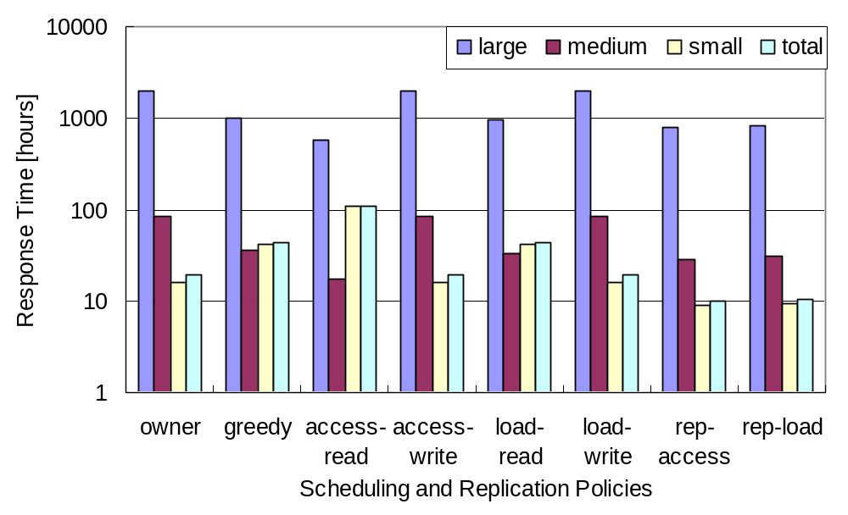
Tier Model Response Time
(T0, T1, T2) = (0.5,0.25,0.025)

Slide 20
Comparison of Response Time
 | Tier Model (w/rep-load) [hours]
Job | Tier0=0.4 | Tier0=0.5 | Tier0=0.6
Large | 1107.225 | 821.4293 | 631.6985
Medium | 39.8839 | 30.91244 | 23.85899
Small | 14.2859 | 9.262224 | 6.25774
Total | 15.90689 | 10.47862 | 7.198592
Job | Central Model [hours]
 | 0.4 | 0.5 | 0.6 | 0.7 | 0.8
Large | x | 1952.214 | 1149.828 | 809.387 | 629.5447
Medium | x | 84.50168 | 42.63323 | 26.63869 | 19.73125
Small | x | 16.21089 | 7.782969 | 5.007441 | 3.799008
Total | x | 19.18618 | 9.513762 | 6.21261 | 4.732188
Estimate | x | 38.57509 | 12.27666 | 7.299947 | 5.194287

Slide 21
Summary of Experimental Results
Although Central Model response time improves with higher Tier 0 site performance, the system quick became unstable for resource-starved situations
For Tier Model, in comparing its aggregate performance to the equivalent amount of resources for Central Model, it is beaten hands down
Can sustain system stability and achieve higher performance while each tier being smaller than Central Model; in particular, Tier 0 is smaller than the stability threshold
Background replication policies prove to be effective

