Slide 1
Bricks: A Performance Evaluation System for Scheduling Algorithms on the Grids
Atsuko Takefusa
Tokyo Institute of Technology
Japan Society for the Promotion of Science
http://ninf.is.titech.ac.jp/bricks/

Slide 2
Scheduling Studies on the Grids
Application Level Scheduling
  APST, AMWAT (AppLeS)
  MW (Condor)
  Prophet, stochastic scheduling, performance surface, …
Job Scheduling
  Match-making (Condor)
  Scheduler for network enabled servers (Ninf, NetSolve)
  Computational economy (Nimrod, G-Commerce)

Slide 3
Evaluation of the Scheduling Algorithms
Unrealistic to compare scheduling algorithms w/physical benchmarks
  Reproducible large scale benchmarks are too difficult under various
  Networks - topology, bandwidth, congestion, variance
  Servers - architecture, performance, load, variance
Validity of scheduling framework modules have not been well-investigated.
  Benchmarking cost of monitor / predictor under real environment HIGH

Slide 4
A Performance Evaluation System: Bricks
Performance evaluation system for
  Scheduling algorithms
  Scheduling framework components
  (e.g., sensors, predictors)
Bricks provides
  Reproducible and controlled evaluation environments
  Flexible setups of simulation environments
  Evaluation environment for external Grid components (e.g., NWS forecaster)

Slide 5
The Bricks Architecture
Scheduling Unit
Predictor
NetworkPredictor
ServerPredictor
Scheduler
ResourceDB
NetworkMonitor
ServerMonitor
Client
Network
Server
Network
Client
Network
Server
Client
Network
Network
Server
Network
Client
Server
Grid Computing Environment

Slide 6
Grid Computing Environment
Client
  Represents user of the Grid system
  Invokes Grid computing Jobs
    Amount of data transmitted to/from server,
    # of executed instructions
Server
  Represents computational resources
Network
  Represents the network interconnecting
  the Client and the Server
Predictor
Scheduler
ResourceDB
NetworkMonitor
ServerMonitor
Represented using queues
Network
Client
Network
Server

Slide 7
Communication/Server Models using queues in Bricks
Extraneous data/job model
Congestion represented by adjusting the amount of arrival data/jobs from other nodes/users
Trace model
Bandwidth/performance at each step = trace data such as observed parameters of real environment.
Need to specify only several parameters
Greater accuracy requires larger simulation cost
Network/Server behaves as if real network/server
Simulation cost lower than the previous model
Need to accumulate the measurements

Slide 8
Issues for Scalable Experiments
Low simulation cost
Scalable network topology
Ease to accumulate traffic trace
Bricks provides scalable communication model
  Hierarchical network topology
  Self-similar traffic trace [Paxson 97]

Slide 9
A Hierarchical Network Topology on Bricks
Local Domain
Client
Client
Server
Server
Client
Server
Server
Server
WAN
Client
Client
Client
trace
LAN
Server
Client
Network
Client
Client
Server
Network
Client
Server
Server
Client
Server

Slide 10
Scheduling Unit
Network/ServerMonitor
Measures/monitors network/server status on the Grid
ResourceDB
Serves as scheduling-specific database, storing the values of various measurements.
Predictor
Reads the measured resource information from ResourceDB, and predicts availability of resources.
Scheduler
Allocates a new task invoked by a client
on suitable server machine(s)
Predictor
Scheduler
ResourceDB
NetworkMonitor
ServerMonitor
Network
Client
Network
Server

Slide 11
Overview of Grid Computing Simulation with Bricks
Scheduling Unit
NetworkPredictor
Predictor
ServerPredictor
Query predictions
Predictions
Perform Predictions
Scheduler
ResourceDB
Query available servers
Store observed information
Inquire
suitable server
NetworkMonitor
ServerMonitor
Return
scheduling info
Monitor periodically
Invoke task
Send the task
Network
Client
Server
Network
Execute task
Return results
Grid Computing Environment

Slide 12
Incorporating External Components
Scheduling Unit module replacement
  Replaceable with other Java scheduling components
  Components could be external - in particular, real Grid scheduling components
  →Allowing their validation and benchmarking under simulated and reproducible environments
Bricks provides the Scheduling Unit SPI.

Slide 13
Scheduling Unit SPI
interface ResourceDB {
void putNetworkInfo();
void putServerInfo();
NetworkInfo getNetworkInfo();
ServerInfo getServerInfo();
}
interface NetworkPredictor {
NetworkInfo getNetworkInfo();
}
interface ServerPredictor {
ServerPredictor getServerInfo();
}
interface Scheduler {
ServerAggregate selectServers();
}
Real / Original grid computing scheduling components are available!
NWS
Persistent
State
NWS Forecaster
NWS API
NWS Adapter
NWSResource
DB
NWSNetwork
Predictor
NWSServer
Predictor
Monitor
Scheduler
Bricks Scheduling Unit SPI
Bricks Grid Computing Environment

Slide 14
Performance of a Deadline Scheduling Scheme
Traditional scheduling → deadline scheduling
  Charging mechanisms will be adopted.
    The Grids consists of various resources.
    The resources are shared by various users.
  Grid Users want the lowest cost machines which process jobs in a fixed period of time
Deadline scheduling
  meets a deadline for returning the results of jobs

Slide 15
A Deadline Scheduling Algorithm
Compute available processing time
  Telapsed = Tdeadline - Tstart
Compute target processing time
  Ttarget = Telapsed x Opt (0 < Opt ≤ 1.0)
Estimate processing time on each server
  Tsi = Wsend/Psend + Wrecv/Precv + Ws/Pserv (0 ≤ i < n)
  Wsend, Wrecv, Ws: send/recv data size, and # of instructions
  Psend, Precv, Pserv: estimated send/recv network throughput, and server performance
Select suitable server i
  Conditions: Diff = Ttarget – Tsi ≥ 0 && Min(Diff)
  If Diff < 0 (∀i) then Min(|Diff|)

Slide 16
Evaluation of The Deadline Scheduling Algorithms
Scheduling algorithms
  Deadline: Opt = 0.5, 0.6, 0.7, 0.8, 0.9, 1.0
  LOTH: select server i such as Min(Tsi)
Environment
  Grid Computing Environment
    # of local domain: 10, # of local domain nodes: 5-10
    Ave. LAN bandwidth: 50-100[Mbits/s]
    Ave. WAN bandwidth: 500-1000[Mbits/s]
    Ave. server performance: 100-500[Mops/s]
    Ave. server Load: 0.1
    Job processing manner on servers: FCFS
  Characteristics of client jobs
    Send/recv data size: 100-5000[Mbits]
    # of instructions: 1.5-1080[Gops]
    Ave. interval of invoking: 60(high load), 90(lower load) [sec]

Slide 17
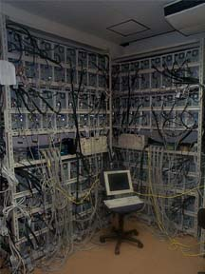
Simulation Environment
The Prospero cluster:
66PE cluster at Matsuoka Lab., Tokyo Institute of Technology.
  Dual Pentium III 800MHz
  Memory: 640MB
  Network: 100Base/TX

Slide 18
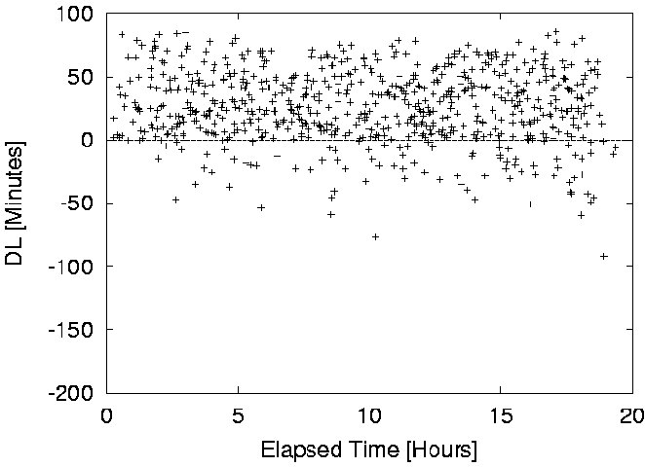
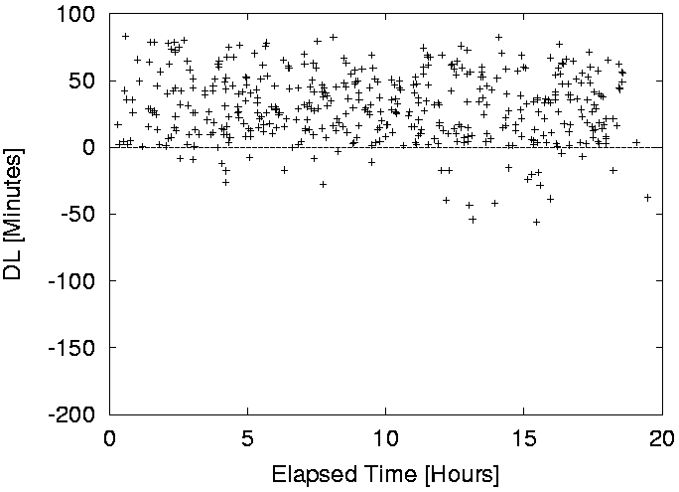
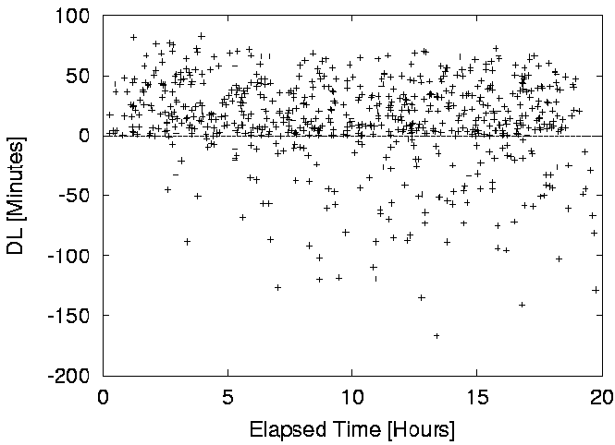
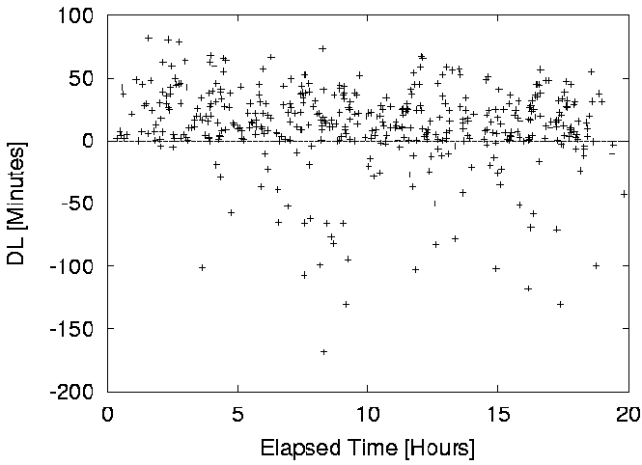
Experimental Results: differences (DL=Tdeadline – Tend)
Interval = 60 (High load)
Interval = 90 (Lower load)
success
Opt = 0.5
fail
Opt = 1.0

Slide 19
Experimental Results
Interval = 90(Lower load), # of jobs = 445
For smaller Opt, fail rates become smaller while costs become higher.
Estimation of prediction error is important.
Cost of LOTH is highest.
Remarkable delay because of FCFS on servers
Opt | Ave [min] | DL+ [min] | DL- [min] | #of Fail | Fail [%] | Cost
0.5 | 30.83 | 33.92 | -20.98 | 30 | 6.7 | 382.3
0.6 | 34.77 | 30.37 | -21.60 | 35 | 7.9 | 338.8
0.7 | 38.83 | 28.56 | -26.54 | 51 | 11.5 | 317.3
0.8 | 43.65 | 26.01 | -34.78 | 63 | 14.2 | 287.5
0.9 | 47.82 | 24.68 | -47.19 | 71 | 16.0 | 273.4
1.0 | 49.26 | 22.82 | -40.14 | 78 | 17.5 | 256.3
LOTH | 29.67 | 34.93 | -13.01 | 33 | 7.4 | 405.7
NOT suitable
Sharing scheduling info.
and fallback mechanisms
are important.

Slide 20
Related Work: Performance Evaluation Environments
Coarse-grained simulator
  Bricks
  Simgrid [UCSD]
Emulator
  MicroGrid [UCSD]
Actual testbed
  APGrid, Grid (US), eGrid, etc.
Accuracy of the experiments
Usability, Scalability, Reproducibility,
ease to control, long-term experiments

Slide 21
Conclusions
The Bricks performance evaluation system for Grid scheduling
  multiple simulated reproducible benchmarking environments for
    Scheduling algorithms
    External Grid components
Experiments of a Deadline scheduling scheme
  The Accuracy of prediction affects deadline scheduling performance
  LOTH is not suitable under charging mechanisms.
  To avoid remarkable delay, sharing scheduling history and fallback mechanisms are important.

Slide 22
Future Work
Simulation model
  Server model for various architectures (e.g., SMP，MPP) and local scheduling schemes (e.g., LSF)
  representation of parallel application tasks (Parameter-sweep applications are available)
System Issues
  Reconsideration of the Scheduling Unit design, interfaces, and data formats (c.f. Global Grid Forum)
  Providing benchmarking sets of Bricks simulations
Evaluation
  Investigation of various job/task scheduling schemes on Bricks (e.g. computational economy)
  Performance evaluation under real environment

