Slide 1
Performance Analysis of Scheduling and Replication Algorithms on Grid Datafarm Architecture for High Energy Physics Applications
Atsuko Takefusa (Ochanomizu Univ.)
Osamu Tatebe (AIST)
Satoshi Matsuoka (TITECH/NII)
Youhei Morita (KEK)

Slide 2
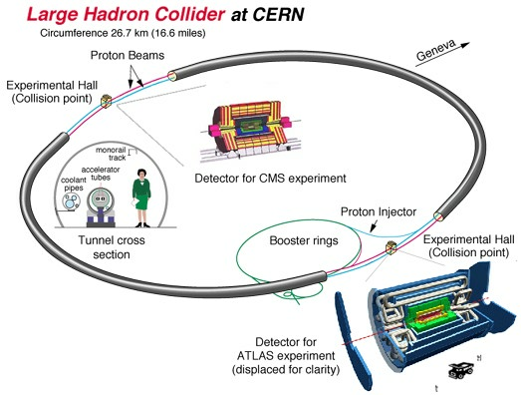

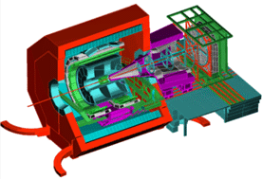
DataGrid
Grid environment for ubiquitous access and analysis of large-scale data
  E.g. CERN Large Hadron Collider (LHC) experiment (starting in 2008)
High speed file
transmission
(GridFTP)
Data replica
management
(Giggle, Globus
Replica Management)
High speed access
of large-scale data
LHC
Perimeter 26.7km
ATLAS Detector
40mx20m
7000 Tons
Detector for
LHCb experiment
~2000 physicists
from 35 countries
Truck
Detector for ALICE experiment
Notes:
DataGrid is a Grid environment for ubiquitous access and analysis of large-scale data such as the CERN LHC experiment.
Technical issues for DataGrid are High speed file transmission, Data replica management, and High speed access of large-scale data.

Slide 3
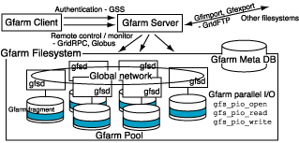
High Speed Data Access for DataGrid
Existing techniques: HPSS, cluster file systems:
  Loosely coupled between computational and I/O nodes
  Difficult to realize scalable local I/O bandwidth
    Takes about 12 days to read 1 [PB] data on 1 [GB/sec] bandwidth network!
Grid Datafarm architecture [AIST, KEK, TITECH, U. of Tokyo]:
  Fusion of computational
  and I/O nodes
  Affinity scheduling
  enabled over
  TB/sec local
  I/O bandwidth
Notes:
Existing techniques of high speed data access for DataGrid are HPSS and cluster file systems.
In these cases, computation and I/O nodes are loosely coupled and it is difficult to realize scalable local I/O bandwidth.
For example, it takes about 12 days to read 1 PB data on 1 GB/sec bandwidth network.
On the other hand, our Grid Datafarm architecture aims at fusion of computational and I/O nodes and affinity scheduling which is enabled over TB/sec local I/O bandwidth for 1PB data access.

Slide 4
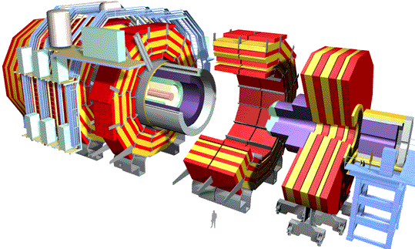
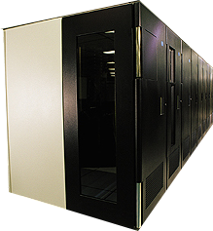

MONARC Hierarchical Computing Model for LHC
1 TIPS = 25,000 SpecInt95
PC (1999) = ~15 SpecInt95
~PBytes/sec
Online System
~100 MBytes/sec
Offline Farm
~20 TIPS
Bunch crossing per 25 nsecs.
100 triggers per second
Event is ~1 MByte in size
Germany Regional Center
Tier 0
~100 MBytes/sec
~622 Mbits/sec or Air Freight
CERN Computer Center >20 TIPS
HPSS
Tier 1
France Regional Center
Italy Regional Center
US Regional Center
HPSS
HPSS
HPSS
HPSS
~2.4 Gbits/sec
Tier 2
Tier2 Center ~1 TIPS
Tier2 Center ~1 TIPS
Tier2 Center ~1 TIPS
Tier2 Center ~1 TIPS
Tier2 Center ~1 TIPS
Tier 3
~622 Mbits/sec
Institute ~0.25TIPS
Physicists work on analysis “channels”.
Each institute has ~10 physicists working on one or more channels
Data for these channels should be cached by the institute server
Institute
Institute
Institute
Physics data cache
100 - 1000 Mbits/sec
Tier 4
Workstations
Notes:
To process such large amounts of data, a Grid computing model consisting of multi-tier worldwide Regional Centres has been studied by the MONARC project.
Being in the development stage, suitability of proposed DataGrid architectures and the performance of DataGrid systems of large-scale realistic applications have not been well investigated.

Slide 5
Performance Analysis of Scheduling and Replication Algorithms on Grid Datafarm Architecture
Comparison of DataGrid models
  MONARC-style hierarchical model
  vs. centralized data storage model
Comparison of scheduling and replication algorithms
  Owner Computes + background replication
  vs. MCT + on-demand replication
Realistic assumptions of job processing for CERN LHC experiments starting in 2008
Assuming Grid Datafarm architecture
Experiments on the Bricks Grid simulator
Notes:
We simulate the performance of different DataGrid system models under various replication and scheduling strategies under realistic assumptions of job processing for the CERN LHC experiments on the Grid Datafarm architecture by using the Bricks Grid simulator, newly enhanced with DataGrid operation.

Slide 6
DataGrid Application Scenario: CERN LHC Experiment
RAW
Calorimeter- digital
value
Collect data from collisions of particles
Analyze data in different levels of hierarchy
  RAW→ESD (Large)
    2-4 times/year
  ESD→AOD (Medium)
    once/month
  AOD→TAG (Small)
    once/4 hours
reconstruction
Calorimeter reconstruction
algorithm
Event Summary
Data (ESD)
Reconstructed info
Pseudo physical info.
Analysis
Group analysis
Calorimeter energy
Calorimeter reconstruction
algorithm
Analysis Object
Data (AOD)
Physical information
Event selection
Electron identification
algorithm
Individual analysis
TAG
Collection of only
relevant information
Notes:
In the LHC experiment at CERN, observed data are collected from a large number of collisions of particles and analyzed through different levels of hierarchy as shown on this slide.

Slide 7
Simulation Model:
Job Processing
A typical job for each of the job classes, Large, Medium, or Small is handled as follows:
  A user (physicist) at the client machine invokes a job
  The DataGrid scheduler selects a suitable set of servers
  Each server loads the data fragment required by the job, over the Grid if non-local
  Each server processes individual portions of the job that the server is assigned to
  The servers send the output to specified storages
  (The client receives only statistical data→negligible)
The time duration to process a job is given as:
ResponseTime = Read + Process + Write
read
data
fragment
process
result
write
Notes:
A typical job for each of the job classes Large, Medium, or Small in the experiments is an independent parallel data processing.

Slide 8
Simulation Model:
DataGrid Architectures
Central Model:
  All the jobs are processed at a single site
  Advantages: performance, manageability
Tier Model (MONARC-style multi-tier center model):
  Jobs are processed in different levels of the hierarchy
    Must facilitate suitable scheduling and replication policies
  Advantages: lower power consumption and cost per site
read
read
(a) process on
owner server
process
write
process
write
process on
owner server
(b) make replica and
process on a
different server
read
process
...
write
Central model
Tier model
Notes:
The MONARC project proposed the multi-tier regional center model, due to the limitation of computational and storage resources that could be concentrated at a single site.
However, remarkable improvement in commodity PC and clustering technologies may make it feasible to construct huge clusters with peta-scale online storage with appropriate data processing capacity.
We compare two categories of models, namely the central model where … and the tier model where …

Slide 9
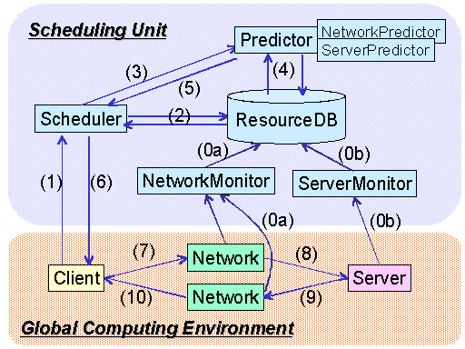
Bricks Grid Simulator
Java based discrete event simulator
Represents the behaviors of network and server using queues
Provides a typical Grid scheduling modules
Flexible settings of simulation environment
  Grid topologies
  (e.g. hierarchical network)
  Behaviors of Server and network
  Client model
Allows to evaluate
various scheduling algorithms
on dynamic Grid environment
http://grid-team.is.titech.ac.jp/bricks/
Notes:
In order to evaluate the performance of various DataGrid application scenarios, we extended our Bricks Grid simulation framework.

Slide 10
DataGrid Extension of the Bricks Grid Simulator
Provides the Replica Manager as a Scheduling Unit module
Provides disk management mechanism
Represents local disk I/O overheads using queues:
  Solid lines: a job workflow for the “owner computes” case
  Solid+dotted lines: a work flow that compute host and data source/destination host are different
Host A
Host B
Processor A
Processor B
read data
process job
Network A to B
Disk A
Disk B
Network B to A
write results
Notes:
For DataGrid simulations, we extended Bricks to provide the Replica Manager as a Scheduling Unit module and disk management mechanism.
Also, the enhanced Bricks represents local disk I/O overheads using queues because the overheads become non-negligible for accurate simulation in petabyte-scale data intensive computing.

Slide 11
Scheduling and Replication Algorithms for Tier Model
Central Model: file affinity scheduling (disk owner-computes rule)
Tier Model: must facilitate scheduling and replication policies
  Online scheduling algorithms
  →on-demand replication
  Replication algorithms
  →background replication

Slide 12
Online Scheduling Algorithms (1/2)
Online DataGrid Scheduler determines
  DataSourceHost (I/O host)
  ComputeHost (compute host)
  DataDestinationHost (I/O host)
Greedy(MCT: Minimum Completion Time)
  Scheduler assigns the job to the host that completes it the earliest
OwnerComputes
  Scheduler selects a ComputeHost that owns the input data and completes the job earliest
  DataSourceHost = ComputeHost = DataDestinationHost

Slide 13
Online Scheduling Algorithms (2/2)
LoadBound-Read
  Scheduler selects a ComputeHost with MCT from the host group which satisfies:
  Performance_{Specified} > Performance_{Estimated}
  Performance_{Estimated} = ProcessorPerformance / (LoadAverage + 1)
  If replicated,
  DataSourceHost != ComputeHost = DataDestinationHost
LoadBound-Write
  Scheduler select a ComputeHost which minimizes response time
  If the selected host does not satisfy
  Performance_{Specified} > Performance_{Estimated},
  the result is sent to the host that maximizes Performance_{Estimated}
  If replicated,
  DataSourceHost = ComputeHost != DataDestinationHost
Notes:
LoadBound-Read and –Write basically select a ComputeHost with MCT and force to replicate to balance the load average over the DataGrid. The difference of the strategies is when replicas are created.

Slide 14
Background Replication Algorithm
Replica Manager periodically collect status of hosts and trigger replica creation and migration at its discretion
LoadBound-Replication:
  Compute Performance_{Estimated} for all the hosts
  Performance_{Estimated} = ProcessorPerformance / (LoadAverage + 1)
  If Performance_{Specified} ＞ Performance_{Estimated},
  the Replica Manager creates a replica with the largest AccessRate and migrate from the host with the min. Performance_{Estimated} to the host with the max.
  AccessRate = N_{accesses} / (T_{Current} – T_{Stored})
  N_{accesses} , T_{Current} , T_{Stored} : current time, time the data was stored, and the total # of accesses to the data for the duration
Notes:
In our simulation, we employ the LoadBound-Replication fashion which create a replica to balance the load averages on the background.

Slide 15
Replica Elimination Algorithm
If the disk space for a job turns out to be insufficient, or some x % of hosts do not embody some y % of available disk space within the entire DataGrid, “replica Elimination” is performed
Select data that have replicas within the Grid
Sort all the selected data by the last recently used (LRU) time
Compute Access Rate AR_{Elimination} for the first N data on the list
AR_{Elimination} = AccessRate / N_{Copies} (N_{Copies} : # of replicas)
Select and eliminate replica for data with min. AR_{Elimination}
while maintaining the following condition:
TotalDiskSize × Compactness > AvailableDiskSize
(Compactness determines the frequency of elimination)
If the above condition is not satisfied, return to step 3 for the next N data (N = 10 in our simulations)

Slide 16
Evaluation on Bricks
Investigate the performance of our simulation scenarios for the LHC experiment:
  Grid Datafarm Architecture
  Central Model vs. Tier Model
  5 different policies: 4 scheduling algorithms + 1 replication algorithms
  Data access localities (random, time locality)
Compare
  Response time, network bandwidth, load average, distribution of data fragments / # of replicas

Slide 17
Experimental Environment for the Grid Datafarm System
Each data required for a single job is fragmented over nodes on the Grid
Parallel I/O and parallel processing
Each job is allocated to a single site and processed on the site
Tier0
Compute/
I/O node
Tier1
Tier2

Slide 18
Simulation Settings: Environment
Model | Disk [PB] | Performance [MSpecInt95] | # of Nodes on the Site | Total I/O Bandwidth
Central | 2 | 0.5-1.8 | 10000 | 1[TB/sec]
Tier | T0 (x1): 2 | 0.6/0.5/0.4 | 10000 | 1[TB/sec]
 | T1 (x4): 1 | 0.3/0.25/0.2 | 5000 | 500[GB/sec]
 | T2 (x16): 0.1 | 0.03/0.025/0.02 | 500 | 50[GB/sec]
Similar in settings to the GriPhyN simulation[Grid2001] for Tier Model
Queuing theory indicates
  Est. avg. response time in Central Model is 38.575-1.337 [hours]
  Central Model with under 0.453318[MSpecInt95] saturates and cannot process LHC jobs
WAN and Local I/O bandwidth are set to 10[Gbps] and 100[MB/sec]
On Grid Datafarm architecture aggregation local I/O bandwidth is:
Total I/O Bandwidth = Local I/O Bandwidth × # of nodes on the site

Slide 19
Simulation Settings: Job
Job | Comp. Size [GSI95*sec] | Frequency (Avg.) | Input [TB] | Output [TB]
Large: RAW→ESD | 1000 | 1/4 [months] | 1000 | 100
Medium: ESD→AOD | 25 | 1/1 [months] | 100 | 10
Small: AOD→TAG | 5 | 1/4[hours] | 10 | 0.1
# of events / job = 1G
Actual parameters for LHC in the MONARC Report2
All the initial data(1PBx1, 100TBx2, 10TBx4) are stored in the Tier0 site and the total # of data is increasing during the simulations
1 year simulation x 10 for each algorithms
executed simulation on the Presto III cluster (Dual Athlon MP 1900+, 768MB memory, 256 nodes) at TITECH

Slide 20
5 Combinations of Scheduling and Replication Algorithms
Scheduling Algorithm | Replication Algorithm | ComputeHost Selection | Timing of Replication | Object of Replica Creation | Destination of Replica
Greedy | - | MCT | Read | Input Data | Compute Host
Owner Computes | - | Owner + MCT | - | - | -
LoadBound-Read | - | MCT + Load | Read | Input Data | Compute Host
LoadBound-Write | - | MCT + Load | Write | Output Data | Arbitrary
Owner Computes | LoadBound- Replication | Owner + MCT | Arbitrary | Arbitrary | Arbitrary
Scheduling (on-demand replication) vs.
OwnerComputes + (background) replication

Slide 21
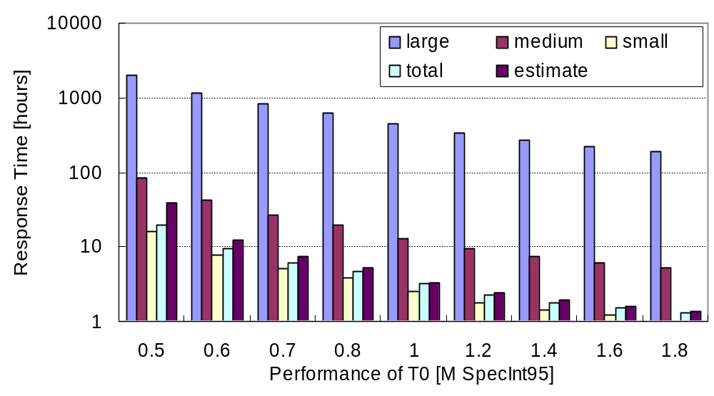
Central Model: Avg. Response Time
(Queuing Theory)
Avg. response time drastically increases
as the site performance decreases

Slide 22
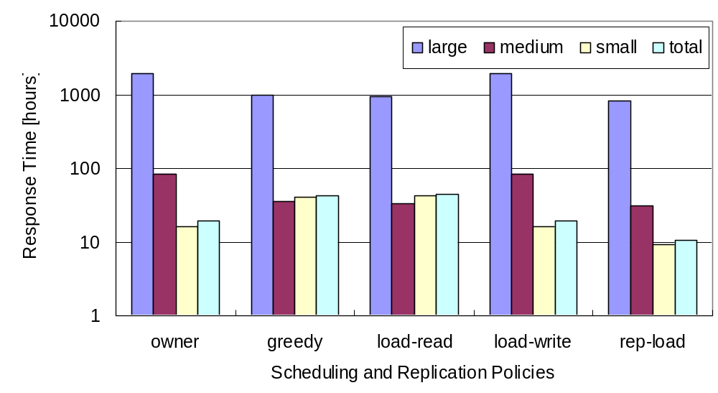
Tier Model: Avg. Response Time
(T0, T1, T2) = (0.5,0.25,0.025)
OwnerComputes+
LoadBound-Replication exhibit improved performance
Greedy and LoadBound-Read show less
performance than OwnerComputes

Slide 23
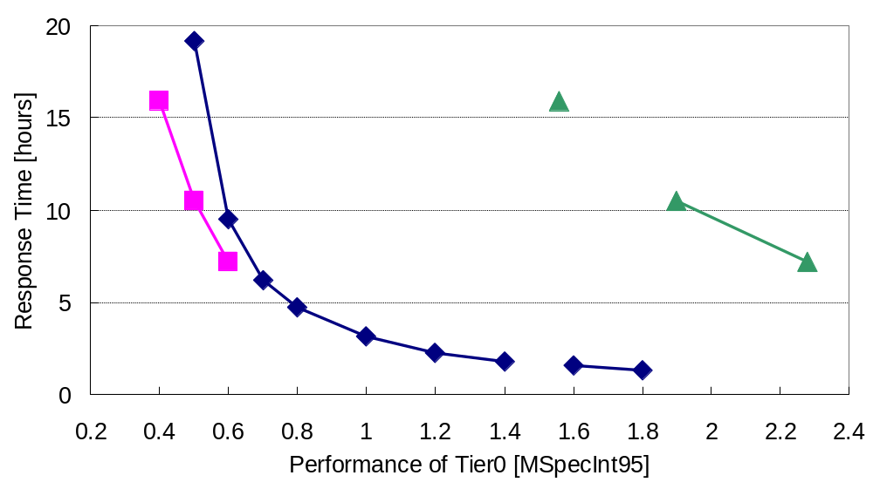
Comparison of Central Model vs. Tier Model
Central w/ 0.453318[MSpecInt95] saturates
Tier w/replication achieves
higher performance
while each tier being
smaller than central
Tier
w/LoadRep
(Total)
Tier
w/LoadRep
2.8GHz Pentium 4
x 10000 processors
Central is effective
Central

Slide 24
Related Work: GriPhyN Simulation Study [HPDC-11, ‘02]
GriPhyN [Univ. of Chicago et al]
  Targets the CERN LHC experiment
  Construct Globus-based peta-scale virtual DataGrid
Simulation study for scheduling and replication for DataGrid
  Propose External Scheduler, Local Scheduler, and Dataset Scheduler for DataGrid scheduling and replication
  Evaluated External and Dataset Scheduling Algorithms
    JobDataPresent (OwnerComputes) + replication shows improved performance
  Not assume the actual parameters for the LHC experiment
  (small job granularity, shorter duration, # of “original” data is NOT increasing)
↔ Experiments on Grid Datafarm architecture
w/ Actual parameters for the CERN LHC

Slide 25
Conclusions
Evaluate the performance of DataGrid system models by using the Bricks Grid simulator, newly enhanced with DataGrid
  Affinity scheduling enabled over TB/sec local I/O bandwidth on the Grid Datafarm architecture
Compare Central vs. MONARC-style Tier Model, assuming the Grid Datafarm architecture:
  Central Model is effective and could be constructed in a feasible fashion at this point
  In Tier Model, OwnerComputes + LoadBound-Replication proves to be effective
  Tier Model achieves higher performance while each tier being smaller than central

