Slide 1
Performance Issues in
Client-Server Global Computing
Atsuko Takefusa
Ochanomizu University
Satoshi Matsuoka
Tokyo Institute of Technology

Slide 2

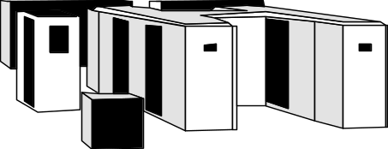
Global Computing System
(a.k.a. the “Grid”)
A global-wide high performance computing environment on the Internet
  Client-Server systems (e.g., Ninf, NetSolve, Nimrod)
  Middleware model systems (e.g., Globus, Legion)
  Java-based systems (e.g., Ninflet, Javelin++)
client
server
task
result
client
Internet
server
client

Slide 3
Performance Issues
Various parameters govern Grid performance
  Execution environment
    # of clients, # of servers, network topology
    Hardware of clients, servers, networks
  Application and data sets
  System implementations
  Scheduling schemes
Reproducible and controlled environments
  Large-scale benchmarks
  Low benchmarking cost
  Objective comparison between different systems or scheduling frameworks

Slide 4
Our Approach
Benchmarks under different parameters [SC97]
  Multiple client
  LAN/WAN
  Applications: Linpack, EP, SDPA
  Sytems: Ninf, NetSolve, CORBA [IPDPS2000]
Performance evaluation system for the Grid: Bricks [HPDC99]
  A discrete event simulator
  Reproducible and controlled environments
  Flexible setups of simulation environments
  Evaluation environment for existing global computing components (ex. NWS)

Slide 5
Outline
Benchmark results of client-server global computing systems
  Multi-client benchmark using Ninf
  Comparison of various client-server systems
    Ninf, NetSolve, CORBA
Performance evaluation system: Bricks
  Overview of the Bricks system
  Incorporating existing global computing components (ex. NWS)
  Bricks experiments
Conclusions and future work

Slide 6
Ninf Multi-client Benchmarks
Communication and overall performance
→ LAN, WAN (Single-site, Multi-site)
Robustness of computational server
→ vector parallel server (Cray J90, 4PE)
Remote library design and reuse
→ Task Parallel(1PE lib), Data Parallel(4PE lib)
Interaction between computation and communication for remote libraries
→ Linpack, EP

Slide 7
WAN Multi-client Benchmarking Environment
Single site
Multiple sites
Clients
Internet
U-Tokyo [Ultra1]
(0.35MB/s, 20ms)
Server
Ocha-U [SS10,2PEx8]
(0.16MB/s, 32ms)
ETL
[J90,4PE]
NITech [Ultra2]
(0.15MB/s, 41ms)
TITech [Ultra1]
(0.036MB/s, 18ms)

Slide 8
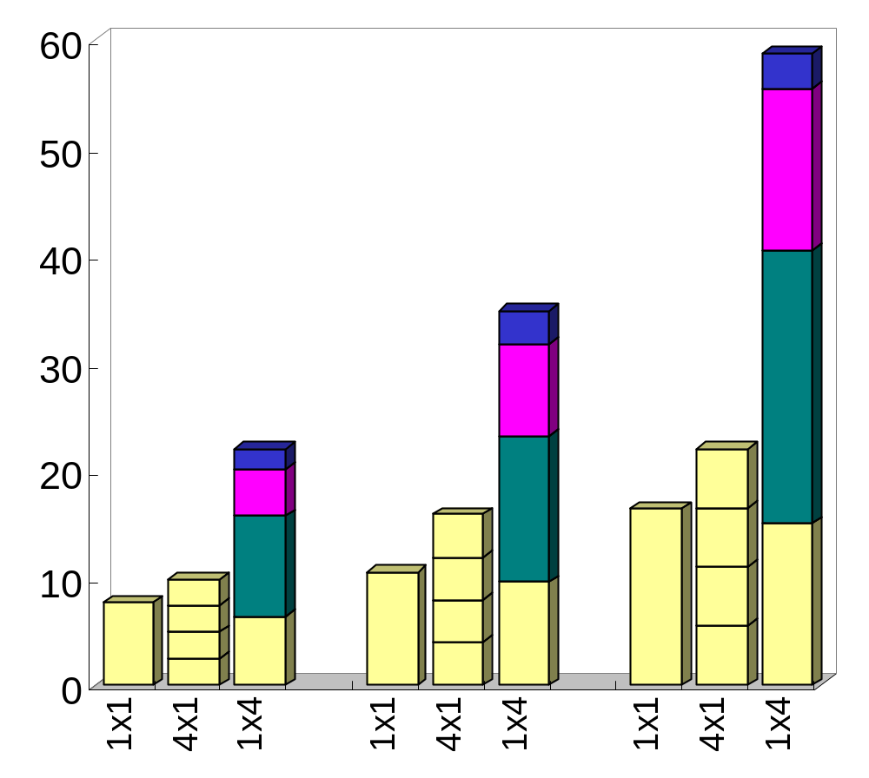
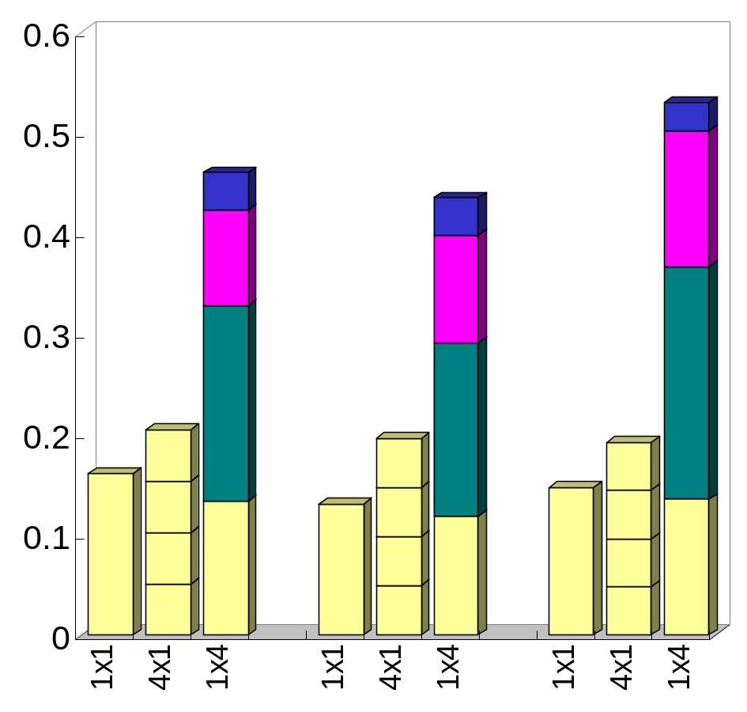
WAN(Single-site, Multi-site) Multi-client Benchmark Results
Effective Performance
Communication Throughput
[Mflops]
[MB/s]
TITech
NITech
U-Tokyo
Ocha-U
600
1000
1400
600
1000
1400
Matrix Size / #clients x #sites
Matrix Size / #clients x #sites

Slide 9
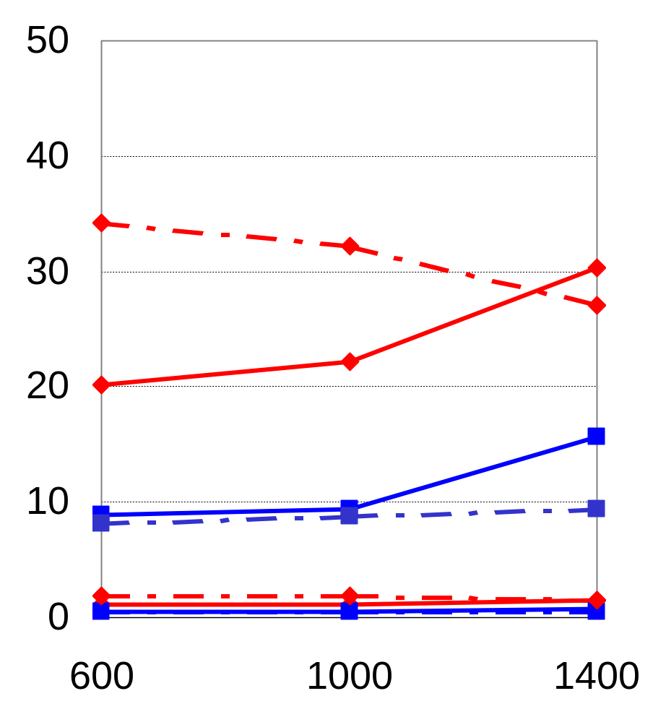
WAN Benchmark Results
Interaction betw. Comp. and Comm.
- CPU Utilization and Load Average-
Single-site(c=4)
Multi-site(c=1x4)
Single-site(c=16)
Multi-sites(c=4x4)
The J90 server does not saturate for n and c.
  Network bandwidth saturation the cause.
Utilization is low due to network congestion, not lack of jobs.
→ Utilization and Load alone are NOT suitable criteria for global computing scheduling.
Load Average
CPU Utilization [%]
CPU Utilization
10
Load Average
0
Matrix Size

Slide 10
Comparison between Client Server Systems [IPDPS2000]
Systems
  Ninf, NetSolve, CORBA(TAO, IIOP[TAO-OmniORB])
LAN (100Base-TX)
  Server: Ultra60[300MHz×2, 256MB] at TITECH
  Client: Ultra2[200MHz×2, 256MB] at TITECH
WAN (ave. 0.6[Mbyte/s])
  Server: Ultra60 at TITECH, Tokyo
  Client: SS5[85MHz, 32MB] at ETL, Tsukuba
Benchmark routine: Linpack

Slide 11
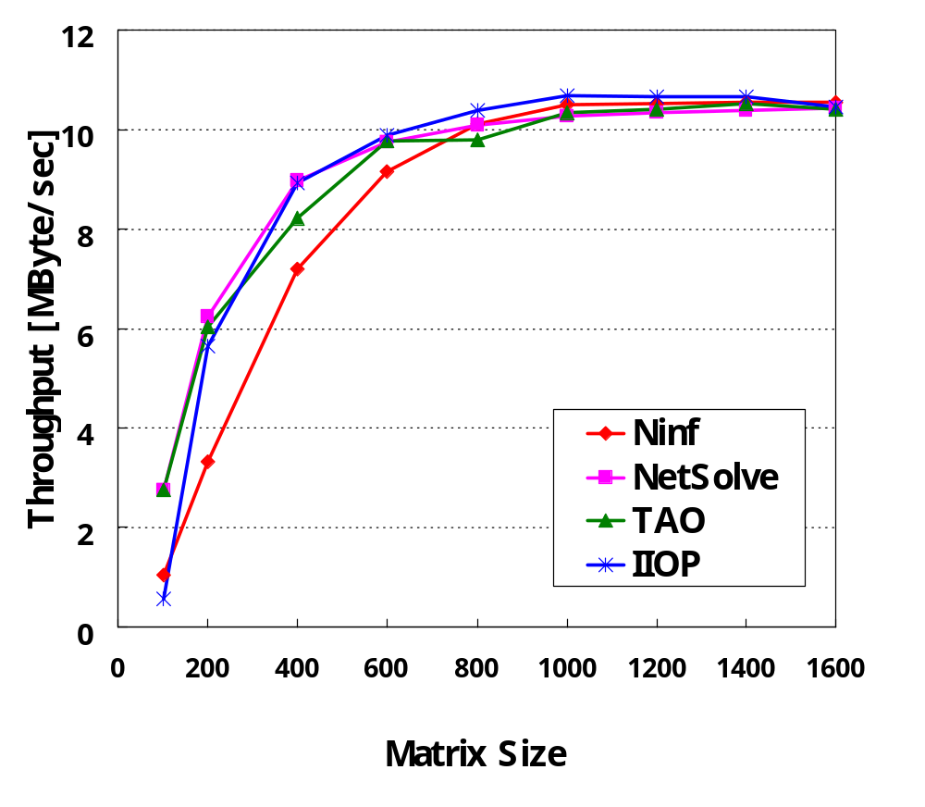
LAN Communication Throughput
Throughput differences between systems are quite small
For smaller problem size, Ninf seems to be slightly slower

Slide 12
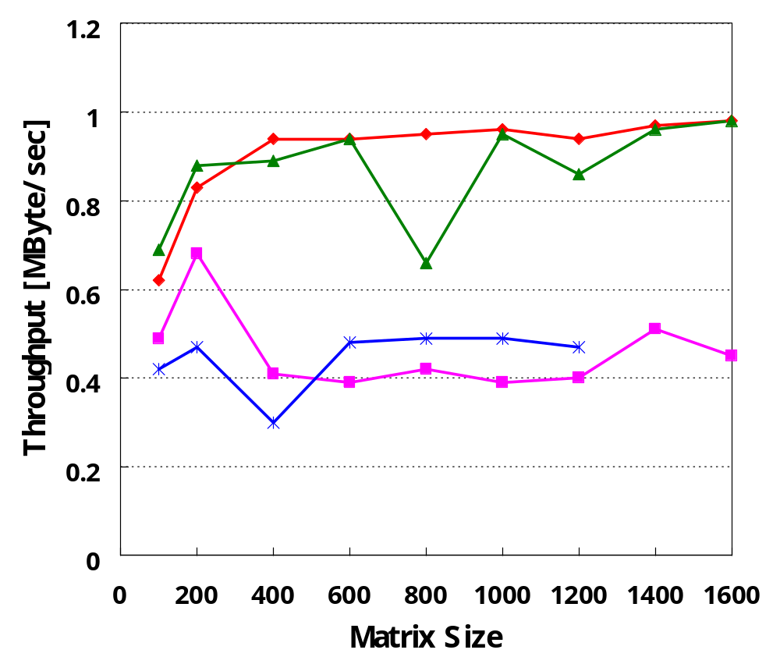
WAN Communication Throughput
TAO closely matches Ninf
→TAO uses a private comm. Protocol, which seems to match the efficiency of that of Ninf
Unlike LAN, IIOP and NetSolve were slower
High interoperability does not come at the expense of performance.
Ninf
TAO
IIOP
NetSolve

Slide 13
Summary of Benchmarks
In WAN, limitation of communication throughput is more significant
We expect multiple client requests will be issued from different sites, causing “false” lowering of load ave.
→The scheme which properly dispatches comm.-/comp.-intensive jobs to the servers is important.
Ninf and TAO are comparable in LAN and WAN
→However, ease-of-programming, availability of Grid services, etc., differentiate dedicated Grid systems and general systems such as CORBA.

Slide 14
Outline
Benchmark results of client-server global computing systems
  Multi-client benchmark using Ninf
  Comparison of various client-server systems
    Ninf, NetSolve, CORBA
Performance evaluation system: Bricks
  Overview of the Bricks system
  Incorporating existing global computing components (ex. NWS)
  Bricks experiments
Conclusions and future work

Slide 15
Overview of Bricks
Consists of simulated Global Computing Environment and Scheduling Unit.
Allows simulation of various behaviors of
  resource scheduling algorithms
  programming modules for scheduling
  network topology of clients and servers
  processing schemes for networks and servers (various queuing schemes)
  using the Bricks script.
Makes benchmarks of existing global scheduling components available

Slide 16
The Bricks Architecture
Scheduling Unit
Predictor
NetworkPredictor
ServerPredictor
Scheduler
ResourceDB
NetworkMonitor
ServerMonitor
Network
Client
Server
Network
Global Computing Environment

Slide 17
Global Computing Environment
Client
  represents user of global computing system
  invokes global computing Tasks
    Amount of data transmitted to/from server,
    # of executed instructions
Server
  represents computational resources
Network
  represents the network interconnecting
  the Client and the Server
Predictor
Scheduler
ResourceDB
NetworkMonitor
ServerMonitor
Represented using queues
Network
Client
Network
Server

Slide 18
Scheduling Unit
NetworkMonitor/ServerMonitor
measures/monitors network/server status in global computing environments
ResourceDB
serves as scheduling-specific database, storing the values of various measurements.
Predictor
reads the measured resource information from ResourceDB, and predicts availability of resources.
Scheduler
allocates a new task invoked by a client
on suitable server machine(s)
Predictor
Scheduler
ResourceDB
NetworkMonitor
ServerMonitor
Network
Client
Network
Server

Slide 19
Overview of Global Computing Simulation with Bricks
Scheduling Unit
NetworkPredictor
Predictor
ServerPredictor
Query predictions
Predictions
Perform Predictions
Scheduler
ResourceDB
Query available servers
Store observed information
Inquire
suitable server
NetworkMonitor
ServerMonitor
Returns
scheduling info
Monitor periodically
Invoke task
Sends the task
Network
Client
Server
Network
Execute task
Return results
Global Computing Environment

Slide 20
Incorporating External Components
Scheduling Unit module replacement
  Replaceable with other Java scheduling components
  Components could be external --- in particular, real global computing scheduling components
  →allowing their validation and benchmarking under simulated and reproducible environments
Bricks provides the Scheduling Unit SPI.

Slide 21
Scheduling Unit SPI
interface ResourceDB {
void putNetworkInfo();
void putServerInfo();
NetworkInfo getNetworkInfo();
ServerInfo getServerInfo();
}
interface NetworkPredictor {
NetworkInfo getNetworkInfo();
}
interface ServerPredictor {
ServerPredictor getServerInfo();
}
interface Scheduler {
ServerAggregate selectServers();
}
NWS
Persistent
State
NWS
Sensor
NWS Forecaster
NWS API
NWS Adapter
NWSResource
DB
NWSNetwork
Predictor
NWSServer
Predictor
Monitor
Scheduler
Bricks Scheduling Unit SPI
Bricks Global Computing Environment

Slide 22
Case study
NWS[UCSD] integration into Bricks
  monitors and predicts the behavior of global computing resources
  has been integrated into several systems, such as AppLeS, Globus, Legion, Ninf
  Orig. C-based API
→ NWS Java API development
→ NWS run under Bricks

Slide 23
The NWS Architecture
Persistent State （→Replace ResourceDB）
is storage for measurements
Name Server
manages the correspondence between the IP/domain address for each independently-running modules of NWS
Sensor （→Network/ServerMonitor）
monitors the states of networks/servers
Forecaster （→ Replace Predictor）
predicts availability of
the resources
Sensor
Persistent State
Persistent State
Forecaster
Forecaster
Name Server
Sensor
Sensor

Slide 24
Bricks Experiments
The experiments conducted by running NWS under a real environment vs. Bricks environment
  Whether Bricks can provide
  A simulation environment for global computing with reproducible results?
  A benchmarking environment for existing global computing components?

Slide 25
Overview of Experiments
NWS Forecaster
1. Actual environment
2. Bricks simulated environment
NWS Sensor
at TITECH
NWS Sensor
at ETL
Observed
bandwidth
Predicted
information
NWS Forecaster
Predicted
information
Scheduler
NWS Persistent State
Monitor
Observed
bandwidth
Network
Client
Server
Network

Slide 26
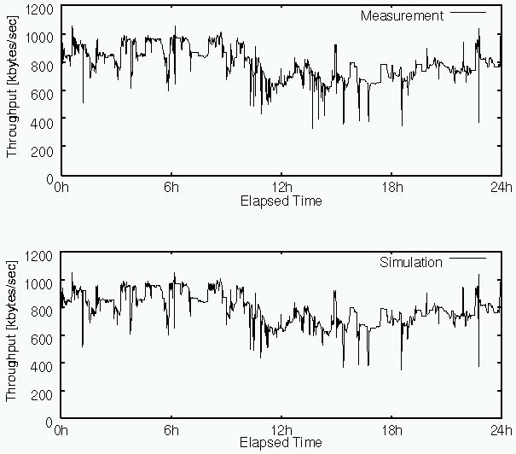
Bricks Experimental Results:
Comparison of Predicted Bandwidth
Under real environment(24hours)
The NWS Forecaster functions and behaves normally under Bricks
Both prediction are very similar
real environment
Bricks provides existing global computing components with a benchmarking environment
Under Bricks (24hours)
Date: 1999/2/1
NWS:
TITECH ⇔ ETL
network monitoring: 60[sec]
network probe :300[KB]
Bricks:
cubic spline interpolation
Bricks

Slide 27
Related Work
Osculant Simulator[Univ. of Florida]
  evaluates Osculant: bottom-up scheduler for heterogeneous computing environment
  makes various simulation settings available
WARMstones [Syracuse Univ.]
  is similar to Bricks, although it seems not have been implemented yet.
  will provide an interface language(MIL) and libraries based on the MESSIAHS system to represent various scheduling algorithms
  has no plan to provide a benchmarking environment for existing global computing components
→Bricks provides SPI

Slide 28
Conclusions
We conducted benchmarks under various environment such as multiple clients, systems.
We proposed the Bricks performance evaluation system for global computing scheduling
  multiple simulated reproducible benchmarking environments for
    Scheduling algorithms
    Existing global computing components
Bricks experiments showed
  Evaluation of existing global computing components now possible

Slide 29
Future Work
Performance evaluation under various parameters
Simulation model of Bricks needs to be more sophisticated and robust
  Task model for parallel application tasks
  Server model for various server machine architectures (e.g., SMP，MPP) and scheduling schemes (e.g., LSF)
Standardization of interface and data representations of Bricks
Communication component integration (e.g., direct support for IP)
Providing benchmarking set of the Bricks simulation
Investigation of various scheduling algorithms on Bricks

