Slide 1




EduAIthon
Team Number : 47
Team Name: LakshyaSetu
Title: PrepSutra: AI Platform for UPSC Mastery
Video link/QR code -2 mins video of your work

Slide 2
EduAIthon
Team Number: - 41 |  | College Name: - R V College of Engineering
Sl. No. | Name | Contact Number | Email.ID
1. | Ramachandra Manjunath Rayakar | +91 99649 75545 | ramachandramr.cs22@rvce.edu.in
2. | Ningaraj P Totagi | +91 96863 69832 | ningarajpt.cs22@rvce.edu.in
3. | Sachin Annigeri | +91 9845814278 | sachinannigeri.cs22@rvce.edu.in
4. | Lakshmeesha K R | +91 91106 92694 | lakshmeeshakr.ai22@rvce.edu.in
5. | Anand Patil | +91 80889 55021 | anandpatil.cd22@rvce.edu.in

Slide 3
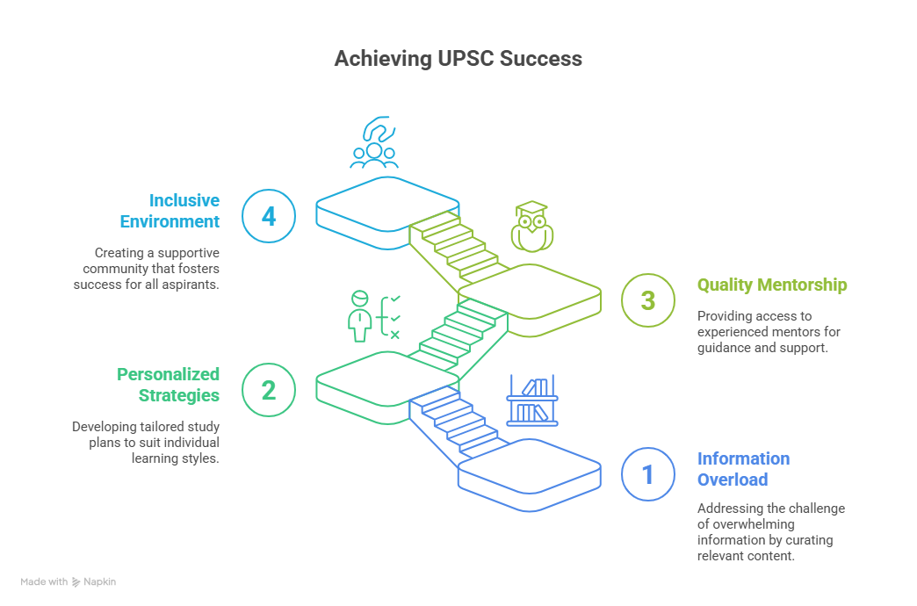
EduAIthon
Problem Definition
UPSC aspirants often grapple with challenges such as information overload, one-size-fits-all preparation strategies, and limited access to high-quality mentorship—issues that are especially acute in rural and semi-urban regions. Despite the growing digital penetration, there is a lack of a unified, intelligent platform that offers a personalized and holistic preparation experience. Current solutions fail to integrate smart planning tools, AI-driven performance feedback, vernacular voice support for inclusivity, and dynamic content curation tailored to the evolving UPSC syllabus and individual learning patterns. This gap highlights the urgent need for an adaptive, tech-driven solution that democratizes UPSC preparation and empowers aspirants across diverse socio-economic backgrounds.

Slide 4
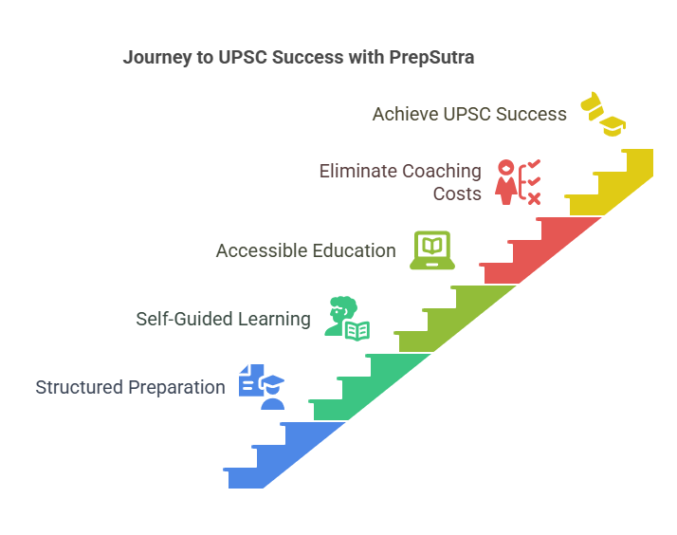
EduAIthon
Introduction
PrepSutra is a free, web-based platform developed to support UPSC aspirants—especially those from rural areas—by offering a structured, self-guided preparation model without relying on paid lectures or coaching. The platform provides tools like a personalized study planner, mock test environment, and content organization features. Aspirants can upload their own notes and textbooks for centralized access. A standout feature is the Article Analyzer (Humanizer), which simplifies current affairs and links them to relevant previous year questions. PrepSutra also includes PYQ analysis, syllabus-based filters, and works efficiently on low-bandwidth connections. Designed to bridge the urban-rural preparation gap, it empowers aspirants with intelligent, accessible, and inclusive resources—bringing quality UPSC preparation to every corner of India.

Slide 5
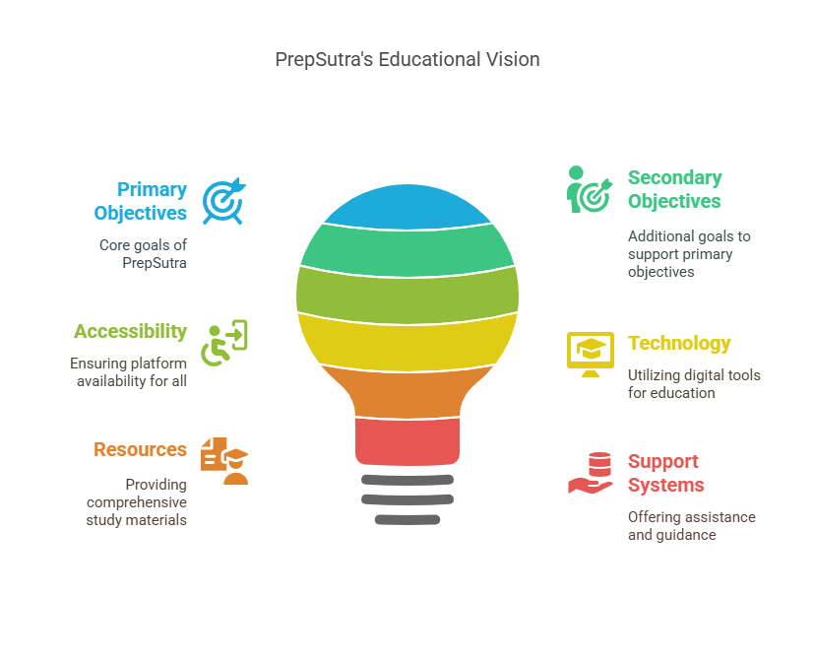
EduAIthon
Obiectives
Primary Objectives:
To develop a modular AI-powered UPSC preparation platform.
To provide smart features like a study planner, GS news summarizer, PYQ analyzer, answer checker, and answer submissions.
Secondary Objectives:
To integrate voice-enabled vernacular support for inclusivity.
Offer dynamic mind maps and visual progress tracking.

Slide 6
EduAIthon
Solution Approach
Methodology:
The development of PrepSutra follows an iterative and modular approach with the following key steps:
•Requirement Analysis: Collecting user needs via surveys, competitor analysis, and academic research to define essential features.
•Design: Creating wireframes and system architecture for a modular platform that supports independent feature development and future scalability.
•Data Collection and Processing: Curating and categorizing PYQs from official UPSC sources; developing syllabus-topic mappings and current affairs databases.
•Development: Building front-end interfaces (dashboard, planner, analyzers) and back-end services (database management, filtering engines, NLP modules for Article Analyzer).
•Testing: Conducting both qualitative testing (user feedback, UX/UI improvements) and quantitative testing (performance benchmarks, algorithm accuracy).
•Deployment: Hosting the platform on a cloud service optimized for Indian internet infrastructure, with continuous monitoring and updates.
•Feedback Loop: Implementing a system for user feedback to refine features and introduce AI-based enhancements gradually.

Slide 7
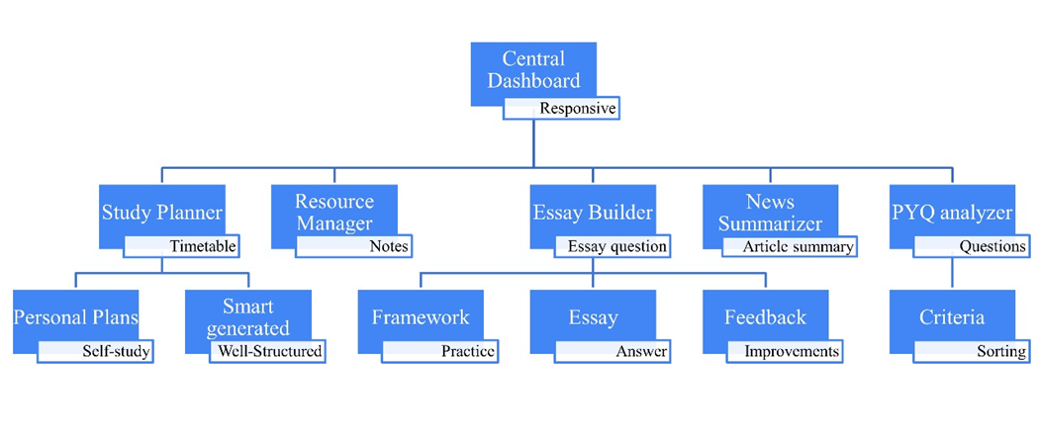
EduAIthon

Slide 8
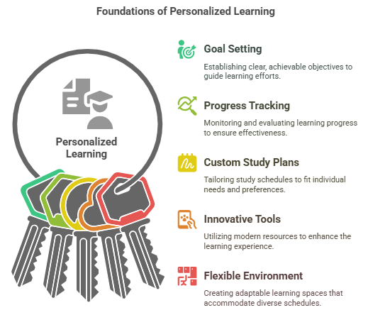
EduAIthon
Key Features:
Self-Guided, Personalized Learning Empowers aspirants to set goals, track progress, and follow custom study plans based on their schedule, subjects, and exam date.
PYQ-Centric Preparation Uses Previous Year Questions as the foundation for learning, with smart filters based on syllabus topics and question types for targeted practice.
Smart Current Affairs with Article Analyzer Simplifies news articles using AI, links them to the UPSC syllabus and PYQs, enhancing relevance and retention of current affairs.
Integrated Practice Tools Offers a realistic mock test environment for MCQs and descriptive questions, along with tools to upload and manage personal study resources.

Slide 9
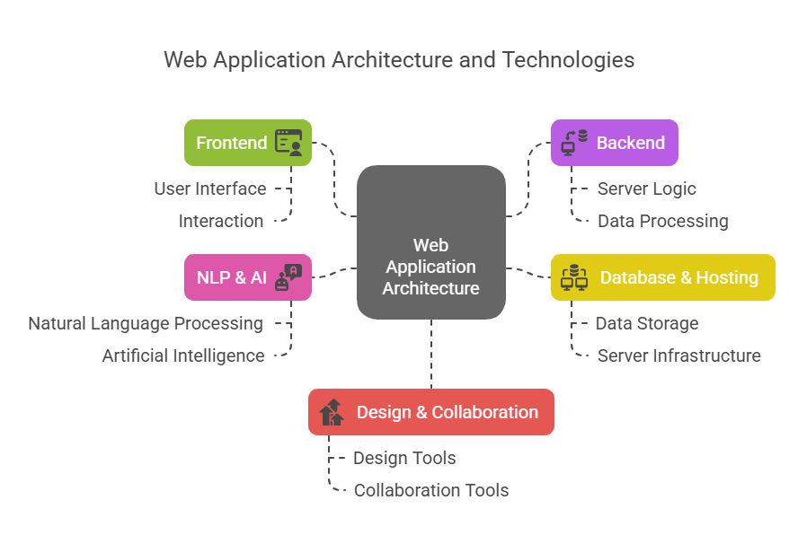
EduAIthon
TOOLS & TECH USED
Frontend: Built using React.js and Tailwind CSS for a responsive, modular, and mobile-optimized UI suited for low-bandwidth environments.
Backend: Uses Node.js with Express.js to handle APIs and server-side logic, ensuring scalability and clean architecture.
Database & Hosting: Implements Firestore (Firebase) for real-time sync and offline support; deployed on Vercel for fast, serverless performance and global reach.
NLP & AI: Article Analyzer prototype uses spaCy and NLTK for content simplification, with plans to integrate advanced models like BERT or GPT-3.5.
Design & Collaboration: Tools like Figma, Google Docs, Trello, and Draw.io were used for UI design, documentation, project tracking, and architecture planning.

Slide 10
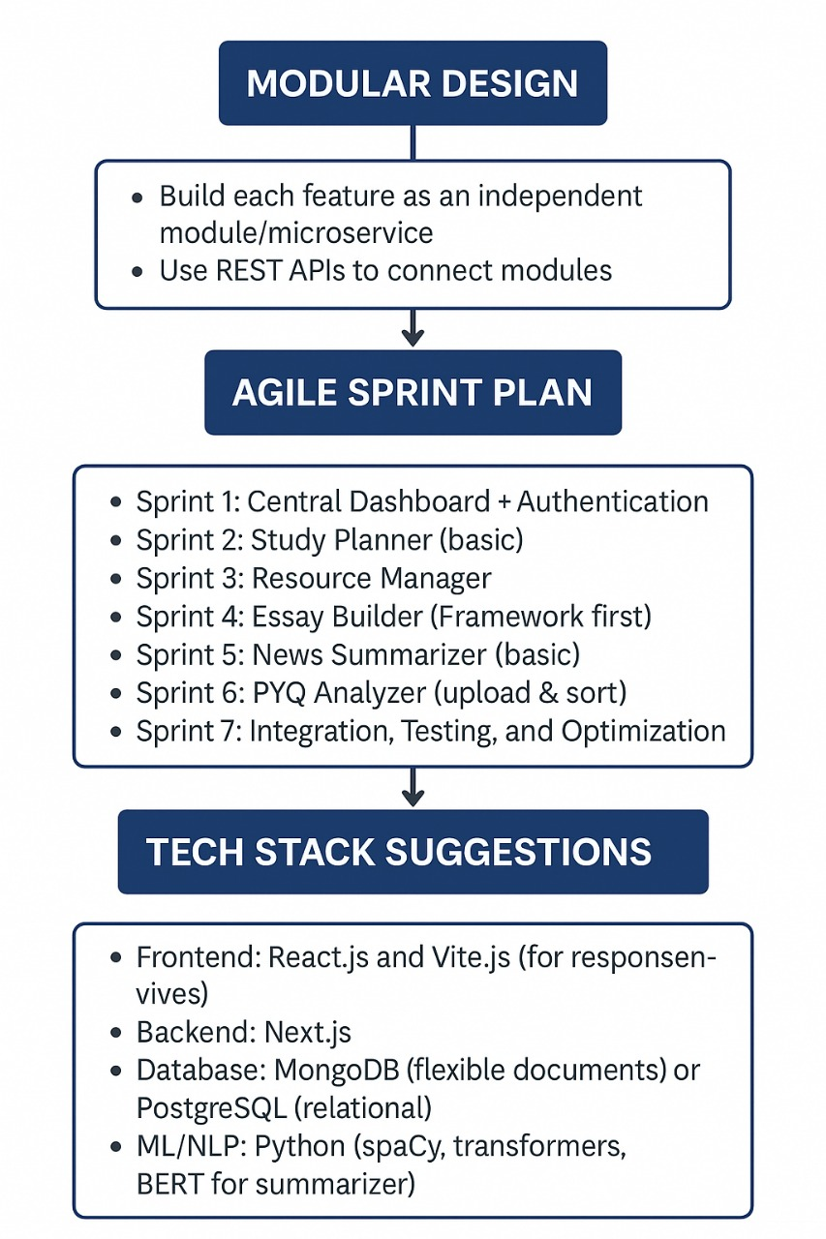
EduAIthon
IMPLEMENTATION

Slide 11
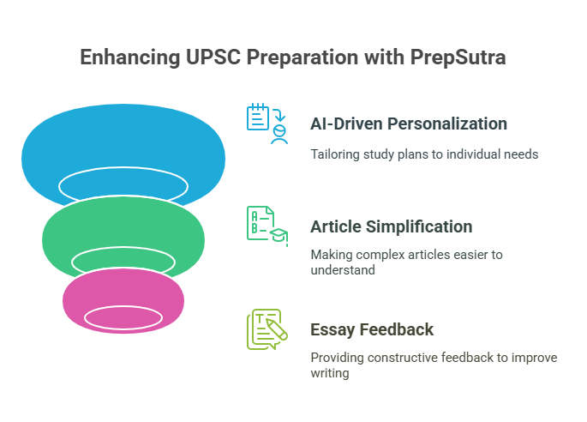
EduAIthon
INNOVATIVE SOLUTION
Smart Study Planner (AI-Driven): Generates personalized timetables based on user input (hours, goals, subjects) and dynamically adjusts plans when users skip days or change targets.
Article Simplification using Gemini API: Users can paste a link to any news article or editorial. The system fetches the content and uses Gemini API to simplify it, summarize it, and map it to UPSC syllabus topics for effective learning.
Essay Topic Suggestions & Feedback: Leveraging Gemini APIs, PrepSutra offers relevant subpoints and structure for essay topics, followed by instant AI-powered feedback to improve coherence, relevance, and language.

Slide 12
EduAIthon
SCOPE AND RESULTS
Scope: PrepSutra is an AI-powered UPSC preparation platform designed especially for aspirants from rural and low-resource backgrounds. It offers key features like a personalized study planner, Previous Year Question analyzer, Article simplifier, and mock test generator. Built with a mobile-responsive and lightweight design, it supports efficient learning even on low-bandwidth connections. The platform emphasizes active recall and syllabus-linked study, aiming to improve time management and topic retention through a structured, question-centric approach.
Results: Currently in its initial release phase, PrepSutra has undergone internal testing that confirms fast performance and smooth user experience. Although formal user testing is yet to be conducted, early assessments highlight its potential to fill gaps in existing UPSC tools by integrating customizable PYQ filtering and open-access resource management. Future work will focus on real-world user trials, feedback-driven improvements, and enhancement of advanced AI features like essay evaluation to ensure PrepSutra evolves into a robust and widely accessible educational platform.

Slide 13
EduAIthon
THANK YOU

Slide 14
EduAIthon

