Slide 1
Vert.x introduction
Bin

Slide 2
Vertx.io
Best fit for a REST based web/desktop application as opposed to using JavaEE. A nodejs-like framework on JVM.
Vert.x is a library not a restrictive container, is highly modular, you just use the bits that you need
Event-driven, Asynchronous, Polyglot, Concurrent, Reactive, Scalable, distributed, Netty NIO
Java8, lambda
RxJava, Reactive Streams

Slide 3
study resources
http://vertx.io/
https://www.youtube.com/watch?v=EMtoN9wFEOU
http://vertx-lab.dynamis-technologies.com/
http://tutorials.jenkov.com/vert.x/index.html
https://groups.google.com/forum/#!forum/vertx

Slide 4
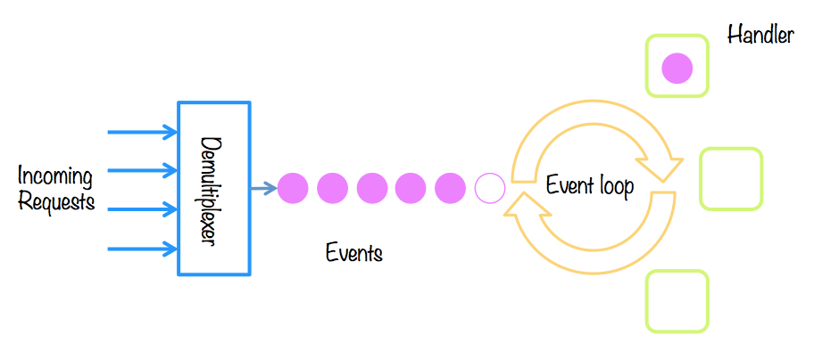
event-loop
Reactor pattern
One reactor one event-loop
Handler codes asynchronous executing

Slide 5
Verticles
3 types of verticles
Standard verticle
All handlers executing on one event-loop thread
codes in executeBlocking() executed in worker thread.
Worker verticle
All handler executing on single thread in worker-thread-pool.
Multiple worker verticle
All handlers executing on multiple threads in worker-thread-pool.
How to communicate between verticles?
Shared data
Event-bus

Slide 6
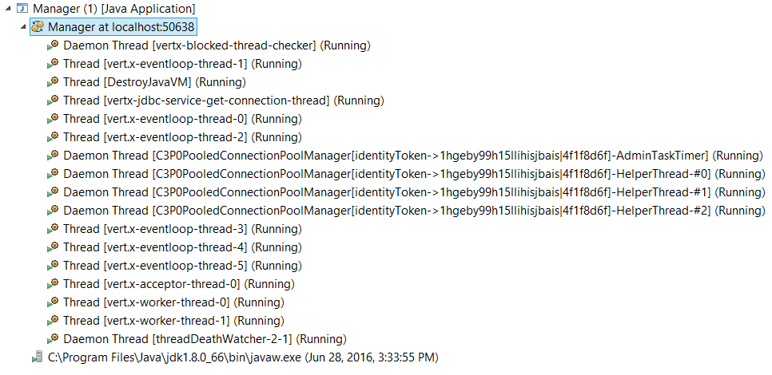
thread model

Slide 7
event-bus

Slide 8
Demo app architecture

Slide 9
concurrent/asynchronous framework
Akka
Rxjava
Disruptor

Slide 10
REST

Slide 11
Demo

