Slide 1
Spark-on-yarn

Slide 2
Client

Slide 3
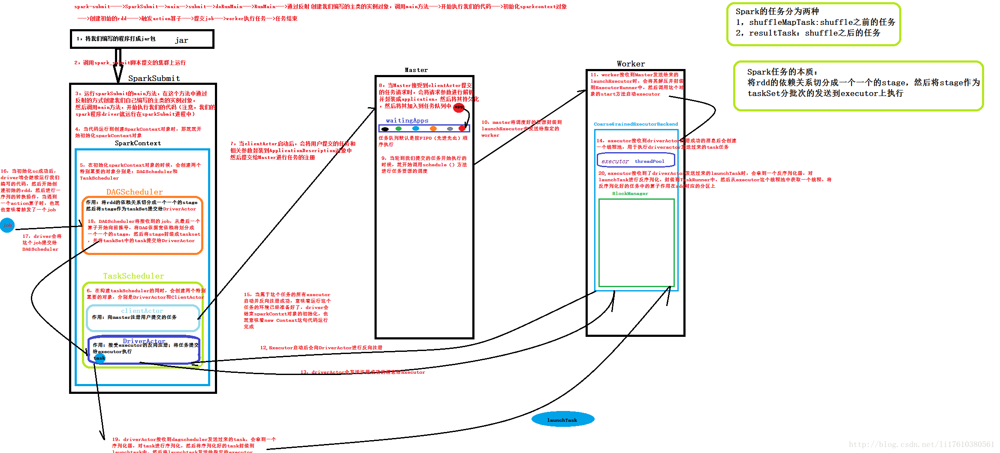
Client模式-回顾spark架构
Notes:
架构图来自网络:https://www.cnblogs.com/shishanyuan/archive/2015/08/19/4721326.html

Slide 4
TaskScheduler

