Slide 1
List of Largest internet companies

Slide 2
Data cleaning
Convert currency to number
Missing value in market cap=>average value
Different cap:
Large-cap, >10billion
Mid-cap, 2-10billion
small-cap, 0-2billion

Slide 3
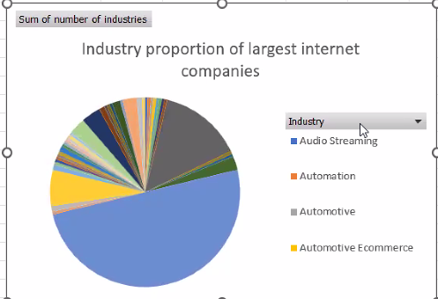
Pivot table
Industry proportion of largest internet companies
Ecommerce 28.3%
Internet 12.26%
Software 6.66%

Slide 4
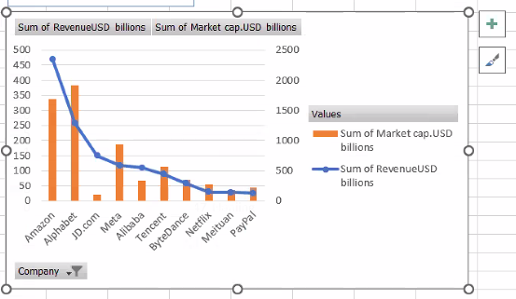
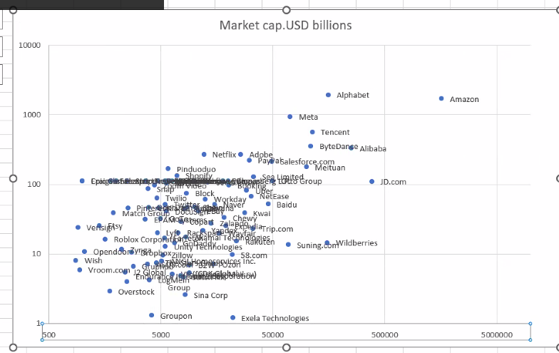
Chart analysis
Higher level category, higher market cap & revenue
Positive correlation between market cap & No. of employees

Slide 5
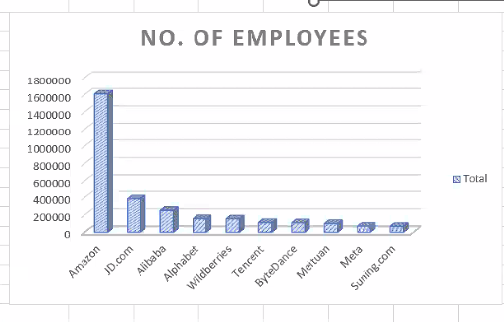
number of employees
Amazon
JD
Ali
Alphabet

Slide 6
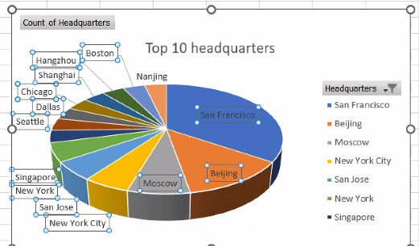
Location of top 10 internet companies
San Francisco
Beijing
Moscow

Slide 7
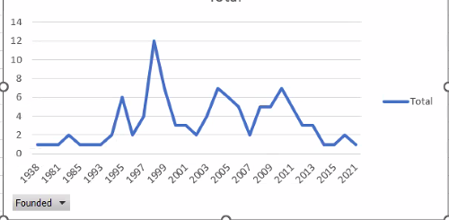
evolution of companies

Slide 8
summary
Internet industries go around ecommerce
Lots of areas : education , travel , automation
Popularizing in America, East Asia & Europe

