Slide 1
Term Project Report
Ning Dian

Slide 2
Goal & Require
Goal:
Achieve the best performance on CIFAR-10 dataset in this class.
Require:
Evaluation metric: Top-1 classification rate (%)
Train data: 50000
Test data: 10000
Deep learning framework: Any framework
(PyTorch, Tensorflow, Keras ...)
Deep learning architecture: Any architecture
You can use ImageNet pre-trained model.

Slide 3
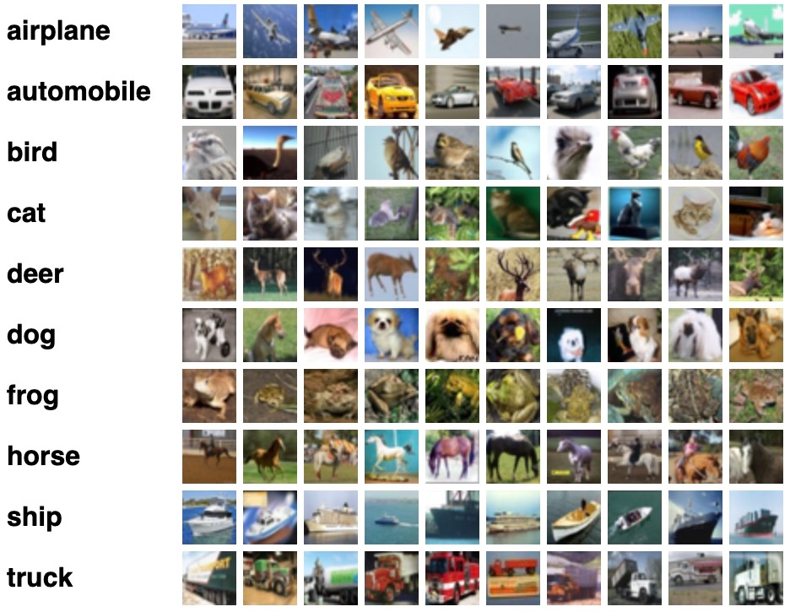
CIFAR-10 Dataset
The CIFAR-10 dataset consists of 60000 32x32 color images in 10 classes, with 6000 images per class. There are 50000 training images and 10000 test images.
The dataset is divided into five training batches and one test batch, each with 10000 images. The test batch contains exactly 1000 randomly-selected images from each class.

Slide 4
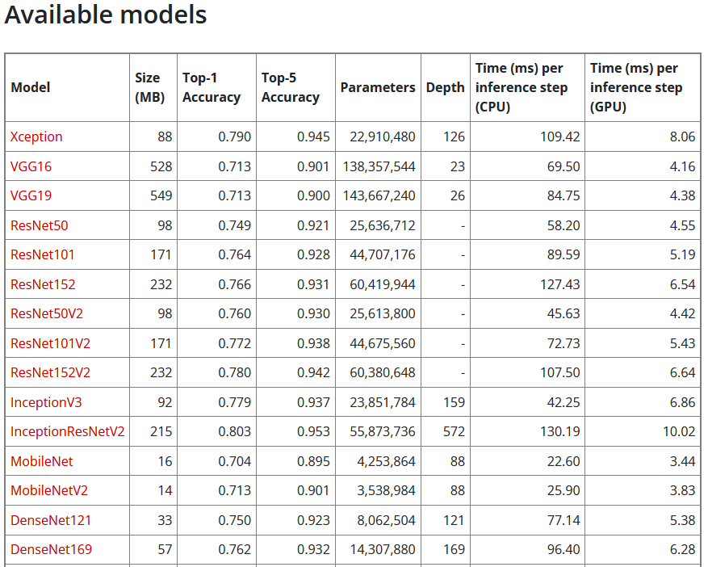
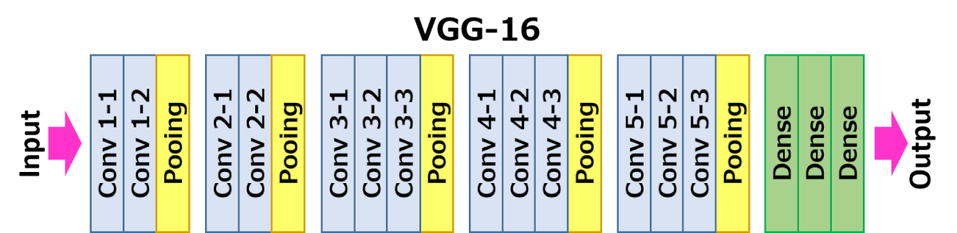
Achieve method – VGG16
Why choose VGG16:
We usually think the model more complex will get more good performance. Actually, it is also relevant with the dataset is suitable for the model or not.
The VGG16 is characterized by its simplicity, using only 3×3 convolutional layers stacked on top of each other in increasing depth. Reducing volume size is handled by max pooling. Two fully-connected layers, each with 4,096 nodes are then followed by a Softmax classifier

Slide 5
Original VGG16 Performance
Table 1. Hyperparameters for VGG16
Hyper Parameter/Structure | Experimental Values | Mine Values
Number hidden trainable layers | 1 - 3 | 1 - 3
Node per trained layers | 64 - 2048 | 1024
Optimizers | Adam, SGD | SGD
Learning Rate | 0.01 – 0.00001 | 0.001
Drop out(b/w each FC layer) | 0.0 – 0.5 | 0.2
Optimizers: I chose the SGD(learning_rate=0.001,momentum=0.9)
Dropout: it will randomly selected neurons are ignored during training. I add it after the flatten layer.
The model is saved in “cifar.h5”

Slide 6
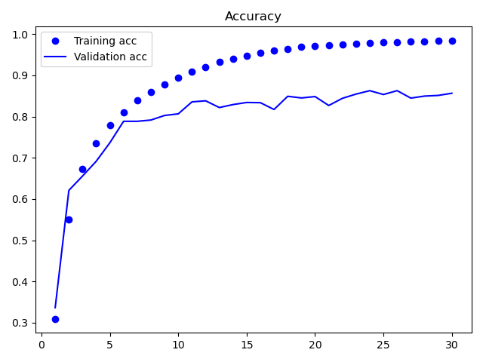
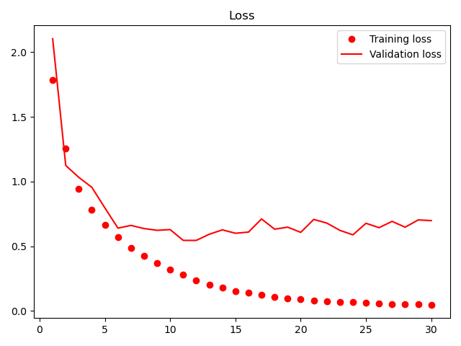
Result
Train_loss: 0.0482 - Train_acc: 0.9844
Test_loss: 0.6982 - Test_acc: 0.8566

