Slide 1
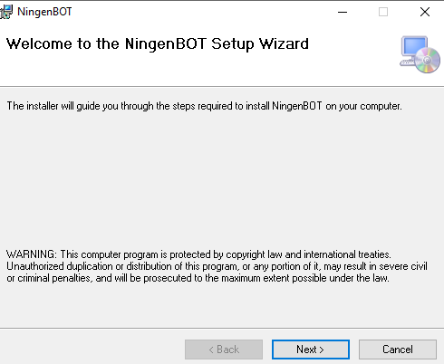
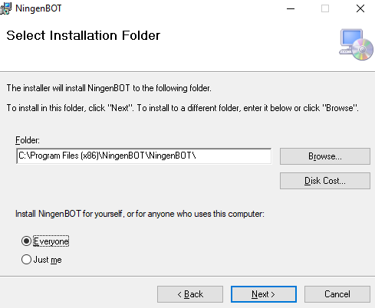

Slide 2
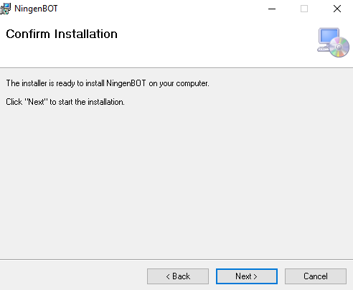
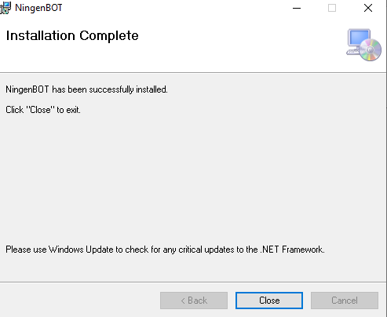

Slide 3
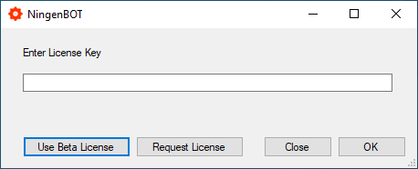
Launch Application

Slide 4
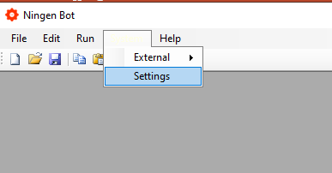
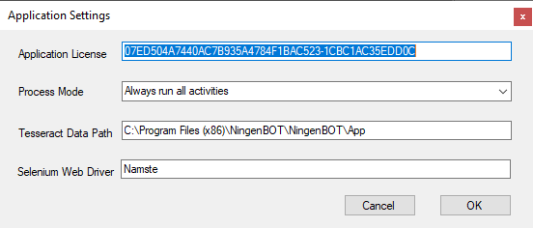

Slide 5
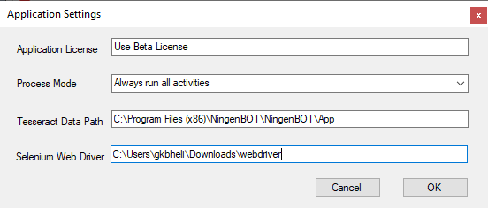
Setup Selenium
Check your browser version
On chrome open : chrome://settings/help
On Edge Browser : edge://settings/help
Go to selenium website and download the driver
Chrome driver
https://chromedriver.chromium.org/downloads
Edge Driver
https://developer.microsoft.com/en-us/microsoft-edge/tools/webdriver/
Download these drivers and put them to any folder of choice and put the detail in web driver location
Notes:
07ED504A7440AC7B935A4784F1BAC523-1CBC1AC35EDD0C
C:\Users\gkbheli\Downloads\webdriver

