Slide 1

Ci/cd azure devops
Angel sevilla camins

Slide 2


planning
Gitops
Continuous integration
Testing
Code Quality
Image build automation
Continuous deployment
Azure Devops Lab

Slide 3
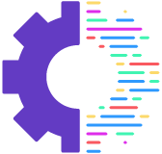
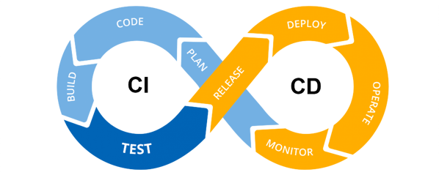
Gitops
GitOps = IaC + PRs + CI/CD
IaC: Infrastructure as code (IaC) is the practice of keeping all infrastructure configuration stored as code.
PRs (Pull requests) are used as the change mechanism for all infrastructure updates.
CI/CD: GitOps automates infrastructure updates using a Git workflow with continuous integration and continuous delivery (CI/CD). When new code is merged, the CI/CD pipeline enacts the change in the environment.
https://about.gitlab.com/topics/gitops/

Slide 4
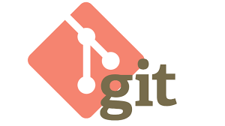
Gitops
GitOps is a system development and management pattern:
Git as the SINGLE source of truth of a system.
Git as the SINGLE place were we operate (create, change and destroy) all environments.
All changes are observable/verifiable
https://www.weave.works/blog/what-is-gitops-really

Slide 5

Gitops
Gitflow
Popular branching model.
Main branches
master
develop
Supporting branches
Feature branches
Release branches
Hotfix branches
https://nvie.com/posts/a-successful-git-branching-model/
https://danielkummer.github.io/git-flow-cheatsheet/

Slide 6
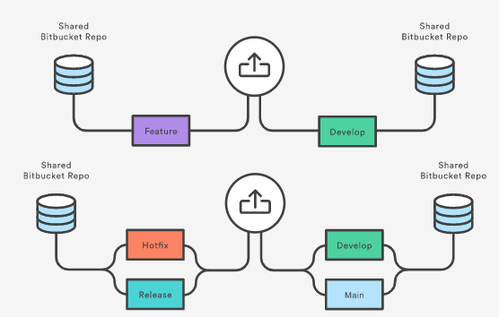
Gitops
Pull request
A pull request is triggered when a feature, release, or hotfix branch needs to be reviewed, and the rest of the team will be notified.
Features are generally merged into the develop branch, while release and hotfix branches are merged into both develop and main.
Pull requests can be used to formally manage all of these merges

Slide 7
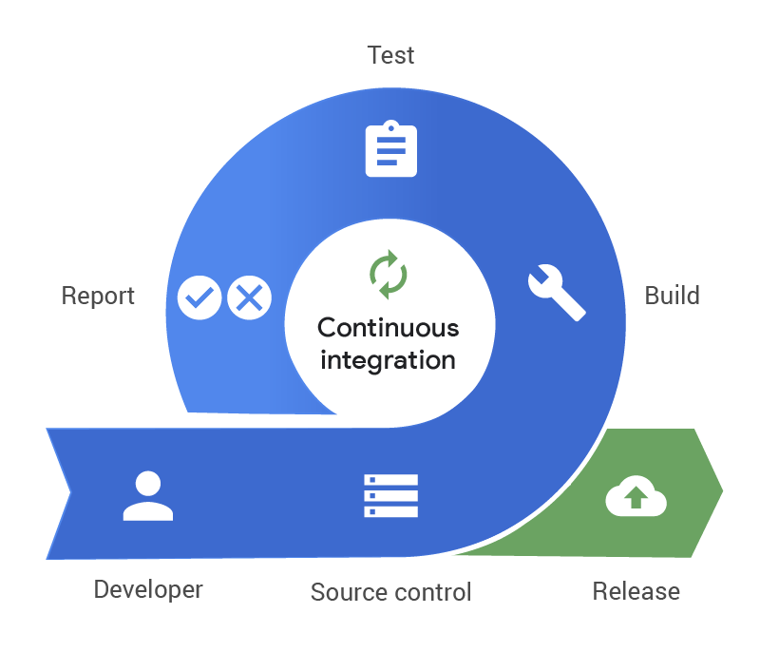
2. Continuos integration
Continuous integration (CI) is the practice of automating the integration of code changes from multiple contributors into a single software project.
CI allows developers to frequently merge code changes into a central repository where builds and tests then run.
CI allows software developers to work independently on features in parallel. When they are ready to merge these features into the end product, they can do so independently and rapidly.
Without CI, developers must manually coordinate and communicate when they are contributing code to the end product.
https://www.atlassian.com/continuous-delivery/continuous-integration

Slide 8


2. Continuos integration
Benefits and challenges
Enable scaling.
Improve the feedback loop.
Enhance communication.
Adoption and installation.
Technology learning curve.
https://www.atlassian.com/continuous-delivery/continuous-integration

Slide 9
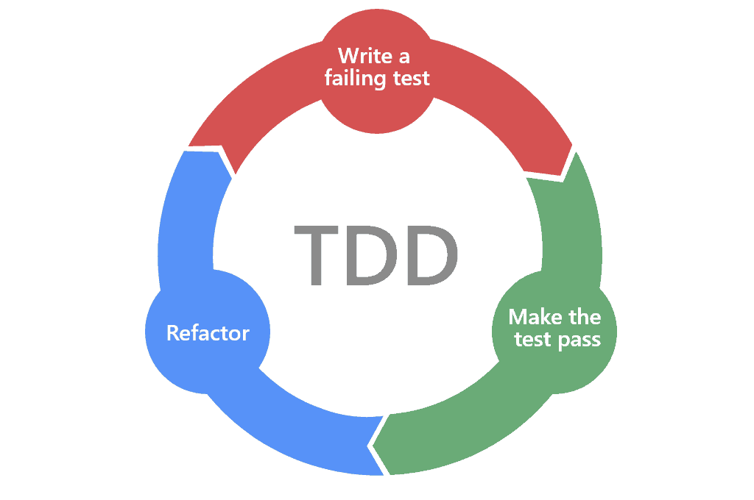
2. Continuos integration
CI best practices
Test Driven Development (TDD).
Once a project has established a CI pipeline with automatic test coverage, it is a best practice to constantly develop and improve the test coverage
TDD is the practice of writing out the test code and test cases before doing any actual feature coding
Pull requests and code review.
Optimize pipeline speed.
https://www.atlassian.com/continuous-delivery/continuous-integration

Slide 10

2. Continuos integration
Testing
Why?
Software development is about managing complexity.
New requirements may conflict with old requirements.
Bugs are a fact of life.
Your team members may have a different understanding.

Slide 11
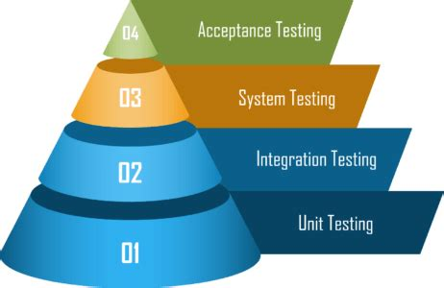
2. Continuos integration
types of tests
Unit tests: testing individual functions, components or modules used by your software.
Integration tests: verify that different modules or services used by your application work well together.
Functional or System tests: focus on the business requirements of an application.
Acceptance testing: formal tests executed to verify if a system satisfies its business requirements.
https://www.atlassian.com/continuous-delivery/software-testing/types-of-software-testing

Slide 12
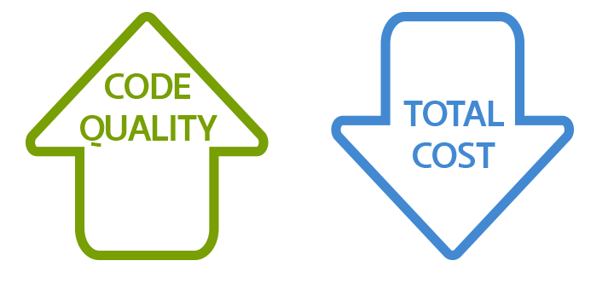
2. Continuos integration
Code Quality
We write code for our colleagues, not for the computer or ourselves”
Telling a story
Test coverage should be appropriate.
Some more mantras:
Keep It Simple Stupid.
Separate Your Concerns.
Don’t Repeat Yourself.
If your method doesn’t fit on the screen anymore: IT IS TOO LONG!!!!

Slide 13
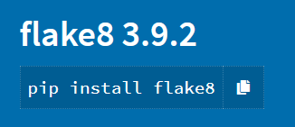
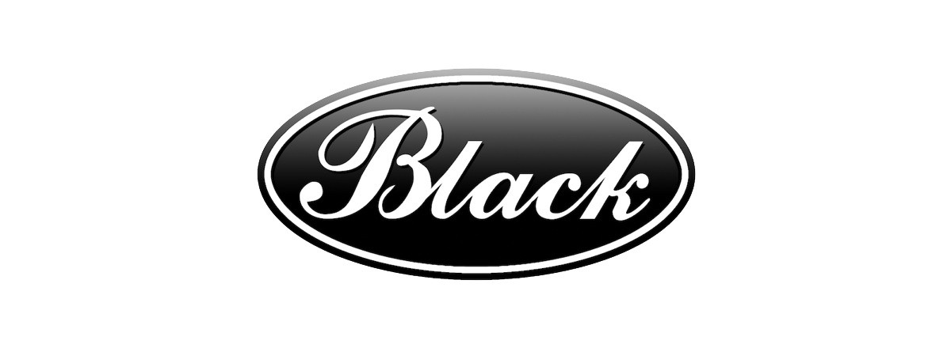
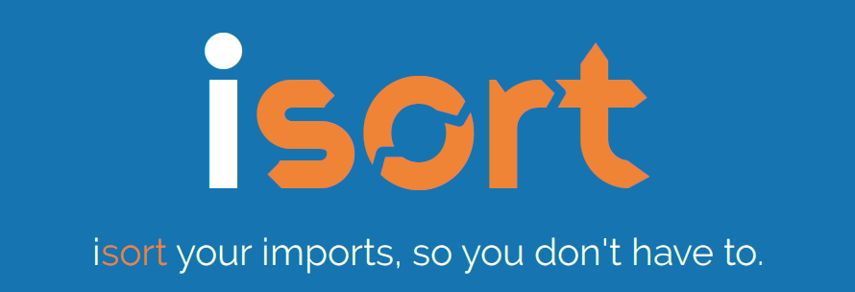
2. Continuos integration
Code Quality
Linting -> flake8
Linting highlights syntactical and stylistic problems in your code to identify and correct subtle programming errors.
It analyzes how the code runs and detects errors, not just formatting!
For example, it detects use of an uninitialized or undefined variable, calls to undefined functions.
Formatting -> black and isort
restructures how code appears.

Slide 14
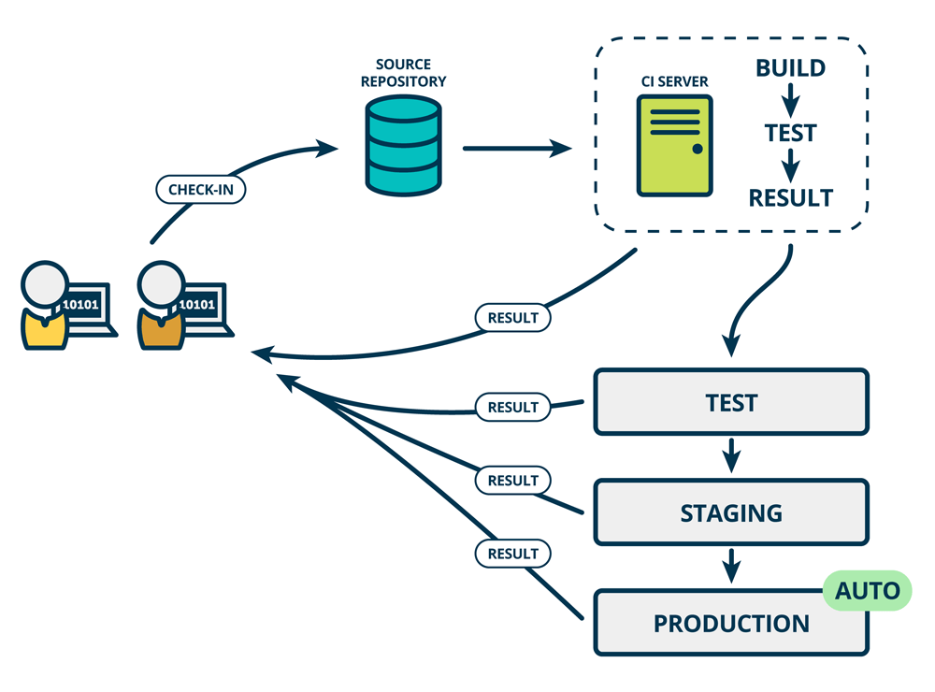
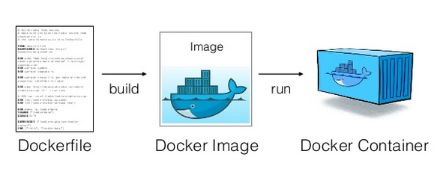
2. Continuos integration
CI with Docker involved

Slide 15
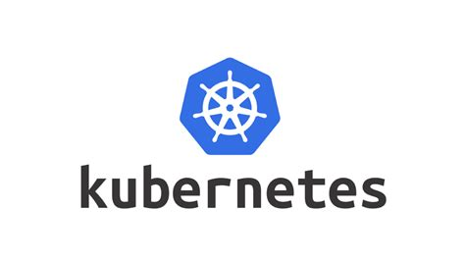
3. Continuous deployment
Continuous deployment vs. continuous delivery
Continuous deployment is a strategy in software development where code changes to an application are released automatically into the production environment.
Continuous delivery is a software development practice where software is built in such a way that it can be released into production at any given time.
https://www.ibm.com/cloud/learn/continuous-deployment

Slide 16
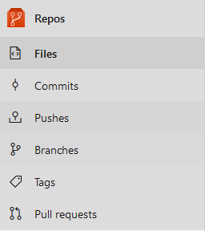
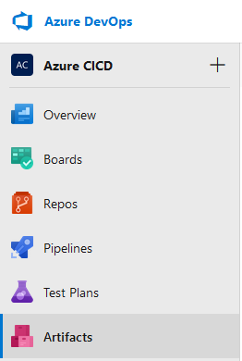
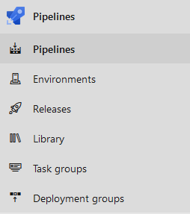
4. Azure devops LAB
Azure Project

Slide 17
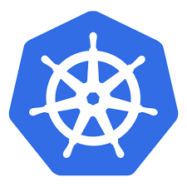
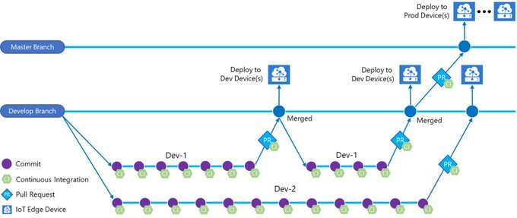
4. Azure devops LAB
Pipeline
Deploy to
Kubernetes
Deploy to
Kubernetes
Deploy to
Kubernetes

Slide 18
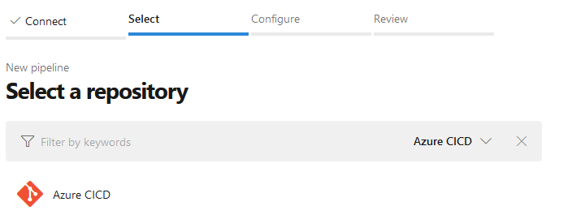
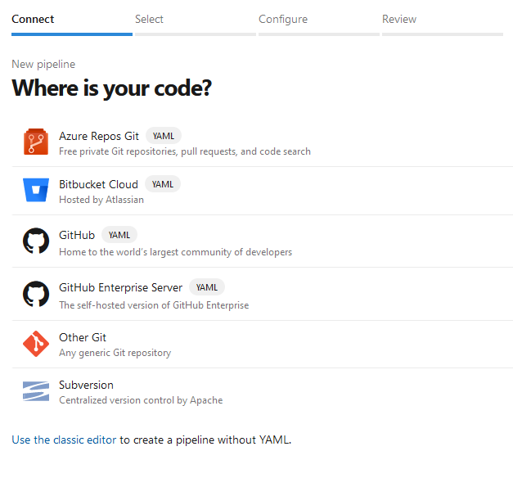
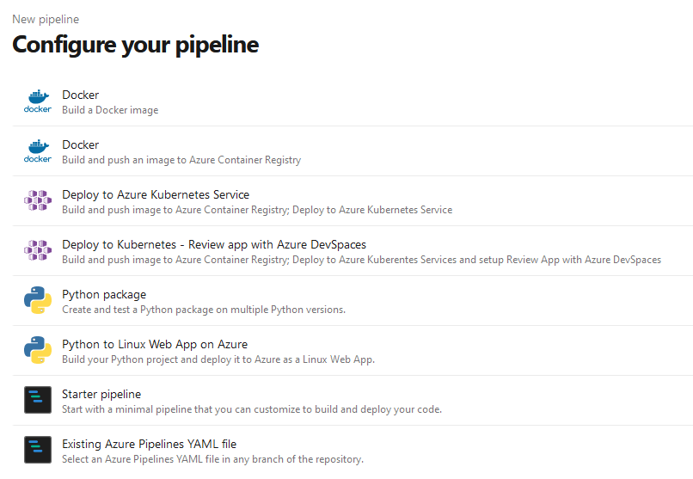
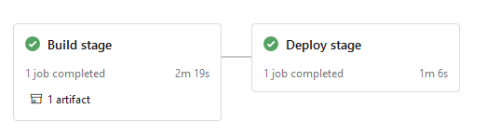
4. Azure devops LAB
Pipeline

Slide 19
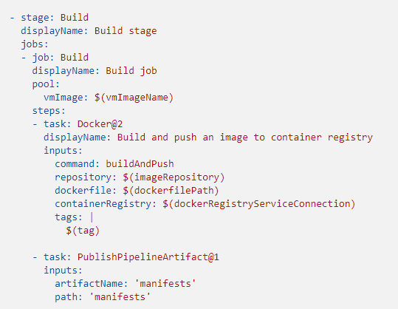
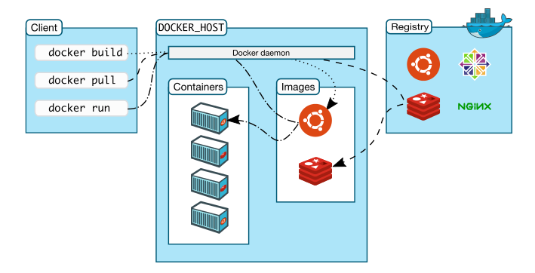
4. Azure devops LAB
Build stage
Image is build and pushed automatically.

Slide 20
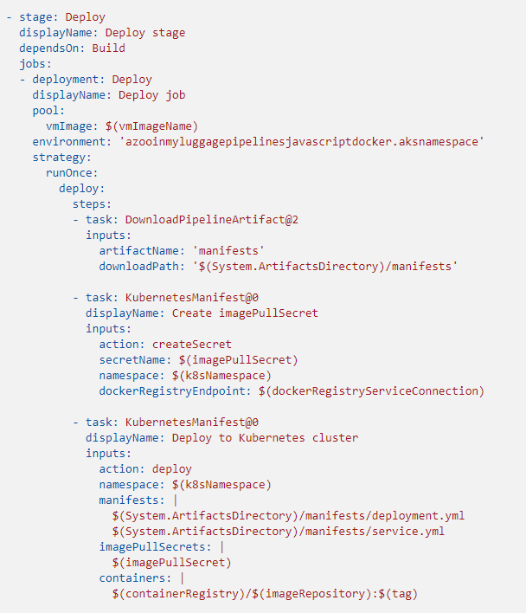
4. Azure devops LAB
Deploy Stage
Azure Kubernetes Service manages your hosted Kubernetes environment
It makes quicker and easier deployment.
The following files are automatically created:
manifest/deployment.yaml
manifest/service.yaml
Every time you change your code:
Image is pushed to an Azure Container Registry (see previous slide).
imagePullSecret is created to pull from the Azure Container Registry resource
Manifests are then deployed to your Azure Kubernetes Service cluster.

Slide 21
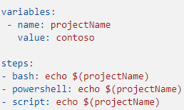
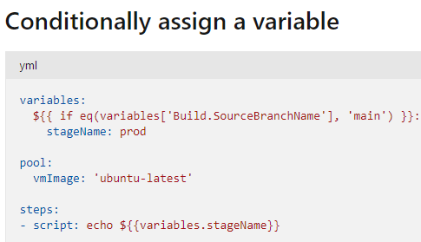
4. Azure devops LAB
Variables & CONDITIONALS
Normally use macro syntax:
As part of an expression
variables can be accessed using:
Index syntax: variables['MyVar’]
Property dereference syntax: variables.MyVar
You can use an if clause to conditionally assign the value or a variable or set inputs for tasks.

Slide 22
4. Azure devops LAB
Functions
eq
Evaluates True if parameters are equal
Min parameters: 2. Max parameters: 2
Converts right parameter to match type of left parameter. Returns False if conversion fails.
Ordinal ignore-case comparison for Strings
and
Evaluates to True if all parameters are True
Min parameters: 2. Max parameters: N
Casts parameters to Boolean for evaluation
Short-circuits after first False

Slide 23
4. Azure devops LAB
Functions
ne
Evaluates True if parameters are not equal
Min parameters: 2. Max parameters: 2
Converts right parameter to match type of left parameter. Returns True if conversion fails.
Ordinal ignore-case comparison for Strings
For more:
https://docs.microsoft.com/en-us/azure/devops/pipelines/process/expressions?view=azure-devops

Slide 24
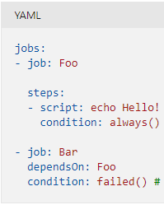
4. Azure devops LAB
Conditionals in jobs
You can specify conditions under which a step, job, or stage will run.
succeededOrFailed() -> Even if a previous dependency has failed, unless the run was canceled.
always() -> Even if a previous dependency has failed, even if the run was canceled.
failed() -> Only when a previous dependency has failed.
succeeded() -> run if all previous steps/jobs have succeeded.

Slide 25
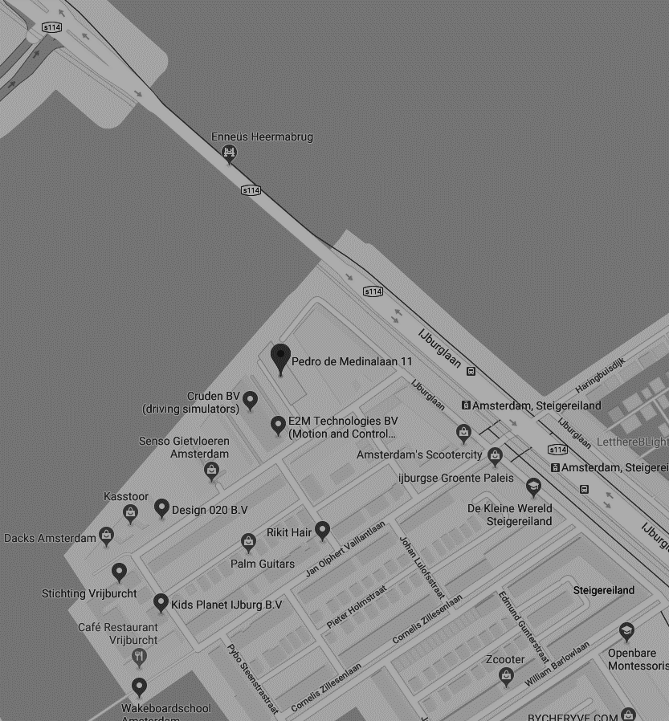
THANK YOU FOR YOUR ATTENTION
Pedro de Medinalaan 11, 1086 XK Amsterdam
020 - 773 1972
www.anchormen.nl

