Slide 1
My hobby project
Data Engineer Use Case

Slide 2
Agenda
Current overview
Design overview
Code review
Improvements

Slide 3





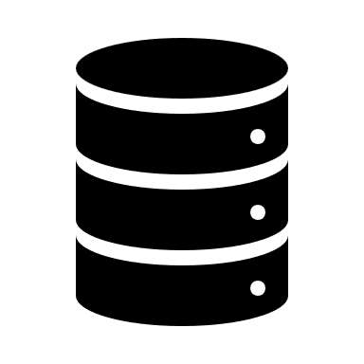


Current overview
CBS pipeline
CBS API
Load meta Data
Load Data
Save as JSON
Save on Cloud
Bronze Framework
Dropbox
Glassdoor
HTML code
Parse HTML to txt
Save as txt
Save on Cloud
Glassdoor pipeline

Slide 4


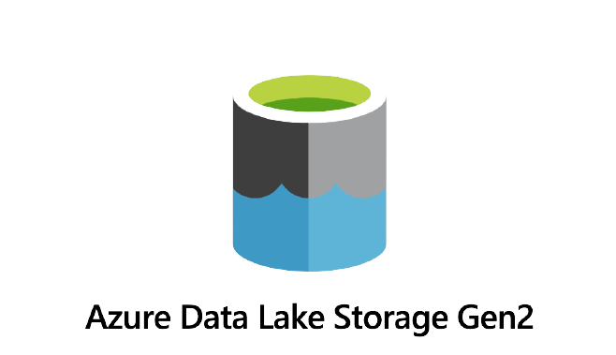
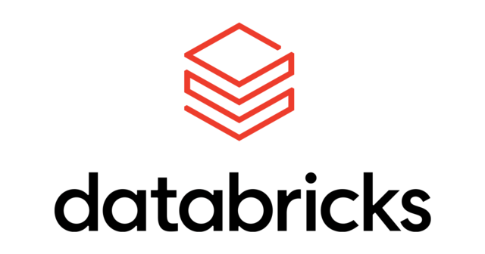
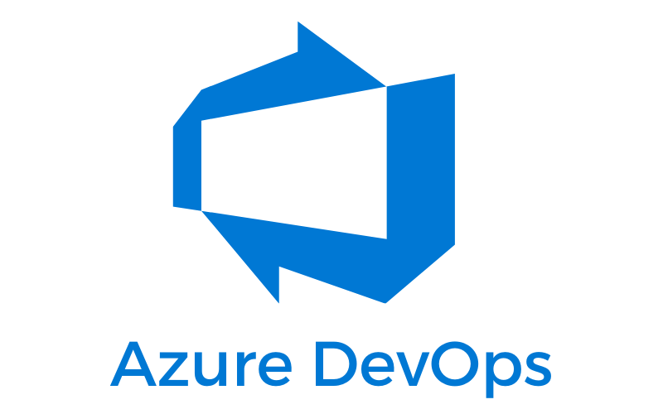

Design overview
CBS pipeline
Pipelines in Spark
CBS API
Load meta data
Load data
Spark Dataframe
Save as Parquet
Convert Meta Data
Bronze Data Storage
Codes in Databricks
Orchestration
Orchestration as Code
Glassdoor
HTML code
Parse HTML to dictionary
Spark Dataframe
Save as Parquet
Scheduling via Databricks Job Clusters
Glassdoor pipeline

Slide 5







Design overview
Bronze Framework
Silver Framework
Gold Framework
Pre-processing Data or Apply Analytics
Apply Analytics
Bronze Data Storage
Silver Data Storage
Gold Data Storage
Visualisation Dashboard
Visualisation Dashboard
Managed by Terraform
Stakeholder
Stakeholder

Slide 6
Code review
Prerequisites
Dropbox:
Make a dropbox account
Go to dropbox developer’s app
Ensure the reading and writing rights are enabled
Generate a token
Token will only last 4 hours before refresh is required
CBS:
Pip install cbsodata
Glassdoor:
Get Chromedriver
Pip install Selenium
Git link for the codes

Slide 7
Improvements
Need to add a proper logging
Need to add unit testing
Add Docker
Set everything in classes as that is industry standards
Setup.py needs to be done properly so that packages can be made and distributed
Requires Artifactory
Necessary for CI/CD pipelines
Many of the infrastructure designs needs to be implemented (see “Design Overview”)
Apply scheduling for the various pipelines
All pipelines needs to be written in a distributed data processing language (such as Spark) to ensure scalability

