Slide 1
Session 2: Quality Control in R
IND E 321
Ning Li (ningli30@uw.edu)
Dr. Shuai Huang (shuaih@uw.edu)

Slide 2
Outline for whole sessions by TA
Introduction to R
R for control chart I
Homework solution I
R for control chart II
Homework solution II
R for control chart III

Slide 3
Hypothesis test
T-test(mean)
Z-test(mean)
F-test(variance)

Slide 4
R packages
qcc: http://cran.r-project.org/web/packages/qcc/qcc.pdf
graphicsQC: http://cran.r-project.org/web/packages/graphicsQC/graphicsQC.pdf
IQCC: http://cran.r-project.org/web/packages/IQCC/IQCC.pdf
qualityTools: http://cran.r-project.org/web/packages/qualityTools/qualityTools.pdf
SixSigma: http://cran.r-project.org/web/packages/SixSigma/SixSigma.pdf

Slide 5
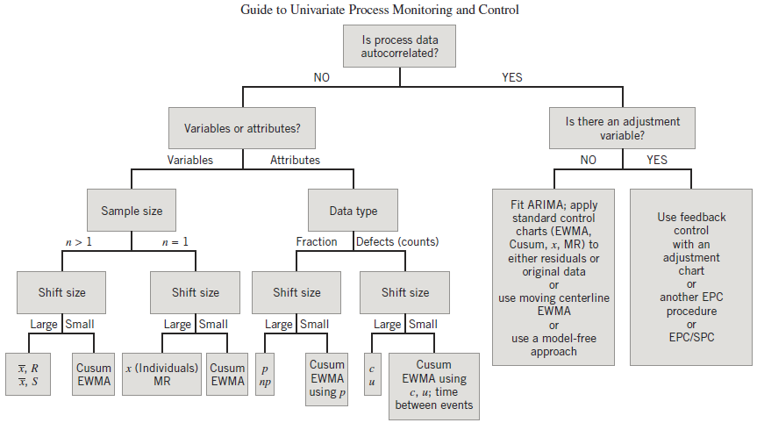

Slide 6
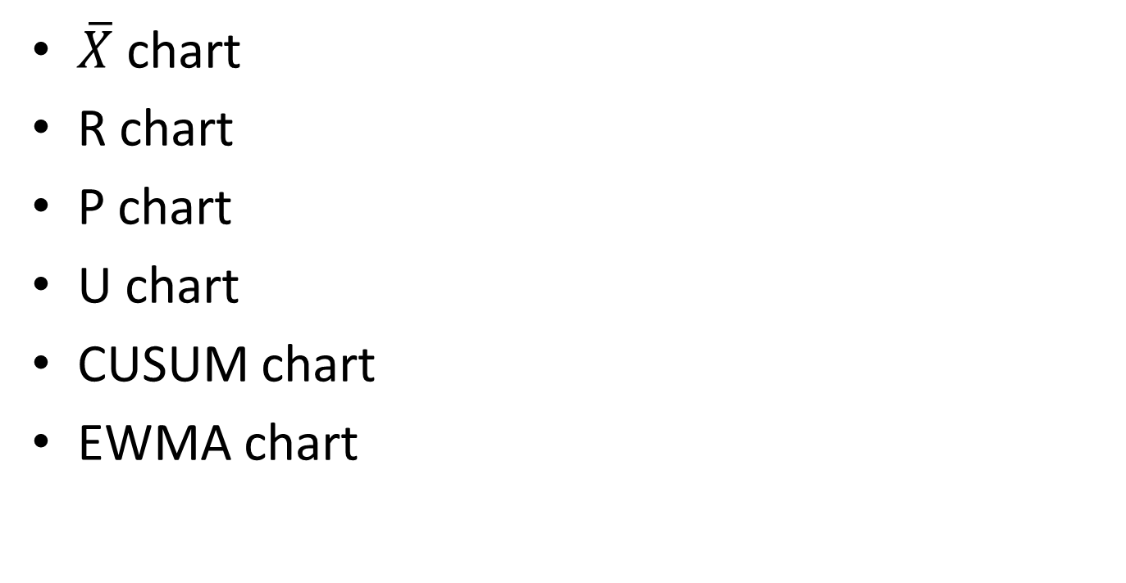
Control Chart Examples
$\overline{X}$ chart
R chart
P chart
U chart
CUSUM chart
EWMA chart

Slide 7

Control Chart Examples
$\overline{X}$ chart
R chart

Slide 8
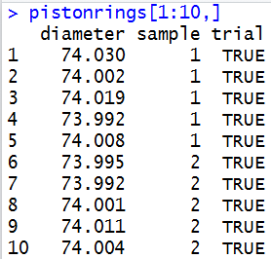
pistonrings

Slide 9
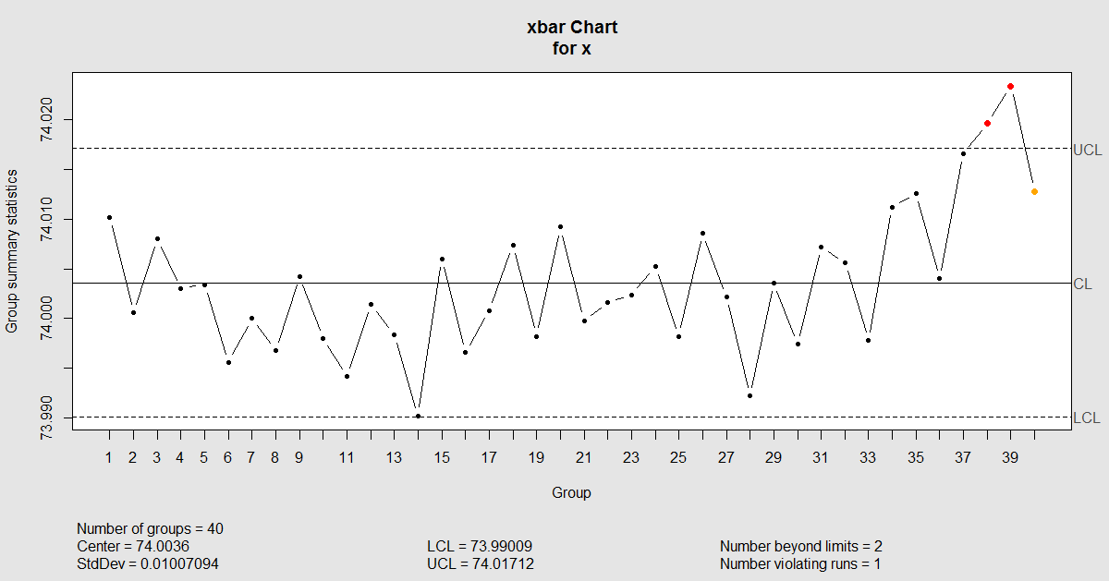

Slide 10
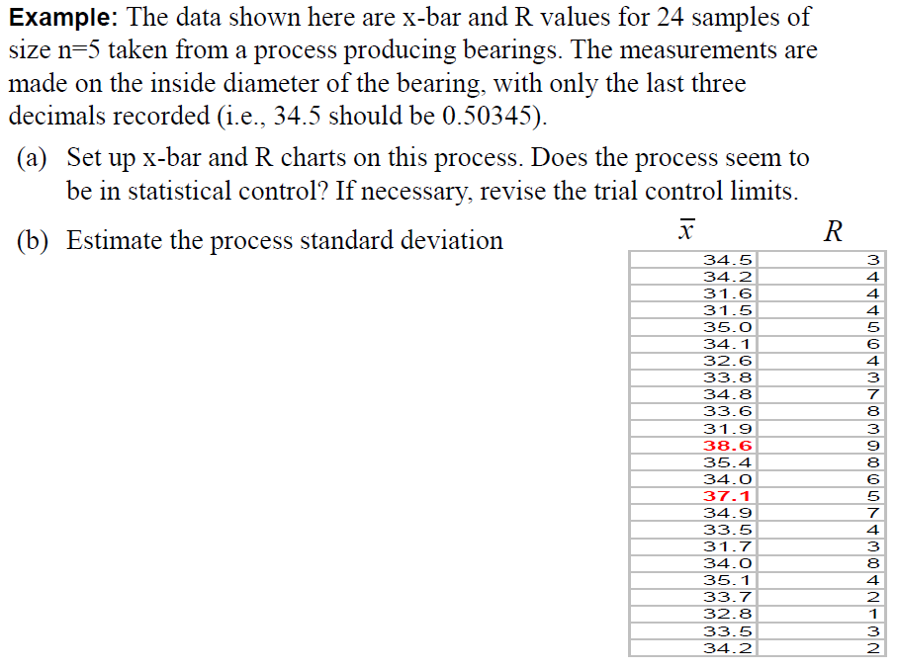
Page 259 in Slides

Slide 11
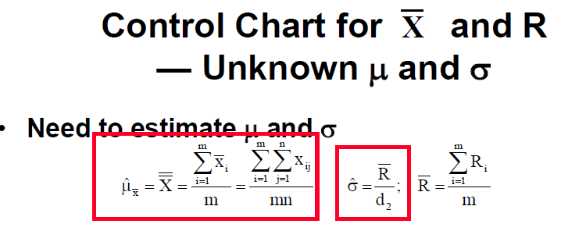
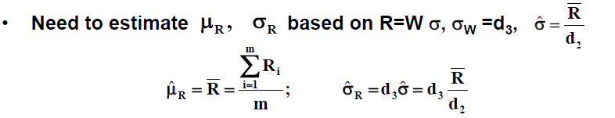

Slide 12
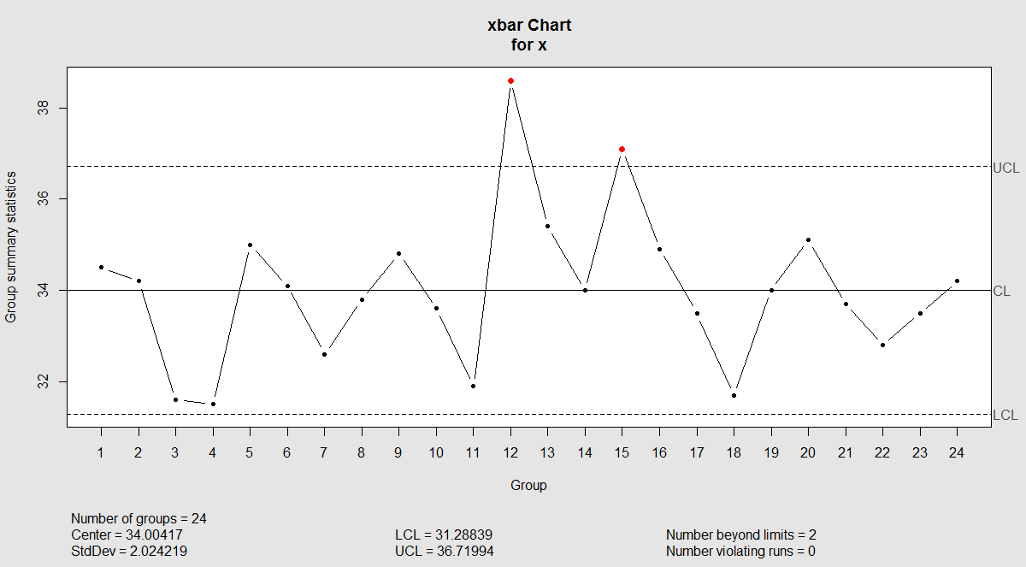

Slide 13
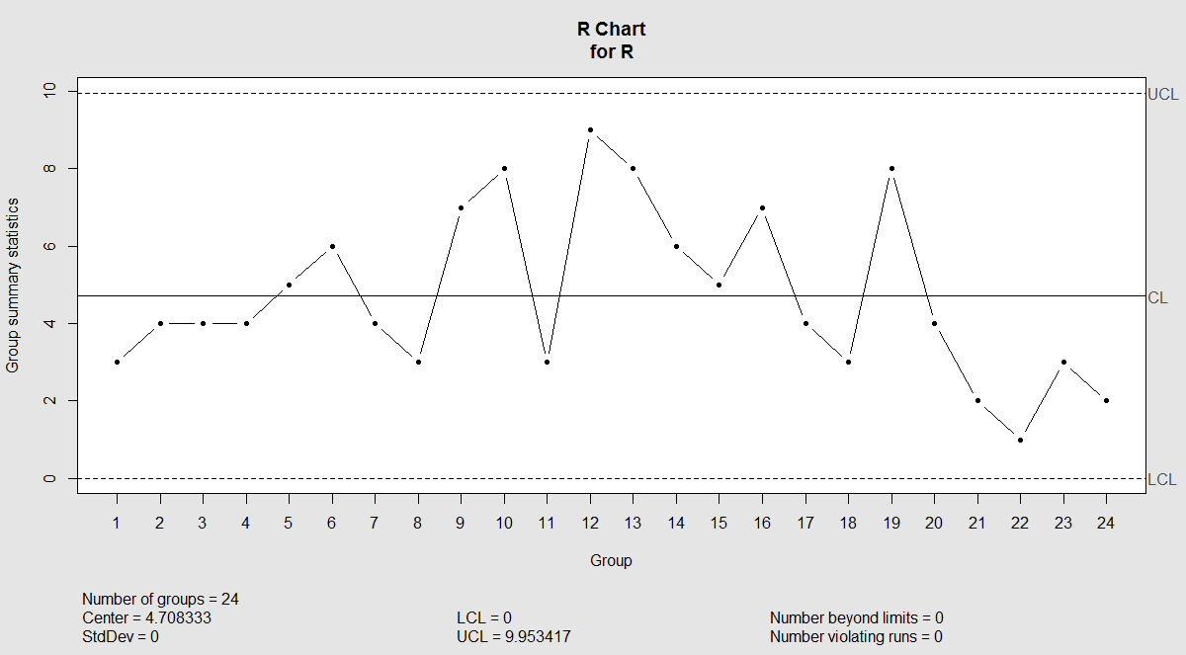

Slide 14
Good luck in your finals

