Slide 1
Session 3: More Practices in R
IND E 321
Ning Li (ningli30@uw.edu)
Dr. Shuai Huang (shuaih@uw.edu)

Slide 2
Outline for whole sessions by TA
Introduction to R
R for control chart I
Homework solution I
R for control chart II
Homework solution II
R for control chart III

Slide 3
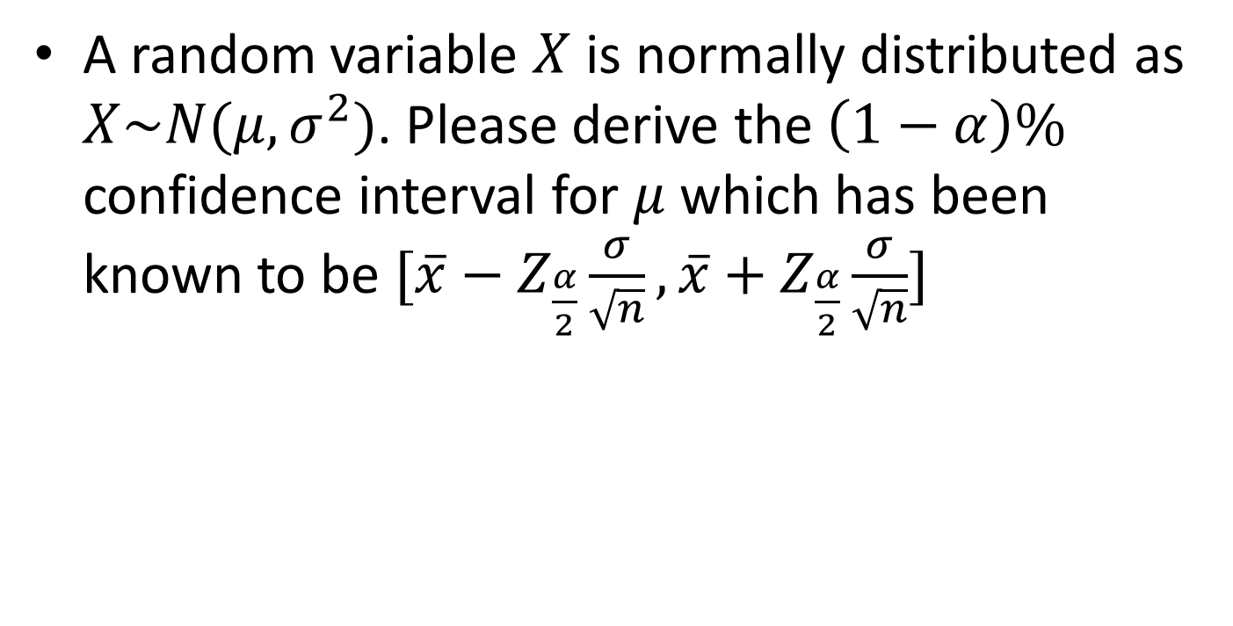
Quiz problem
A random variable $X$ is normally distributed as $X\sim N(μ,σ^{2})$. Please derive the $\left(1−α\right)\%$ confidence interval for $μ$ which has been known to be $[\overline{x}−Z_{\frac{α}{2}}\frac{σ}{\sqrt{n}},\overline{x}+Z_{\frac{α}{2}}\frac{σ}{\sqrt{n}}]$

Slide 4
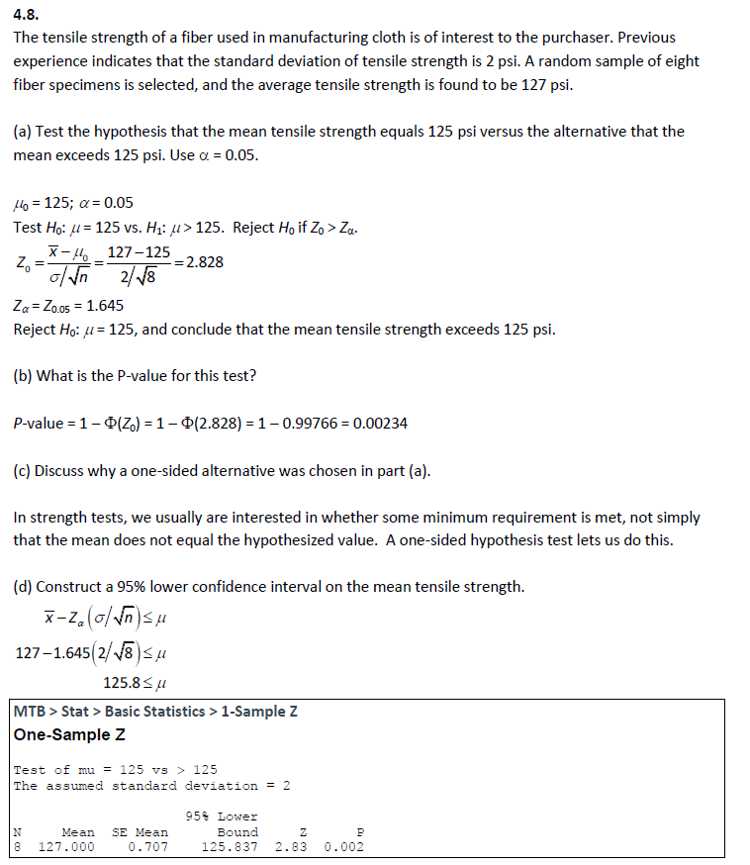
HW2 problem4.8

Slide 5
HW2 problem4.8

Slide 6
HW2 problem4.8

Slide 7
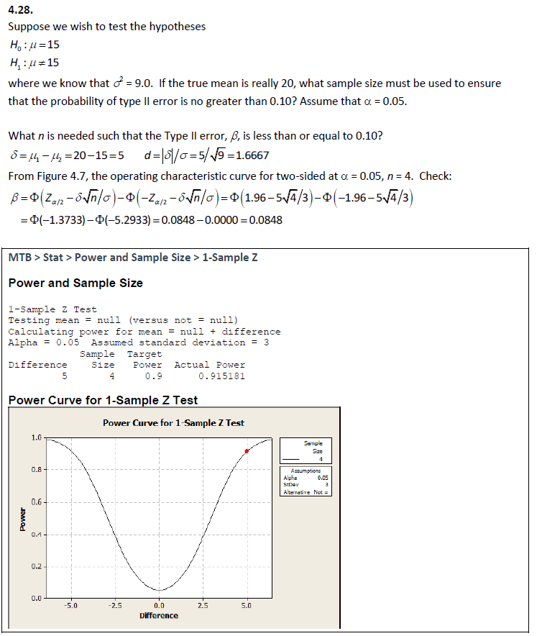
HW2 problem4.28

Slide 8
HW2 problem4.28

Slide 9
HW2 problem4.28

Slide 10
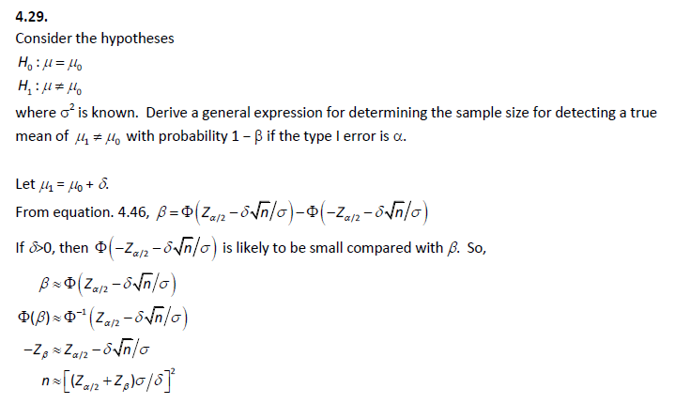
HW2 problem4.29

Slide 11
HW2 problem4.29

Slide 12
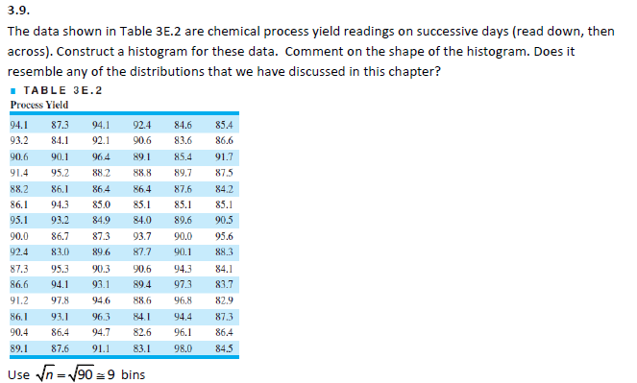
HW1 problem3.9

Slide 13
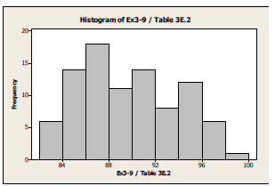

HW1 problem3.9
N=$\sqrt{90}≈9$
The distribution seems to be heavy tail in the right hand side. It is temping to suspect that there are two modes, however, the 2nd mode is rather minor than significant.

Slide 14
Mistake collection
1-0.9977 = ?
Two sided hypothesis test
Normality assumption

Slide 15
Thank you.

