Slide 1
Session 4:Homework and midterm solution
IND E 321
Ning Li (ningli30@uw.edu)
Dr. Shuai Huang (shuaih@uw.edu)

Slide 2
Outline for whole sessions by TA
Introduction to R
R for control chart I
Homework solution I
Homework and exam solution II
R for control chart II
R for control chart III

Slide 3
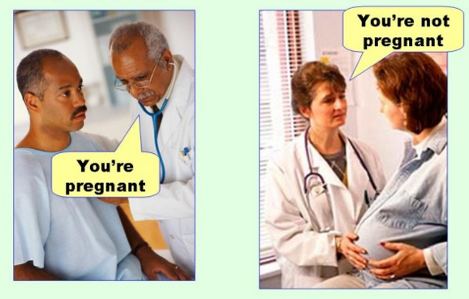
Midterm problem
Q1 part 2) Which one is Type I error?
(a) Left (b) Right

Slide 4
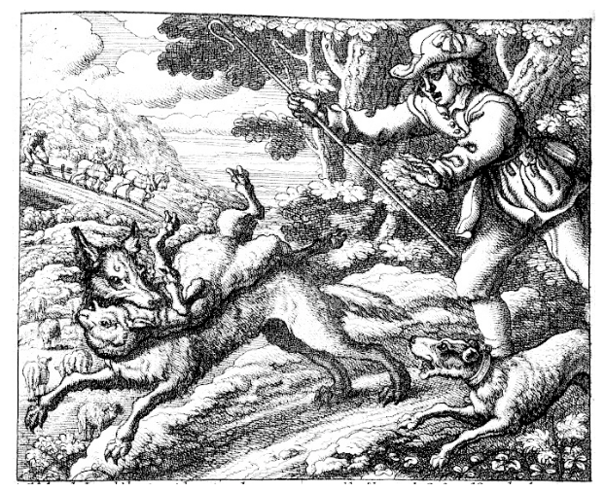
Midterm problem
Question1 part 2)

Slide 5
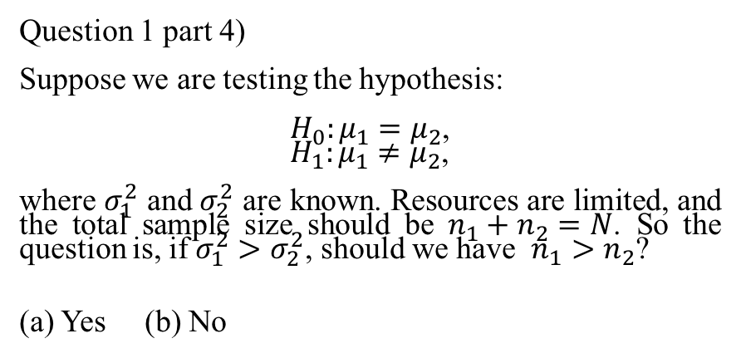
Midterm problem
Question 1 part 4)
Suppose we are testing the hypothesis:
$H_{0}:μ_{1}=μ_{2}$,
$H_{1}:μ_{1}≠μ_{2}$,
where $σ_{1}^{2}$ and $σ_{2}^{2}$ are known. Resources are limited, and the total sample size should be $n_{1}+n_{2}=N$. So the question is, if $σ_{1}^{2}>σ_{2}^{2}$, should we have $n_{1}>n_{2}$?
(a) Yes (b) No

Slide 6
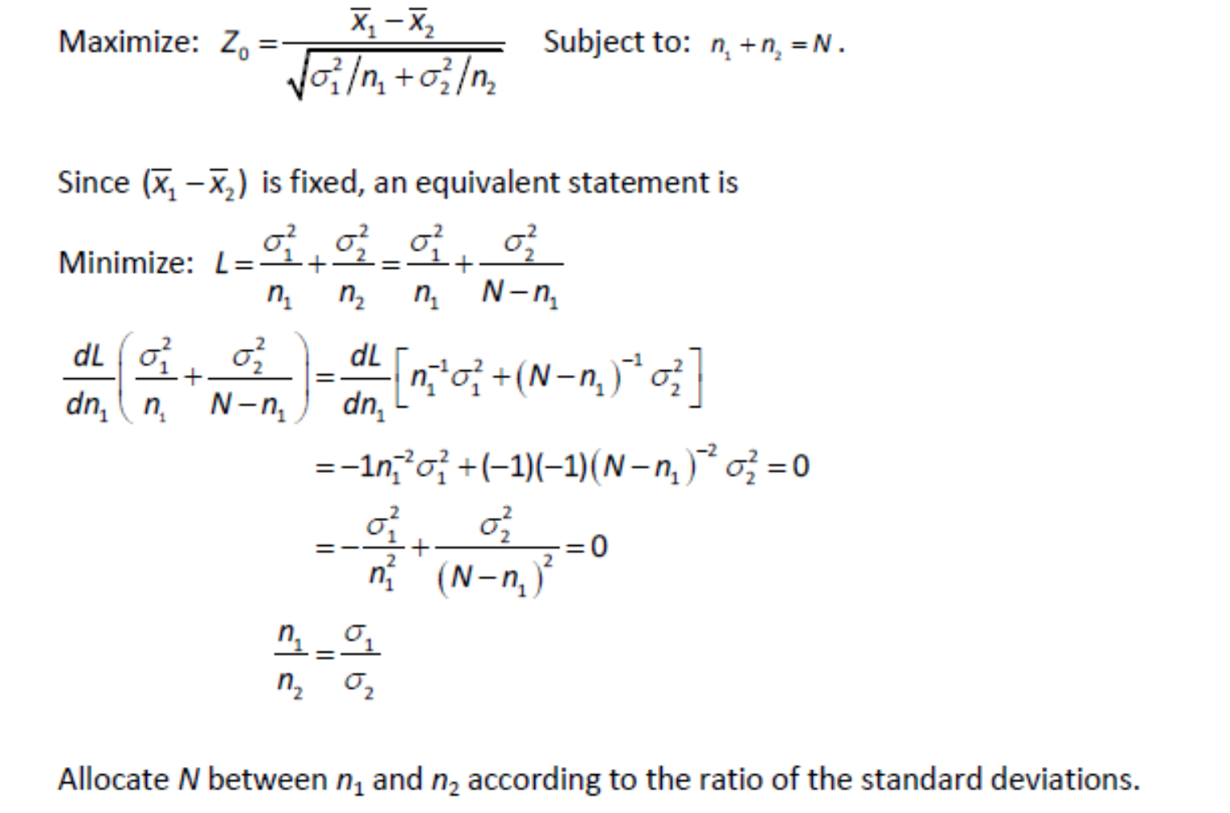
Midterm problem

Slide 7
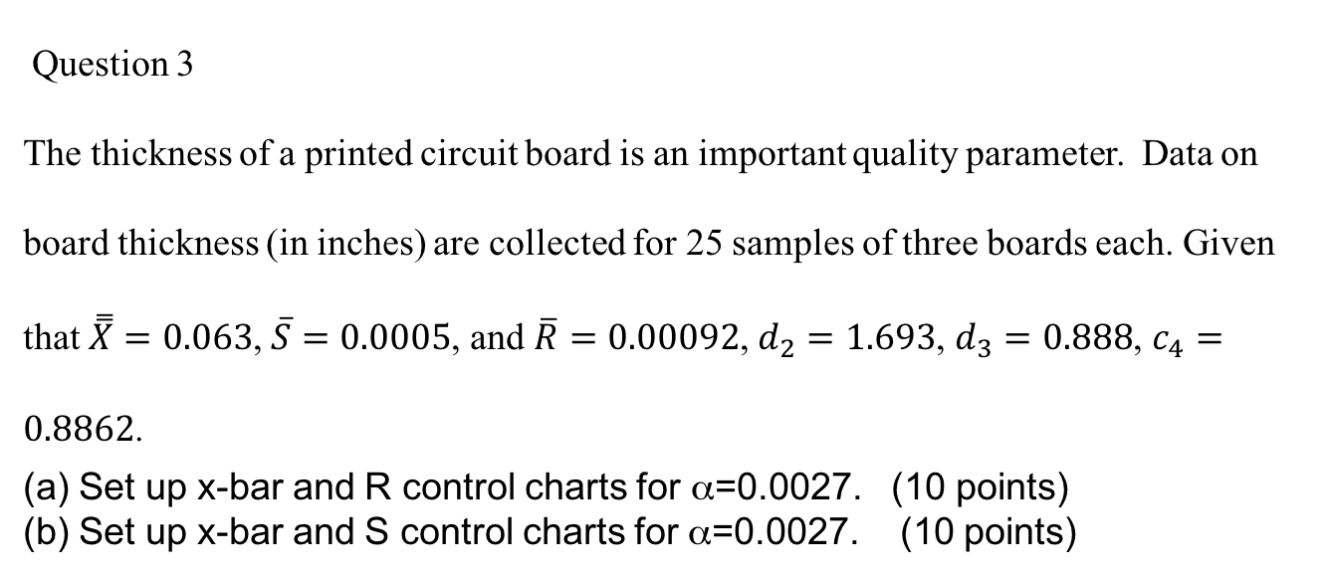
Midterm problem
Question 3
The thickness of a printed circuit board is an important quality parameter. Data on board thickness (in inches) are collected for 25 samples of three boards each. Given that $\overset{̿}{X}=0.063$, $\overline{S}=0.0005$, and $\overline{R}=0.00092$, $d_{2}=1.693$, $d_{3}=0.888$, $c_{4}=0.8862$.
Set up x-bar and R control charts for α=0.0027. (10 points)
Set up x-bar and S control charts for α=0.0027. (10 points)

Slide 8
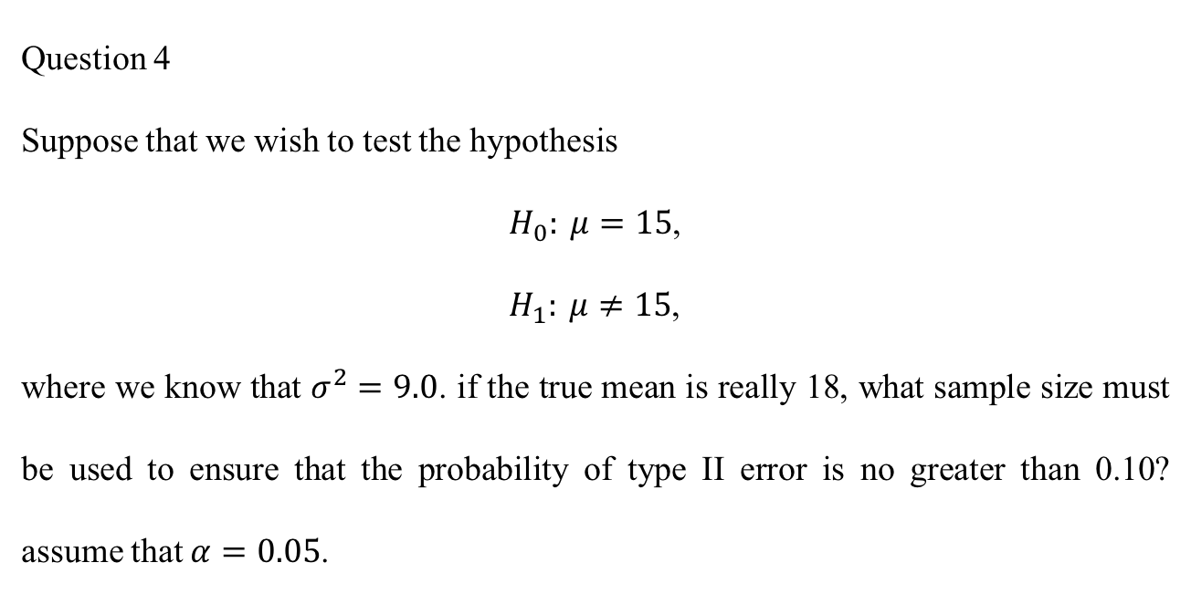
Midterm problem
Question 4
Suppose that we wish to test the hypothesis
$H_{0}: μ=15$,
$H_{1}: μ≠15$,
where we know that $σ^{2}=9.0$. if the true mean is really 18, what sample size must be used to ensure that the probability of type II error is no greater than 0.10? assume that $α=0.05$.

Slide 9
Midterm problem
Question 5
An x-bar chart with three-sigma limits has parameters as follows:
UCL = 104
CL = 100
LCL = 96
n = 5.
Suppose the process quality characteristic being controlled is normally distributed with a true mean of 98 and a standard deviation of 8. What is the probability that the control chart would exhibit lack of control by at least the third point plotted?

Slide 10
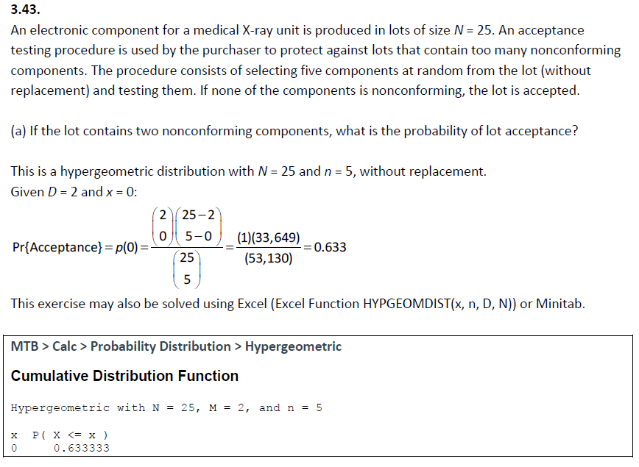
Homework 4 problem

Slide 11
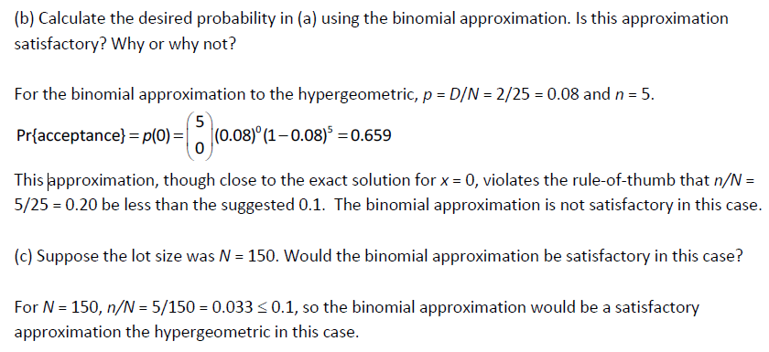
Homework 4 problem

Slide 12
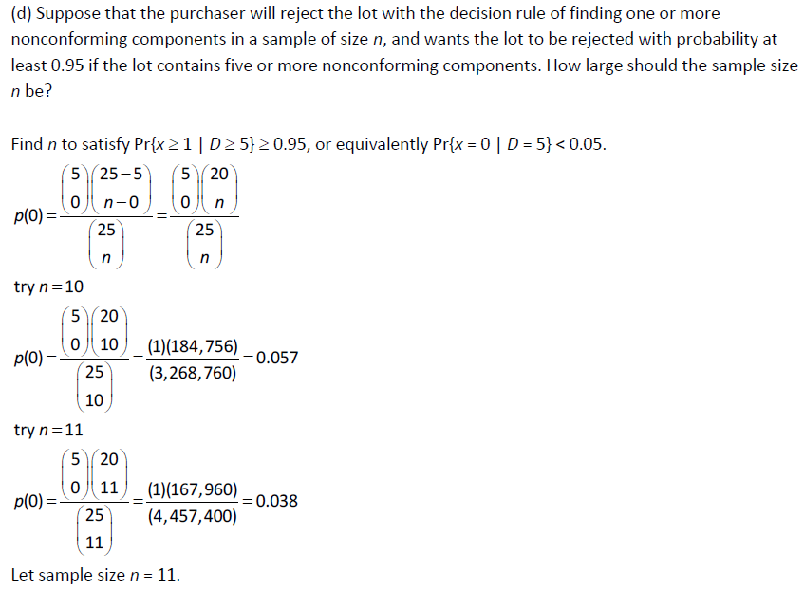
Homework 4 problem

Slide 13
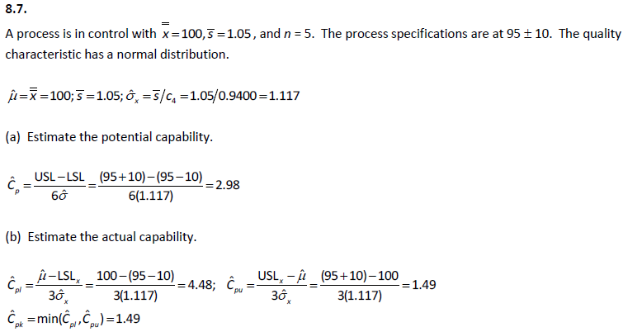
Homework 4 problem

Slide 14
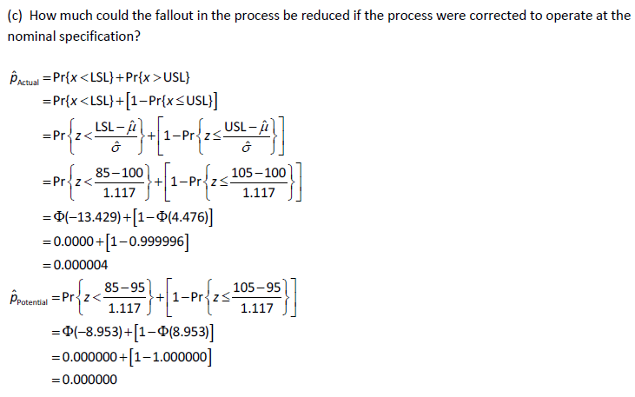
Homework 4 problem

Slide 15
Thank you.

