Slide 1
Session 5: Quality Control in R
IND E 321
Ning Li (ningli30@uw.edu)
Dr. Shuai Huang (shuaih@uw.edu)

Slide 2
Outline for whole sessions by TA
Introduction to R
R for control chart I
Homework solution I
Homework and exam solution II
R for control chart II

Slide 3
R packages
qcc: http://cran.r-project.org/web/packages/qcc/qcc.pdf
graphicsQC: http://cran.r-project.org/web/packages/graphicsQC/graphicsQC.pdf
IQCC: http://cran.r-project.org/web/packages/IQCC/IQCC.pdf
qualityTools: http://cran.r-project.org/web/packages/qualityTools/qualityTools.pdf
SixSigma: http://cran.r-project.org/web/packages/SixSigma/SixSigma.pdf

Slide 4

QCC Examples
$\overline{X}$ chart
R chart
P chart
U chart
CUSUM chart
EWMA chart

Slide 5
QCC Examples
$\overline{X}$ chart
R chart
P chart
U chart
CUSUM chart
EWMA chart

Slide 6
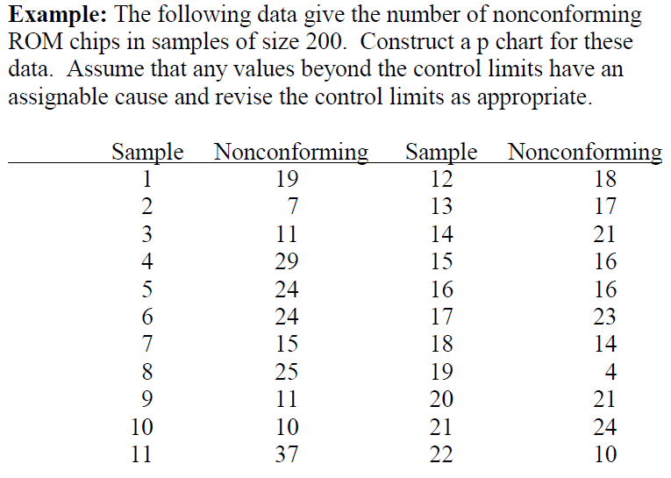

Slide 7
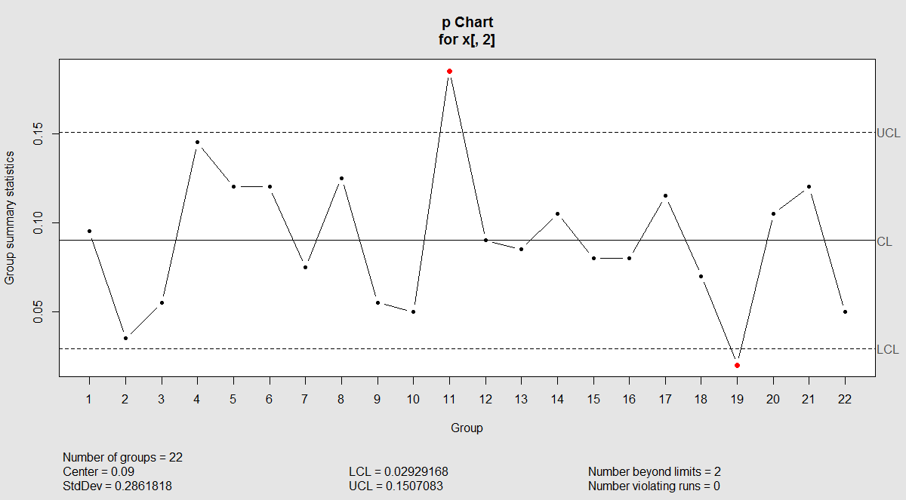

Slide 8
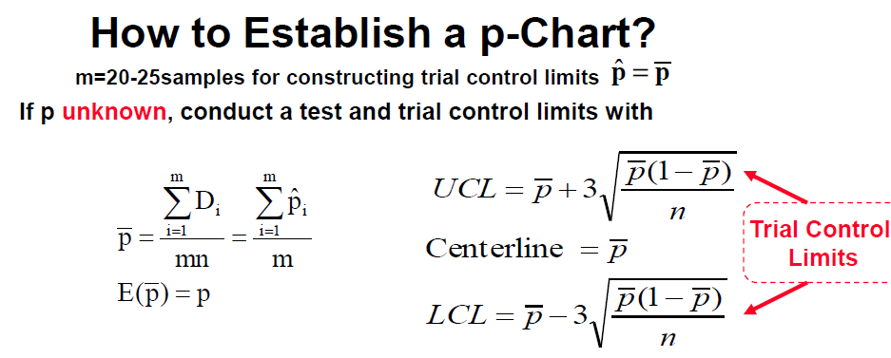

Slide 9
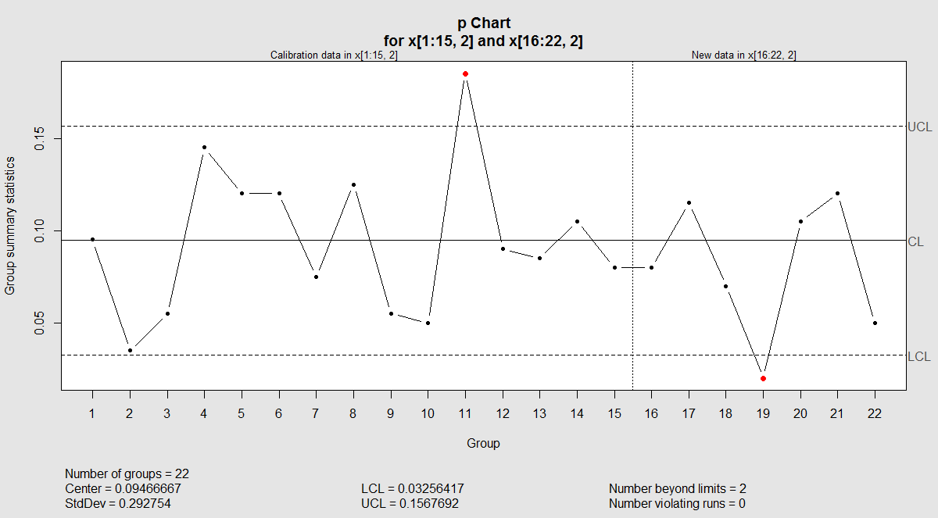
Monitor new samples

Slide 10
Practice in class
$\overline{X}$ chart
R chart
P chart
U chart
CUSUM chart
EWMA chart

Slide 11
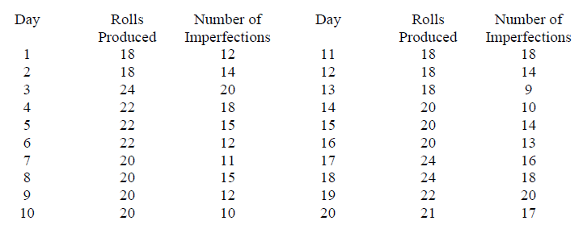
Set up a chart for the following data set. Use first 15 samples as calibration data, and remaining 5 as new samples to monitor. Page 329

Slide 12
QCC Examples
$\overline{X}$ chart
R chart
P chart
U chart
CUSUM chart
EWMA chart

Slide 13
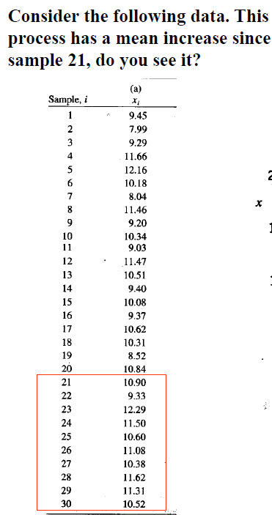
Page 335

Slide 14
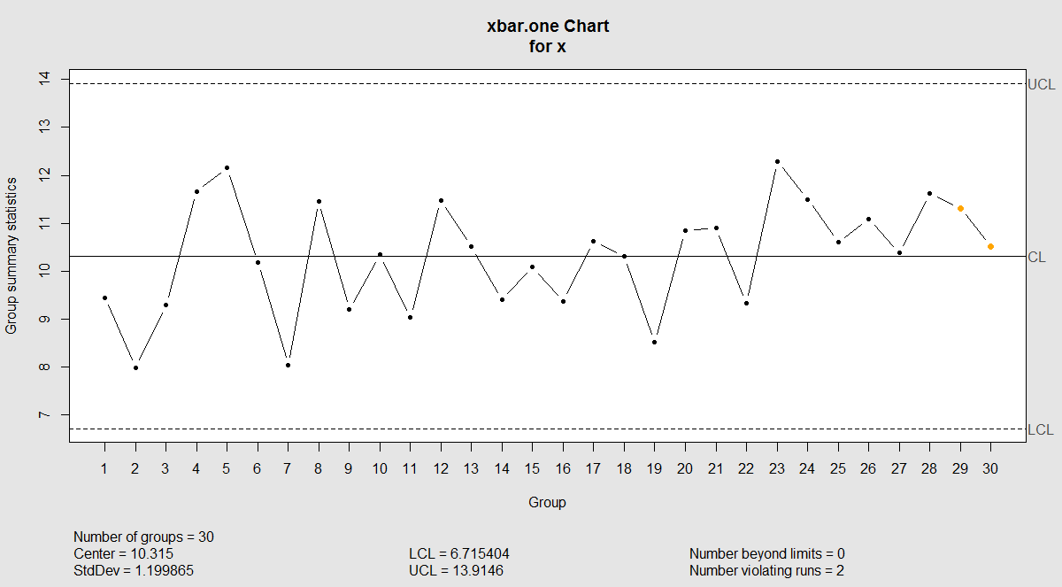
X bar chart

Slide 15
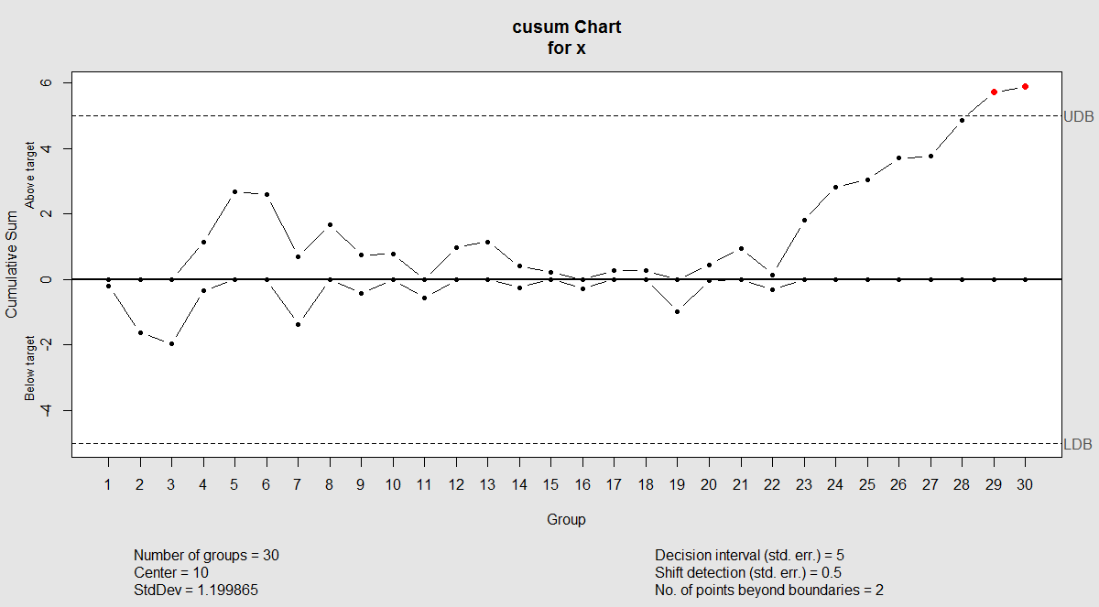
CUSUM Chart

Slide 16
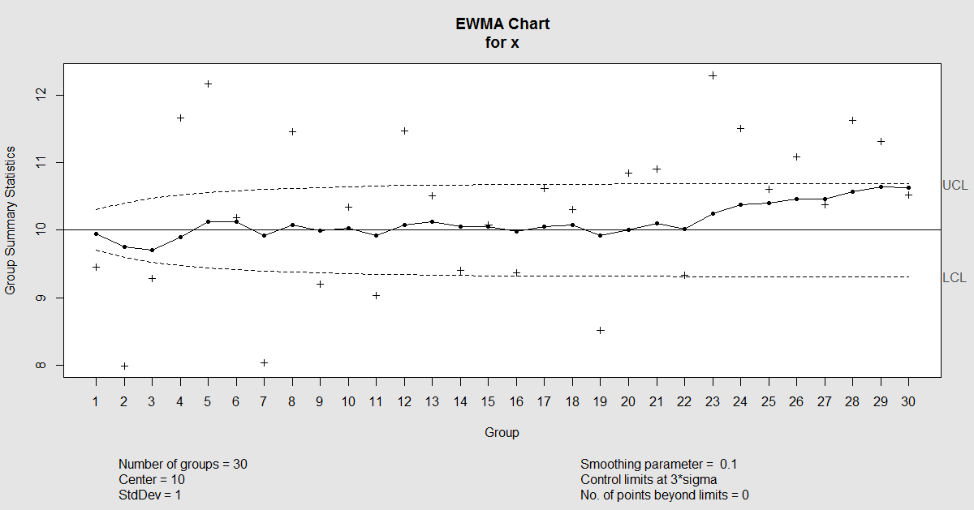
EWMA Chart

Slide 17
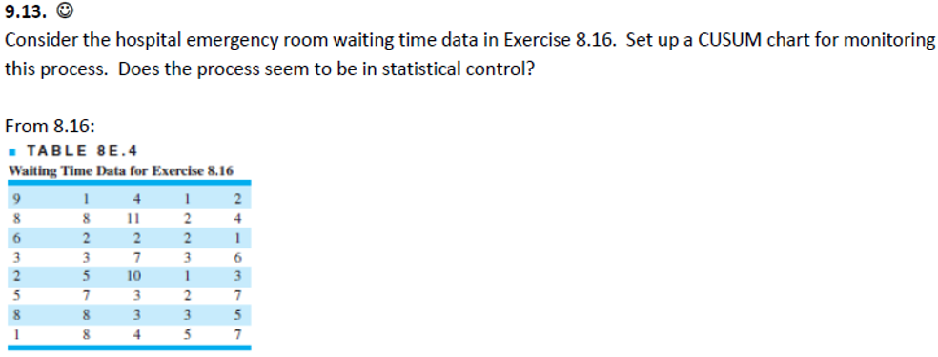
Homework Question 9.13
$$μ_{0}=4.5 \\ σ=2.79 \\ k=0.25 \\ h=8.01$$

Slide 18
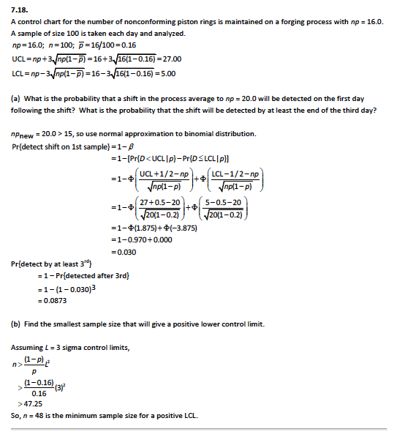
Homework Question 7.18

Slide 19
Homework Question 7.18

Slide 20
Homework Question 7.18

Slide 21
Homework Question 7.18

Slide 22
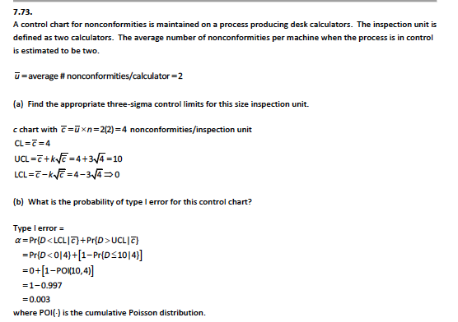
Homework Question 7.73

Slide 23
Good luck in your finals

