Slide 1




CS MAJOR PATHWAY
CSC220 Final Project Presentation
<Fanghui He, Yining Hua, Qiaqia Ji, Yanwan Zhu>

Slide 2
Introduction
Didn’t have chance to attend the major presentation?
Get familiar with the CS major and have fun!
Our project is a game that navigates the player through the life of a CS major.
Notes:
Course overview, course information, course contents, declare major, advise

Slide 3
Why We Choose It
Help students get familiar with the CS department and its course offerings .
We like pixel games!
Challenging, but doable.

Slide 4
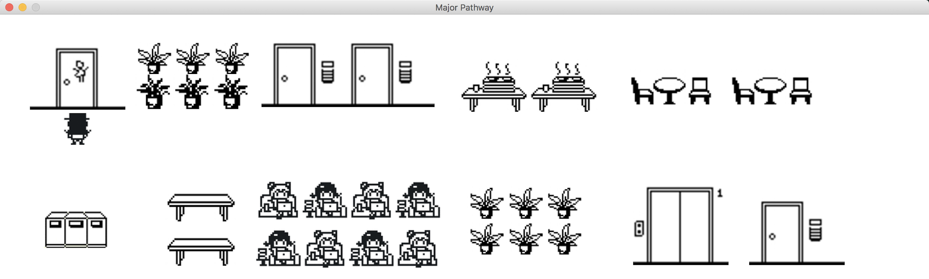
Demo

Slide 5
Discussion of the implementation
Setting logic, images
Main character
Professor
Computer

Slide 6
Scene Logic
Shift of scenes on the same floor
Place an object on two ends and checkDistance(object , mainCharacter )
Shift between Floors (Staircase)
Staircase.moveUp( )
Staircase.moveDown( )
Shift from the floors to offices & from offices to floors
The “Scene” variable keeps track of scene shifts (If condition)

Slide 7




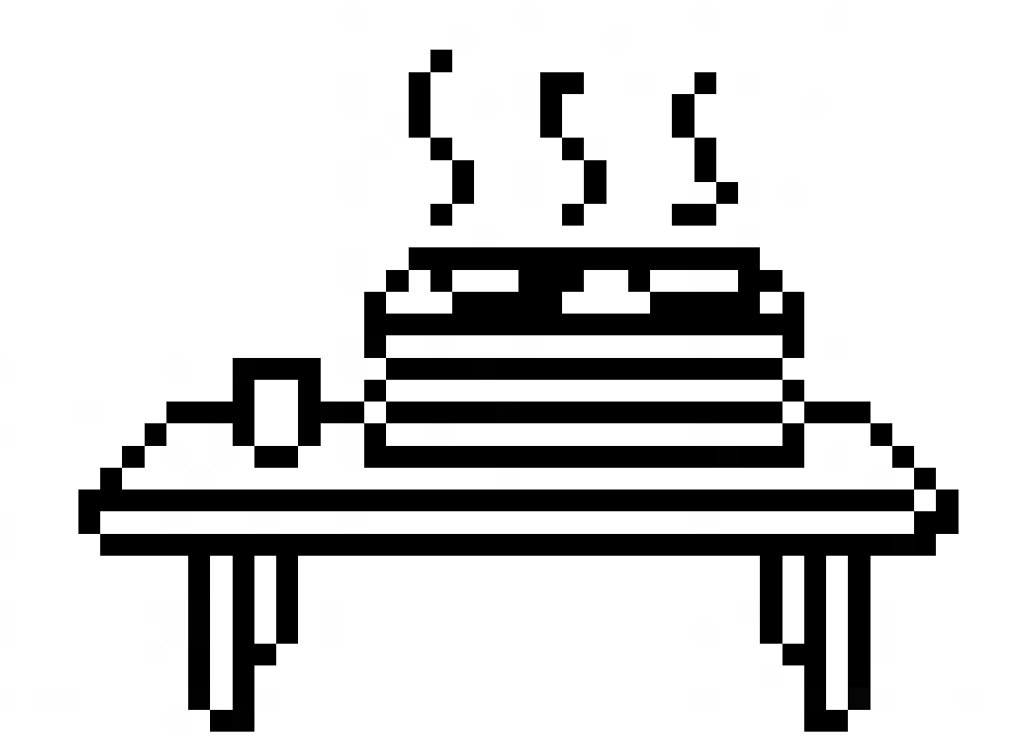



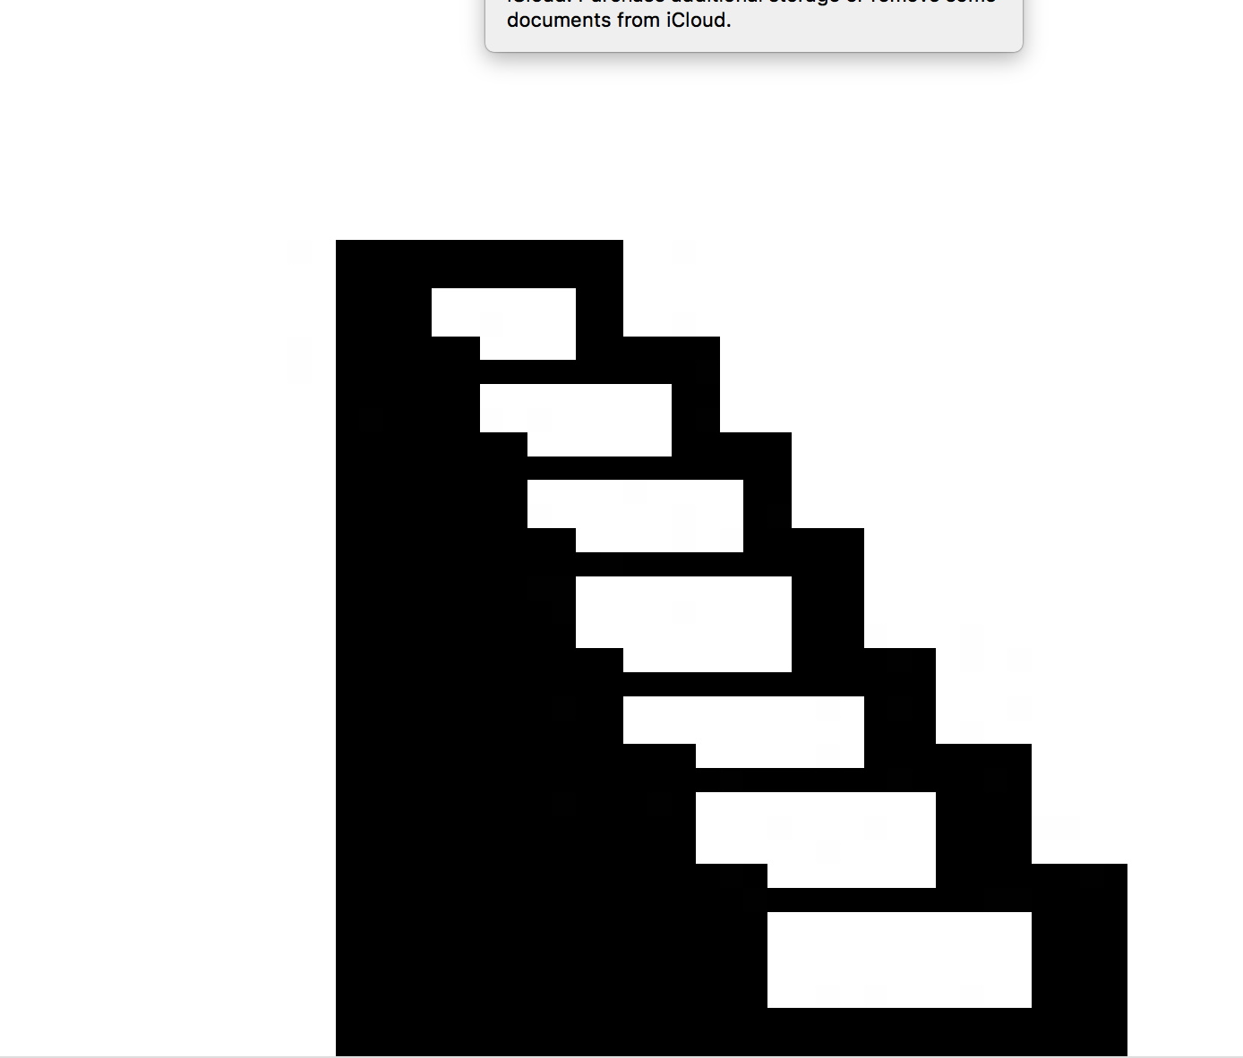





Images

Slide 8




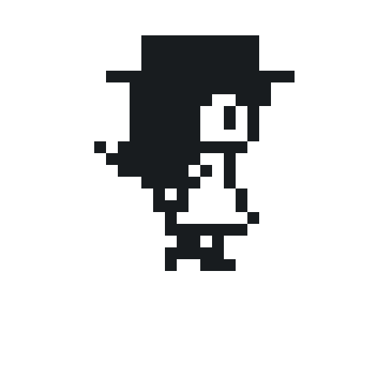


Main Character

Slide 9
Character
def __init__(self, px, py): self.image = Image( Point(px,py), "front.gif" ) self.imageID = 'front' self.positionX = px self.positionY = py self.year = 'first year' self.classes = [] self.major = False

Slide 10
Character
leftKey, rightKey, upKey, downKey:
For selecting keyboard control system:
“Left” or “A”, “Right” or “D”, “Up” or “W”, “Down” or “S”
Move
Declare
checkInfo
updateClasses
...

Slide 11





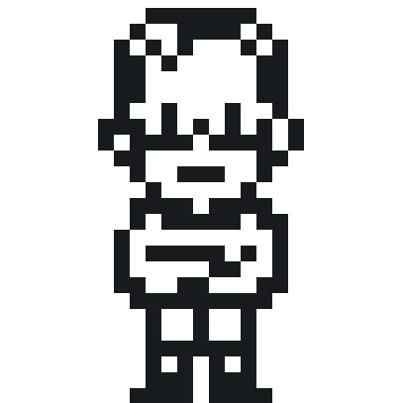
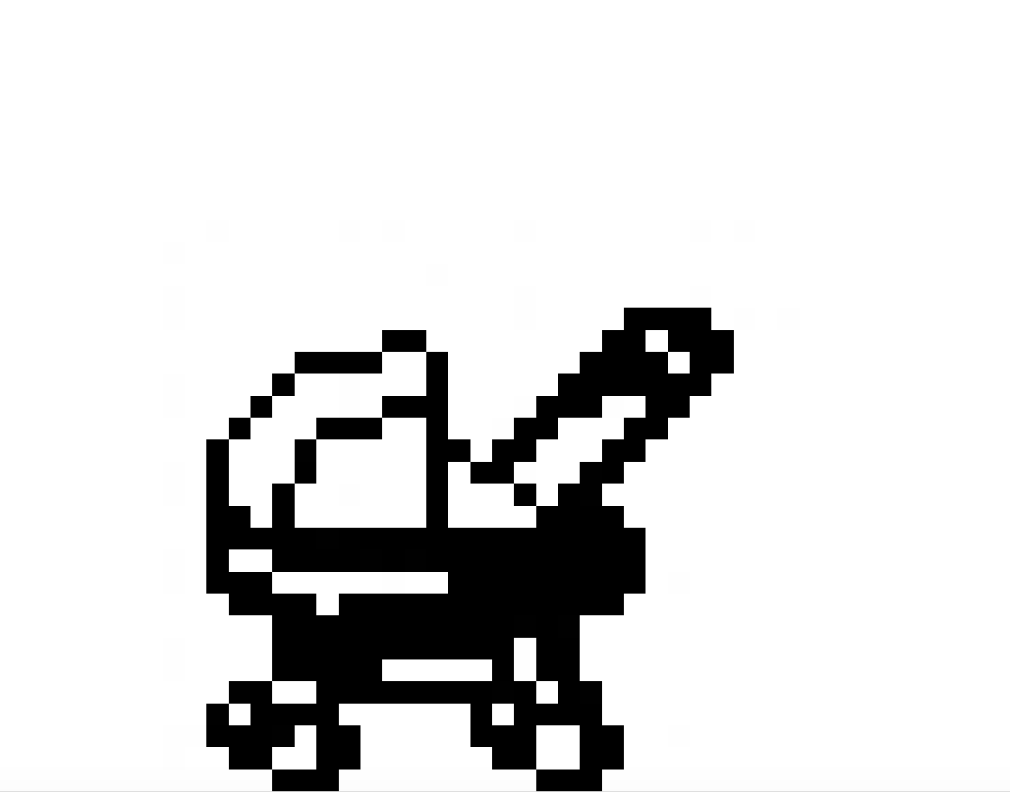
Professors

Slide 12

Professor

Slide 13
Professor
Initialization
def __init__(self, name, px, py,image):

Slide 14
Professor
def chatWith(self, mainCharacter):
Button(top, text = "Chat", command = self.chat)
Button(top, text = "Close", command=top.destroy)
Button(top, text = "Declare", command= lambda: self.declare(mainCharacter))

Slide 15
Professor
Global initialization -- replace the same professor variable for different professors

Slide 16


Computer

Slide 17
Computer
Initialization
def __init__(self, px, py):
self.image = Image(Point(px,py), "computer1.gif")
self.imageID = 'black'
self.positionX = px
self.positionY = py

Slide 18
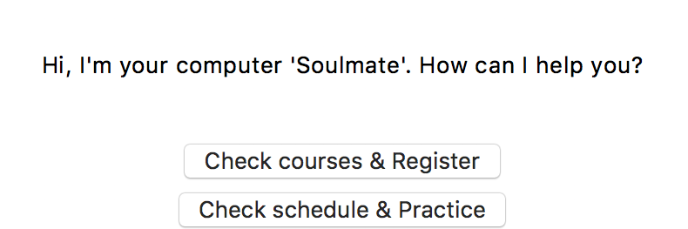

Computer
Chat/Close
Check courses & register
Display course list for each semester (fixed, spring/fall, expected)
Click to check course info (descriptions, prerequisites)
Register (add course to schedule)
Check schedule & practice
Display schedule
Click to practice sample problems

Slide 19
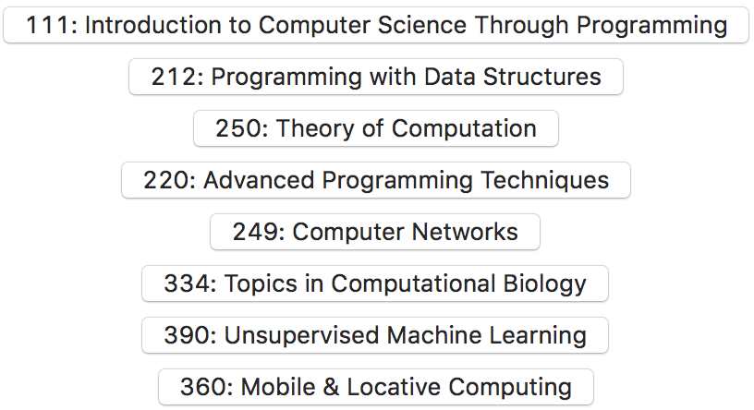
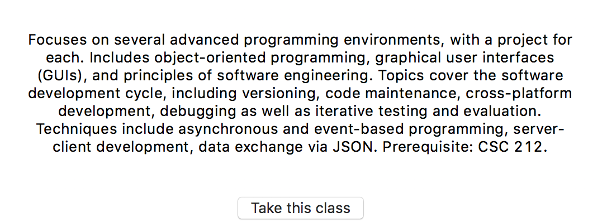
Computer
Sample spring course list and info

Slide 20
One particular challenge
Mac and Windows
How to move between different scenes

Slide 21
Future work / regrets
Improve the Computer class.
Add adivise( ) funtion
Add GPA and graduate( ) when semester == “senior2”
Add random events like hackathon, datafest...
Allow interactions with the NPCs
Sound

Slide 22
Thank You:)

