Slide 1
Pratt Fellows 2016
Real-Time 3D Visualization for Prostate ARFI Imaging
Ningrui Li
Advisor: Dr. Kathy Nightingale

Slide 2
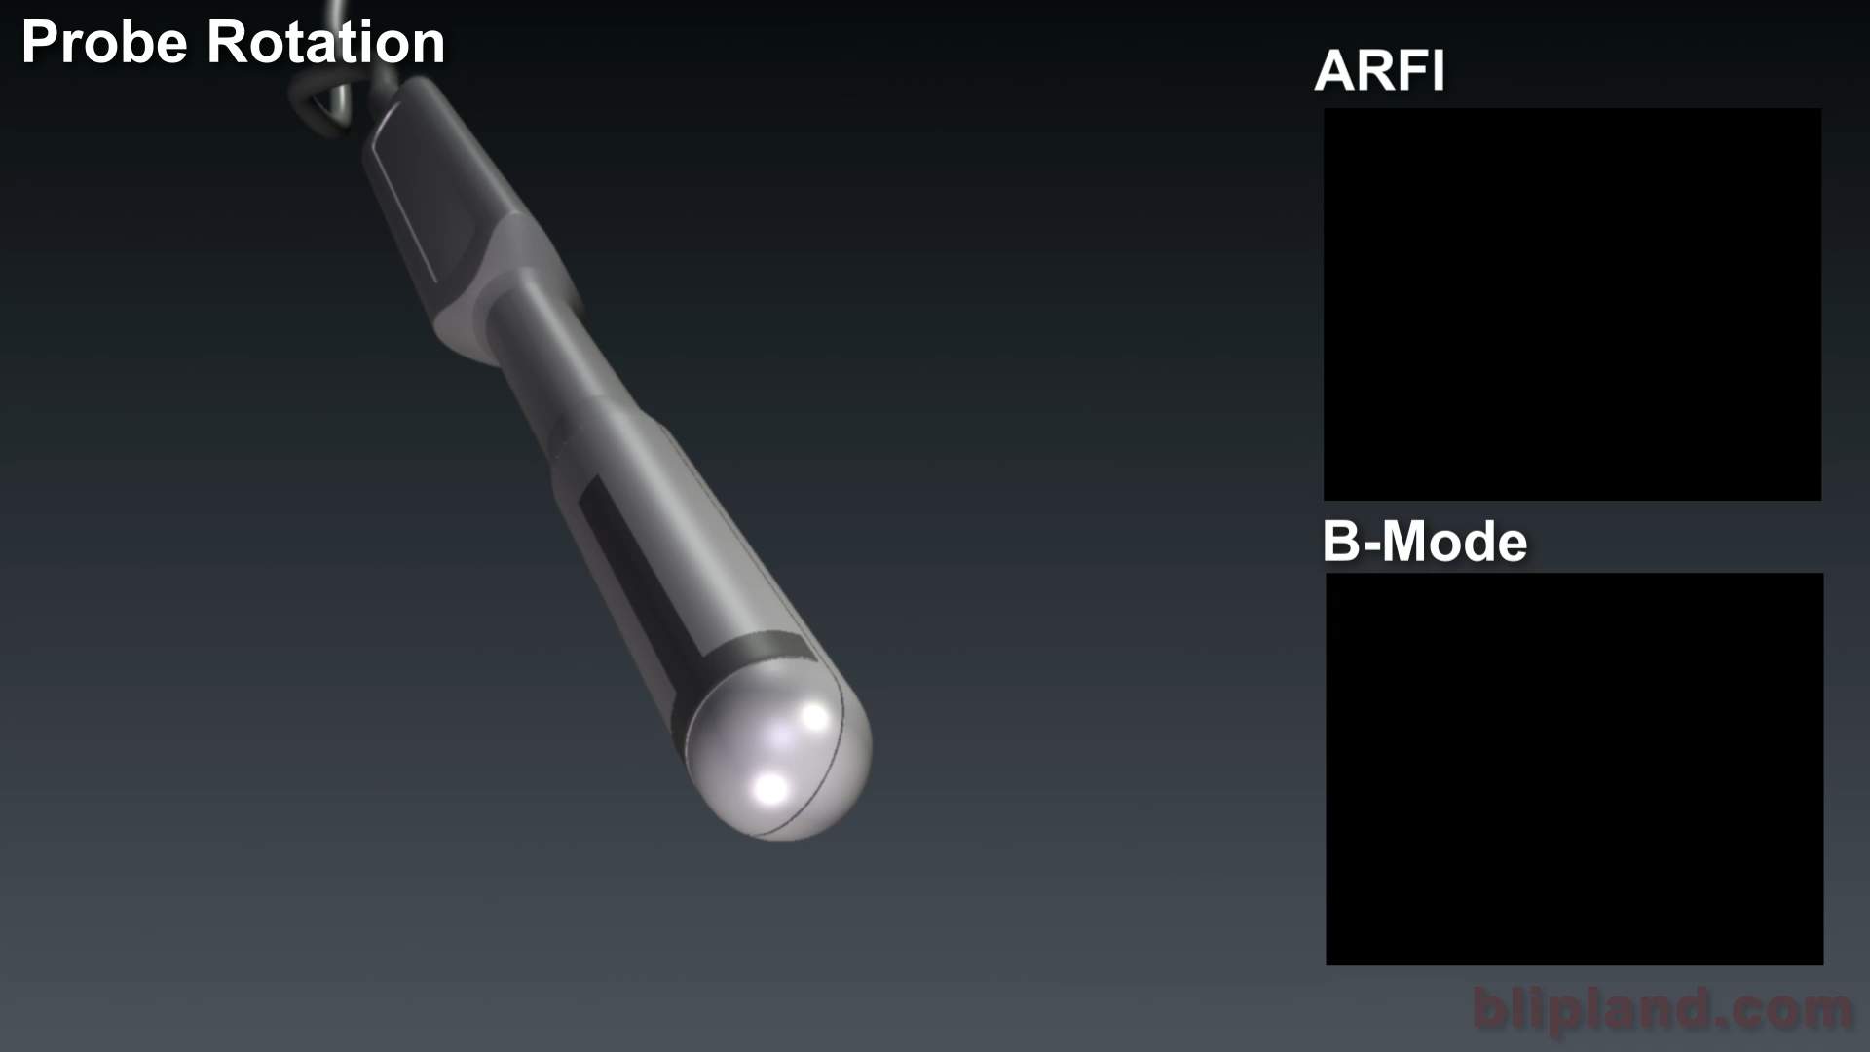
Objectives
Integrate a real-time 3D display system into the current prostate imaging workflow.
Notes:
The goal of this project is to more effectively diagnose prostate cancer using ultrasound elasticity imaging. In the current prostate imaging setup, a sidefiring ultrasound probe is attached to a rotation stage. The probe is rotated in one degree increments, and a sagittal image plane is acquired at each position. These images are processed offline, and an image volume is constructed through scan conversion. However, if we are able to construct these volumes in real-time, we can begin identifying suspicious regions during the imaging process. We can return to those regions, and sample more finely at those locations.

Slide 3
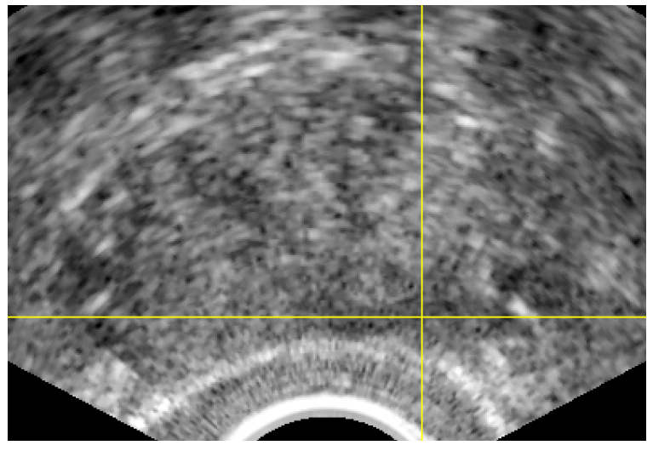
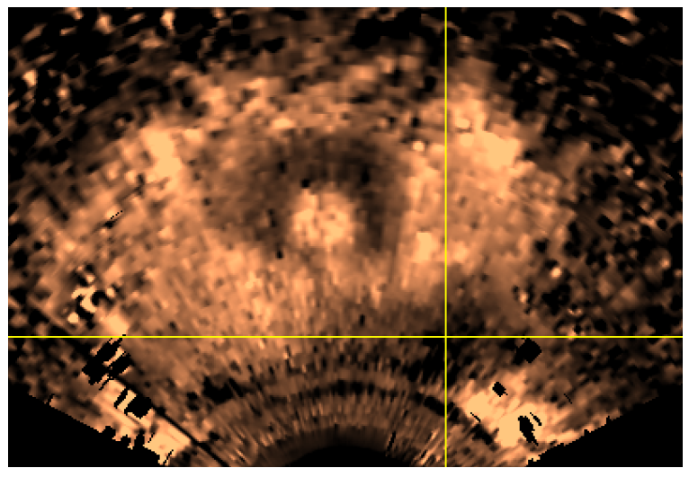
ARFI Prostate Imaging
Acoustic radiation force impulse (ARFI) imaging
  Uses tissue stiffness as a contrast mechanism
B-mode Image (left) vs. ARFI Image (right)
Notes:
We use acoustic radiation force impulse imaging to create images of tissue stiffness. To do this, we transmit a focused high intensity ultrasound pulse into the body, which generates a downwards force on the tissue, and we track tissue displacement. Less displacement means that the tissue in that region is relatively stiffer. This alternative contrast mechanism allows us to see lesions that we might otherwise miss using conventional B-mode ultrasound imaging.

Slide 4
Block Diagram
U/S
Probe
Patient
Scanner
Rotation Stage
User
Visualization System
Notes:
Note that I’ve only really been working on the visualization system by itself.

Slide 5
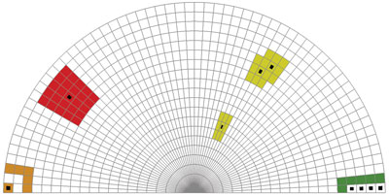
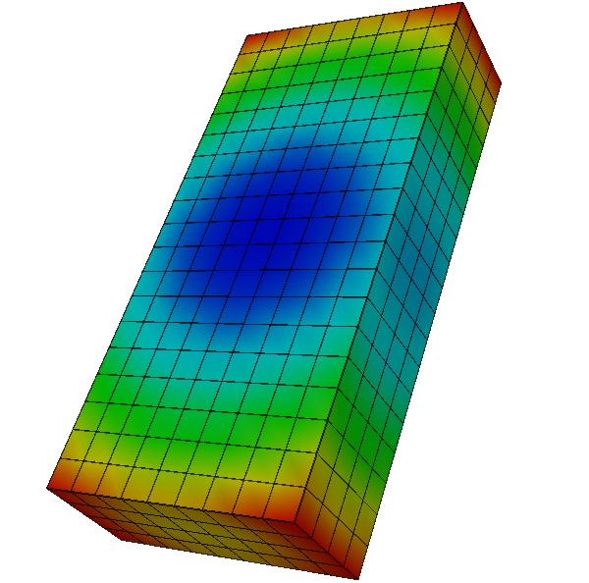
VTK Dataset Types
vtkUnstructuredGrid
  Arbitrary combination of every possible cell type
vtkStructuredGrid
  Uniformly spaced set of points
Notes:
vtkUnstructuredGrid image from: https://blog.kitware.com/source/files/28_2118110326.jpg
vtkStructuredGrid image from: http://www.win.tue.nl/~wstahw/edu/2Z860/college1/points.jpg

Slide 6
VTK Pipeline
Read in image data into an unstructured grid.
Re-sample image data onto a structured grid.
Slice/clip structured image volume.

Slide 7
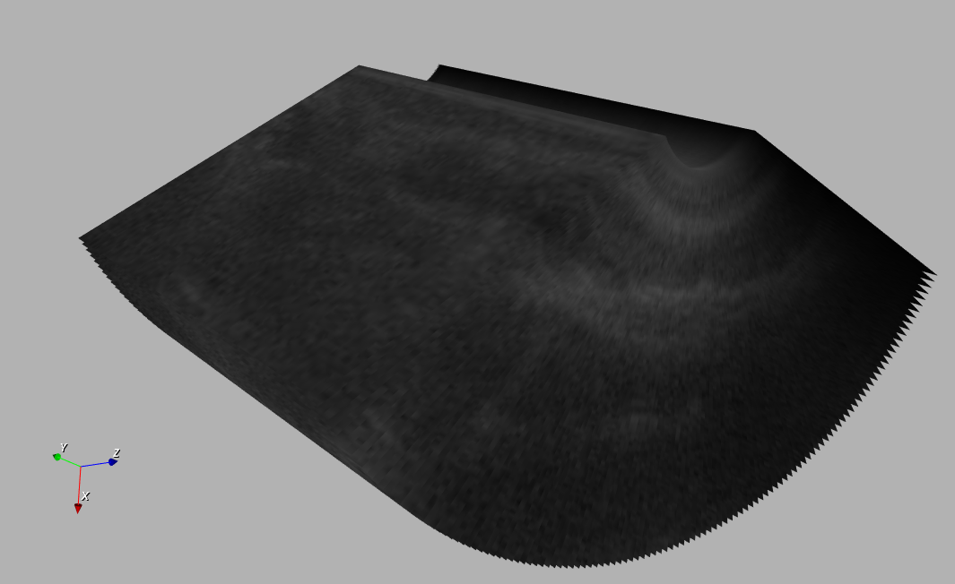
VTK Pipeline
Read in image data into an unstructured grid.
Re-sample image data onto a structured grid.
Slice/clip structured image volume.
Discrete image planes combined into a single unstructured grid.

Slide 8
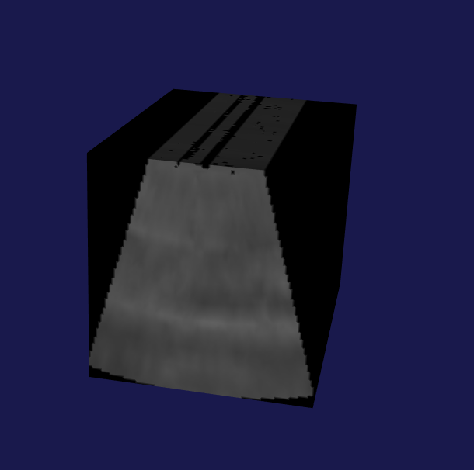
VTK Pipeline
Read in image data into an unstructured grid.
Re-sample image data onto a structured grid.
Slice/clip structured image volume.
Structured grid with re-sampled image volume data.

Slide 9
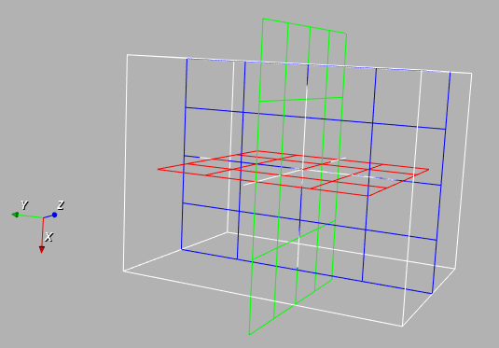
VTK Pipeline
Read in image data into an unstructured grid.
Re-sample image data onto a structured grid.
Slice/clip structured image volume.
Interactive plane widgets for selecting slice planes.

Slide 10
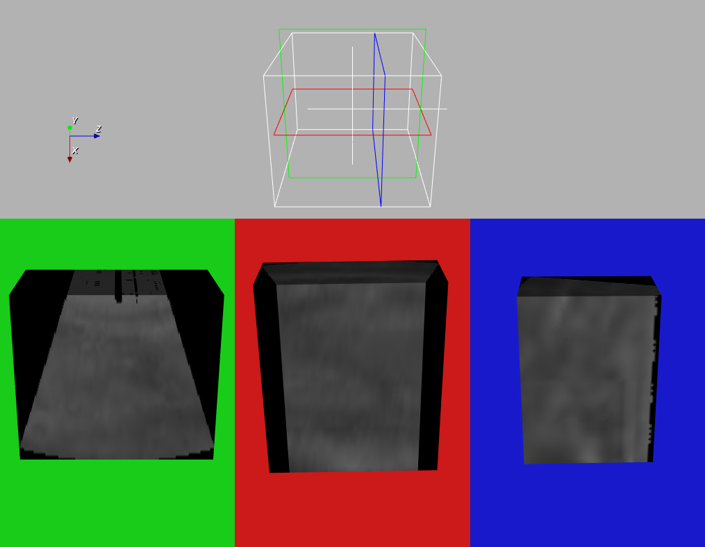
Results
Volume outline with widgets showing location of clip planes.
Image volumes clipped by axial, coronal, and sagittal planes.

Slide 11
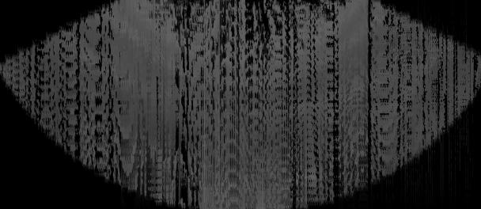
Challenges
Long computational time required for interpolation.
Variable angle offset between image planes may create artifacts.
Degenerate image volume created when triangulating overlapping image planes.

Slide 12
Conclusions and Future Work
Interface visualization system with the rotation stage.
Implement direct data streaming from the scanner through standard input.
Reduce number of redundant computations by interpolating only newly acquired images.
Notes:
So far I’ve created the software framework for reading in image planes and using them to construct an image volume. I have also developed a

Slide 13
Acknowledgements
Thanks to Dr. Nightingale, Dr. Palmeri, and everyone else in Duke Ultrasound!
Thanks to Dr. Palmeri for the animation showing the prostate image acquisition process!

