Slide 1


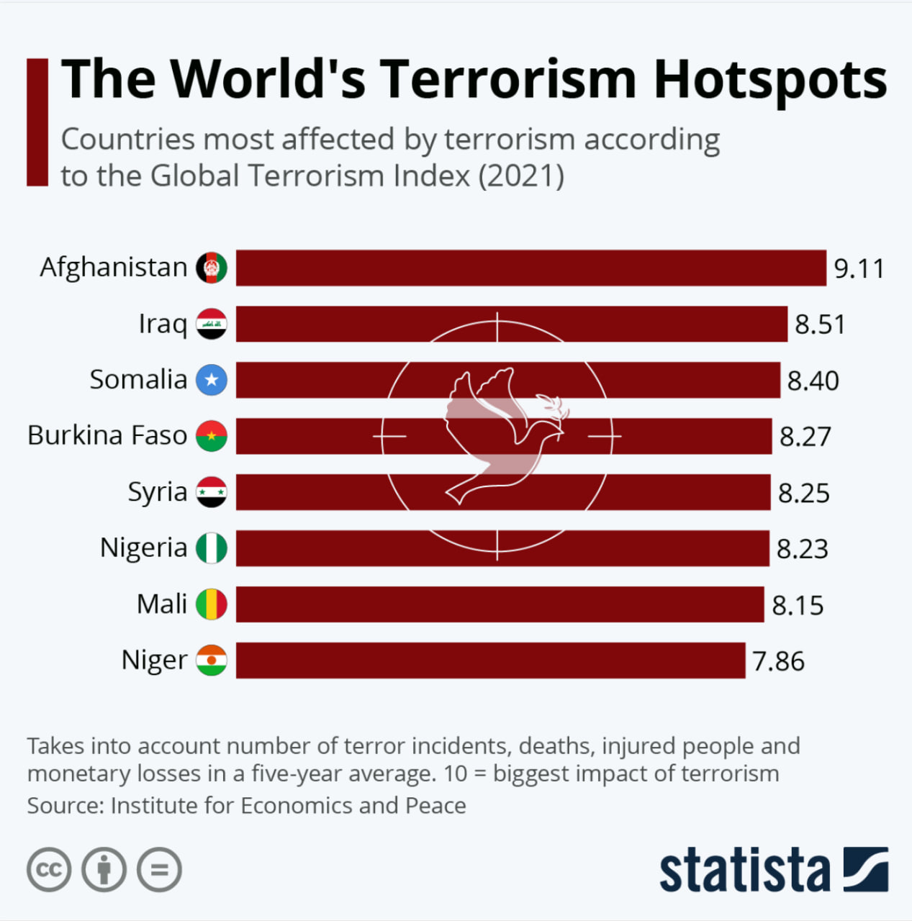
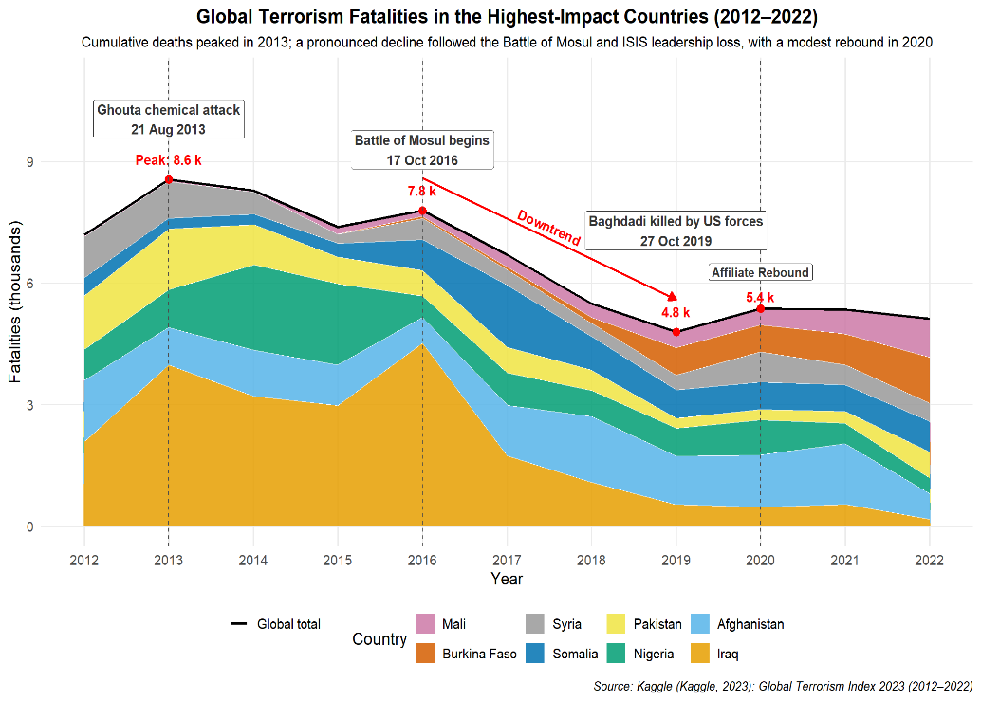



Visualizing Global Terrorism Index Score (2011-2021) Team Coral*
Introduction
Data
Tools Used
Pitch to the Editorial Board
Terrorism significantly affects global stability and safety. Identifying patterns in terrorism enable policymakers to make informed decisions and allocate resources effectively.
Kaggle (Kaggle, 2023): Global Terrorism Index 2023 (contains over 47,000 terrorist incidents for the period 2012 to 2022)
Tidyverse (Wickham et al., 2019): R packages including dplyr, tidyr, ggplot2 for data analysis and visualization
Why Should You Adopt Our Visualization?
Enhanced Editorial Decision-Making Through Trend Analysis
The stacked area chart shows evolving trends that cannot be shown via static bar charts.
Help identify emerging hotspots, highlights positive shifts.
By aligning data with key geopolitical events, strategic planning for investigations and coverage is supported.
Early detection of newsworthy changes for timely coverage supports strategic planning for investigations and reporting.
Stronger Reader Engagement and Credibility
Helps readers to understand the "why" and "how", not just the "what".
Trends identified in the stack area chart add depth, which turns rankings into a story of change over time.
Visualizing conflict trajectories helps explain underlying developments.
These improvements strengthen the visualization's story development and audience engagement with the trend-based visuals. Readers learns about the impact of geopolitical events on terrorism via story telling.
Original Visualization
Improved Visualization
The figure below was published by the Statista Journal (Buchholz, K. (March 2, 2022):
The chart clearly ranks countries affected by terrorism but exhibits several weaknesses:
Scores are very close, making quick differentiation difficult.
Uniform red bars further reduces visual clarity.
Background graphic distracts from the primary data.
The chart shows temporal trends by identifying how terrorism fatalities have changed over time for each country from 2012 to 2022, allowing users to identify peaks, declines and stability periods.
Comparative analysis across countries is enabled as terrorism fatalities trends differ across countries, e.g. evaluation of how terrorism fatalities have progressed across different countries within the same timeframe.
References & Additional Information:
*Information and Communication Technology Cluster, Singapore Institute of Technology • https://github.com/ninguest/CSC3107_TerrorismIndex_Visualization_Project • Published: 2025–06–29
Notes:
\

