Slide 1
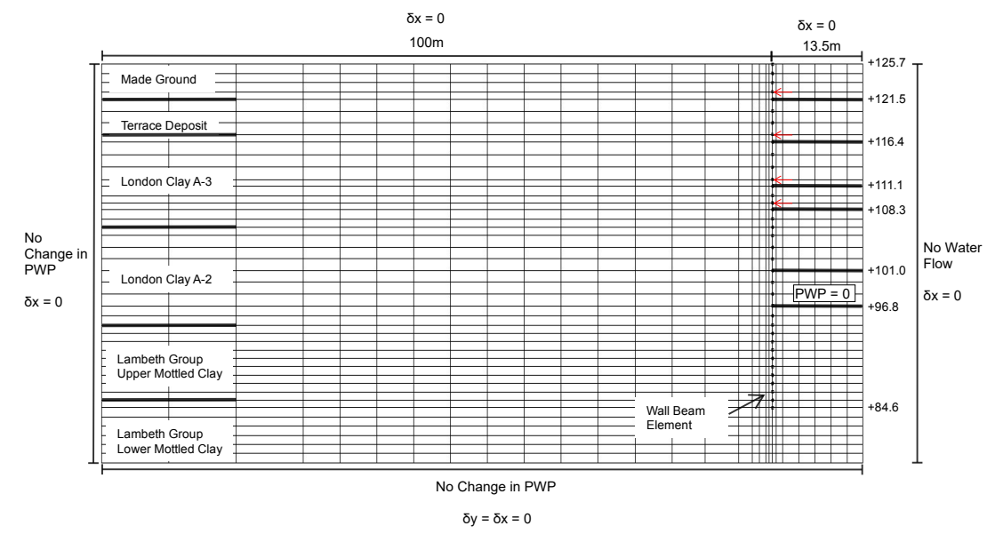
MCMC (Ground truth: 14700,92250 )

Slide 2
Z_{t}: Soil parameters inferred at stage k
Observation for stage t
Observation for stage t+1
y_{t}: Observations at stage k
y_{t}
y_{t+1}
Inference for stage k
Inference for stage k+1
Z_{t-1}
Z_{t}
Z_{t+1}
…
Prior for stage t
Prior for stage t+1
…
Posterior after stage t-1
Posterior after stage t
Posterior after stage t+1

Slide 3
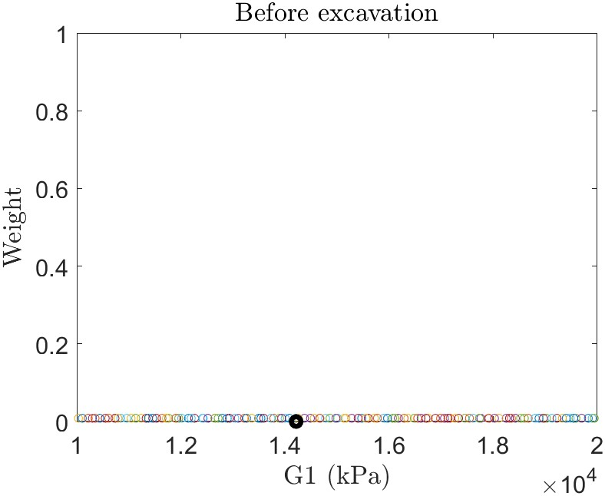
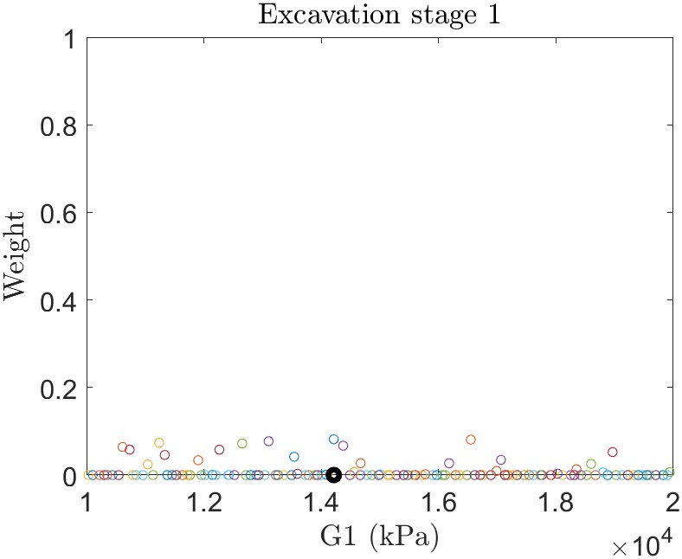
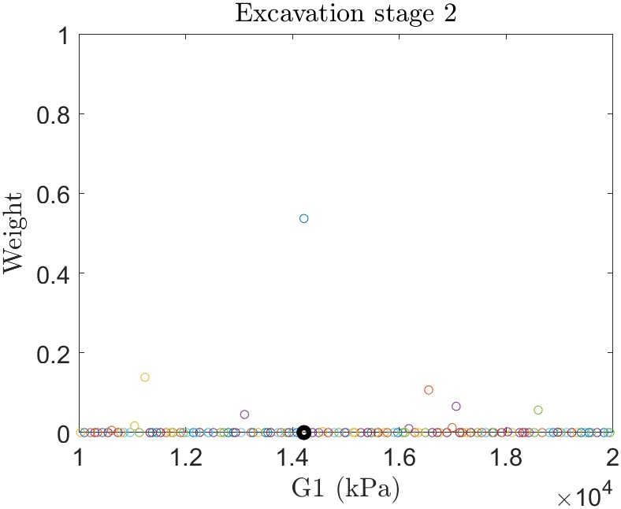
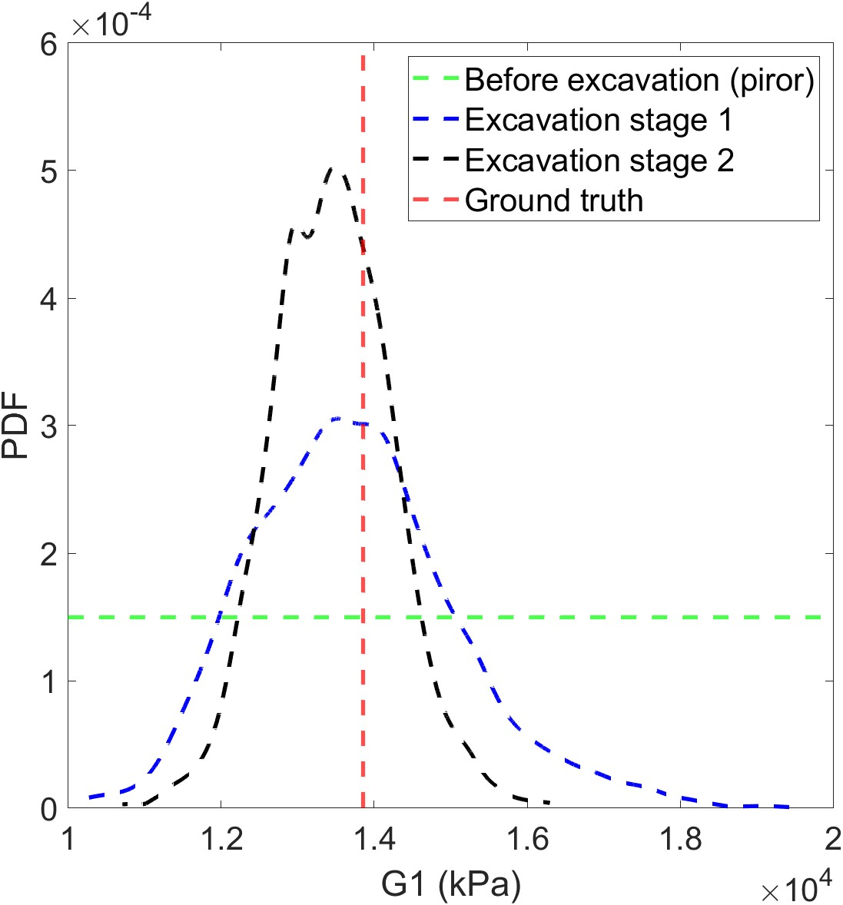

Slide 4
