Slide 1
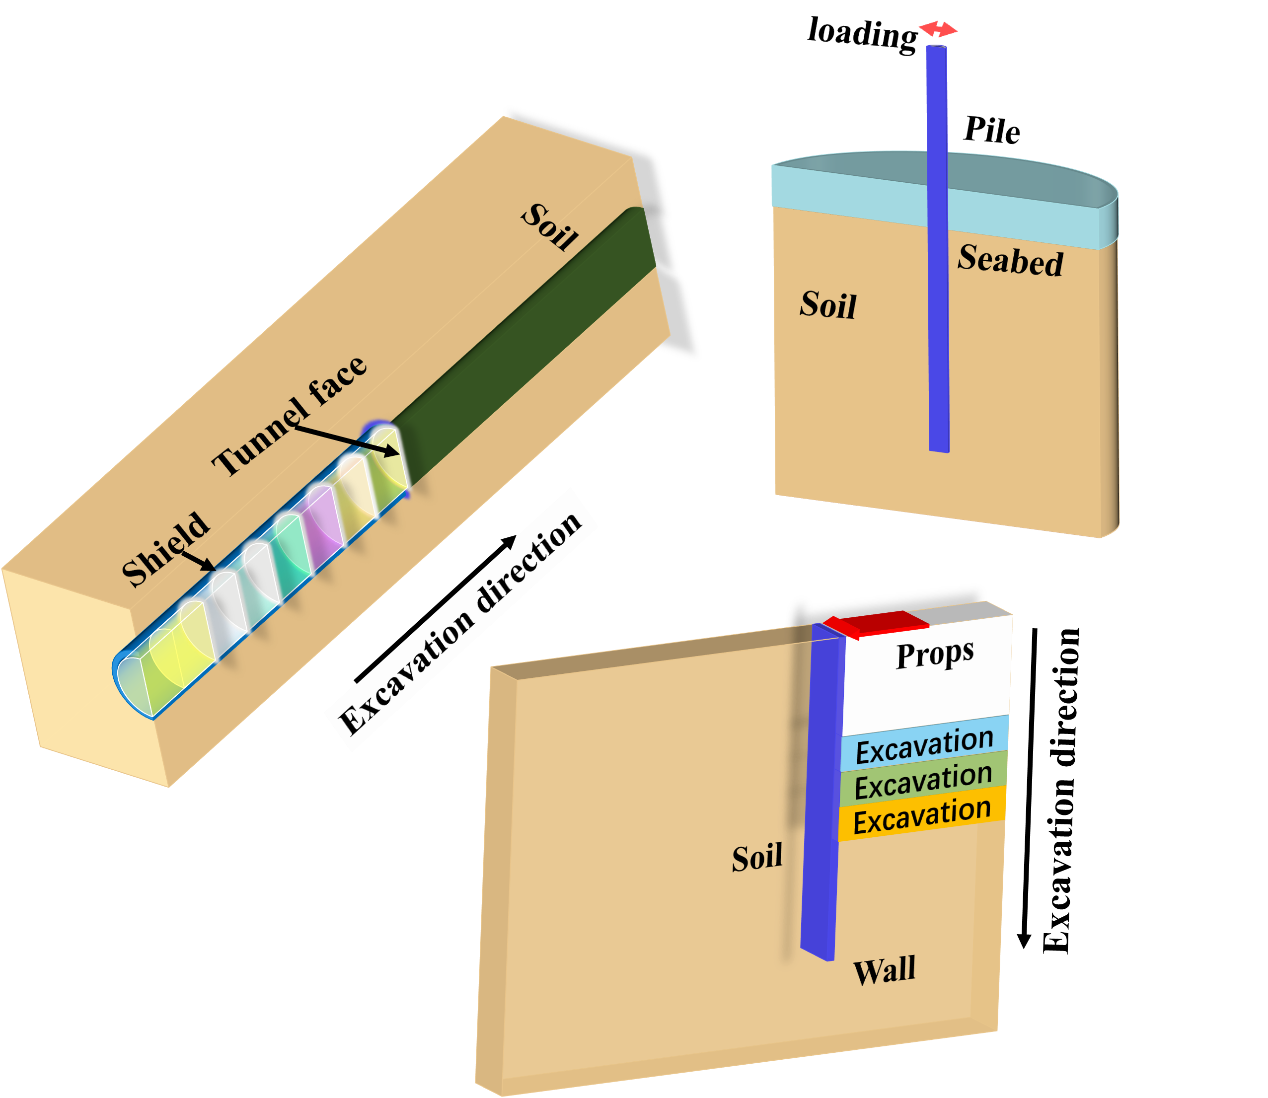
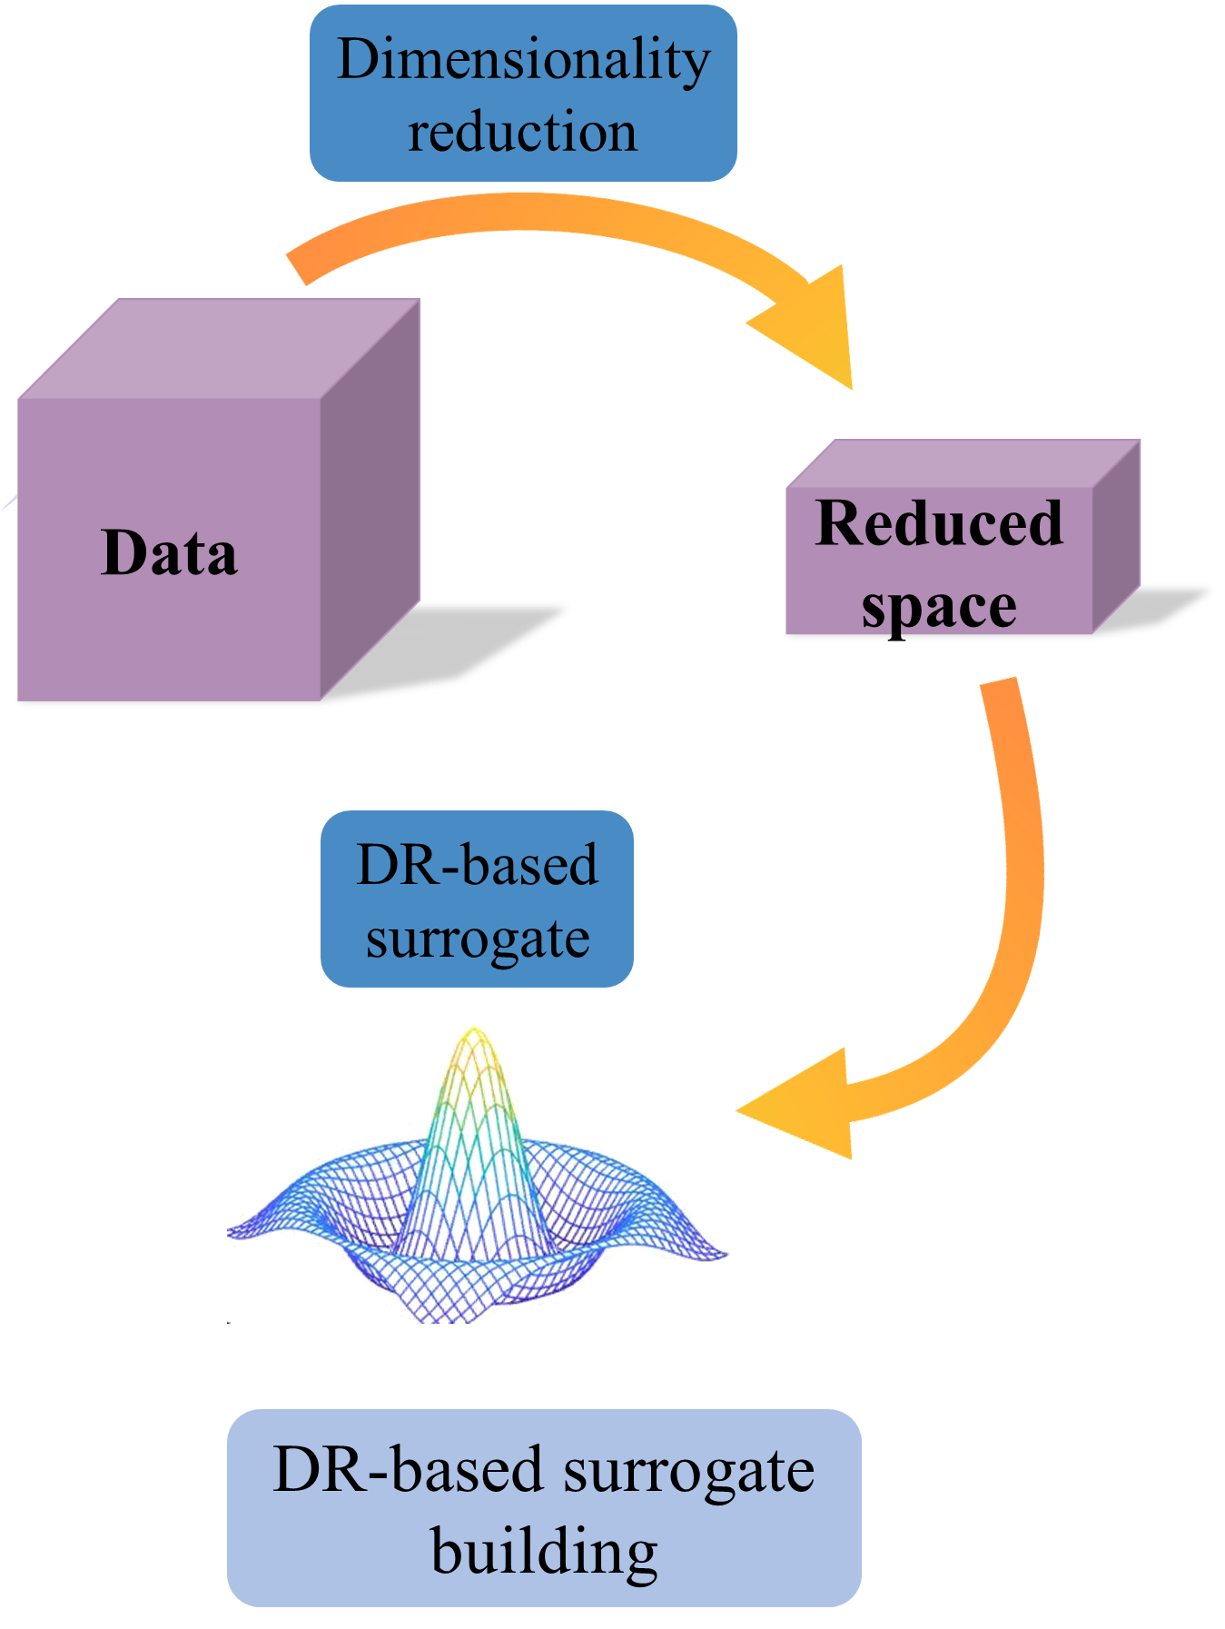
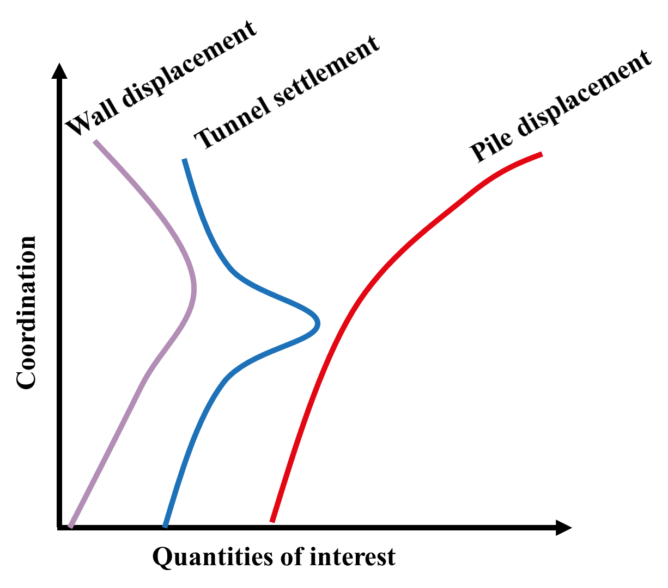
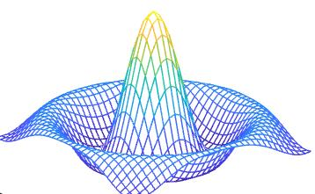

ICFEP
Simulation
Dimensionality reduction
Data
Reduce space
Observation
Sequential Bayesian inference
DR-based surrogate
MCMC
ICFEP
DR-based surrogate building
Wall displacement
Tunnel settlement
Pile displacement
loading
Coordination
Pile
Soil
Dimensionality reduction
Seabed
Quantities of interest
Soil
Data
Tunnel face
Reduced space
Shield
Excavation direction
Soil
Props
DR-based surrogate
Excavation
Excavation direction
Excavation
Excavation
Wall
DR-based surrogate building

