Slide 1
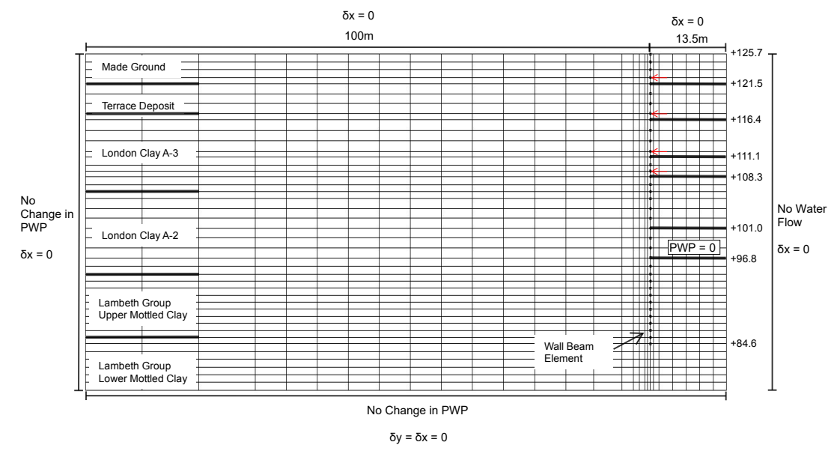

Slide 2
Input parameter range (MPa) |  | Ground truth (kPa) | Sampler method | FE Simulation runs
G1 | 100-202 | 14213 | MCMC/SMC
G2 | 53-227.4 | 62915 | MCMC/SMC | 120
G3 | 38.9-150 | 64906 | MCMC/SMC
G4 | 53.5-150 | 85774 | MCMC/SMC
G5 | 55-183 | 97856 | MCMC/SMC
G6 | 55-183 | 138519 | MCMC/SMC

Slide 3
Z_{t}: Soil parameters inferred at stage k
Observation for stage t
Observation for stage t+1
y_{t}: Observations at stage k
y_{t}
y_{t+1}
Inference for stage k
Inference for stage k+1
Z_{t-1}
Z_{t}
Z_{t+1}
…
Prior for stage t
Prior for stage t+1
…
Posterior after stage t-1
Posterior after stage t
Posterior after stage t+1

Slide 4
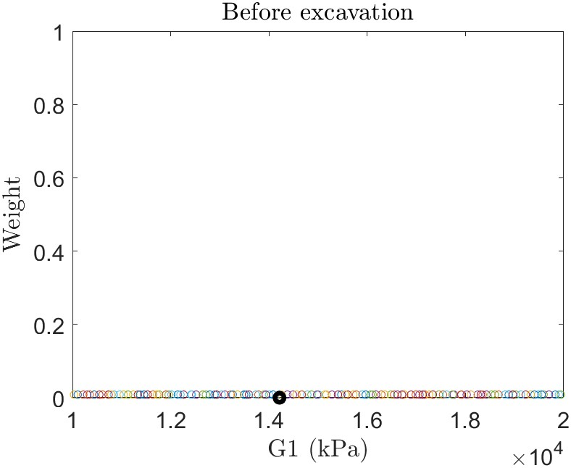
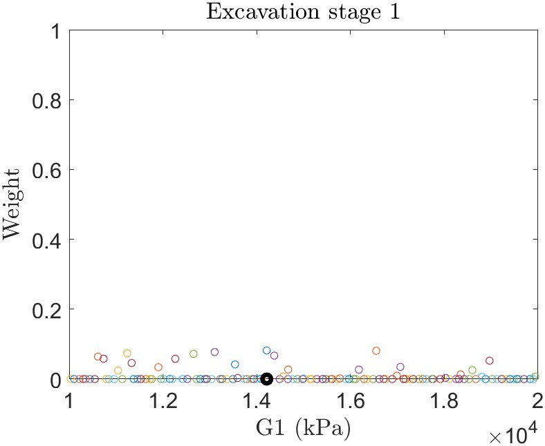
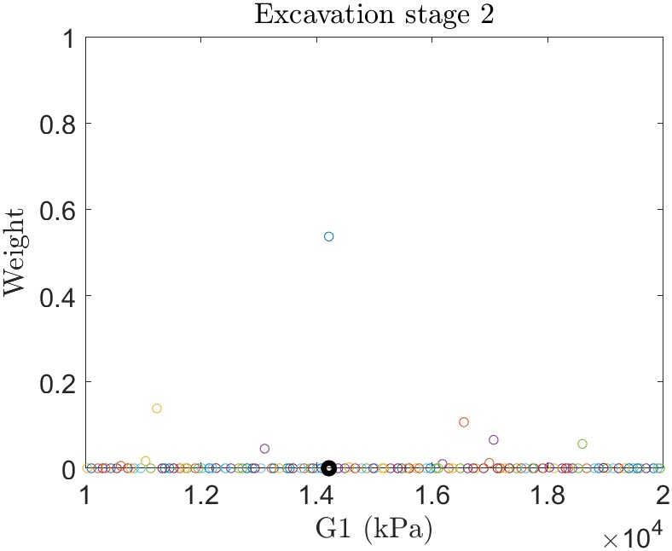
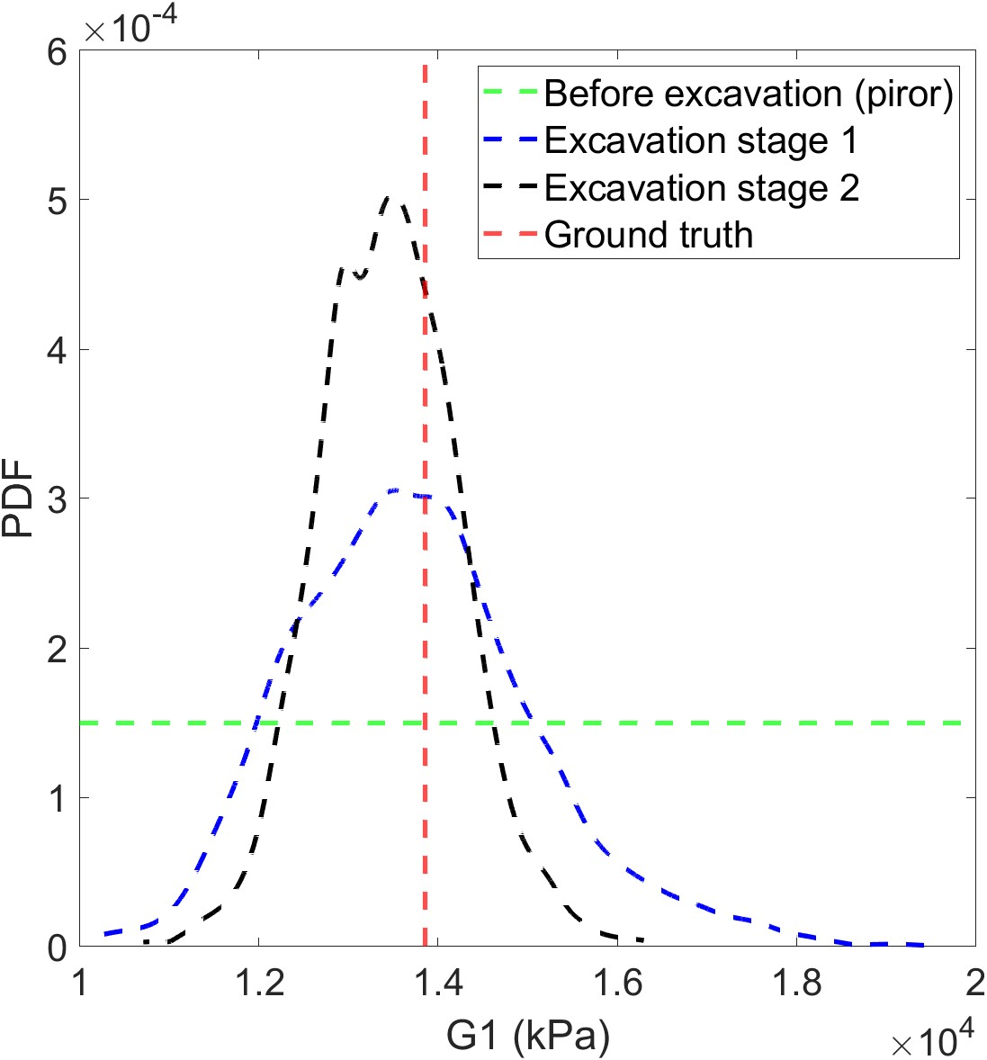

Slide 5
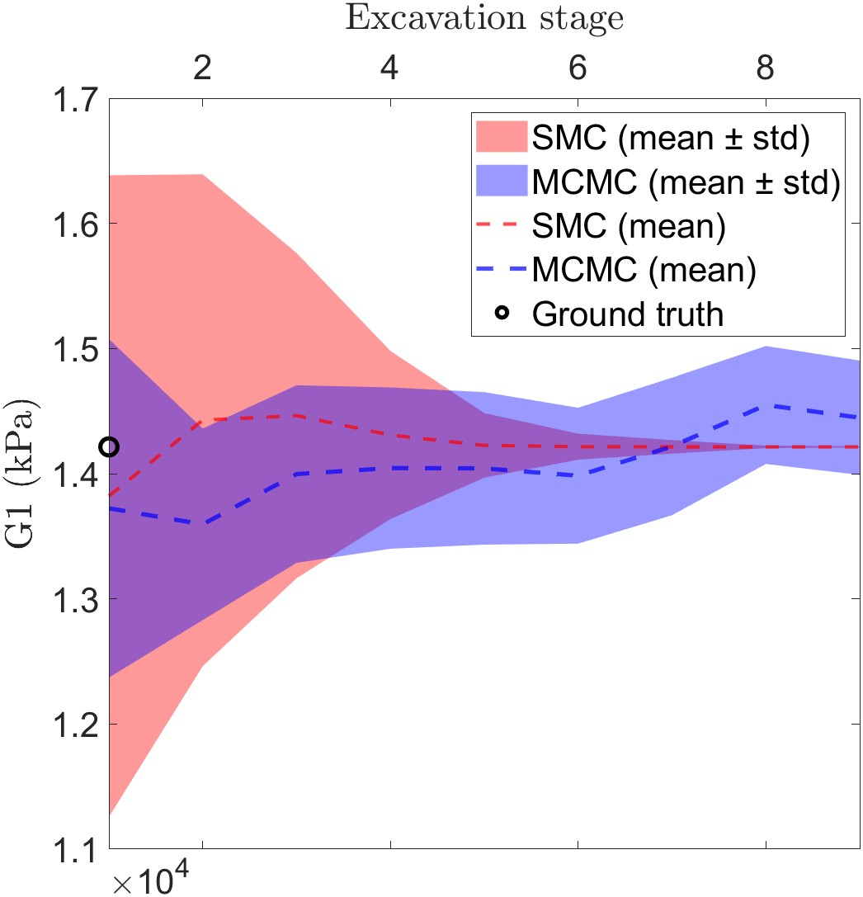
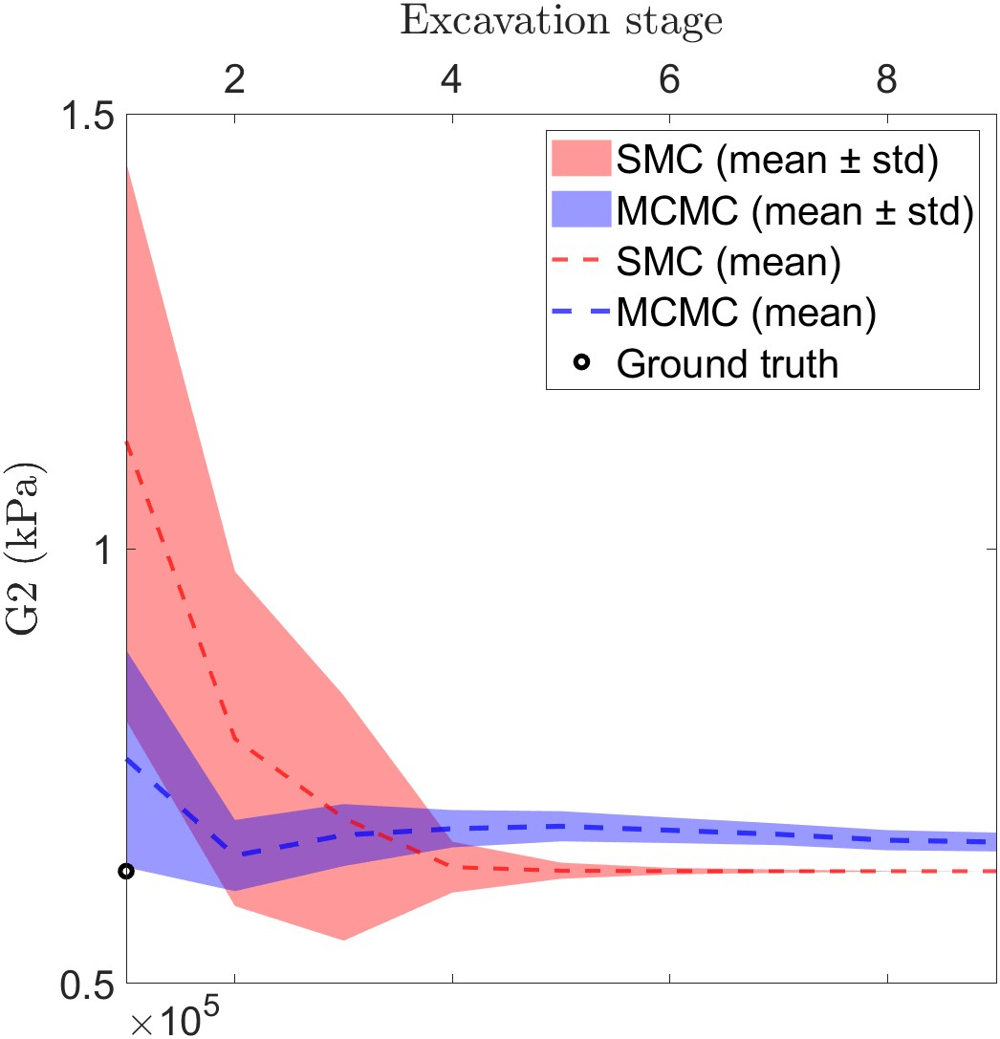
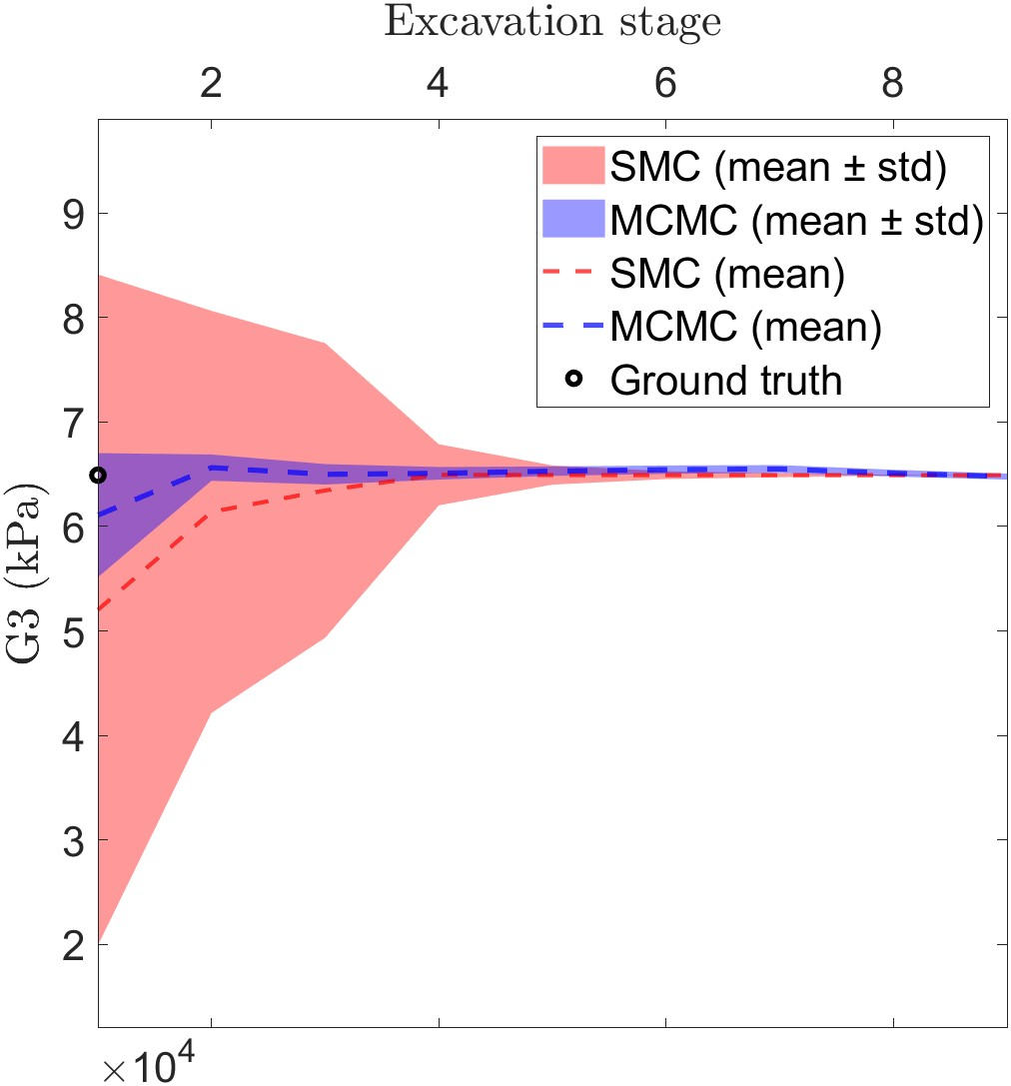
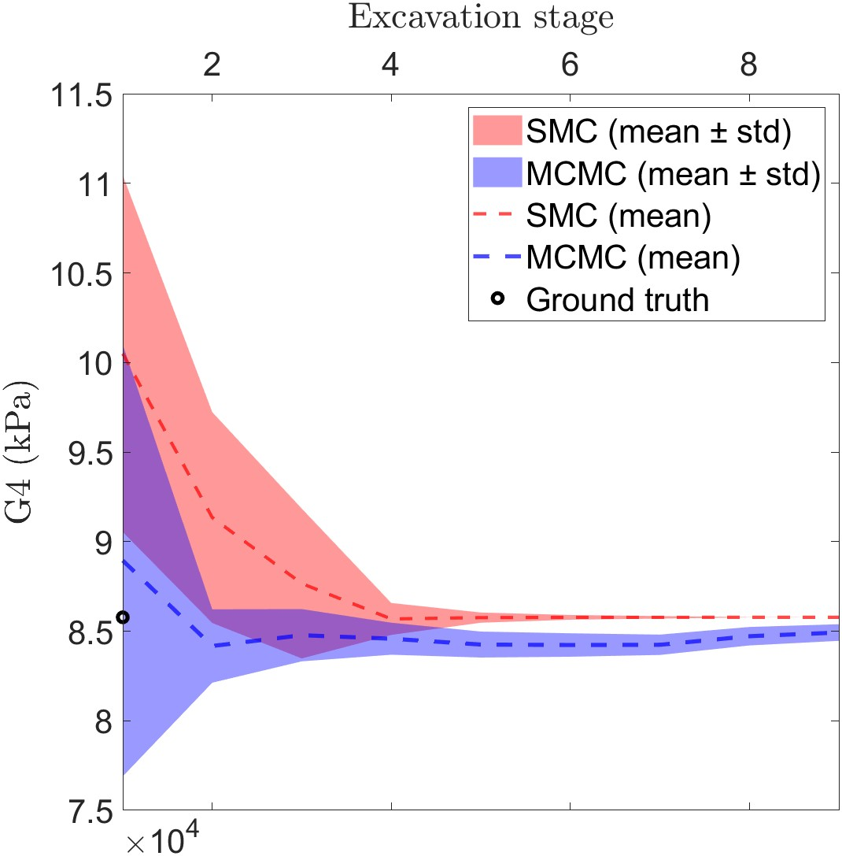
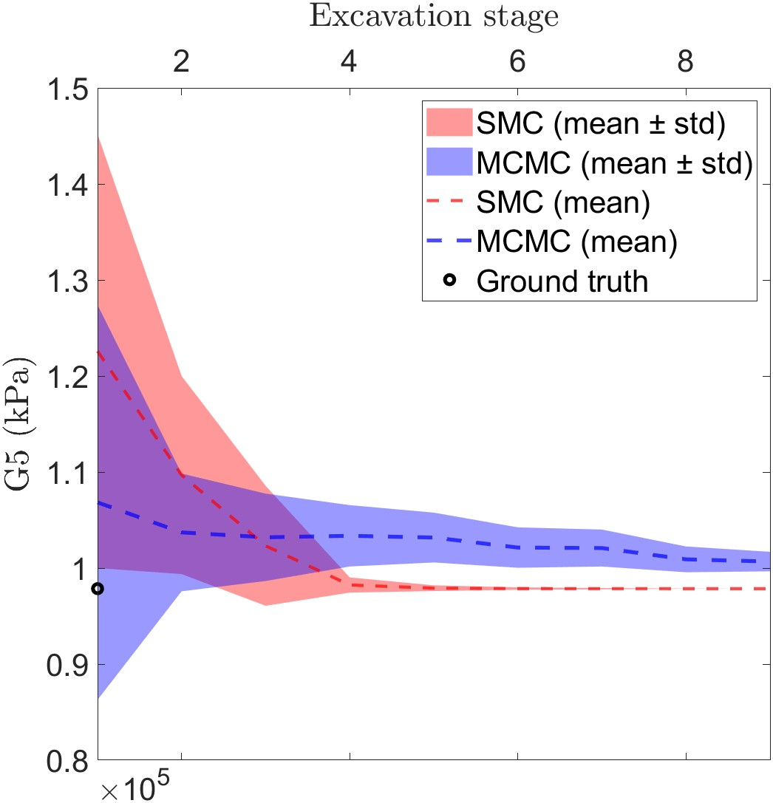
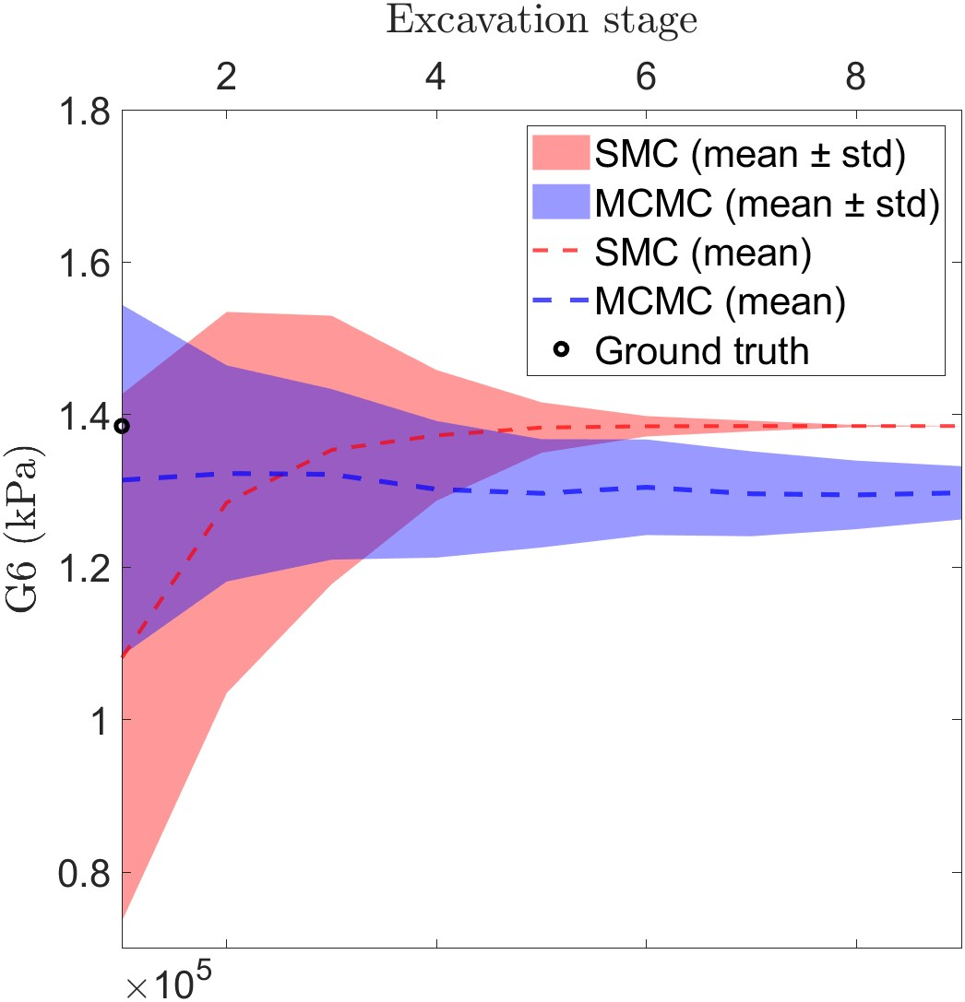

Slide 6
14213.92
62915.81
64906.05
85774.29
97856.69
138519.4

Slide 7
