Slide 1
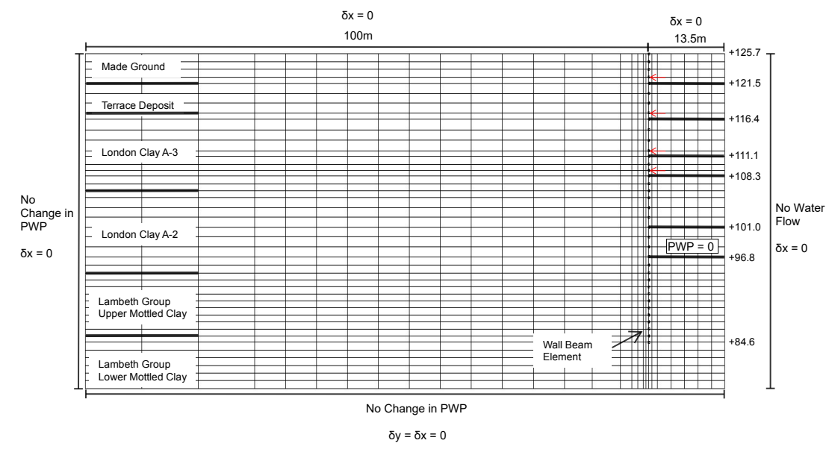

Slide 2
Case | Input parameter range (MPa) |  | Ground truth (MPa) | Sampler method | FE Simulation runs
 | G1 | 100-202 | 14.7 | MCMC/SMC | 30
A | G2 | 53-227.4 | 92.2 | MCMC/SMC
B | G1 | 100-202 | 14.213 | MCMC/SMC | 120
 | G2 | 53-227.4 | 62.915 | MCMC/SMC
 | G3 | 38.9-150 | 64.906 | MCMC/SMC
 | G4 | 53.5-150 | 85.774 | MCMC/SMC
 | G5 | 55-183 | 97.856 | MCMC/SMC
 | G6 | 55-183 | 138.519 | MCMC/SMC

Slide 3
Z_{t}: Soil parameters inferred at stage t
Observation for stage t
Observation for stage t+1
y_{t}: Observations at stage t
y_{t}
y_{t+1}
Inference for stage t
Inference for stage t+1
Z_{t-1}
Z_{t}
Z_{t+1}
…
Prior for stage t
Prior for stage t+1
…
Posterior after stage t-1
Posterior after stage t
Posterior after stage t+1

Slide 4
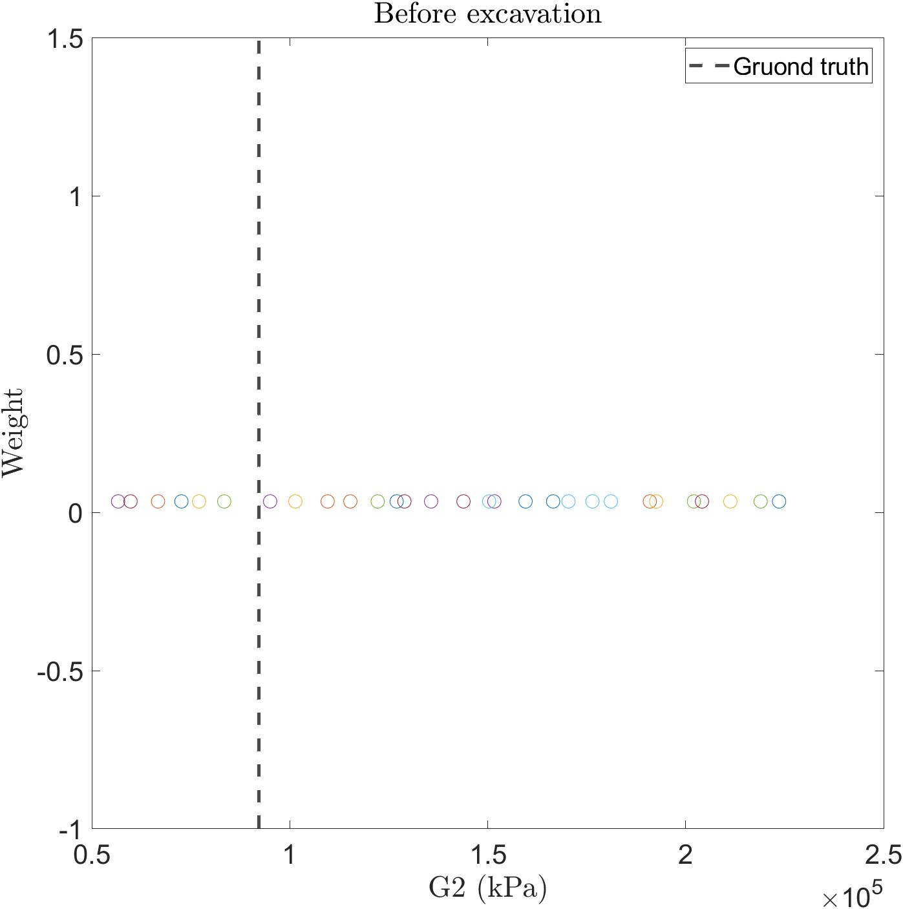
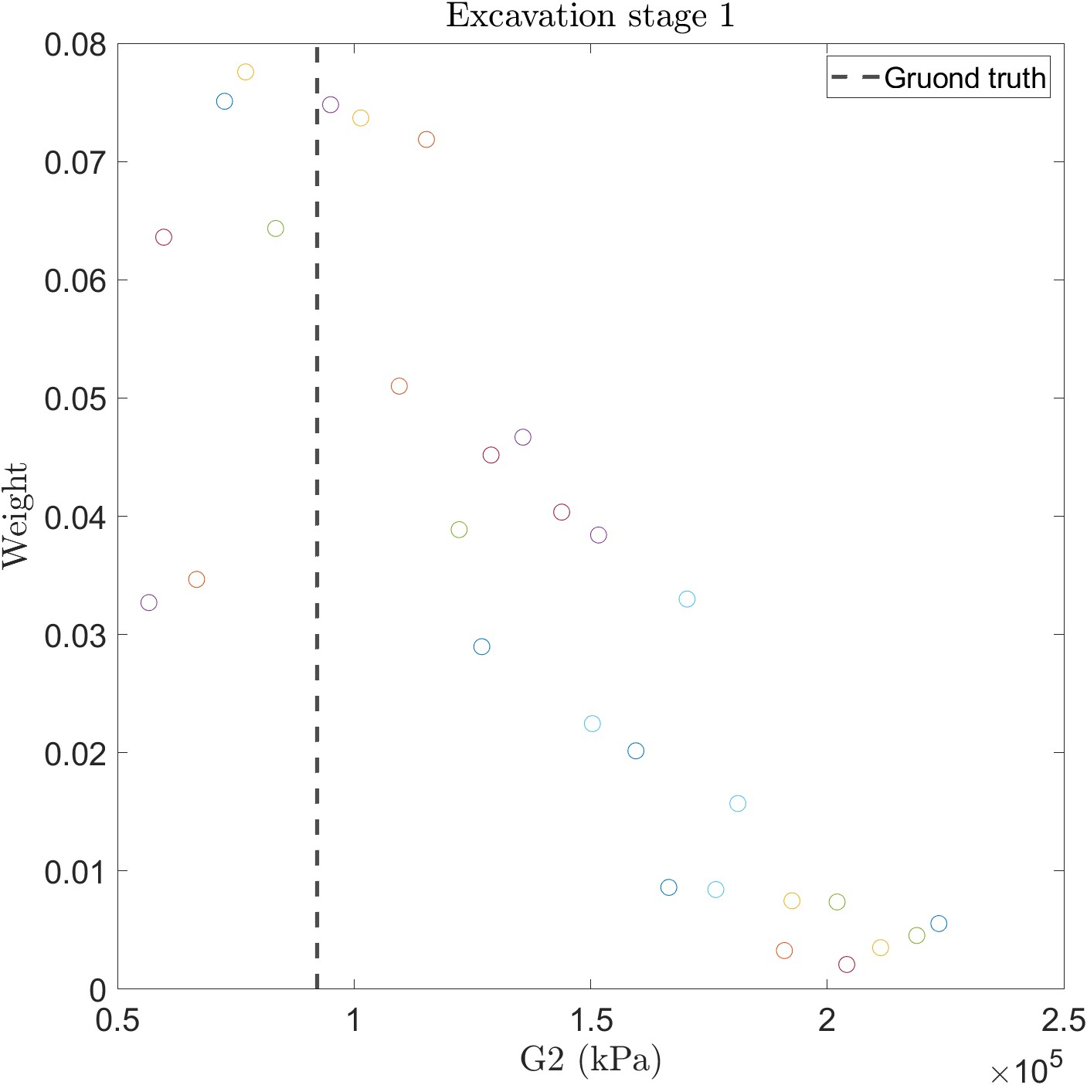
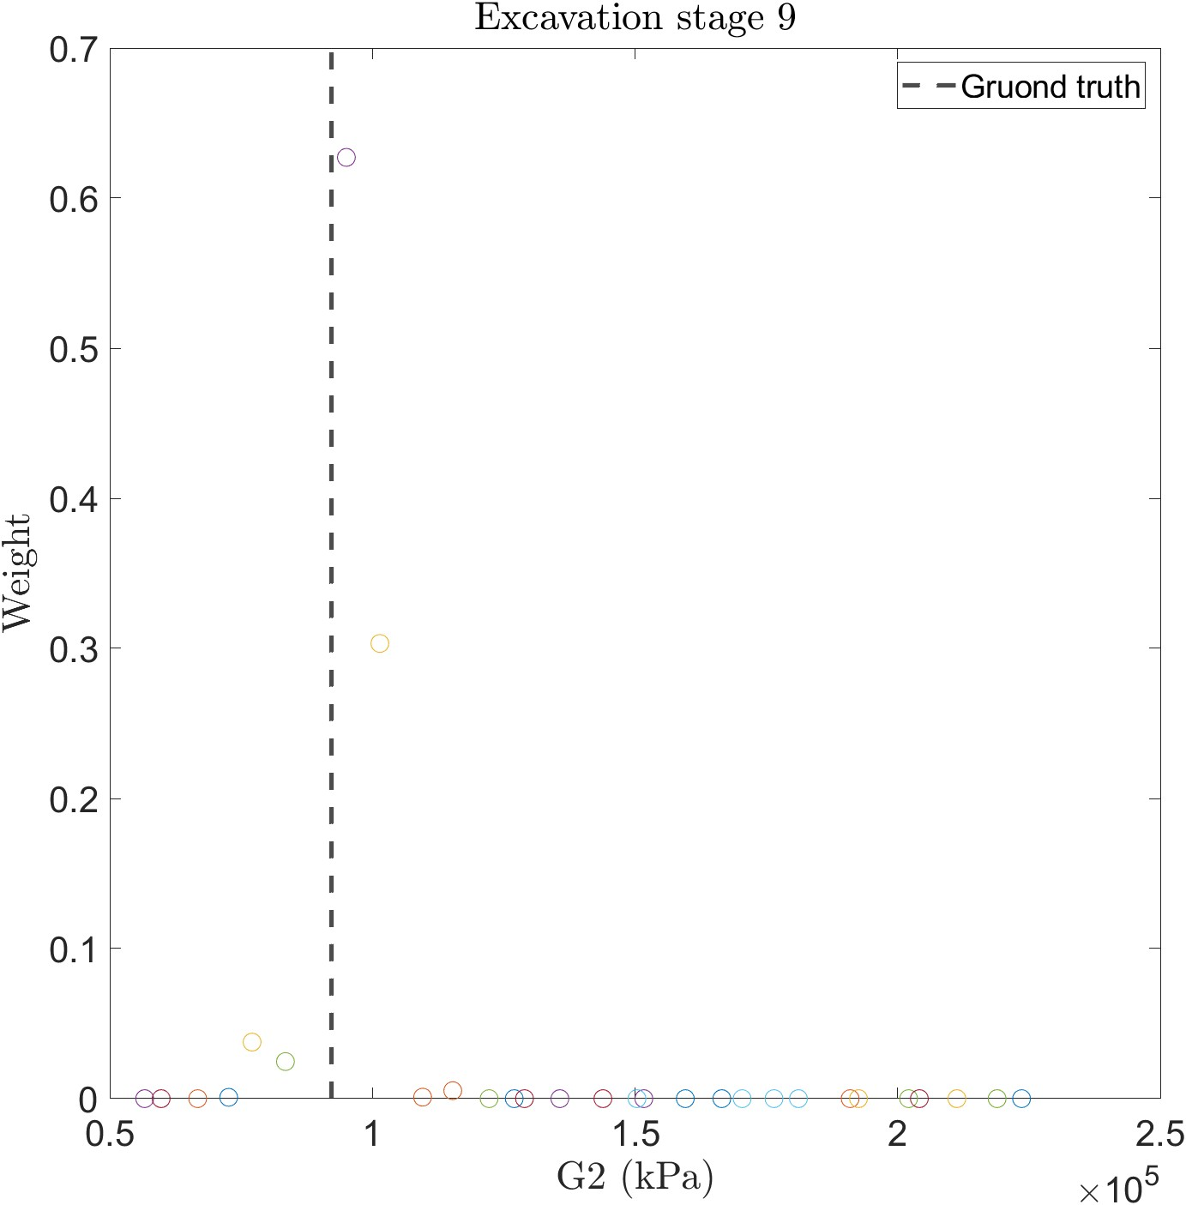
30 runs
…

Slide 5
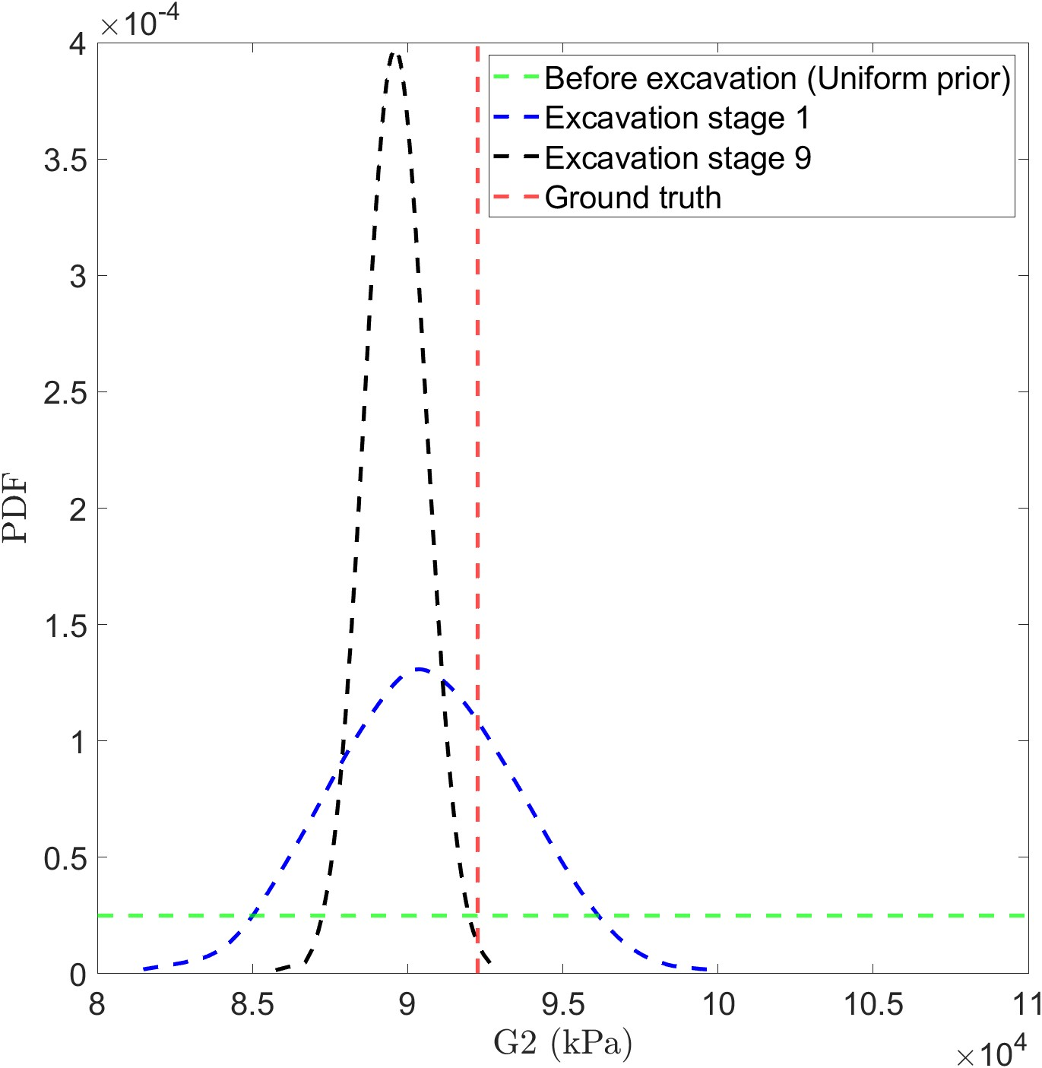
30 runs

Slide 6
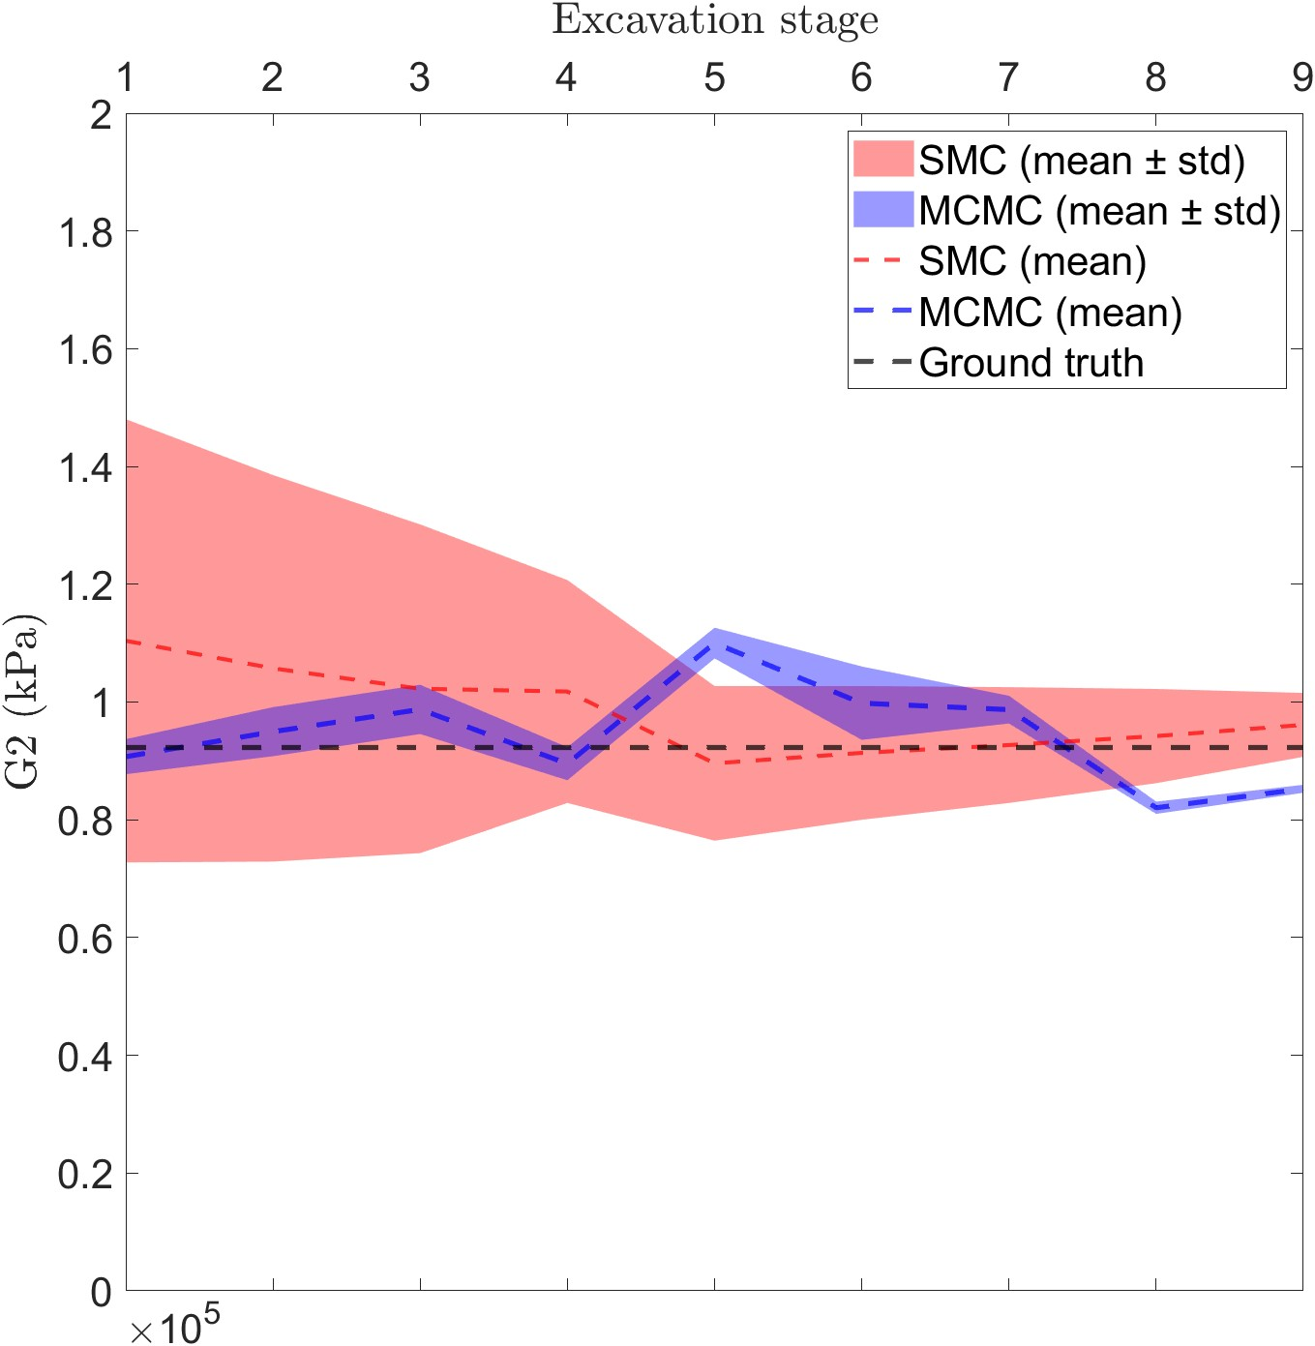
2 variables-30runs
G1 and G2 (only show G2)
14717.98
92257.51
30 runs

Slide 7
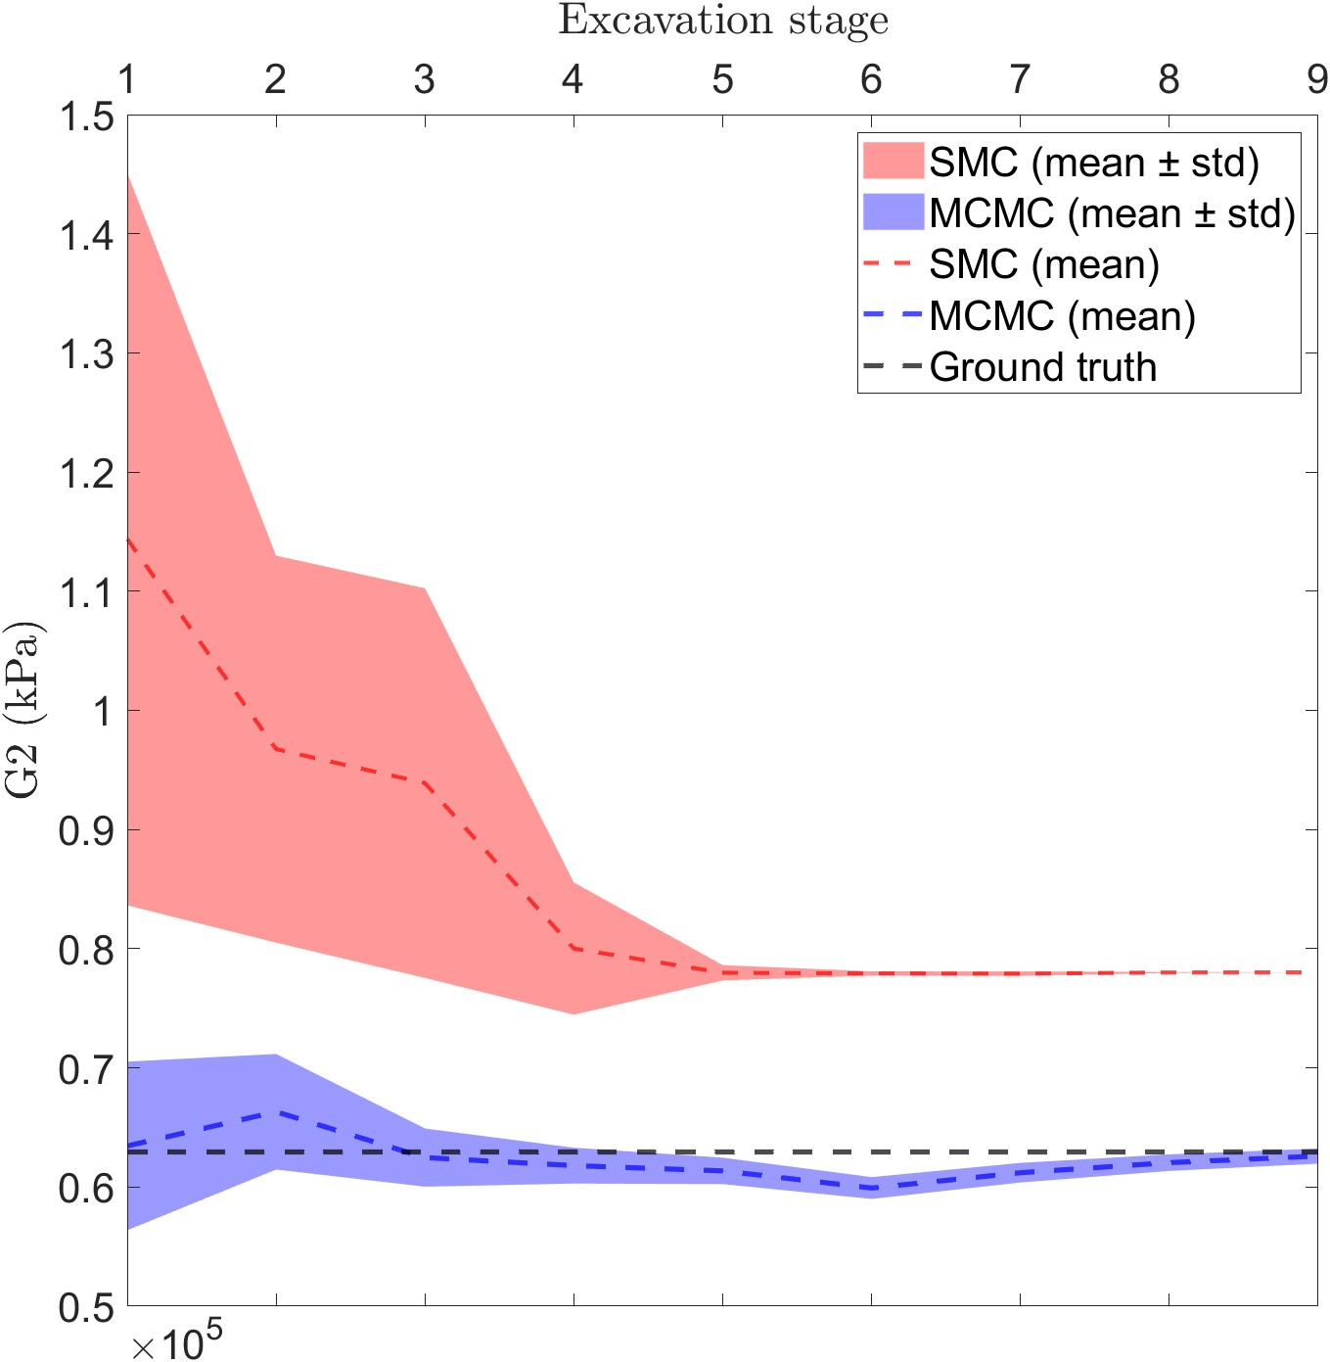
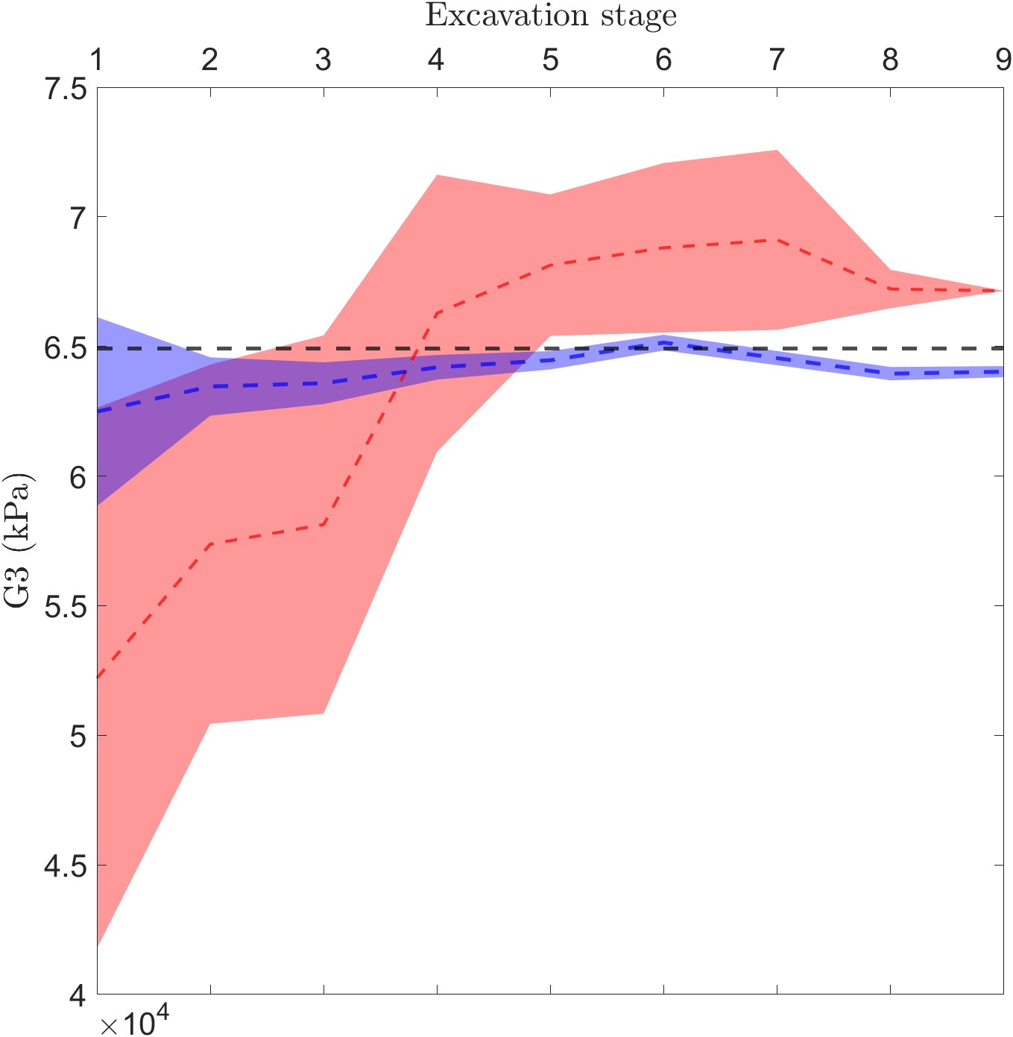
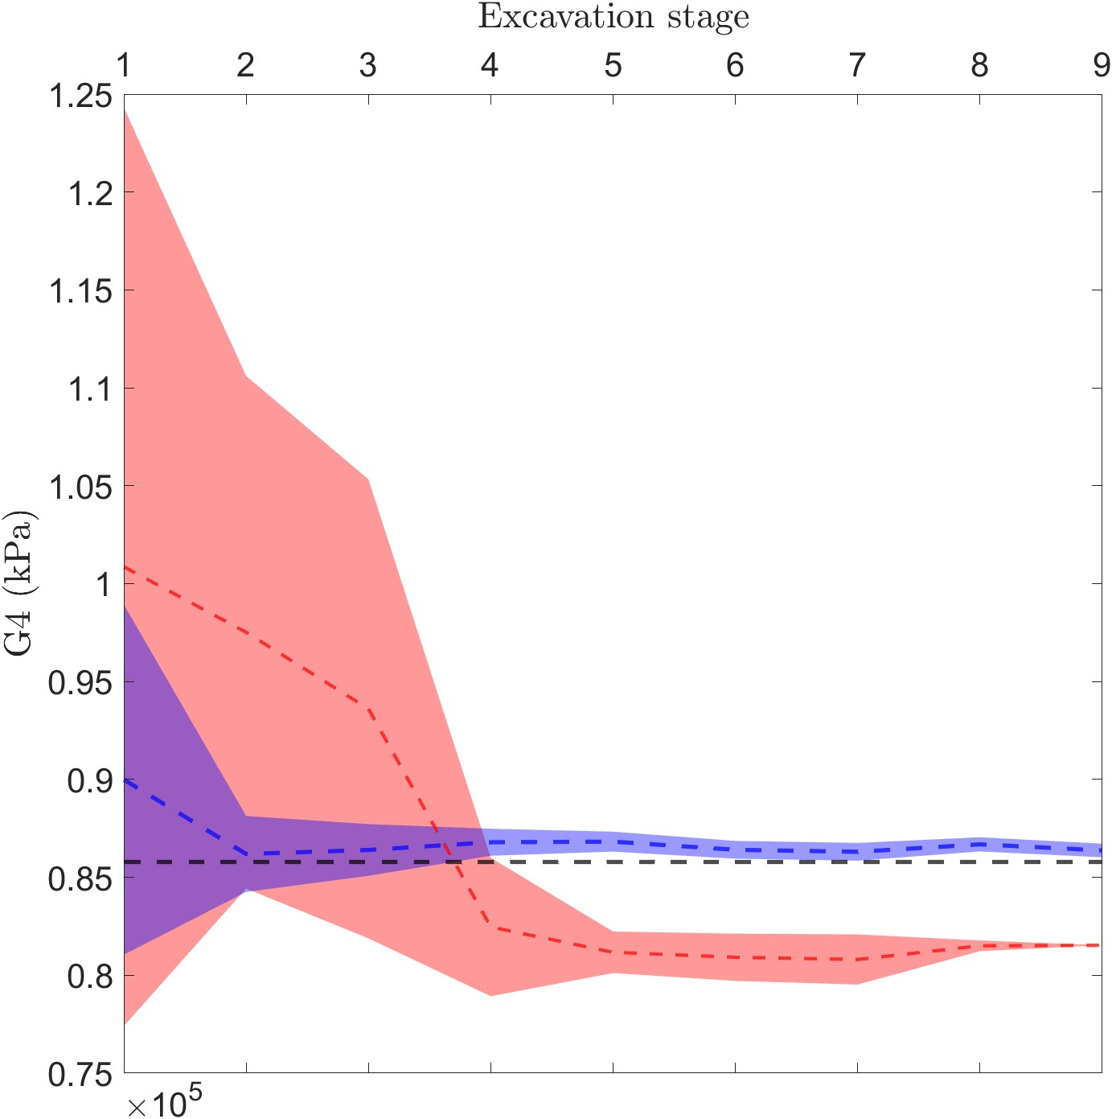
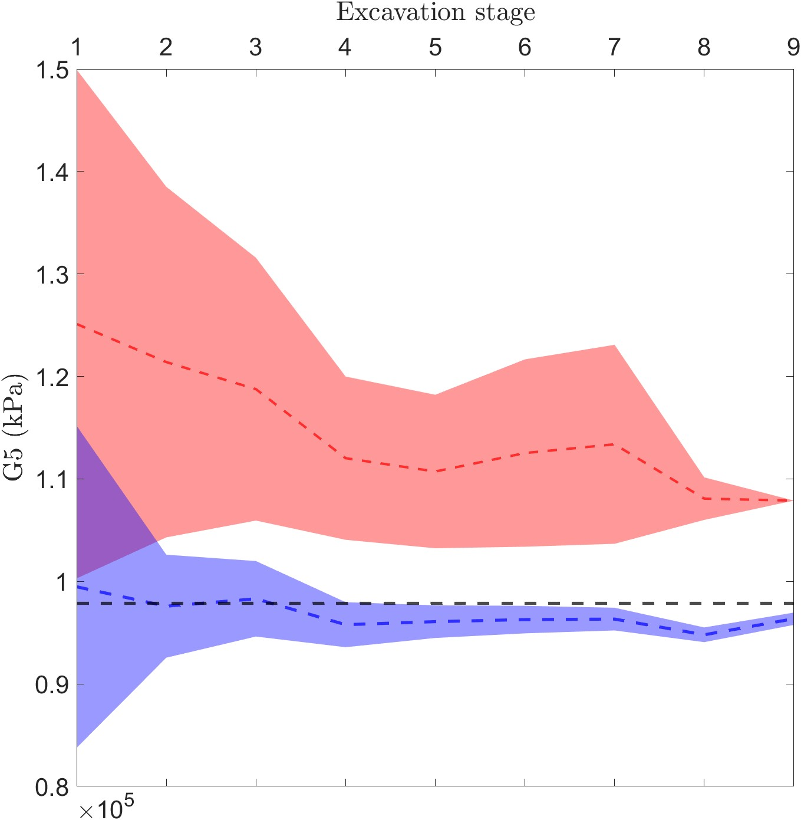
6 variables-120runs
(only show G2-G5)
14213.92
62915.81
64906.05
85774.29
97856.69
138519.4

