Slide 1


Detecting Adversarial Faces Using Only Real Face Self-Perturbations
Qian Wang ¹, Yongqin Xian ², Hefei Ling ^{1,∗}, Jinyuan Zhang ³,
Xiaorui Lin ³, Ping Li ¹, Jiazhong Chen ¹, Ning Yu ⁴
¹ Huazhong University of Science and Technology, Wuhan, China
² Google, Switzerland
³ Software Development Center, Industrial and Commercial Bank of China
⁴ Salesforce Research, USA
Code at: https://github.com/cc13qq/SPAD

Slide 2
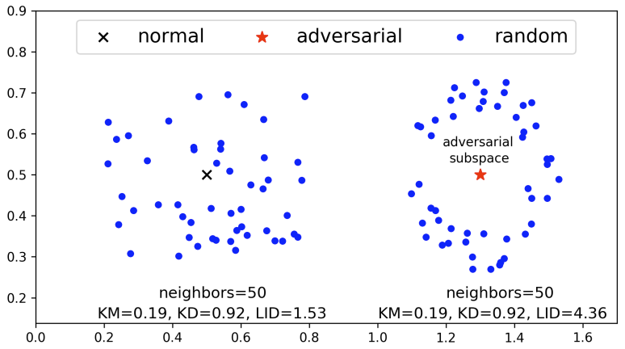
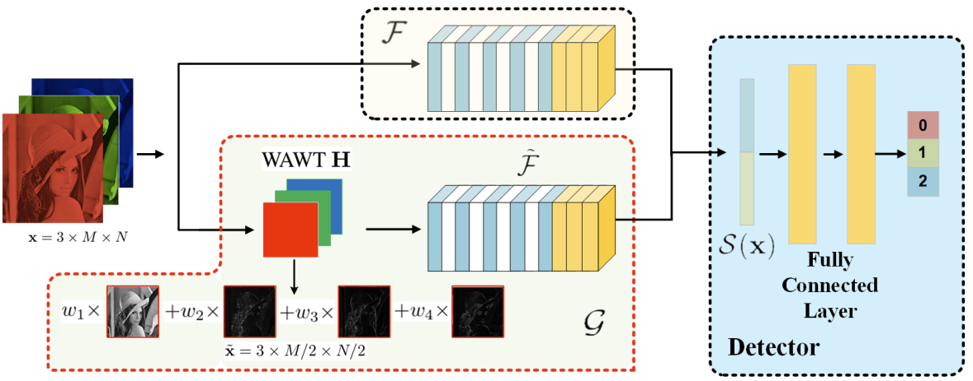
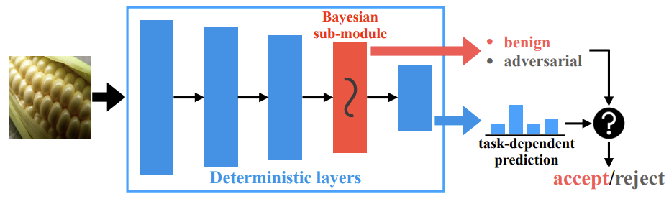
Adversarial Face (adv-face) Detection
ICLR 2018: LID
AAAI 2021: SID
CVPR 2021: LiBRe
Previous works are not able to detect GAN-made adversarial faces, and use adversarial examples and access to facial recognition system (FRS) for training.

Slide 3
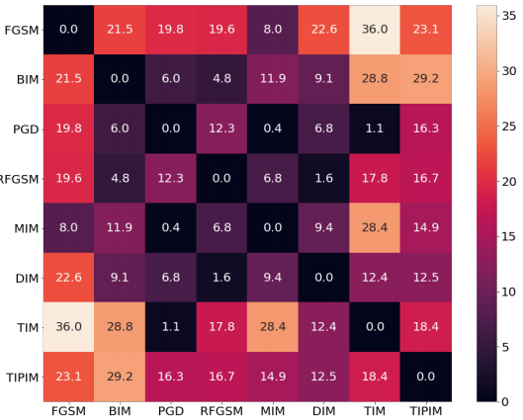
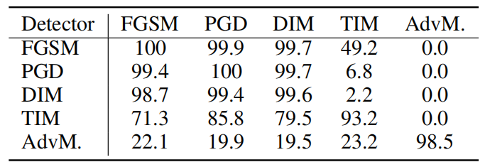
Intrinsic Similarity of Adv-faces
Detection accuracy on adv-faces generated by various of attacks. Networks are trained on adv-faces generated by attacks in the left column, and tested on adv-faces produced by attacks in the top row.
Fréchet Inception Distance heat map of attacks.

Slide 4
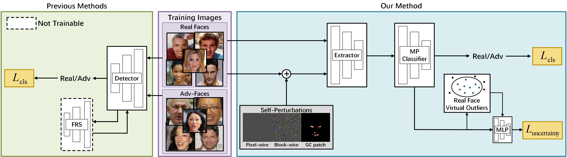
Method Overview
We design three kinds of self-perturbations to generate synthesized pseudo-adv faces. Our method is agnostic to both attacks and FRS, using only real faces with self-perturbations in the training phase.

Slide 5
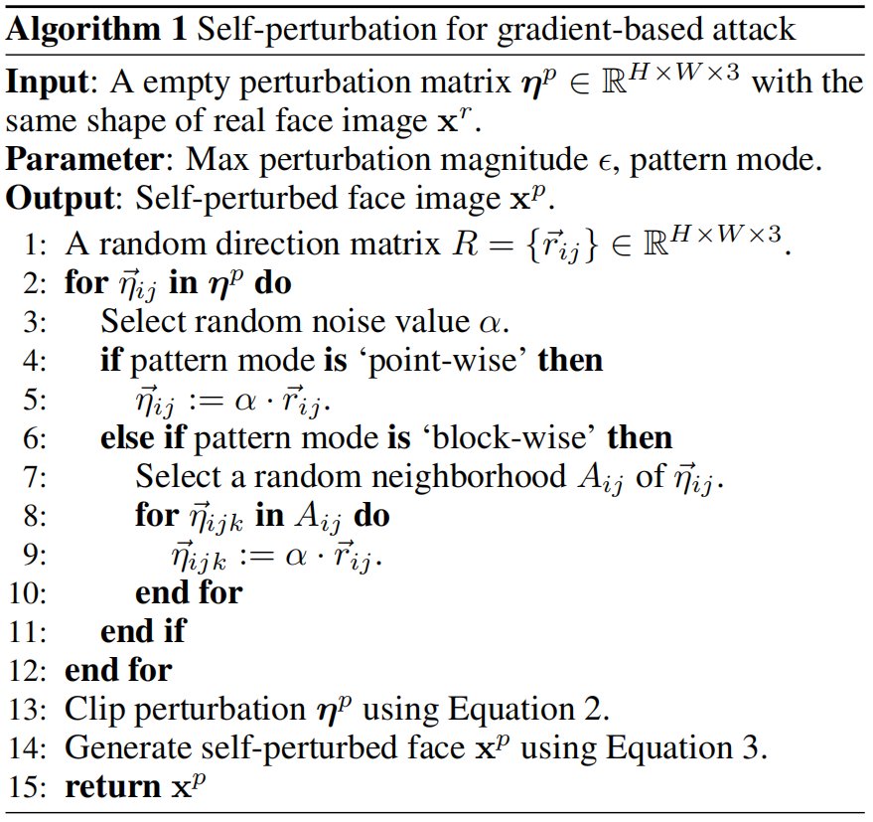
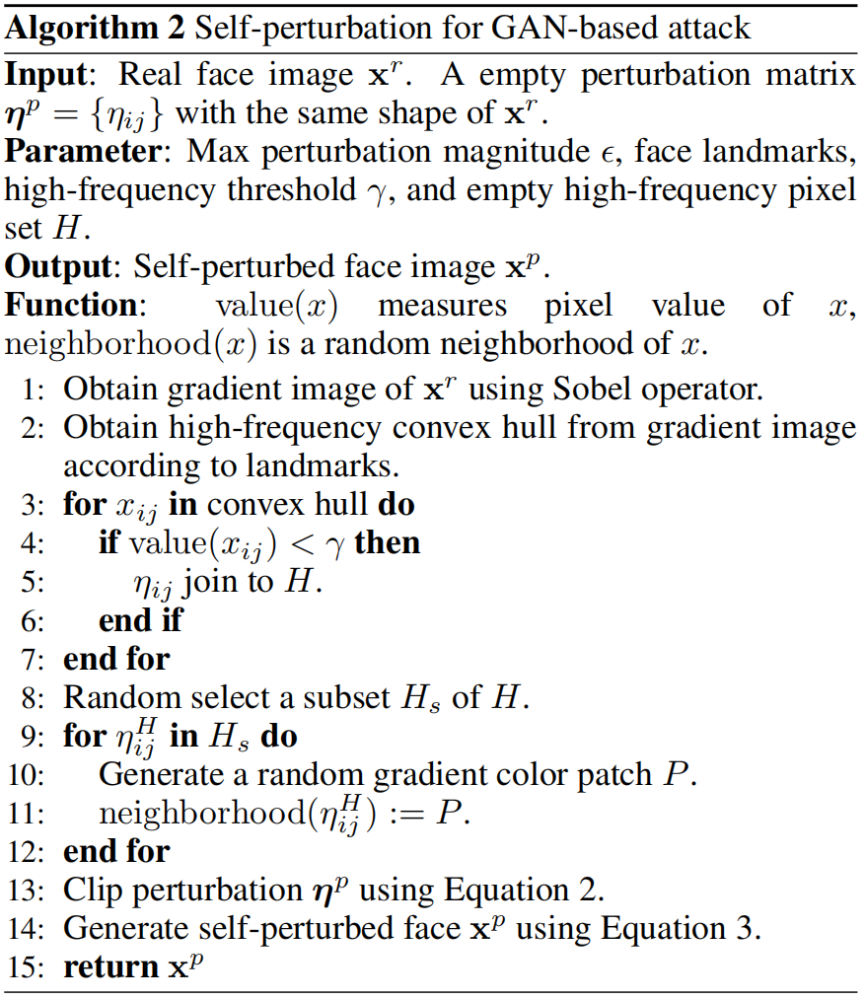
Self-Perturbations

Slide 6
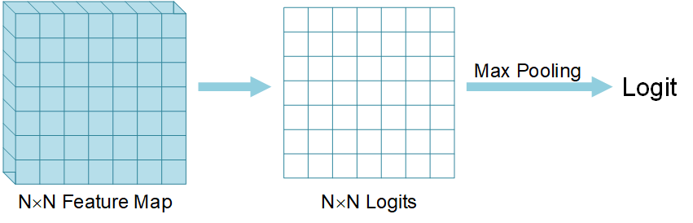
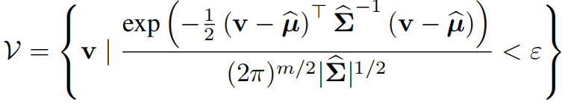
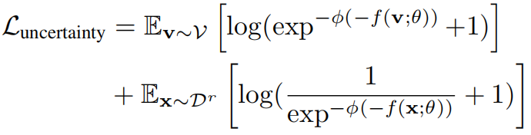
Classifier and Regularization
Max-Pooling Classifier (MPC): Capture abnormal local color aberrations.
Decision Boundary Regularization
Sample virtual outliers of real face class:
Narrow the decision boundary of real face class to boost the performance:
The training objective combines the real-adv classification loss and the regularization term:

Slide 7
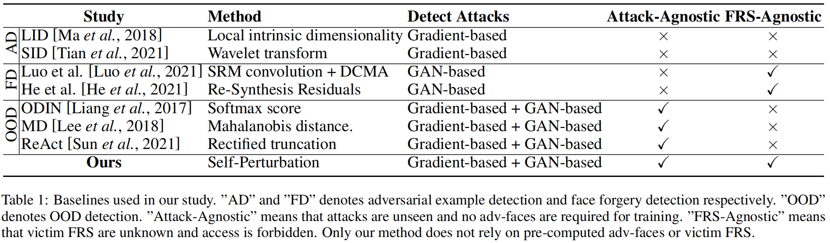
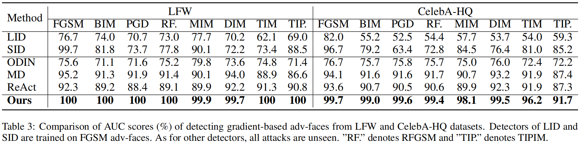
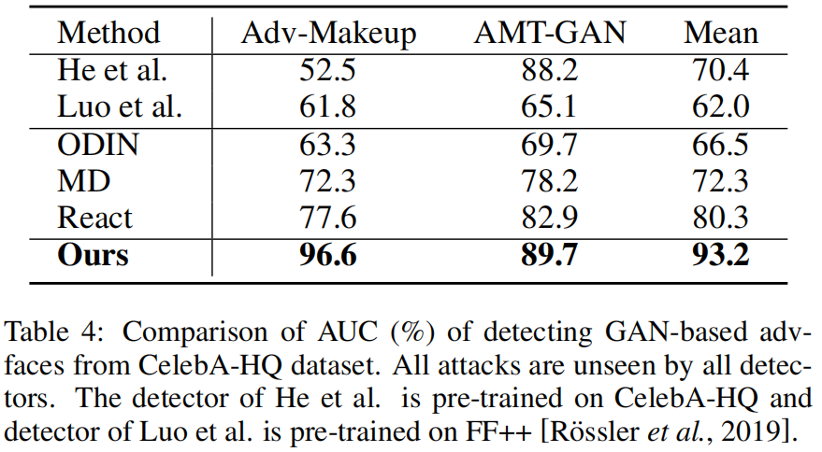

Slide 8
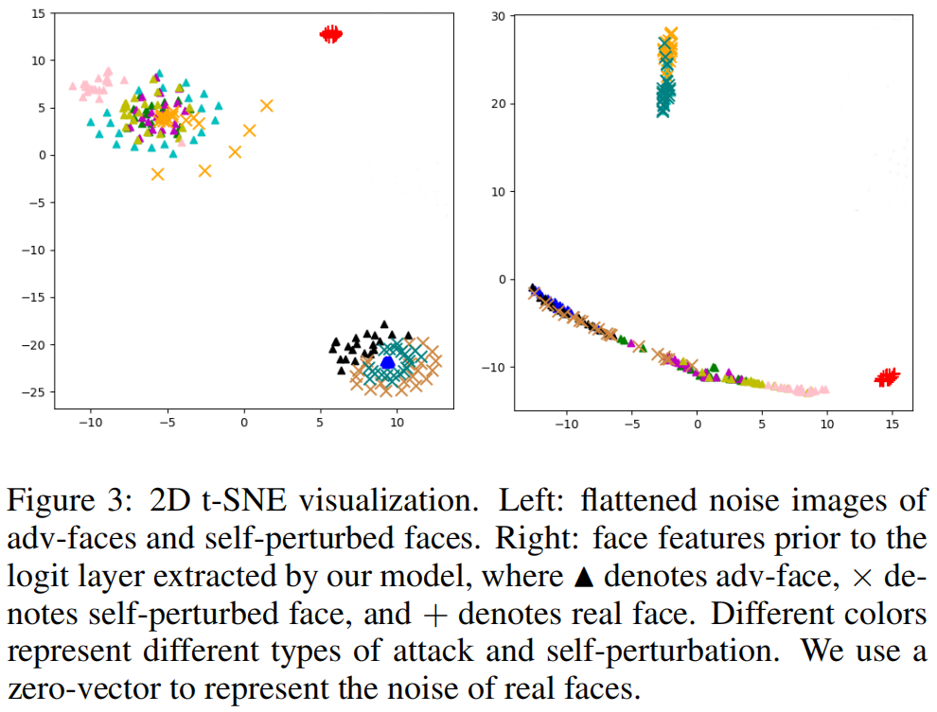
Functionality of Self-Perturbations

