Slide 1
Robust Feature Points Correspondences for Visual Object Tracking
made by Ning Yu from EI AC 09
ningyu.hust@gmail.com
supervised by Prof. Wenyu Liu
06/13/2013

Slide 2
Outline
Targets
Motivation
Framework
Robust Feature Points Selection
Robust Points Correspondences Discovery
Motion and Scale Determination
Experimental Results
Contributions

Slide 3
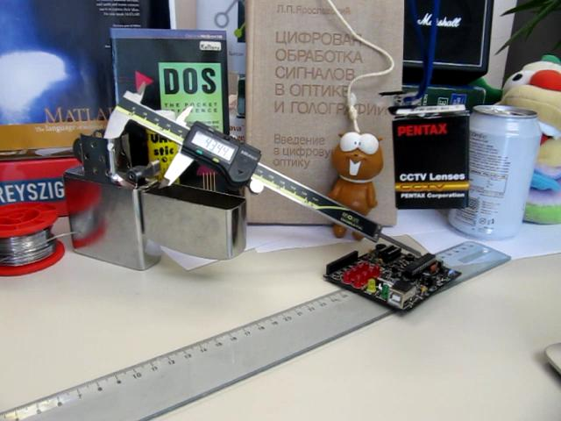
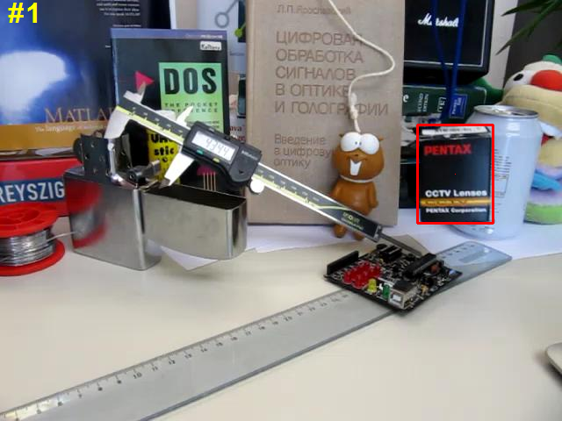
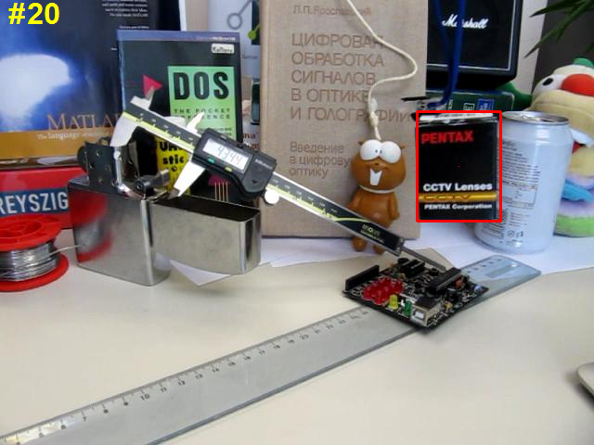
Targets
What algorithm?

Slide 4
Targets
Challenges:
Shape deformation
Occlusion
Heavy appearance changes
Heavy illumination changes
Motion blur
Background clutter
Trade-off:
Plasticity
Stability
Goals:
Accuracy
Robustness
Efficiency

Slide 5
Motivation
S. Gu, Y. Zhang and C. Tomasi. Efficient Visual Object Tracking with Online Nearest Neighbor Classifier. In ACCV, 2010.:
SIFT feature points —— too local!
+ Nearest neighbor classifer —— not robust! space-consuming!
+ Efficient subwindow search —— simple but still time-consuming!

Slide 6
Motivation
Select the most robust feature points, motivated by T. Ma in CVPR 2010
—— overcome occlusion and background clutter!
+ lower time complexity!
Feature information + geometric information
—— no longer local!
Points correspondences matching, motivated by H. Liu in CVPR 2010
—— generative approach instead of discriminative one!
—— lower space complexity!
One-step oriented drift
—— no filters! no iterations!
—— simple but accurate!
Sample reservoir clustering, motivate by J. Shi in PAMI 2000
—— more robust! Trade-off between plasticity and stability!
—— overcome shape deformation , appearance changes and illumination changes

Slide 7
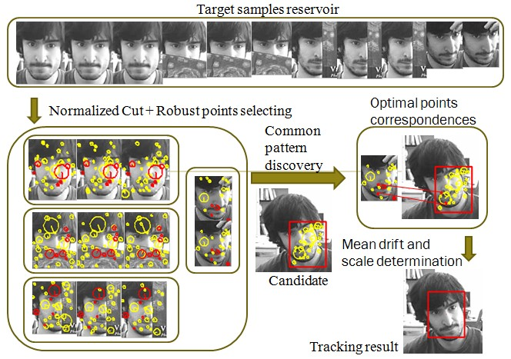
Framework

Slide 8
Framework
Characteristics:
tracking-by-correspondences framework
generative approach
adaptively-selected appearances
one-step oriented motion model
online clustered sample reservoir
Key techniques:
maximal weighted clique
common pattern discovery
graph clustering

Slide 9



Robust Feature Points Selection
Feature similarity
Geometric similarity

Slide 10


Robust Feature Points Selection
Intra-frame mutex constraint
Inter-frame mutex constraint

Slide 11



Robust Feature Points Selection
Maximal weighted clique
where

Slide 12
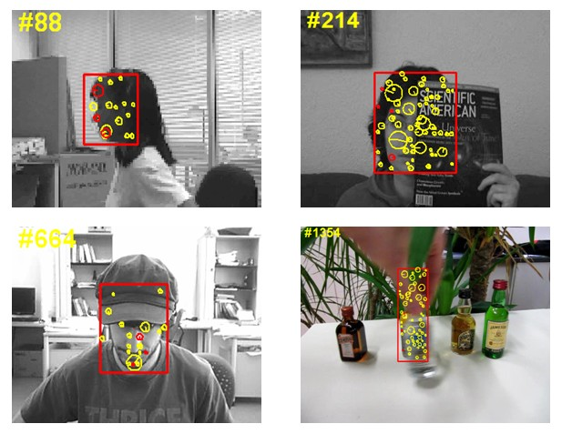
Robust Feature Points Selection

Slide 13
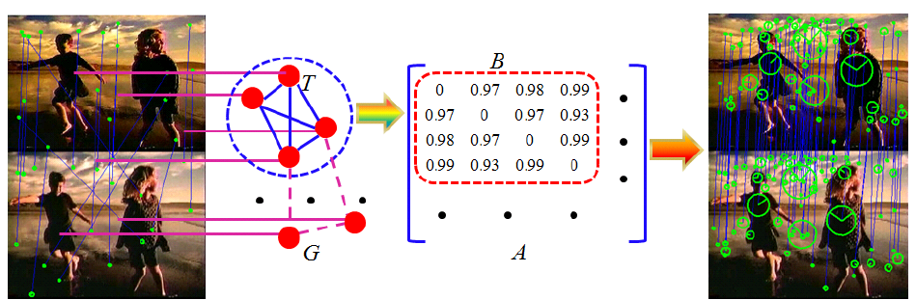
Robust Points Correspondences Discovery

Slide 14



Robust Points Correspondences Discovery
Feature consistency
Geometric consistency

Slide 15


Robust Points Correspondences Discovery
Common visual pattern discovery
where

Slide 16


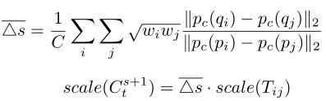
Motion and scale determination
Motion drift
Scaling determination

Slide 17
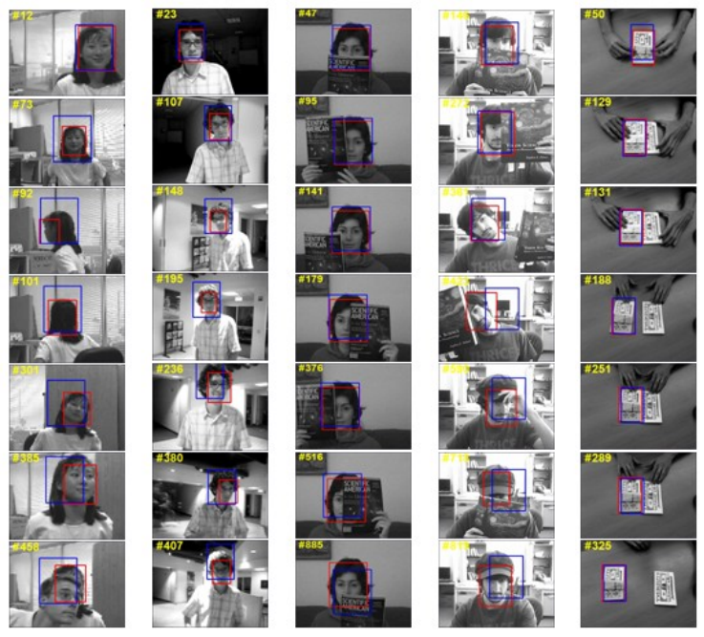
Experimental Results

Slide 18
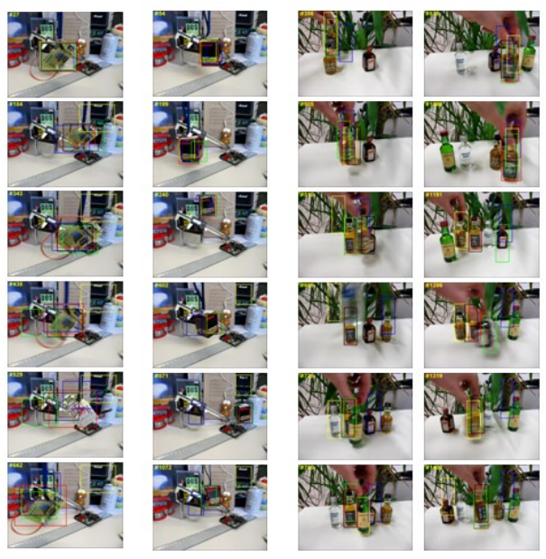
Experimental Results

Slide 19
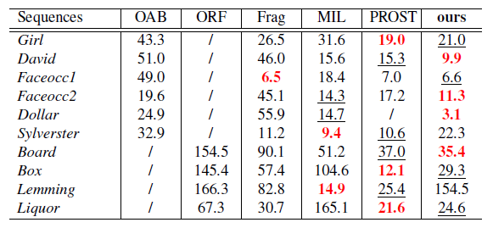
Experimental Results —— Average Centre Location Error

Slide 20
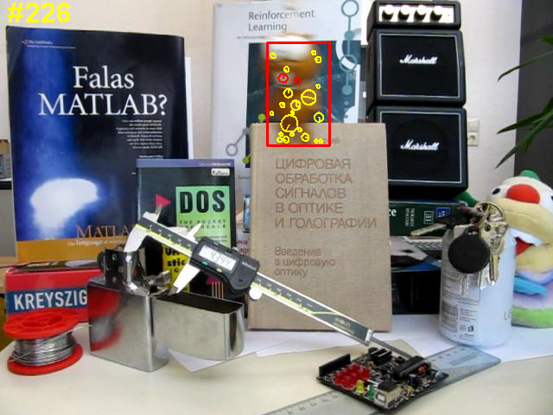
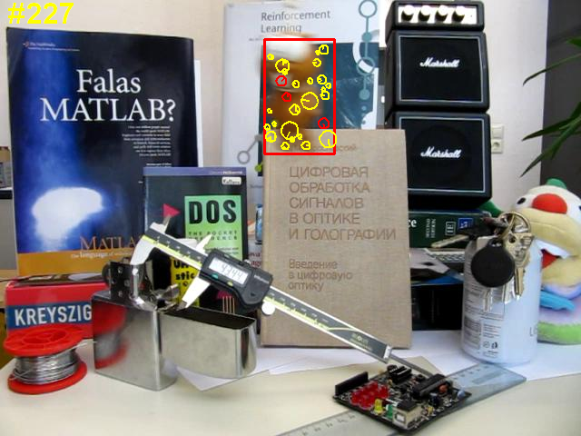
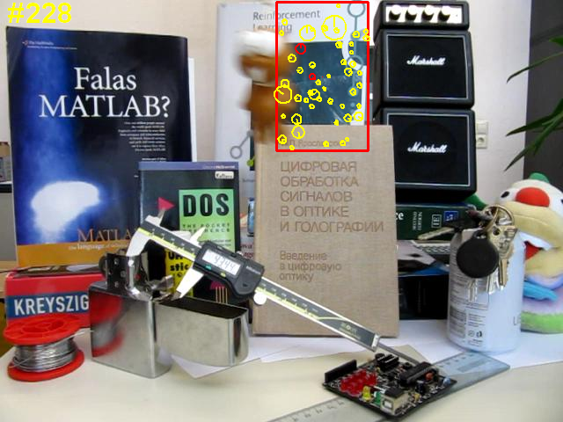
Experimental Results —— failed

Slide 21
Contributions
Challenges:
Shape deformation —— OVERCOMED!
Occlusion —— OVERCOMED!
Heavy appearance changes —— OVERCOMED!
Heavy illumination changes —— OVERCOMED!
Motion blur —— WANTED!
Background clutter —— OVERCOMED!

Slide 22
Contributions
Goals:
Accuracy —— COMPLETED!
Robustness —— COMPLETED!
Efficiency —— WANTED!

Slide 23
Deeply thank you for your time and listening!
Any questions?

