Slide 1
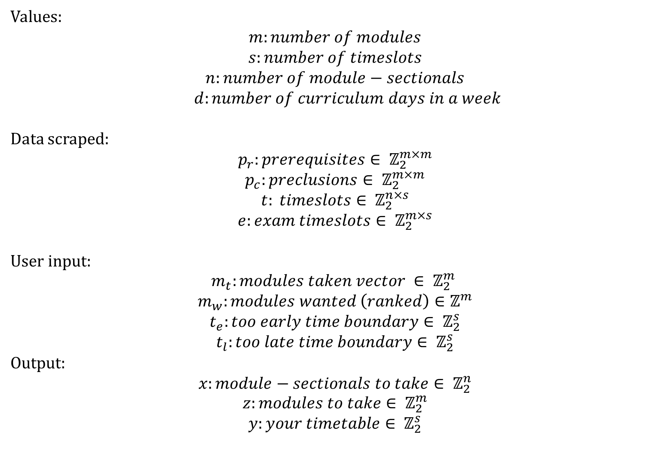
Values:
$$m:number of modules$$
$$s:number of timeslots$$
$$n:number of module−sectionals$$
$d:number of curriculum days in a week$
Data scraped:
$$p_{r}:prerequisites∈ ℤ_{2}^{m×m}$$
$$p_{c}:preclusions∈ ℤ_{2}^{m×m}$$
$$t: timeslots∈ ℤ_{2}^{n×s}$$
$$e:exam timeslots∈ ℤ_{2}^{m×s}$$
User input:
$$m_{t}:modules taken vector ∈ ℤ_{2}^{m}$$
$$m_{w}:modules wanted \left(ranked\right)∈ℤ^{m}$$
$$t_{e}:too early time boundary∈ ℤ_{2}^{s}$$
$$t_{l}:too late time boundary∈ ℤ_{2}^{s}$$
Output:
$$x:module−sectionals to take∈ ℤ_{2}^{n}$$
$$z:modules to take∈ ℤ_{2}^{m}$$
$$y:your timetable∈ ℤ_{2}^{s}$$

Slide 2
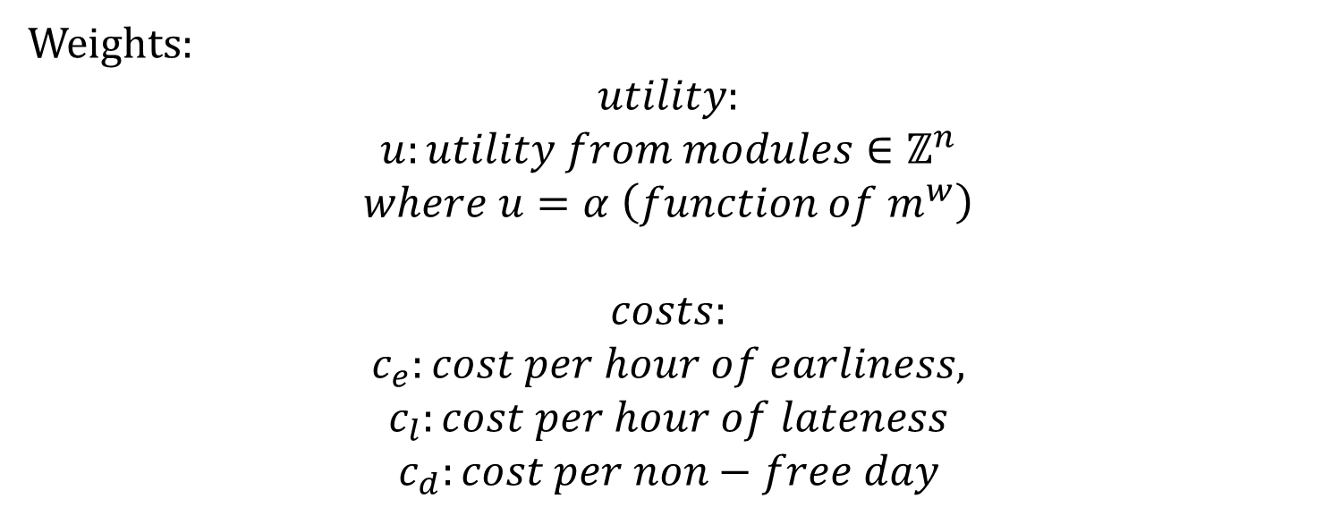
Weights:
$$utility:$$
$$u:utility from modules∈ℤ^{n}$$
$$where u=α \left(function of m^{w}\right)$$
$$costs:$$
$$c_{e}:cost per hour of earliness,$$
$$c_{l}:cost per hour of lateness$$
$$c_{d}:cost per non−free day$$

Slide 3
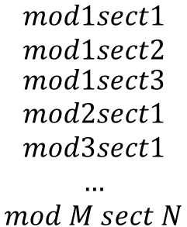
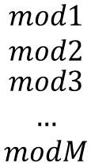
Our Module-Sectionals Converter “MSC”
$$\begin{matrix}mod1sect1 \\ mod1sect2 \\ \begin{aligned}mod1sect3 \\ mod2sect1 \\ mod3sect1 \\ … \\ mod M sect N\end{aligned}\end{matrix}$$
$$\begin{matrix}mod1 \\ mod2 \\ \begin{aligned}mod3 \\ … \\ modM\end{aligned}\end{matrix}$$
1 | 1 | 1 | 0 | 0 | … | 0
0 | 0 | 0 | 1 | 0 | … | 0
0 | 0 | 0 | 0 | 1 | … | 0
… | … | … | … | … | … | 0
0 | 0 | 0 | 0 | 0 | 0 | 1

Slide 4
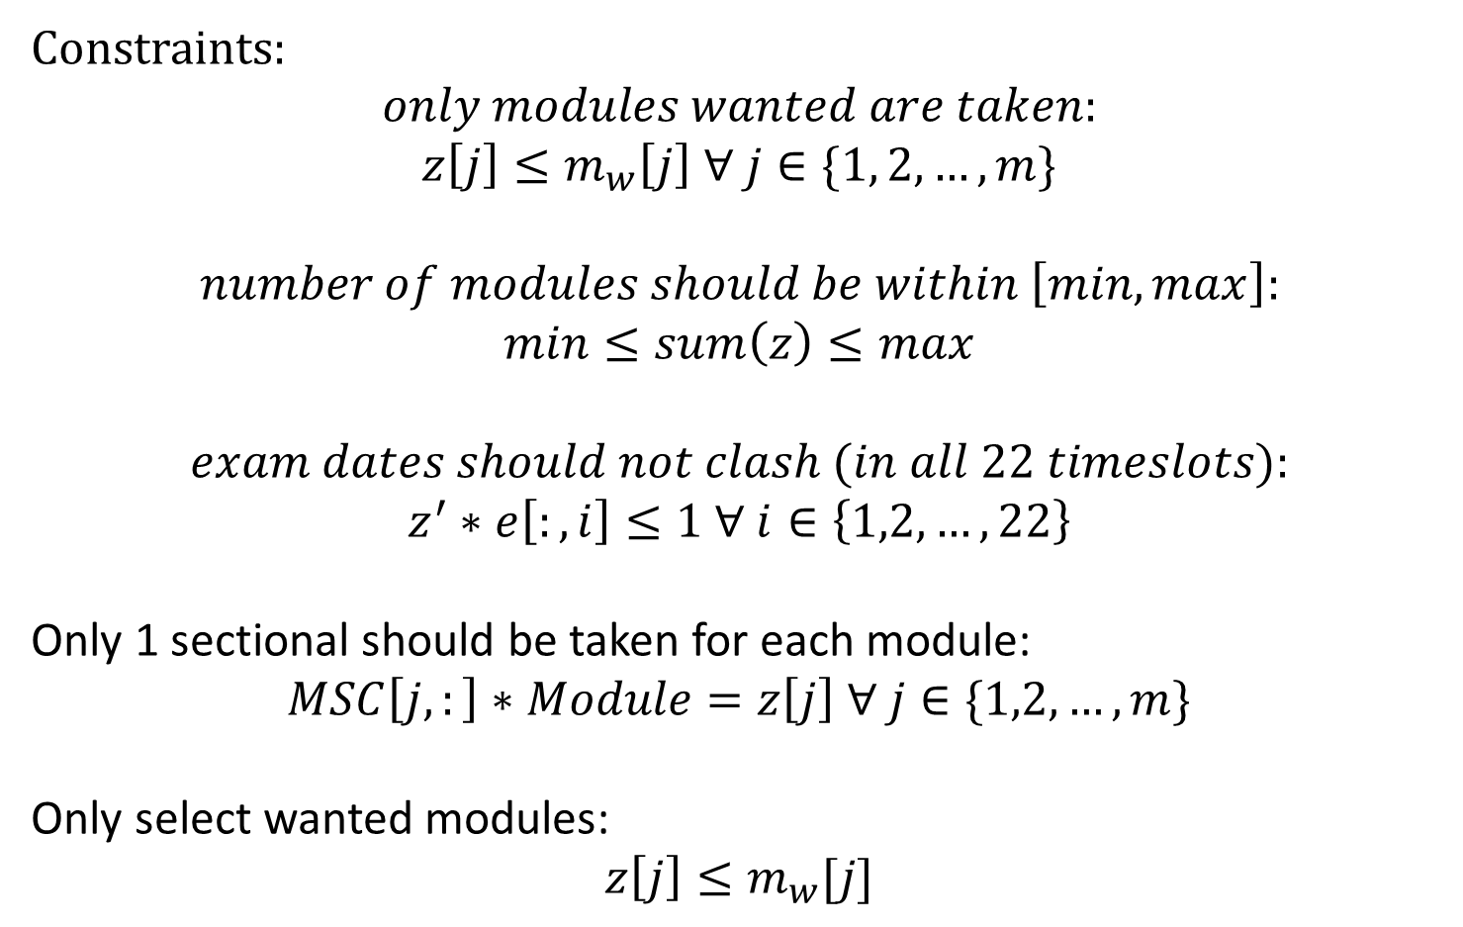
Constraints:
$$only modules wanted are taken:$$
$$z\left[j\right]≤m_{w}\left[j\right] ∀ j∈\{1, 2,…,m\}$$
$$number of modules should be within \left[min, max\right]:$$
$$min≤sum\left(z\right)≤max$$
$$exam dates should not clash (in all 22 timeslots):$$
$$z^{′}∗e\left[:,i\right]≤1 ∀ i∈\left\{1,2, …, 22\right\}$$
Only 1 sectional should be taken for each module:
$$MSC\left[j,:\right]∗Module=z\left[j\right] ∀ j∈\{1,2,…,m\}$$
Only select wanted modules:
$$z\left[j\right]≤m_{w}[j]$$

Slide 5
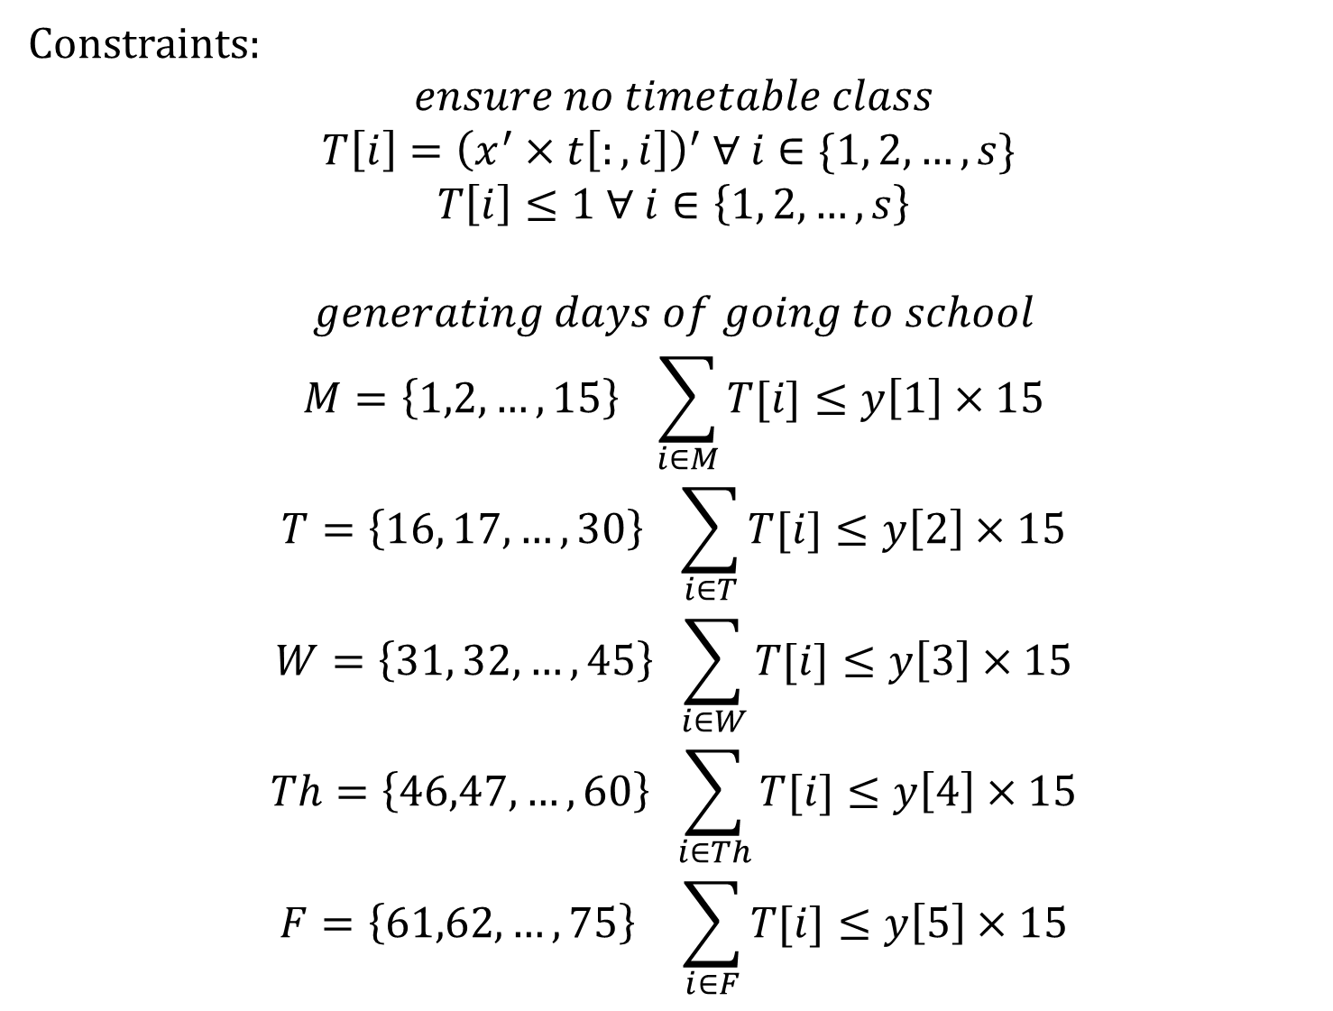
Constraints:
$$ensure no timetable class$$
$$T\left[i\right]={\left(x^{′}×t\left[:,i\right]\right)}^{′} ∀ i∈\{1, 2, …, s\}$$
$$T\left[i\right]≤1 ∀ i∈\left\{1, 2, …, s\right\}$$
$$generating days of going to school$$
$$M=\left\{1,2,…,15\right\} \sum_{i∈M}{T[i]≤y\left[1\right]×15}$$
$$T=\left\{16, 17, …, 30\right\} \sum_{i∈T}{T[i]≤y\left[2\right]×15}$$
$$W=\left\{31, 32, …, 45\right\} \sum_{i∈W}{T[i]≤y\left[3\right]×15}$$
$$Th=\left\{46,47,…,60\right\} \sum_{i∈Th}{T[i]≤y\left[4\right]×15}$$
$$F=\left\{61,62,…,75\right\} \sum_{i∈F}{T[i]≤y\left[5\right]×15}$$

Slide 6
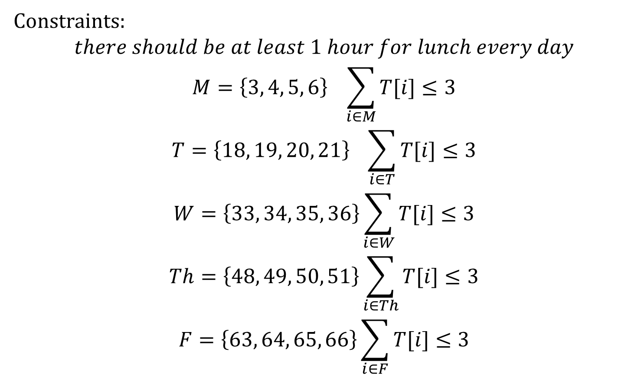
Constraints:
$$there should be at least 1 hour for lunch every day$$
$$M=\left\{3, 4, 5, 6\right\} \sum_{i∈M}{T[i]≤3}$$
$$T=\left\{18, 19, 20, 21\right\} \sum_{i∈T}{T[i]≤3}$$
$$W=\left\{33, 34, 35, 36\right\}\sum_{i∈W}{T[i]≤3}$$
$$Th=\left\{48, 49, 50, 51\right\}\sum_{i∈Th}{T[i]≤3}$$
$$F=\left\{63, 64, 65, 66\right\}\sum_{i∈F}{T[i]≤3}$$

Slide 7
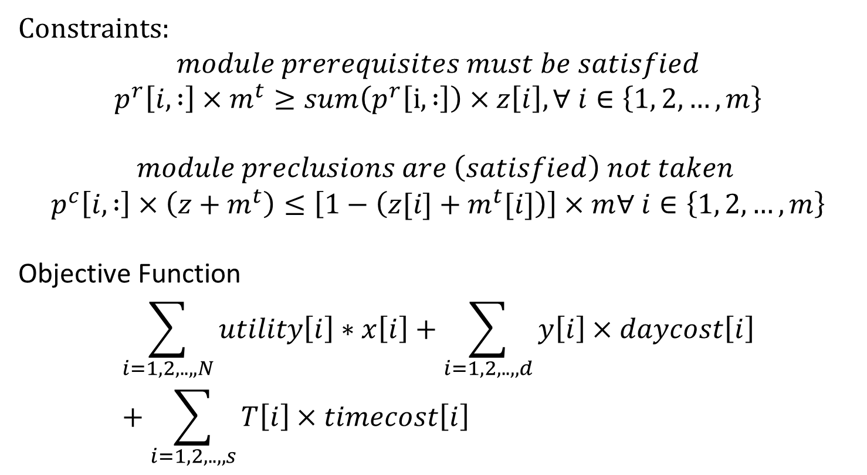
Constraints:
$$module prerequisites must be satisfied$$
$$p^{r}\left[i, :\right]×m^{t}≥sum\left(p^{r}\left[i, :\right]\right)×z\left[i\right], ∀ i∈\left\{1, 2, …, m\right\}$$
$$module preclusions are \left(satisfied\right) not taken$$
$$p^{c}\left[i, :\right]×\left(z+m^{t}\right)≤\left[1−\left(z[i]+m^{t}[i]\right)\right]×m∀ i∈\left\{1, 2, …, m\right\}$$
Objective Function
$$\sum_{i=1,2,..,,N}{utility\left[i\right]∗x\left[i\right]}+\sum_{i=1,2,..,,d}{y\left[i\right]×daycost\left[i\right]}+\sum_{i=1,2,..,,s}{T\left[i\right]×timecost\left[i\right]}$$

