Slide 1
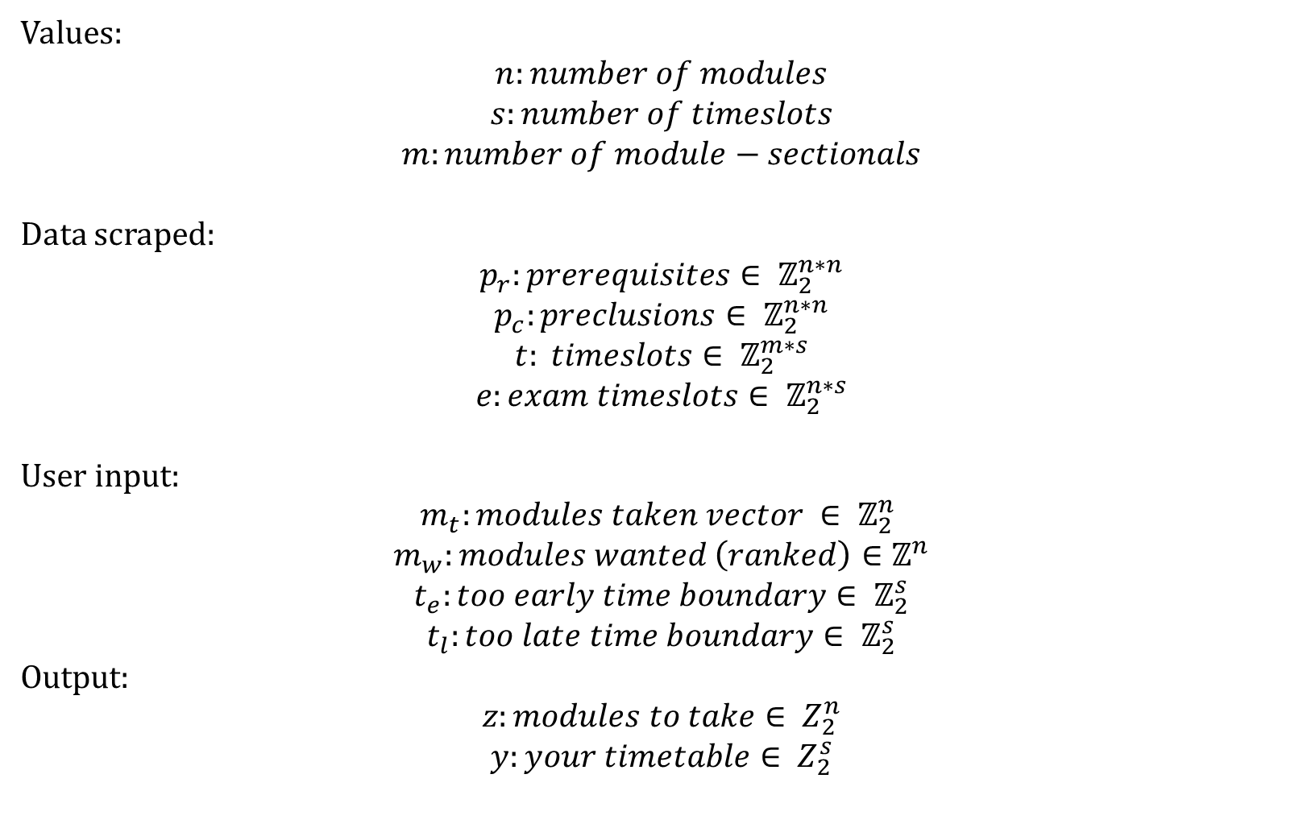
Values:
$$n:number of modules$$
$$s:number of timeslots$$
$$m:number of module−sectionals$$
Data scraped:
$$p_{r}:prerequisites∈ ℤ_{2}^{n∗n}$$
$$p_{c}:preclusions∈ ℤ_{2}^{n∗n}$$
$$t: timeslots∈ ℤ_{2}^{m∗s}$$
$$e:exam timeslots∈ ℤ_{2}^{n∗s}$$
User input:
$$m_{t}:modules taken vector ∈ ℤ_{2}^{n}$$
$$m_{w}:modules wanted \left(ranked\right)∈ℤ^{n}$$
$$t_{e}:too early time boundary∈ ℤ_{2}^{s}$$
$$t_{l}:too late time boundary∈ ℤ_{2}^{s}$$
Output:
$$z:modules to take∈ Z_{2}^{n}$$
$$y:your timetable∈ Z_{2}^{s}$$

Slide 2
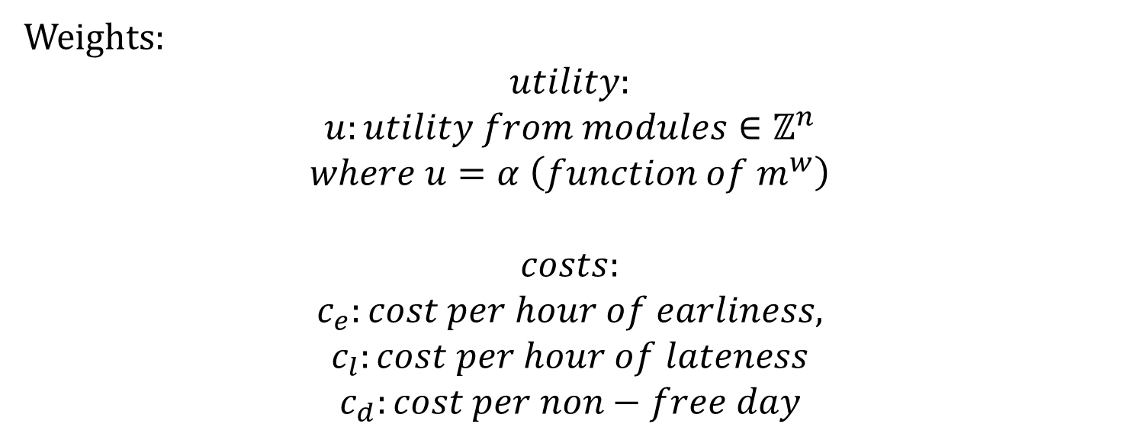
Weights:
$$utility:$$
$$u:utility from modules∈ℤ^{n}$$
$$where u=α \left(function of m^{w}\right)$$
$$costs:$$
$$c_{e}:cost per hour of earliness,$$
$$c_{l}:cost per hour of lateness$$
$$c_{d}:cost per non−free day$$

Slide 3
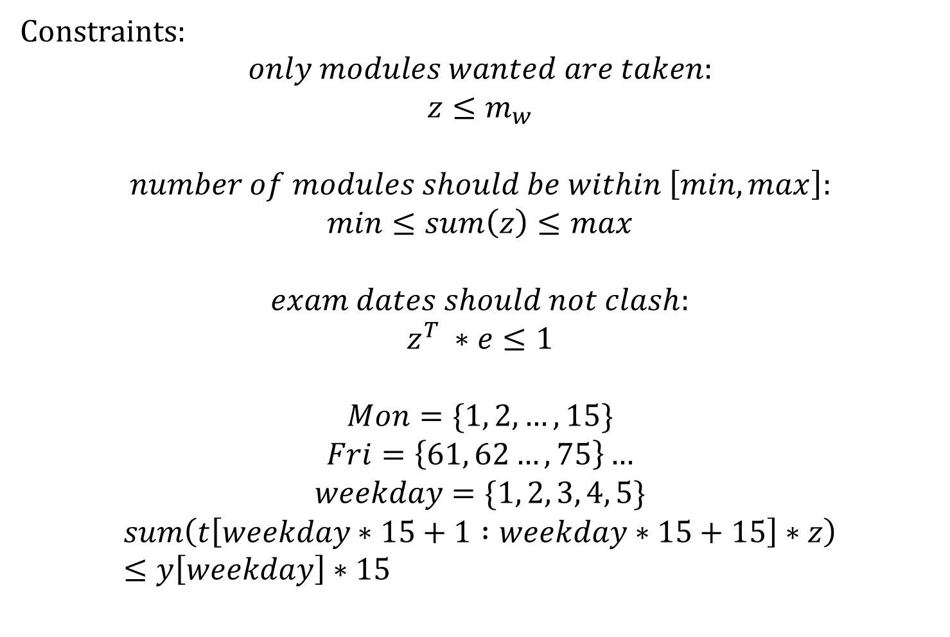
Constraints:
$$only modules wanted are taken:$$
$$z≤m_{w}$$
$$number of modules should be within \left[min, max\right]:$$
$$min≤sum\left(z\right)≤max$$
$$exam dates should not clash:$$
$$z^{T} ∗e≤1$$
$$Mon=\{1, 2, …,15\}$$
$$Fri=\left\{61, 62…,75\right\}…$$
$$weekday=\{1, 2, 3, 4, 5\}$$
$$sum\left(t\left[weekday∗15+1 :weekday∗15+15\right]∗z\right)≤y\left[weekday\right]∗15$$

